Slide 1
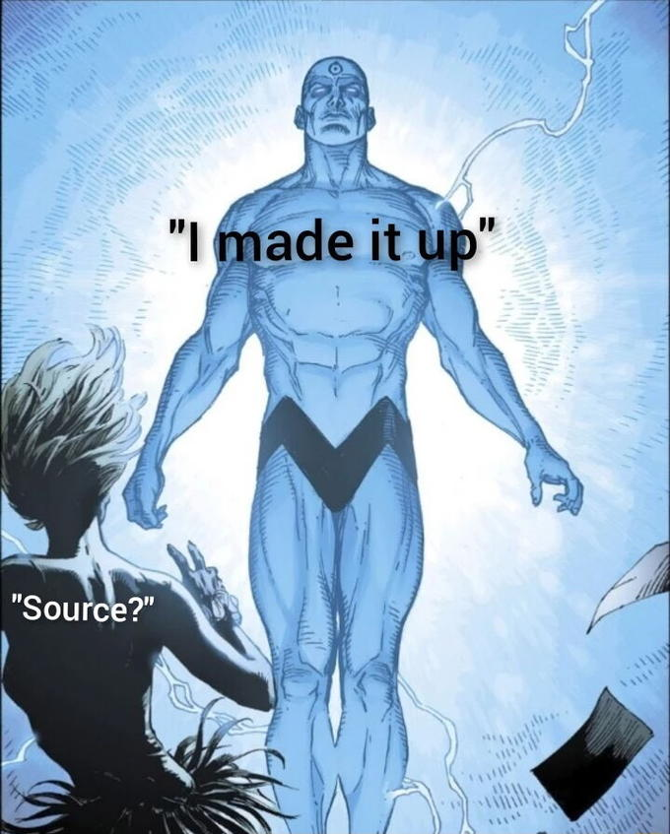
Hi
there
,
what
‘s
the
time
?
It’s
6
:
5
6
PM
.
LIES
Notes:
Large language models are trained to predict text.
You can structure that text like a conversation, and now you have an AI playing the part of any character you want.

Slide 2
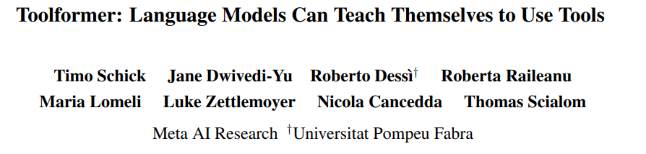
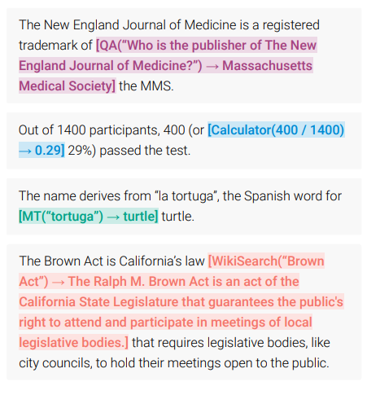
Notes:
[2302.04761] Toolformer: Language Models Can Teach Themselves to Use Tools (arxiv.org)

Slide 3
Please write the sentence “I don’t know what to use as an example.” verbatim and nothing else.
I
don’t
know
what
to
use
as
an
example
.

Slide 4
“What time is it?”
The current time is
[NOW()
->
2023-03-06 7:04 PM
]
7:04 PM.
Stop token, call the function
Function return value gives more context to help the AI respond.
Benefits of this approach: keeps execution closer to where it is used

Slide 5
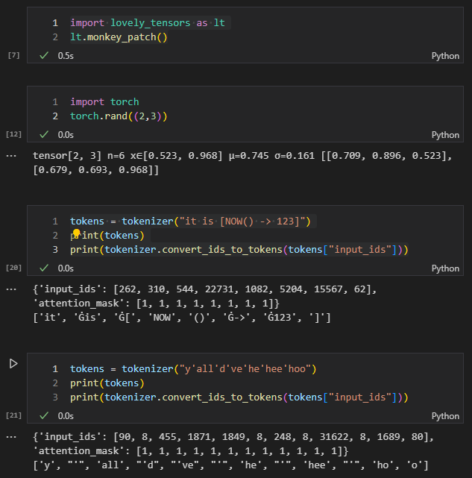


Notes:
AI doesn’t process strings like most programming, instead it’s better to break it up into tokens.
The structure of these tokens can be important. Like how a telephone number is more readable to humans when you have dashes in it.
The token mappings is like the b
Interesting that the ‘d and ‘ve stayed together

Slide 6
What time is it?
The current time is
[NOW()
->
2023-03-06 7:04 PM
]
7:04 PM.
Treat it as markup and hide the function calls
The current time is
7:04 PM.
Seeing the function calls is neat tho, so maybe a symbol?
The current time is
λ
7:04 PM.

Slide 7
In practice
HEADER WITH EXAMPLES
CONVERSATION HISTORY
LATEST INPUT
SPEAKER IDENTIFIER

Slide 8
In practice
HEADER WITH EXAMPLES
You are an AI assistant with several tools
available to you. The tools are the following:
NOW: Print the current time.
WEEKDAY: Gets the week day for a given date.
MATH: Evaluates a math expression. You should always use this tool to evaluate math expressions.
SNAP: Rearranges windows on the screen. Takes the name of the window and the position as arguments.
DO NOT USE TOOLS WITHIN TOOLS! KEEP ALL TOOL CALLS SEPARATE FROM EACH OTHER!
YOU ARE ENCOURAGED TO USE TOOLS TO ENSURE THE ACCURACY OF YOUR RESPONSES!
YOU ARE TO EXPLAIN
YOUR REASONING AND SHOW YOUR WORK, WITH CLEAR CONNECTIONS BETWEEN CONCLUSIONS!
DO NOT PUT A LINE BREAK BEFORE A TOOL CALL!
User: What day of the week was 2023-03-03?
Assistant: The date 2023-03-03 is a [WEEKDAY(2023-03-03) -> Thursday] Thursday.
User: Is today a Friday?
Assistant: Today's date is [NOW() -> 2023-03-03 03:19:47.980140] 2023-03-03, which is a [WEEKDAY(2023-03-03) -> Thursday] Thursday, not a Friday.
User: What is the time?
Assistant:
CONVERSATION HISTORY
LATEST INPUT
SPEAKER IDENTIFIER

Slide 9
It’s all just moving data around and transforming it.
Spoken words as text
Mic
Audio
Transcriber
Prompt builder
Inference
requests
Inference
requests
Inference model
Inference
responses
HTML ON UR SCREEN
Inference
responses
Websocket

Slide 10




Restarts faster
Text prediction model
Voice transcription model
Why doesn’t the largest model simply eat the smaller ones?

Slide 11
Web browser
Web browser
WEBSOCKETS
WEBSOCKETS
Text prediction server
Main server
WEBSOCKETS

Slide 12
Next video topic, vote in the comments
The blockchain I made in C#
Reinforcement learning
Downloading videos
Schizophrenia and deals with the devil

