Slide 1
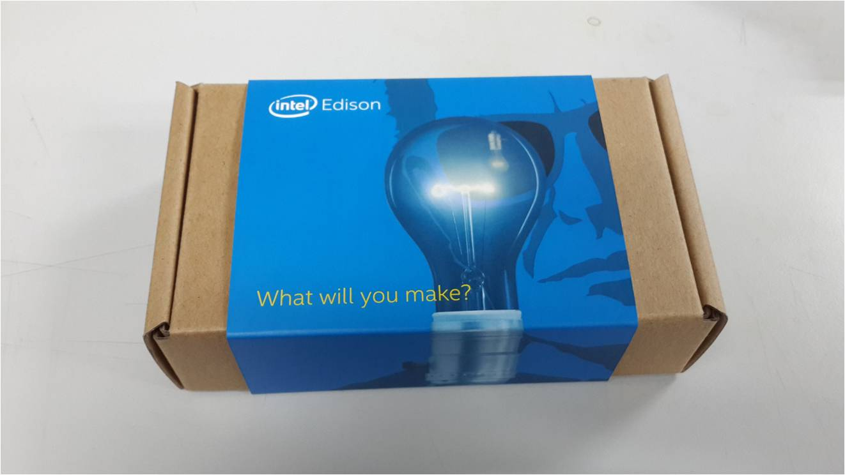

INTEL LABS UXR DSL
Intel Edison
Out of Box Experience
June 4, 2014

Slide 2





Contributors: IL UXR DSL Open Design
Adam Jordan, Team Captain
Carlos Montesinos, Tech Lead
Victoria Fang, Design Lead
Seth Hunter, Creative Technologist
Lucas Ainsworth, Designer

Slide 3
Project Goals
Provide actionable insights and UX design direction for the Edison Out-of-Box Experience which:
Minimize user setup time
Minimize user pain points during configuration
Enable a more seamless workflow for IoT and Wearables Development
Enable both “wired” and “wireless” configuration and programming flows.

Slide 4
Project Scope
End deliverables will provide UX recommendations which include: user experience flow, technical implementation, visual concept mockups and software requirements for the OOBE.
This document provides:
Edison OOBE “wired” and “wireless” setup flow (diagramed in a separate PDF)
Visual look and feel example mockup and website recommendations
Recommendations for implementing the AP configuration
Software requirements and initial thoughts on implementation to support OOBE
Recommendations, insights, & next steps

Slide 5
OOBE Recommended Approach

Slide 6
OOBE UX Key Recommendation
Support both “wired” and “wireless” configuration and development because:
a) Wireless configuration will be necessary when switching networks or troubleshooting during development of products in clothing, the environment or embedded in objects with no expansion board option. b) A web interface with a GUI will work across platforms and is easier for new users to understand and utilize from multiple devices during development. c) Wireless configuration will scale well when developing with multiple Edisons. d) Competitive products (Spark.io, pinocchio, Electric Imp) provide wireless configuration techniques. e) Reduced configuration time

Slide 7
Software Development Recommendations
The flow diagram is included as a separate PDF. The following software elements are needed to support the suggested OOBE flow:
The front end of the “Getting Started” website
The scripts and server elements for configuration on Edison and the front end web configuration Interface
Bonjour MDNS support and integration with the Arduino IDE, Eclipse IDE and XDK IDE for transferring programs after compiling. (Please refer to Larry or Norm for implementation recommendations)
The Web Socket Debug application for wireless debug streaming. (Please refer to Larry or Norm for implementation recommendations)

Slide 8
Visual Concept Mockups

Slide 9
Concept Mockup Notes
Any prior mockups are concepts only and should not be taken as a product ready designs – the flow diagrams should be referred to as the most up to date recommendation for design next steps.
The website should allow the user to specify their operating system and receive specific instructions relative to their OS. The initial website should be reviewed by users in the Edison Trial for clarity.
Competitive Setup guides utilize a 1-2-3 high level scaffolding to guide the user. Both Galileo and Edison setups should follow this approach for consistency and clarity.

Slide 10
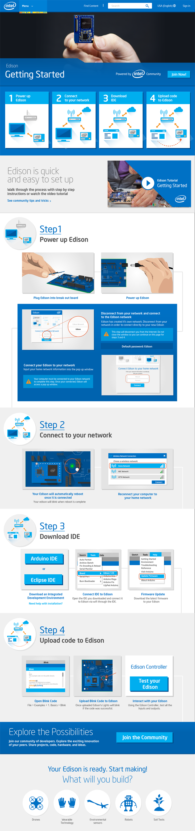
NOTE
Content depicted is concept level only.
This page should support accessing instructions for both the wireless and wired flows.
It should also allow the user to specify their operating system and receive specific instructions relative to their OS.
Latest recommendation is to have 3 steps in the wireless flow:
1. Power Up Edison
2. Configure Edison
3. Program Edison
See flow diagrams for further details.
Sub-divide instructions into a few high level steps.
Provide a video tutorial to get started.
Notes:
Clearly define steps to divide up the setup into comprehensible chunks

Slide 11
Provide clear and friendly visuals and screenshots.
NOTE
Latest recommendation is to include flow starting from powering up the Edison until all necessary drivers are installed. See flow diagrams for details.
Actual copy and diagrams should be updated to align with the latest flow diagrams and crafted for clarity.
Notes:
Clearly define steps to divide up the setup into comprehensible chunks

Slide 12
Provide clear call to action to join the Intel Edison community
NOTE
Content depicted is concept level only.
Notes:
Clearly define steps to divide up the setup into comprehensible chunks

Slide 13
Additional Hardware Recommendations
Hardware Reset AP button: Support “pushing and holding” a button on the Edison expansion board (such as SW1UI4 in the top right corner) for 5 seconds to reset the wireless card AP broadcast mode in case the user runs into an issue where they enter the wrote SSID or password. As a backup the user can reset the wireless by programming the board via the serial UART, but this provides a simpler means of trying again.
LED Status Feedback: If any LEDs on the expansion board are available for feedback on the wifi status through blinks or long holds this would be useful during the AP configuration process. Having a dedicated WLAN LED would be awesome for future versions.

Slide 14
Considerations & Next Steps

Slide 15
Recommended Next Steps for Product Team
Based on latest flows, write copy, design layout and visuals for Getting Started and Edison configuration screens.
Test the “wired” OBEE with users for clarity during internal trial and “wireless” flows after the required software components are developed
Flesh out and develop the highlighted parts of the flow in orange “needs development”. These include: -OBEE website development -AP Config: Edison OBEE yocto scripts and web server -AP Config: the web configuration front end -Programming: Bonjour support for each IDE, and -Programming: web socket debugging tools.

Slide 16
Technical Notes
AP capability for Edison (Web Configuration tool and Edison Scripts): The included flow diagram (page 3) outlines a flow similar to the Arduino Yun. We suggest going through the Arduino Yun AP configuration process for reference. The back end will require a developer familiar with Linux programming. The front end will require a developer familiar with Javascript, Bonjour, and caching data via cookies.
Wireless programming via bonjour for IDEs (Arduino & Eclipse) Each IDE needs to support wireless code transfer. Bonjour capabilities will need to be incorporated into the IDEs and a secure method of transfer after selecting your port such as SFTP or SCP.
Wireless debugging support tool An wireless alternative to serial debugging is necessary when no physical connection is available. We suggest a service running on the Edison which broadcasts debug messages over a web console to a PC client webpage at the Edison’s bonjour address on the same LAN. This solution would work across multiple operating systems and should have a similar look and feel as the configuration webpage.

Slide 17
Addendum: Considerations for Incorporating BT Capabilities

Slide 18
Pros and Cons for WIFI Configuration using BT
We considered BT Configuration as an option and present initial thoughts on pros and cons and potential benefits of a comprehensive application for Edison.
PROS
Enables user to stay online during setup
Reduces confusion as to which network the user is on
Enables real-time feedback on connection progress
May enable future app features (management)
No need to reset in order to update configuration settings
CONS
May require drivers
Requires custom app for iOS and Android
Requires BT 4.0 on Edison
Requires ability to restart wifi & maintain BT connection
Requires user to have smartphone
Requires user to download the app

Slide 19
Initial Thoughts and Ideas: BT Application for Edison
The value proposition for a bluetooth enabled application for mobile devices could potentially include comprehensive management features for developers using the BT capabilities which may include:
Management interface to update firmware and trigger over-the-air updates.
A real-time monitoring and control application that allows the user to turn pins on and off to check the status and control multiple Edisons.
A WIFI configuration tool that does not require the user to switch networks and would provide real-time feedback on the wireless connection status.
A proper design process should be a leveraged for the development of these applications so that it can be extended to future IoT device management systems within NDGs product lines.

