Slide 1

Customer Support Ticket Classification
Team Mentor: Mr. Shaksham Kapoor
Coordinator: Snehal Tambe
Team Members: Rohan Kumar
Rohit Kumar
Tayal Devanshu

Slide 2
Outline
Introduction
Problem Statement & Objective
Project Architecture
EDA
Data Preprocessing
TF-IDF
Baseline Models
Vector Space Embeddings
Hypertuning Parameter
Hypertuned Models
Comparison
Streamlit UI
Insights
Technology Stack
Conclusion
Future Scope

Slide 3
Introduction
This case study shows how to create a model for text analysis and classification and deploy it as a web service in google colab in order to automatically classify support tickets.
Our combined team tried 3 different approaches to tackle this challenge using:
Logistic Regression
Random Forest
Lightgbm

Slide 4
Problem Statement & Objective
Problem Statement
Company XYZ is well-known in the space of eCommerce and has been serving its customers happily for the past 30 years. They follow their motto, “Customer is King”, seriously, and ensure that customers' issues are resolved in time. However, it is a time taking task. For each ticket, a team of SMEs read the ticket to understand the issue and assign it to the appropriate support level. This means, many times, for a simple issue, a customer might need to wait for hours, maybe days before it is resolved, which is not good. An unhappy customer could mean a loss of millions of dollars in revenue.
Objective
Objective is to automatically classify the tickets to either one of the levels (L0 or L1) based on its content.

Slide 5
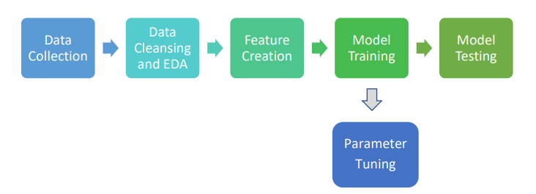
Architecture

Slide 6
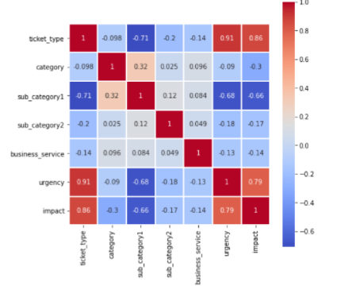
Exploratory Data Analysis

Slide 7
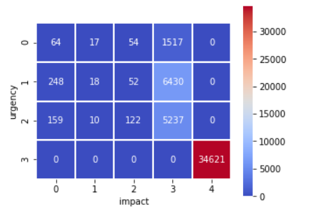
EDA

Slide 8
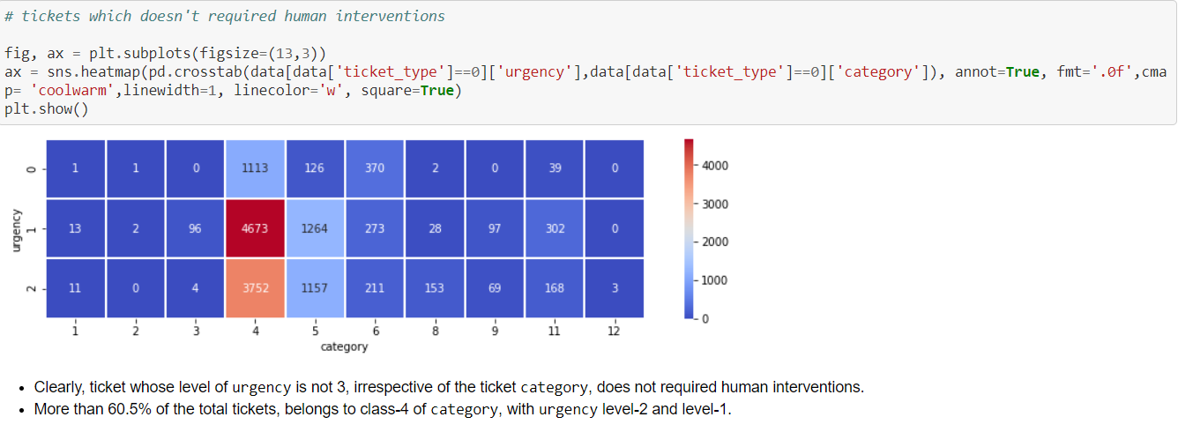
EDA

Slide 9
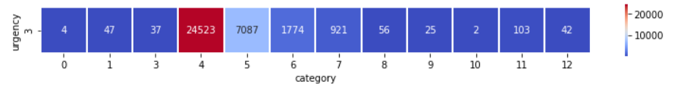
EDA

Slide 10
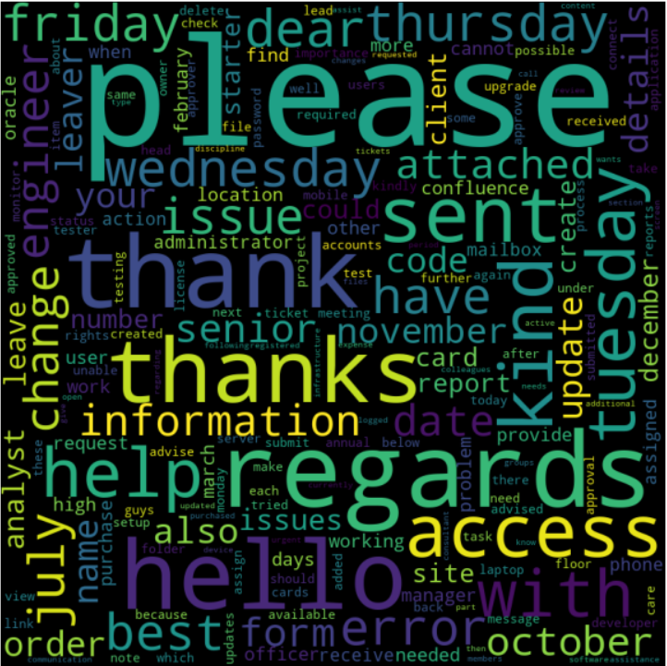

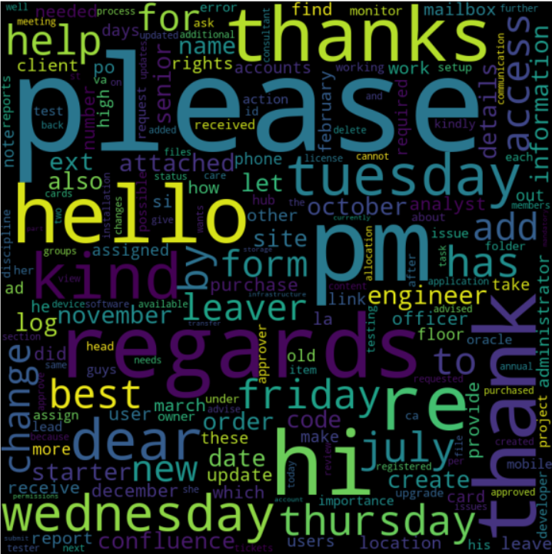
EDA
Word Cloud a) Entire doc, b) for ticket type 1 & c) for ticket type 0

Slide 11
Data Preprocessing
It is the process of preparing raw text for NLP (Natural Language Processing) so that machines can understand human language.
We performed the two most basic data preprocessing techniques on our text data:
1. Normalizing Text
2. Removing Stopwords

Slide 12
TF-IDF
Term Frequency-Inverse Document Frequency (TFIDF) is another method of representing text data in a vector format.
In TF-IDF each document is taken as a list whose length is equal to the number of unique words/tokens in all documents (corpus), but the vector here not only represents the presence and absence of a word, but also the frequency of the word—both in the current document and the whole corpus.

Slide 13
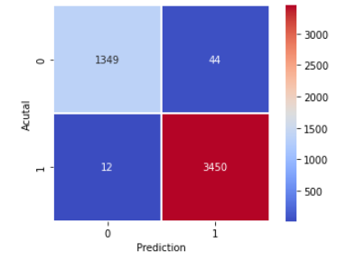
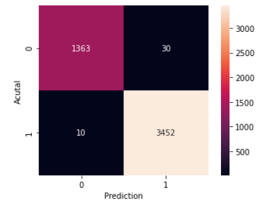
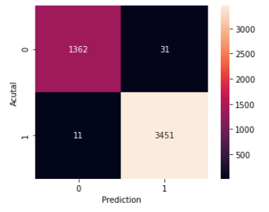
Baseline Model
We have trained our dataset on three different models :
Logistic Regression | Random Forest | LightGBM
98.85% | 99.18% | 99.13%

Slide 14
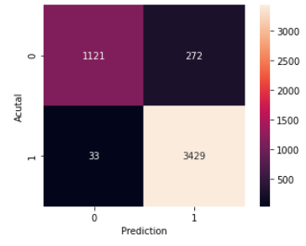
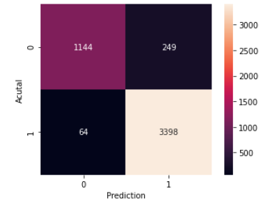
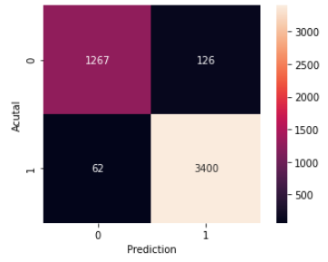
Vector Space Embeddings
We have further trained our model using 3 different Vector Space models.
Word2Vec | Fasttext | Glove
93.72% | 93.55% | 96.13%

Slide 15
Hyperparameter tuning
A hypermeter is a parameter whose value is used to control the learning process.
There are two methods to achieve this goal.
1.GridSearchCV : It implements the most obvious way of finding an optimal value for anything. It simply tries all the possible values (that you pass) one at a time and returns which one yielded the best model results, based on the scoring that you want.
2.RandomizedSearchCV : RandomSearchCV has the same purpose as GridSearchCV: they both were designed to find the best parameters to improve your model. However, here not all parameters are tested.

Slide 16
Hyperparameter Models
Model | Parameters | Range
Logistic Regression | Penalty | { ‘l2’ }
 | C | { 0.1, 1, 10, 100, 1000 }
Random Forest | N_estimators | { 10, 20, 30,…, 90, 100}
 | Max_depth | { None, 3, 5, 10 }
 | Criterion | { ‘gini’, ‘ entropy’ }
LightGBM | N_estimators | { 10, 20, 30,…, 90, 100}
 | Max_depth | { None, 3, 5, 10 }
 | Criterion | { ‘gini’, ‘ entropy’ }

Slide 17
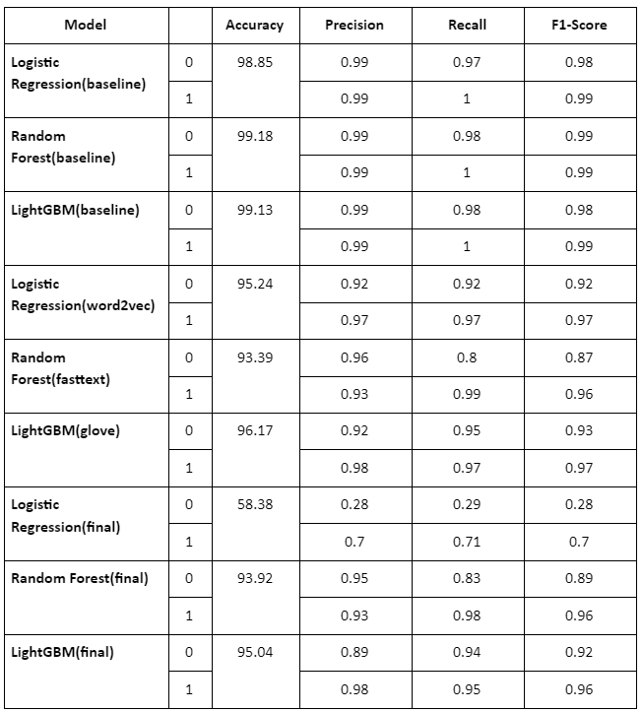
Comparison

Slide 18
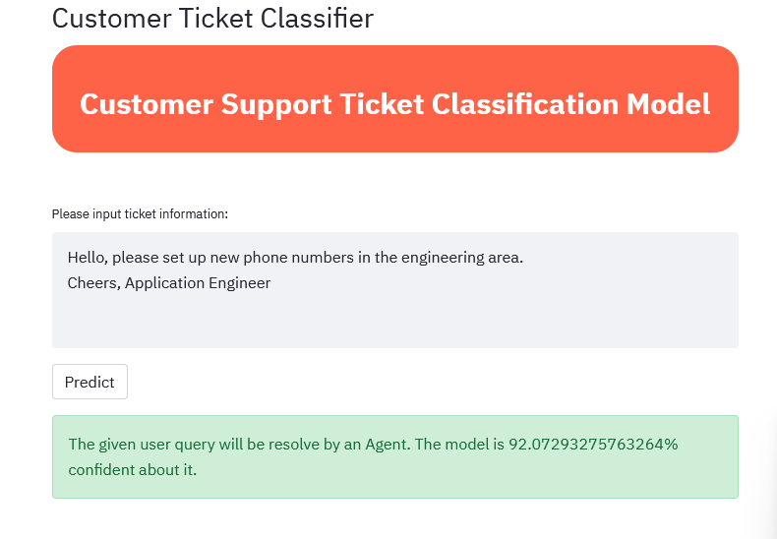
Streamlit
Notes:
Streamlit is an open-source python library that makes it easy to create and share beautiful, custom web apps for machine learning and data science.

Slide 19
Insights
Urgency level 3 and impact level 4 are the most impactable features for the business since ~ 71% of the tickets belongs here.
This can be further developed and deployed to third party customer service as an external API to classify the queries which can be solved by bots and not require human intervention as it will free up the human resource.
From the correlation matrix, we can deduce that ticket_type, urgency and impact have very high correlations.
Clearly, ticket whose level of urgency is not 3, irrespective of the ticket category, does not required human interventions. More than 60.5% of the total tickets, belongs to class - 4 of category, with urgency level-2 and level-1.
Notes:
Final points on the business models.

Slide 20
Technology
Stack
Pandas | Python library used for data manipulation & analysis.
Numpy | Used to perform a wide variety of mathematical operations on arrays.
Matplotlib | used for data visualization and exploratory data analysis.
Seaborn | used for data visualization and exploratory data analysis.
Wordcloud | It is a data visualization technique used for representing text data
NLTK | Python package used for Natural Language Processing (NLP).
Sklearn | Used for model building and evaluation using various metrics.
Pickle | Used to dump/load a model or any python object.
Embedding-as-service | Used for vector space models.
Streamlit | Used to create and share beautiful, custom web apps for machine learning and data science.

Slide 21
Conclusion
We learnt operations on data like .
Performing EDA to obtain information on how the data was impacting certain business requirements.
Learnt data quality improvement measures post EDA.
We learned techniques to transform text data into vectorized format using TF-IDF and vector space models.
Multiple trials of various hypertuning techniques were implemented to finalize best possible algorithm to implement.
UI development was done in order to create UI for determining the ticket type based on inputs.

Slide 22
Future Scope
We can experiment with advanced vector space models like ELMO, BERT. These advanced models resolve the limitations present in existing techniques like word2vec.
We can try Bayesian techniques for hyper-parameter tuning.
We can experiment with deep learning models. Since we have text data, experimenting with RNN (recurrent neural networks) might be more useful.
We can extend the functionality by automating the process of assigning the category and subcategory for a given query.

Slide 23
Questions?

Slide 24
Thank You

