Slide 3
Conquer!
Powerflasher Hamburg presents a marketing concept for FDT.
Aachen, 28.Februar 2011.
Notes:
Titel neu!

Slide 4
Who's got the longest?
FDT, Flash Builder and IntelliJ are constantly rearming with new features.

Slide 5
Who's got a lot, can do a lot.
Notes:
Ganz nach dem Motto:

Slide 6
The dilemma.
In order to not stay behind, FDT needs to constantly develop new, expensive features, introduce them to the community and write documentations.
Notes:
Aber: Das Dilemma.

Slide 7
As a matter of fact, we all love to have many features.
Notes:
Wenn wir uns tief in die Augen blicken:

Slide 8
And that's why we have a plan of action:
Before developing new features, we analyze the wishes and problems of the community. A variety of methods will determine which features are really reasonable.
Notes:
Beispiele:
– Jira
– 100$ Game
– Umfragen usw.

Slide 9
But:

Slide 10
The fact of matter is.
We don’t know if the new features are really used.
We know that 80% of our customers are happy with knowing just 20% of our features.

Slide 11
We want to change this. With a golden strategy.
Notes:
…von der wir glauben damit auch international Awards gewinnen zu können.

Slide 12
Our common goal.

Slide 13
1. Win new customers.
We want to reach more Flash developers, convince them and motivate to buy.
The strategic key message: FDT makes you more efficient.

Slide 14
2. Community bonding.
We want to sustainably convince users to their decision and extend their customer loyalty.
Therefore we want to help users to use FDT more efficiently and share their love.

Slide 15
3. Improve FDT.
We want to lead FDT the right way.
For this purpose we listen to the community better than ever before.

Slide 16
Outline of the strategy.
Win new customers
Community bonding
Improve FDT

Slide 17
Implementing the new strategy.

Slide 18
The approach:
Instead of classic advertisement, we're going an entirely different way.
The whole communication stategy is based upon a new tool for FDT.
The tool changes the perception of FDT positively while keeping the number of features.

Slide 19
The idea: Productivity Booster.

Slide 20
The idea.
We make every developer an FDT heavy-user who can take any of our evengalists.

Slide 21
How it works.
We track what features are used, and how frequently.
So we can present them the results.

Slide 22
Concretely.
We inform developers about:
Frequently used features
Seldomly used features
Unused features
New Features
etc.

Slide 23
One step further.
We provide a short tutorial to every feature information.
The developer automatically teaches themselves during everyday's business.

Slide 24
That's what the Productivity Booser could look like.

Slide 25
Curtains up!

Slide 26
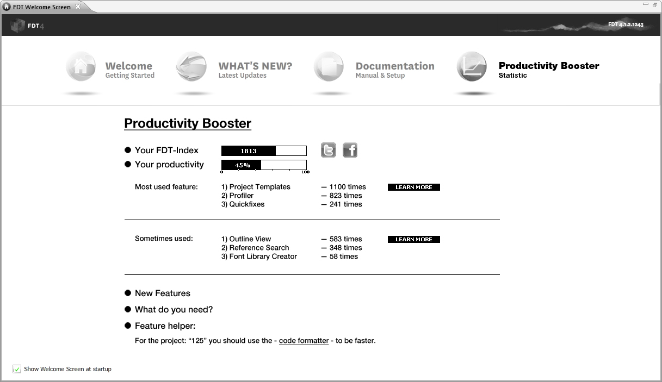

Slide 27
That's how we use Productivity Booster for our strategy.
Notes:
Es folgen examplarische Ideen. Einige könnte man sofort zumsetzen. Einige sind eher als Sprungbrett zu verstehen.

Slide 28
Win new Customers
Community bonding
Improve FDT

Slide 29
Our chance.
Analyzing the data tracked, we can convince potential customers with solid arguments.
Furthermore, everyone using FDT frequently, enthusiastically and now also efficiently, is the perfect multiplier.

Slide 30
The idea: Feature charts.
On the FDT Website frequency of usage of all features are displayed.
Images visualize the top features.
This not only convinces people interested, but also existing customers.

Slide 31
The idea: Upgrade recommendations.
If the developer uses Pure or Plus, we show them what features of the upgrade would have helped, respectively.

Slide 32
Community bonding
Win new customers
Improve FDT

Slide 33
Our chance.
People that use FDT joyfully, often and now also efficiently, are the perfect multiplier.
We just need to get them to motivate others.

Slide 34
The idea: FDT Index.
We visualize every developer's degree of efficiency with the FDT Index.
We opine this to be something to be proud of.
That's why you can share your current FDT Index with only one click in FDT on Facebook and Twitter.

Slide 35
The idea: Tweet & win.
A raffle that reminds the Flash community of FDT's efficiency.
We motivate FDT users to twitter their degree of efficiency - right out of FDT.
Every week, we raffle off tickets to conferences, licenses etc. among the Top 100.

Slide 36
The idea: FDT heavy user.
Resulting from the FDT Index, heavy users are determined. They will be ranked and displayed on our website, and may oficially call themselves FDT Heavy User.
Further incentives and reports may be published on the blog.

Slide 37
Improve FDT
Win new customers
Community bonding

Slide 38
Our chance.
We can store the tracking data in order to have a quantitative foundation for future decisions:
Improve features
Promote unused features
Optimize sales arguments
etc.

Slide 39
More feature requests.
Due to the productivity booster, developers preoccupy themselves more with FDT's features. For instance when analyzing their efficiency.
That's when we invite them to send us their feature requests.

Slide 40
Concluding.

Slide 41
This is the Productivity Booster.
The Productivity Booster is not only some new feature.
The Productivity Booster is a versatile marketing tool.

Slide 42
Productivity Booster
Convince
Win new customers
Push revenue
Increase market share
Powerful new sales arguments
Notes:
Der Productivity Booster als Impuls und Basis für die gesamte Marketingstrategie.

Slide 43
Productivity Booster
Überzeugen
Convince
Motivate
Neukunden gewinnen
Absatz steigern
Marktanteil erhöhen
Schlagkräftige, neue Verkaufsargumente
Win new customers
Push revenue
Increase market share
Powerful new sales arguments
Community bonding
Positive product perception
Enthusiastic customers
Multiplier

Slide 44
Productivity Booster
Convince
Motivate
Optimize
Win new customers
Push revenue
Increase market share
Powerful new sales arguments
Community bonding
Positive product perception
Enthusiastic customers
Multiplier
Improve FDT
Decisions based on numbers
Perceived feature supremacy
More feature requests

Slide 45
Has Powerflasher convinced you?
Over to you.

Slide 46
Fabian Nöthe
Kreativdirektor
E fn@powerflasher.de
T 040 380 766 131
PABLO SAHLMEN
Kommunikationsberatung
E ps@powerflasher.de
T 040 380 766 130

