Slide 1


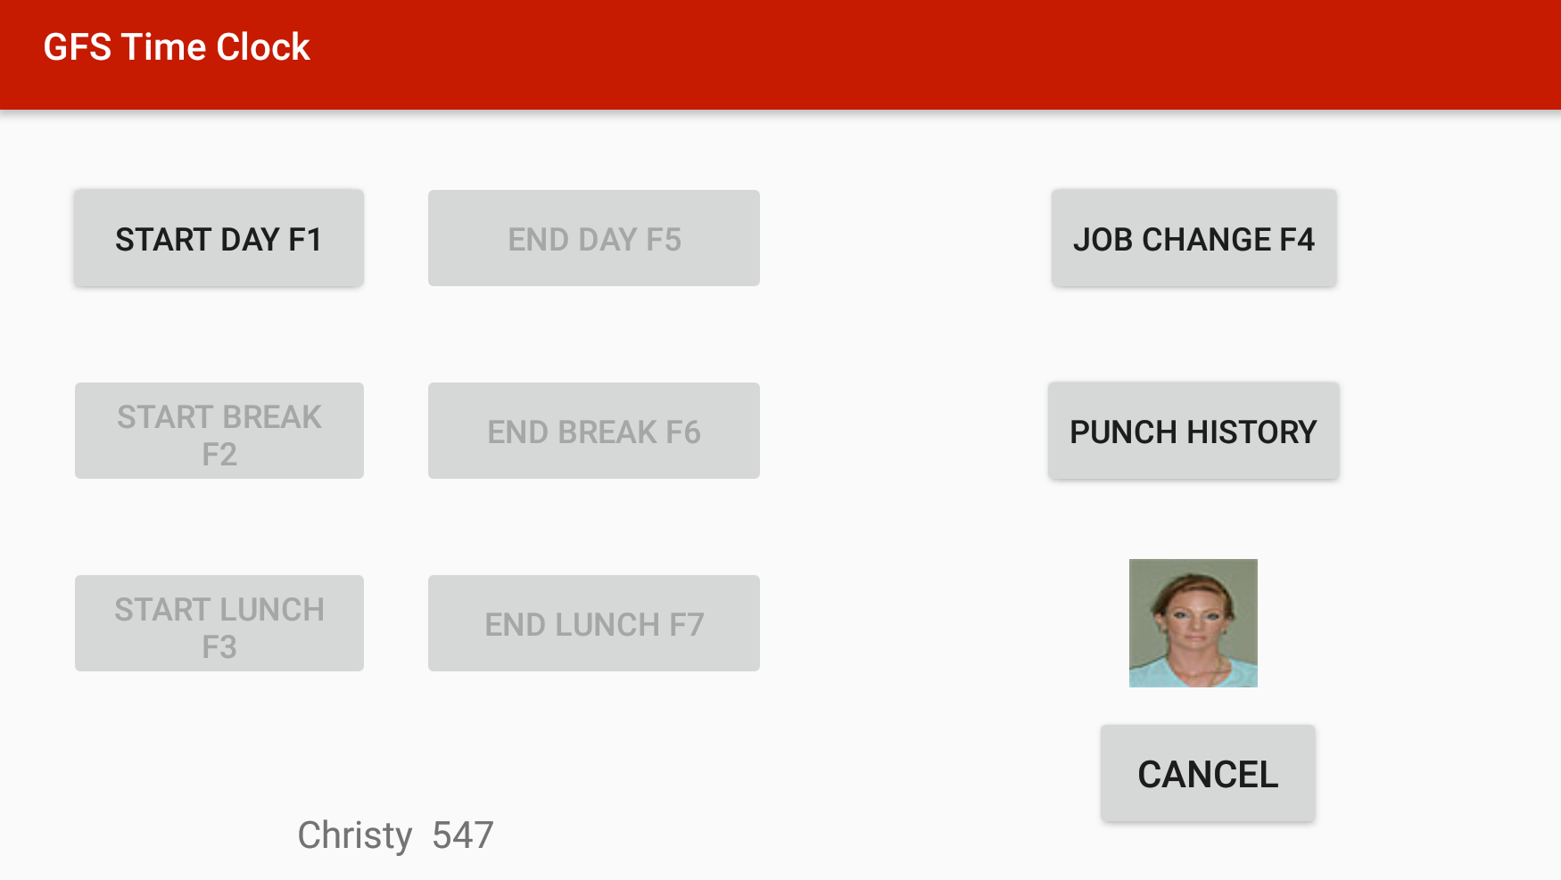
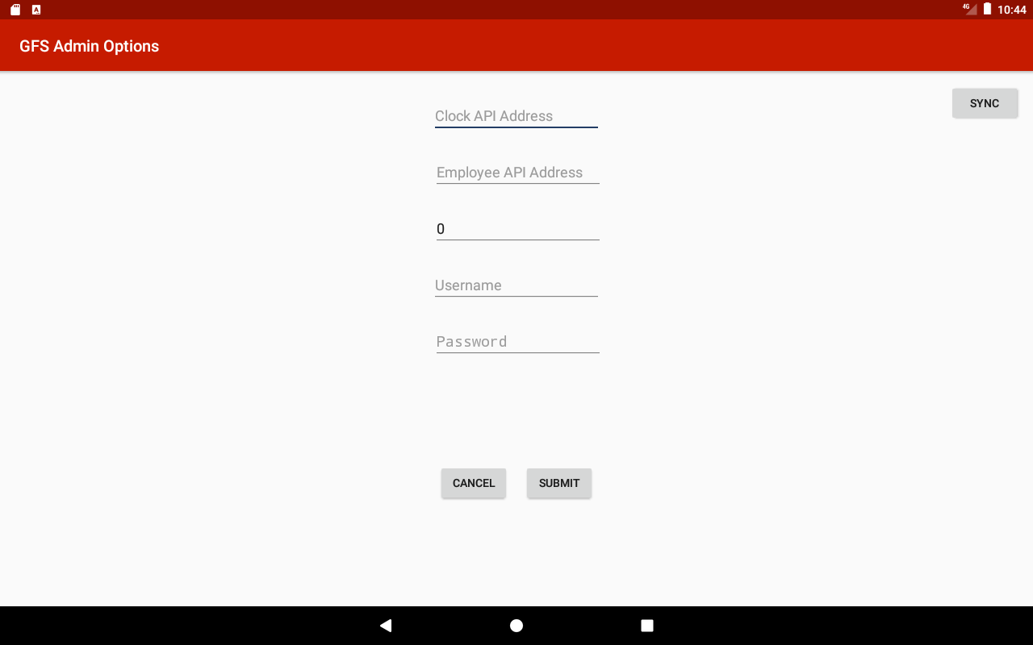

GFS Time Clock
Kent Sinclair, Thanh Nguyen | Advisors: Dr. Robert Adams, GVSU | Ron Hull, Ehsan Rahman, James Uhi li, Gordon Food Service
Abstract
Goal
Challenges
Gordon Food Service uses wall mounted timeclocks which cost $1,800 to $2,000 per unit for hourly employees across 130 distribution centers. By replacing current timeclocks with $300 tablet, software, and mount package for a potential savings of $200,000.
Develop a networked clock that leverages commodity hardware and software to reduce maintenance and replacement cost over dedicated time clock solutions.
As an operating system and ecosystem, Android is optimized single user mobile applications. Commodity hardware Maintain consistent experience across various API devices
Initial Software Options
Options Screen
Implementation
AngularJS Web Application
Native (Java) Android Application
The timeclock Native Android app, with backwards compatibility for Android API 17, Android 4.2 Jelly Bean. Offline functionality using a local Realm database to store cached punches. Configuration using Android shared preferences to hold passwords and API information. Network connectivity is achieved through the Retrofit library to build API calls. FasterXML/Jackson is used to translate between Java objects and JSON. Image downloading and caching is handling using the Picasso library
Application Features
Time Clock functionality including ability to clock in and out for work and breaks as seen in figure 1.Flexibilty to scan user badge using device camera, barcode scanner, or manually. The Android application makes use of a persistent configuration via. Android SharedPreferences. In addition the application makes use of offline or disconnected mode.
Future
Figure 1(phone)
Deployment will require a few steps to be taken by GFS prior to going live: Distribution center wifi testing (for deadzone and sync frequency).3D printed mounting solution. User testing involving potential UI Updates. In depth hardware consideration
Admin Panel
Open Source / Libraries
Zxing (https://github.com/zxing/zxing/)
Realm-java (https://github.com/realm/realm-java)
Retrofit (https://github.com/square/retrofit)
OkHttp(https://github.com/square/okhttp)
FasterXML (https://github.com/FasterXML/jackson)
RxAndroid(https://github.com/ReactiveX/RxAndroid)
Figure 2 (tablet)

