Slide 1
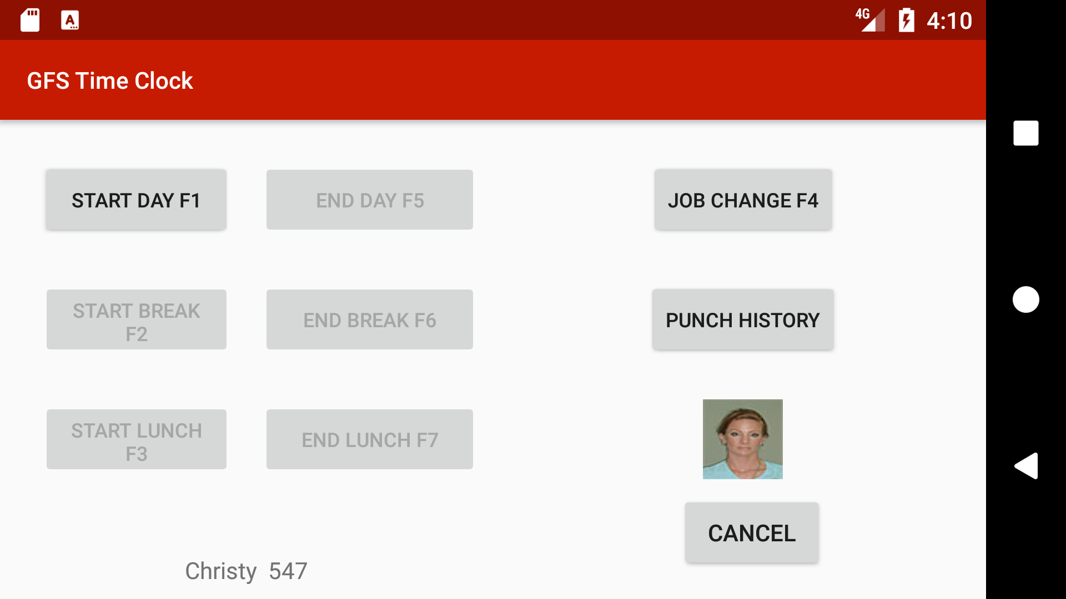
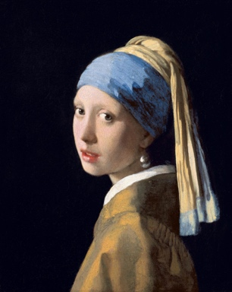
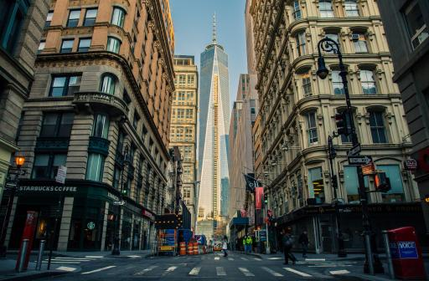
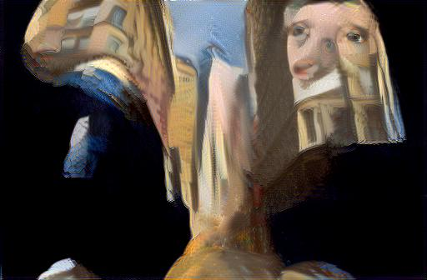
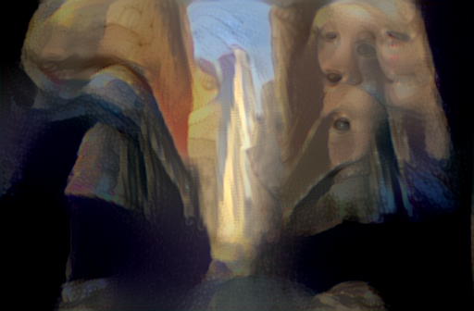
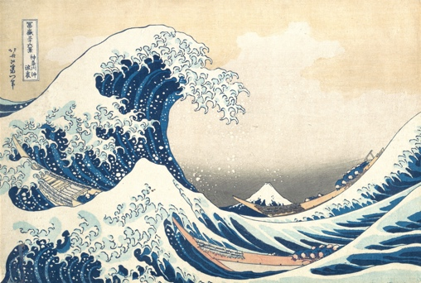

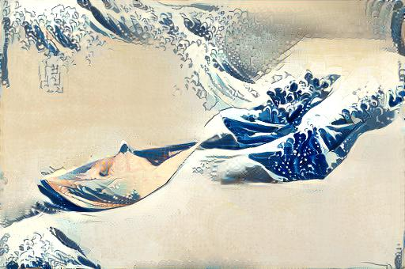
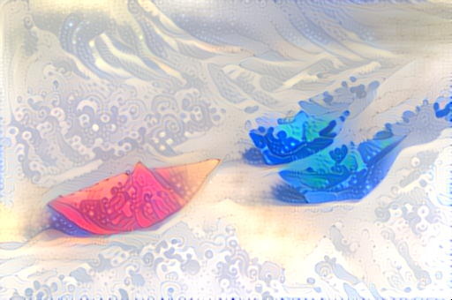
GFS Time Clock
Kent Sinclair, Thanh Nguyen Sponsor: Gordon Food Service
Goal
Context
Develop a networked clock that leverages commodity hardware and software to reduce maintenance and replacement cost over dedicated time clock solutions.
The current dedicated time clocks used by Gordon Food Services cost upwards of 2000USD per unit. Replacing these units will a 300USD tablet, software, and mount package will permit cost savings by eliminating costly hardware replacements and software licensing for the dedicated time clocks.
Problems
Figure 4: Results for several different styles and images. Results captured after 450 iterations of the algorithm. Uses α/β ratio on the scale of 10⁻². Overall results are successful, but there are cases that do not work well.
As an operating system and ecosystem, Android is very specifically optimized for use in the context of single user mobile applications.
Discussion
Dramatic improvement in the reduction of artifacts.
Content image correlates weakly with higher layers (conv5_1), which contain data on specific features. This reduces the weight of those layers, thereby reducing their impact.
Beneficial in cases where the style image has a strong content:
In Girl with a Pearl Earring, this reduces facial artifacts
Not suitable if style is defined by high level features:
In abstract, large brush strokes are lost during style transfer
Results
Meets goals established for the project:
Generates new image similar to designated style image
Produces observable improvement over original method
Maintains higher content fidelity
Using different number of segments allows for varied output
Enhanced version stylizes images into the target style:
Colors are truer to the content image than the original
Artifacts from the style image are less likely to occur
Other differences:
Optimizes spatial configuration faster for the same style and content mage than the original algorithm
However, mask calculation slows algorithm (O(n²) operation)
Implementation
Conclusions and Future Work
Native Android app, with backwards compatibility for Android API 17, Android 4.2 Jelly Bean.
Offline functionality is backed using a local Realm database to store cached punches
Configuration using Android SharedPreferences to hold passwords and API information.
Network connectivity is achieved through the Retrofit library, using the Jackson JSON Parser to translate between Java objects and JSON.
Image downloading and caching is handling using the Picasso library
This project used Torch and Lua to develop an enhanced version of a new algorithm for transferring artistic style. The improved algorithm uses image segmentation to generate weight masks for each style layer, producing images more faithful to the content image, while still incorporating the target style. The project was successful at improving the artistic style transfer algorithm, but can still be improved. Ideally, it would use two sets of masks, one for the content image and one for the style image. The segments of the style image would then be used to identify regions with similar textures in the content image and allow the algorithm to perform a more directed style transfer. Another possible improvement would be utilize a CNN model specifically trained on artwork classification.
References
J. Schmidhuber, "Deep learning in neural networks: An overview," Neural Networks, vol. 61, no. 0893-6080, pp. 85-117, 2015.
A. Z. Karen Simonyan, "Very Deep Convolutional Networks for Large-Scale Image Recognition," Computing Research Repository, no. 1409.1556, 2104.
A. Karpathy, "CS231n Convolutional Neural Networks for Visual Recognition," [Online]. Available: http://cs231n.github.io/convolutional-networks/. [Accessed 2016].
A. E. a. M. B. Leon Gatys, "A Neural Algorithm of Artistic Style," Journal of Vision, vol. 16, no. 12, p. 326, 2015.
A. E. a. M. B. Leon Gatys, "Image Style Transfer Using Convolutional Neural Networks," in The IEEE Conference on Computer Vision and Pattern Recognition, 2016.
R. K. K. a. C. F. Collobert, "Torch7: A matlab-like environment for machine learning.," in BigLearn, NIPS Workshop, 2011.
V. A. P. a. I. D. R. Carl Yuheng Ren, "gSLICr: SLIC superpixels at over 250Hz," 2015.
R. a. S. A. a. S. K. a. L. A. a. F. P. a. S. S. Achanta, "SLIC Superpixels Compared to State-of-the-Art Superpixel Methods," IEEE Trans. Pattern Anal. Mach. Intel., vol. 34, no. 11, pp. 2274-2282, Nov 2012.
Figure 3: Original method (second from right) and enhanced method (far right). Artifacts from original style image are less apparent, and colors resemble the content image more than the style image.

