Slide 1


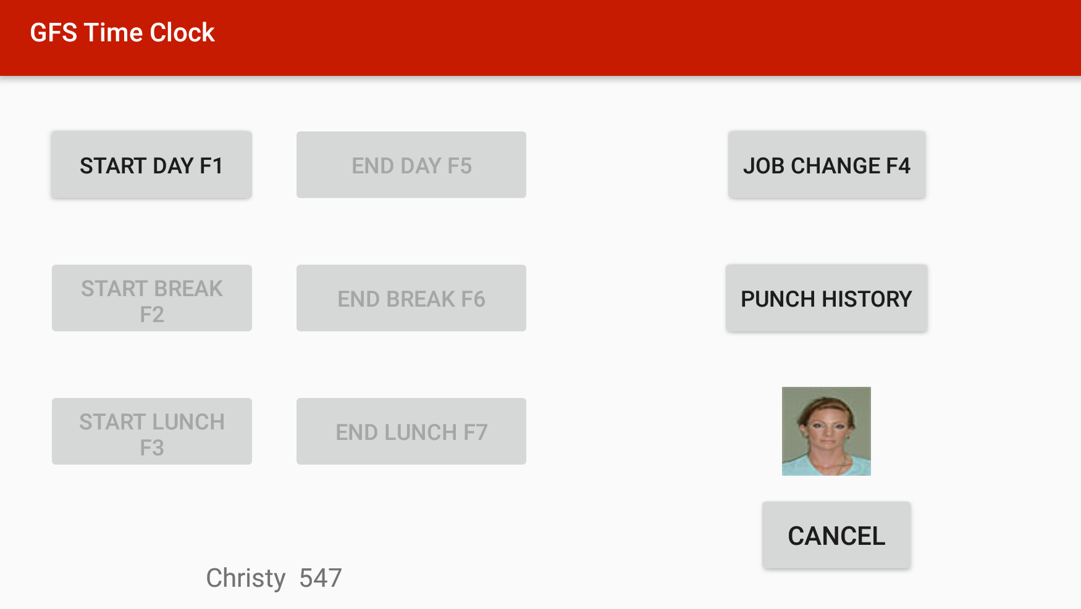
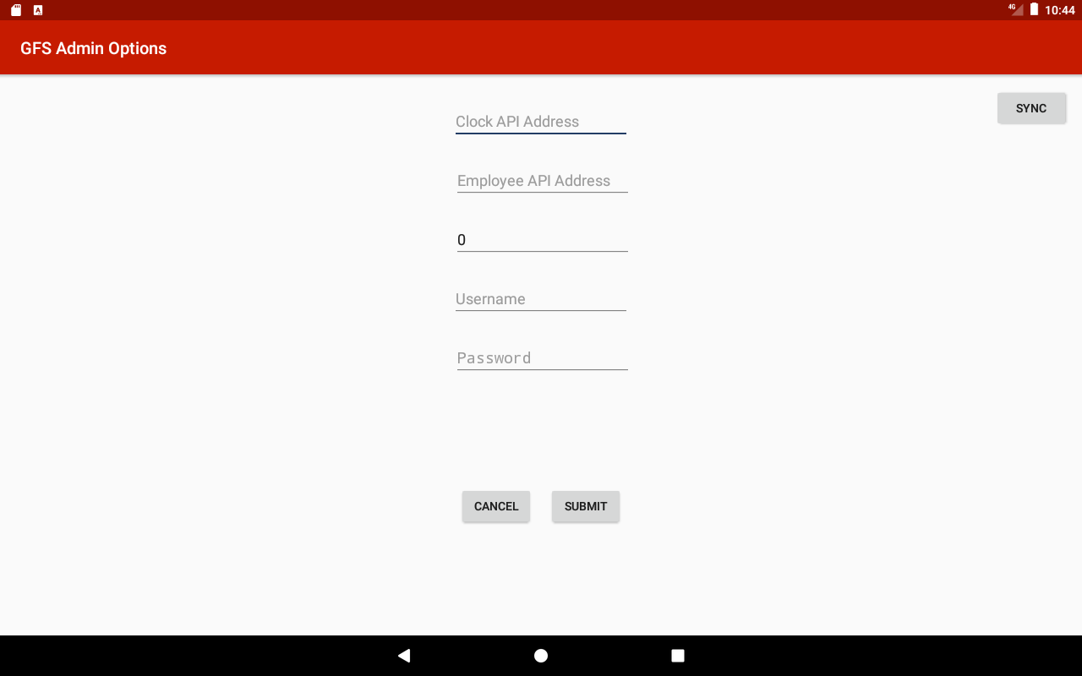
GFS Time Clock
Kent Sinclair, Thanh Nguyen | Advisors: Dr. Robert Adams, GVSU | Ron Hull, Ehsan Rahman, James Uhi li Gordon Food Service
Abstract
Goal
Challenges
Gordon Food Service uses wall mounted timeclocks which cost $1,800 to $2,000 per unit for hourly employees across 130 distribution centers. By replacing current timeclocks with $300 tablet, software, and mount package for a potential savings of $200,000.
Develop a networked clock that leverages commodity hardware and software to reduce maintenance and replacement cost over dedicated time clock solutions.
As an operating system and ecosystem, Android is optimized single user mobile applications.
Commodity hardware
Maintain consistent experience across various API devices
Initial Software Options
Options Screen
Implementation
AngularJS Web Application
Native (Java) Android Application
Native Android app, with backwards compatibility for Android API 17, Android 4.2 Jelly Bean.
Offline functionality using a local Realm database to store cached punches
Configuration using Android shared preferences to hold passwords and API information.
Network connectivity is achieved through the Retrofit library to build API calls.
FasterXML/Jackson is used to translate between Java objects and JSON.
Image downloading and caching is handling using the Picasso library
Features
Time Clock functionality:
"F1" = Start day
"F2" = Start Break
"F3" = Start Lunch
"F4" = Job Change
"F5" = End Day
"F6" = End Break
"F7" = End Lunch
Manual input –Physical Scanner or Keyboard(debugging)
Persistent Configuration - SharedPreferences
Offline / disconnected functionality
Personalized Options Screen (fig. 1)
Figure 1(phone)
Admin Panel
Future
Open Source / Libraries
Deployment will require a few steps to be taken by GFS prior to going live:
Distribution center wifi testing (for deadzone and sync frequency).
3D printed mounting solution
User testing involving potential UI Updates
In depth hardware consideration
Android (https://github.com/android)
Zxing (https://github.com/zxing/zxing/)
Realm-java (https://github.com/realm/realm-java)
Retrofit (https://github.com/square/retrofit)
OkHttp(https://github.com/square/okhttp)
FasterXML (https://github.com/FasterXML/jackson)
RxAndroid(https://github.com/ReactiveX/RxAndroid)
Figure 2 (tablet)

