Slide 1
Game 15
powered by game fifteen 2 team

Slide 3
IT’s ABOUT The GAMe
just a sliding puzzle game…

Slide 4
IT’S All ABOUT THE PROJECT
just teamwork project for the high quality code course
at telerik academy…

Slide 5
IT’S All ABOUT THE CODE
just c# code with some extremely YAGNI classes, methods, documentation
and so on...

Slide 6
IT’S All ABOUT THE SOLID
just SOLID things…

Slide 7
IT’S All ABOUT THE UX
just to have fun…

Slide 8
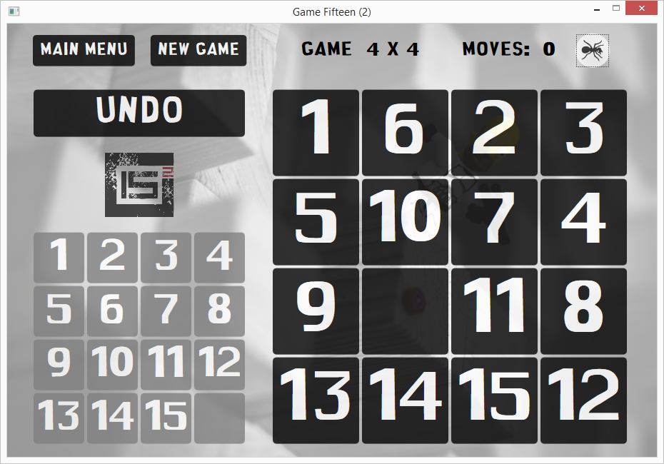
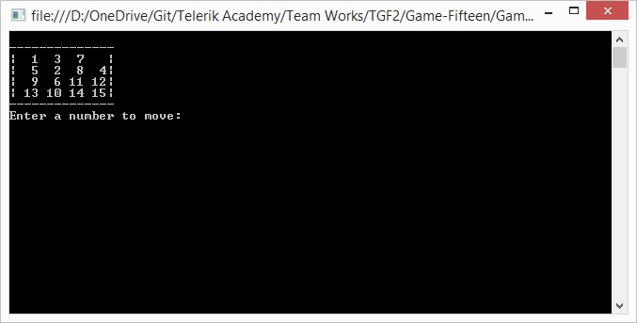
IT’s all about the UI
CLASSIC
OLD SCHOOL

Slide 9
IT’S All ABOUT THE LOGIC
just one logic…

Slide 10
IT’S All ABOUT the patterns
just about a lot…

Slide 11
IT’S All ABOUT THE features
just new features…

Slide 12
IT’S All ABOUT THE tests
just 97 percent code coverage…

Slide 13
IT’S All about the Cop
just stylecop…

Slide 14
IT’S All ABOUT the team
just THE TEAM…

Slide 15
IT’S All ABOUT us
just five of us…

Slide 16
Name | GitHub | Telerik Academy
Dobromira Boycheva | dobromiraboycheva | dobromira.boycheva
Iliqna Antova | iliantova | iliant
Ivo Paounov | IvoPaunov | ivo.paunov
Mariya Steffanova | Mariya Steffanova | MariyaSteffanova
Simeon Georgiev | SimoPrG | simeon.georgiev.5076

Slide 17
IT’S All about the END
just end…

