Slide 1
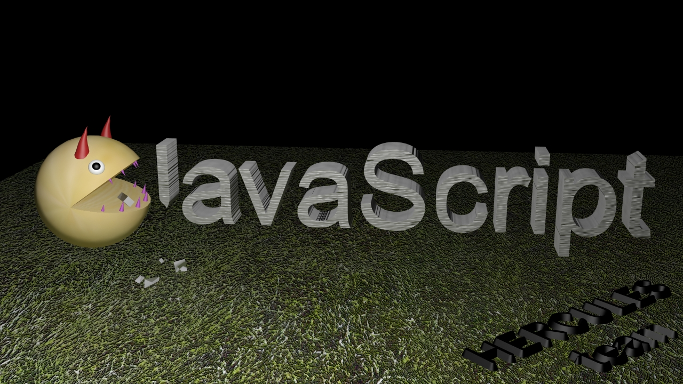
Team HERCULES
Insert Pacman Pic here
The Evil Pacman

Slide 2
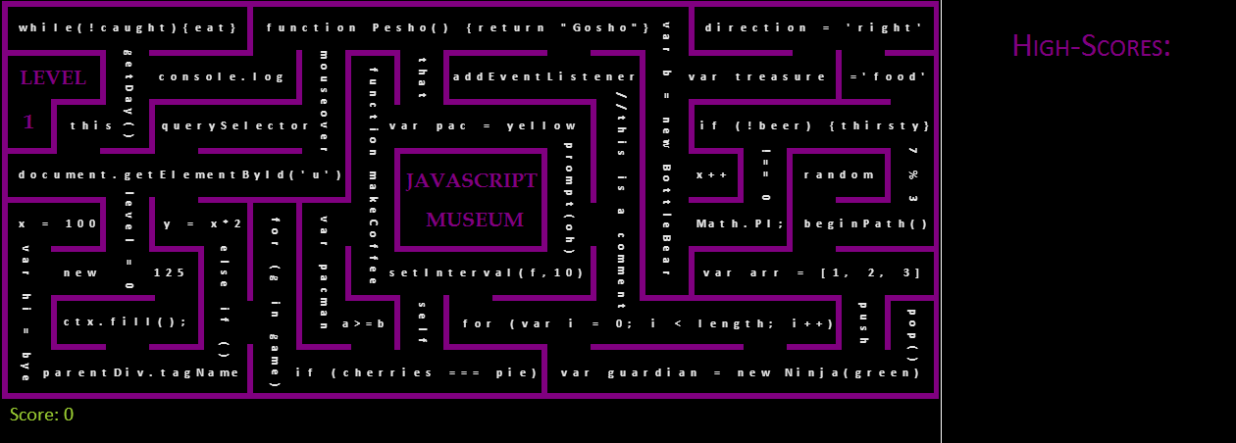

The JavaScript Museum
was a peaceful place, where kids loved to hang in, to learn
the knacks of JavaScript.
Score field
Game field
Until the day when…

Slide 3
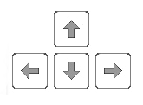

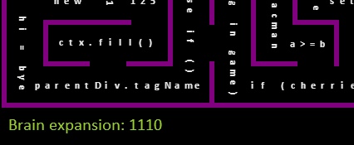
The Evil Pacman
broke in.
He was greedy and wanted all the treasures in the museum for himself.
He started eating through them, swallowing every last piece of JavaScript knowledge there was. The more he ate, the cleverer he got.
What he didn’t expect though were…
The Evil Pacman
Treasures (Food)
Brain Expansion / Score

Slide 4

The JavaSript Guardians
– Nick, Don, Kenny and Paul, who swore to protect the JavaScript treasures with their lives.
They chased after The Evil Pacman to keep as much of the treasures as they could.
Nick
Don
Kenny
Paul

Slide 5
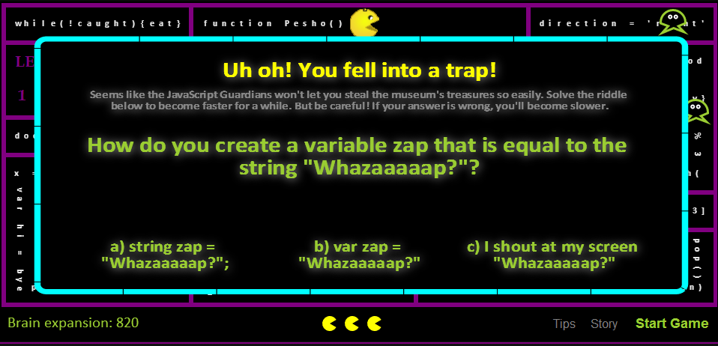
But Pacman was sneaky and managed to avoid the Guardians for a while.
However, he didn’t know about the traps the guardians had set. Every now and then he stumbled upon one.
He had to solve a riddle in order to get out. If he answered correctly, he got extra power (speed) to keep going but if he didn’t, he was slowed down by a special slowing-down potion, stirred by one of the Guardians (who we shall not name), until it wore out.

Slide 6

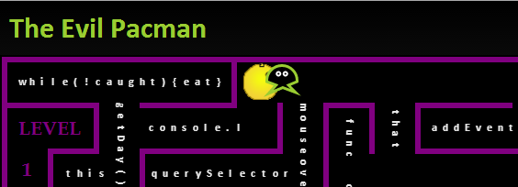
If Pacman managed to eat all the treasures, a door to a new room in the museum revealed itself, leading The Evil One to more treasures (next level).
But when he didn’t listen and kept eating through the treasures, the Guardians had had enough. When they caught him for a third time, he was banned from the JavaScript Museum and the Guardians continued with their peaceful lives, happy that the treasures were safe for the studious little kids to learn from.
But he wasn’t always so lucky. The first two times Pacman was caught, he got a warning and the Guardians let him go.
Lives
GAME OVER

