Slide 1
Introduction to Knowledge Graph
-- The basics, storing schema, others
Luyue Zhao 11/27/2022
“The one thing better than perfection, is standardization.”

Slide 2
Abstract
These slides will introduce the basic concept of knowledge graphs, applications, storing mechanisms, and others, of knowledge graphs.

Slide 3
Index
1. Why knowledge graph?
2. What is knowledge graph?
3. Usage of knowledge graphs
4. Describe a knowledge graph

Slide 4
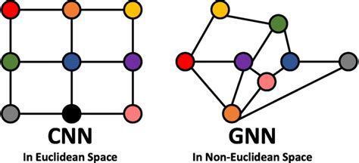
Why knowledge graph?
Graph is one of the most intuitive and omnipresent ways to represent information and data.
Image is a graph.

Slide 5
Why knowledge graph?
Text is a graph:
The
Quick
Brown
Fox
…

Slide 6
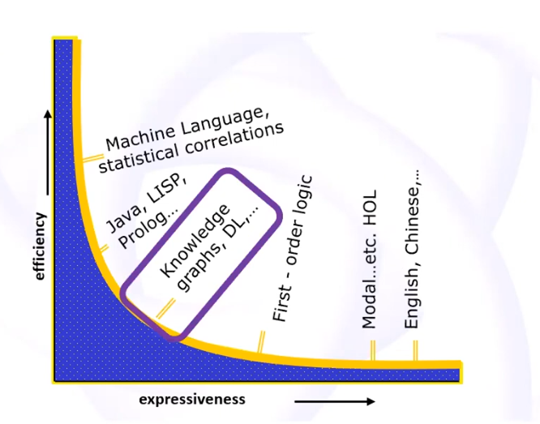
Why knowledge graph?
Graphs stand in the middle between human and machine.
Graph is understandable by human, and interpretable by machine.
With the implementation in NLP, graphs are better suited than sentence embedding or Word2Vec in interpretability.

Slide 7
What is knowledge graph?
A
C
B
Directed Labeled Graph
Nodes and Edges have well-defined meanings

Slide 8
What is knowledge graph?
Subject
Object
Predicate
Directed Labeled Graph
Nodes and Edges have well-defined meanings

Slide 9
What is knowledge graph?
Class
A
Class
B
Subclass of
Directed Labeled Graph
Nodes and Edges have well-defined meanings

Slide 10
What is knowledge graph?
Alice
Bob
Friend
Directed Labeled Graph
Nodes and Edges have well-defined meanings

Slide 11
What is knowledge graph?
Person
Human
Animal
Subclass of
Subclass of
Directed Labeled Graph
Nodes and Edges have well-defined meanings

Slide 12
How to define meanings?
User’s actions
“friend (request)” action
Human Understandable languages
Wordnet
Logical Specifications
Set of Axioms
Associative definition
Cat – Images of cats
Embeddings
Statistics on a corpus of texts; BERT

Slide 13
Usage – Natural Language Processing
Entity Extraction, Relation Extraction and reasoning
Albert Einstein is a German-born theoretical physicist who developed the theory of relativity.
Germany
Born in
Albert
Einstein
Theoretical physicist
Occupation
Developed
Theory of relativity

Slide 14
Usage – Natural Language Processing
Entity Extraction, Relation Extraction and reasoning
Albert Einstein is a German-born theoretical physicist who developed the theory of relativity.
Germany
Born in
Albert
Einstein
Theoretical physicist
Subclass of
Physicist
Occupation
Developed
develop
Theory of relativity
Physics
Subclass of

Slide 15
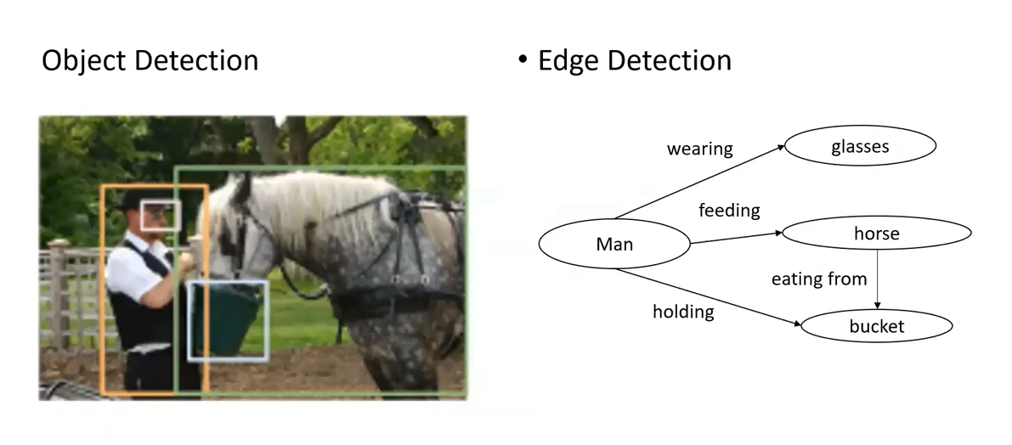
Computer Vision

Slide 16
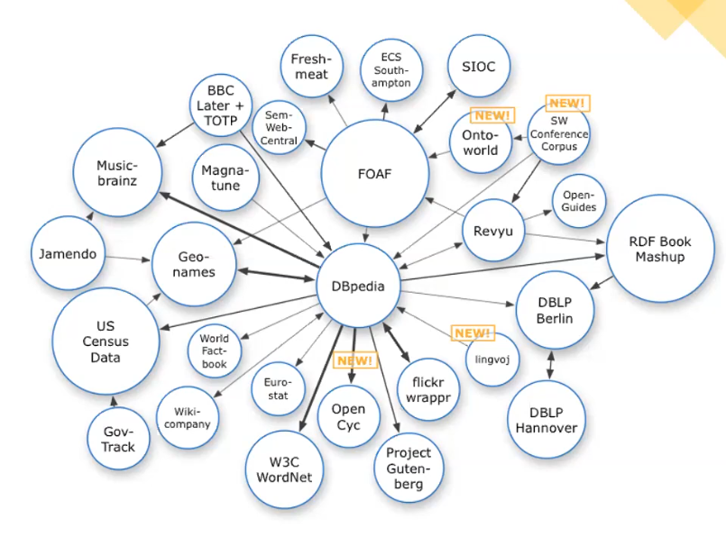
Current Development
From online heterogeneous, unconstructed data
To structured information which can be reasoned with.

Slide 17
Other Usage of Knowledge graph
Web search engine (Google Knowledge Graph, Microsoft KG,…)
Production Information (Amazon, Ebay,…)
Question & Answer
Scientific analysis:
Search, discovery, data exploration & dissection
Heterogeneous data connections

Slide 18
What is “knowledge graph?”
Closed-world assumption: “what we know.”
Open-world assumption: “what we have”.
The “atom” of knowledge graphs are always the entities and relations between them (i.e. triplets).

Slide 19
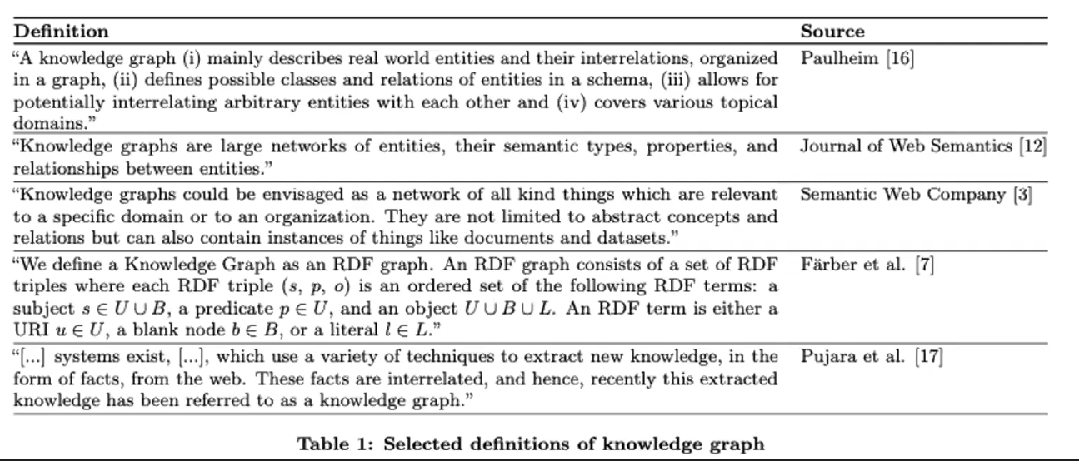
What is “knowledge graph?”

Slide 20
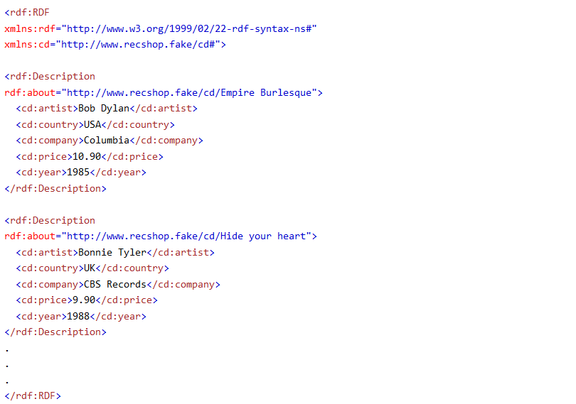
Resource Description Framework
RDF stands for Resource Description Framework
designed to be read and understood by computers
written in XML
Constructed on triplets

Slide 21
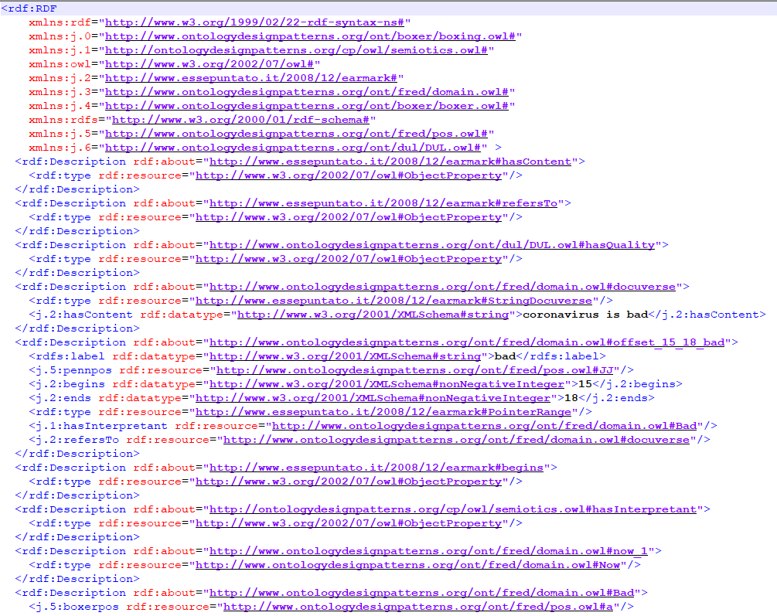
Resource Description Framework
URI(Uniform Resource Identifier)
j.0: Abbreviations
The word “bad”, begin from index of 15(nonnegativeinteger), end at 18, and writes like a string “bad”, which is interpreted as the fred domain object: “ont/fred/domain.owl#bad”, which are referred elsewhere.

Slide 22
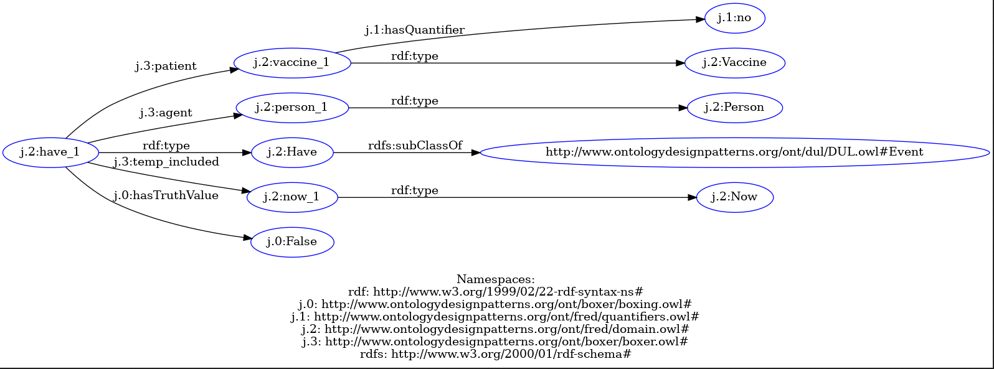
We have no vaccine

Slide 23
But this is not enough…
Having a unique URI doesn’t mean computer can reason with the data.
For example:
What is “begins”, labeled by “http://www.essepuntato.it/2008/12/earmark#begins”?
URI is not URL, you cannot open it.
To truly achieve a globally recognizable knowledge graph, we need a standard.

Slide 24
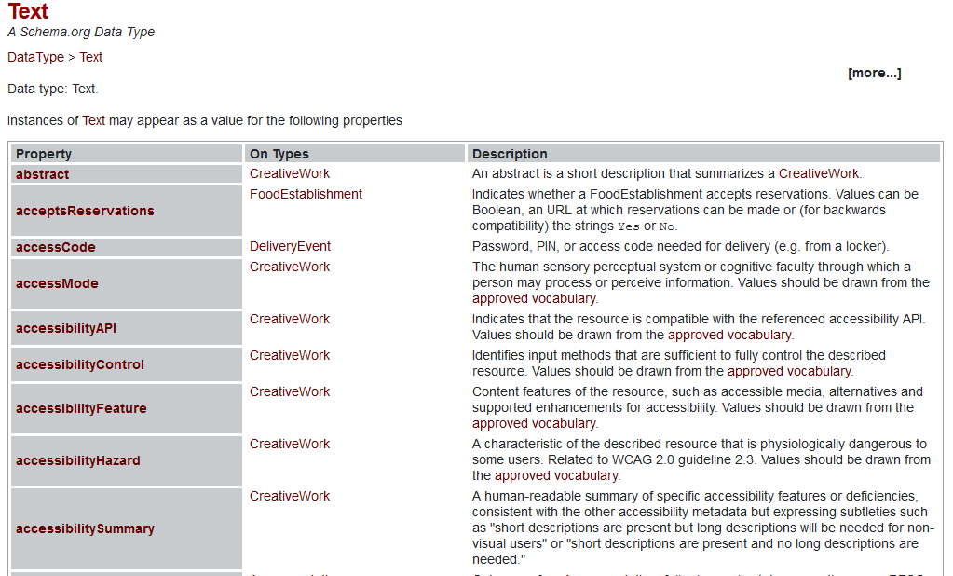
Schema.org
Schema.org is a collaborative, community activity with a mission to create, maintain, and promote schemas for structured data on the Internet, on web pages, in email messages, and beyond.
Schema.org types defines the restraints that could be utilized for knowledge reasonings.

Slide 25

OWL (Web Ontology Language)
OWL is a ontology programming and reasoning language enabling sophisticated reasoning in knowledge graphs.
Unlike schema.org, OWL is designed with knowledge reasoning as a primary objective. Each axiom defined by OWL can be directly translated into precise mathematical logic axioms. Such that for example, $rdfs:domain and rdfs:range$ are precisely mathematically defined, while $schema:domaininclude, schema:rangeinclude$ are not.

Slide 26
Conclusion
Knowledge graph: using in translate human knowledge to machine interpretable graphs.
Directed Edge Graph, Triplets, RDF format.
Broad usage and bottom-up development.
Standards: schema.org, OWL,…

