Slide 1


TeamItaly CTF 2022
Challenge: Family Business
Category: Misc
Author: Luigi Loffredo <LL3006>

Slide 2
Introduction
This challenge’s attachment contains a few binary “.pizza” files and a README.md which specifies how they’re encoded
It is hinted in the challenge description that these files contain video data
Your goal is to decode the files to a known format and find the flag

Slide 3
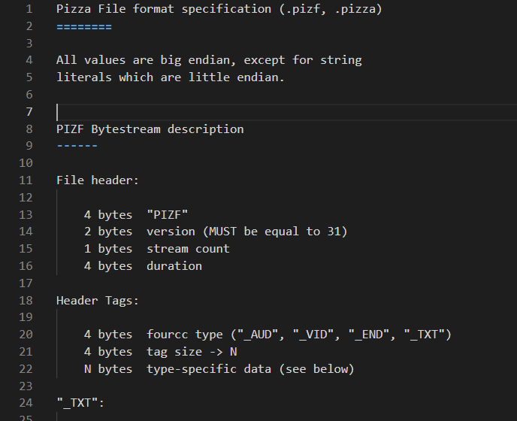
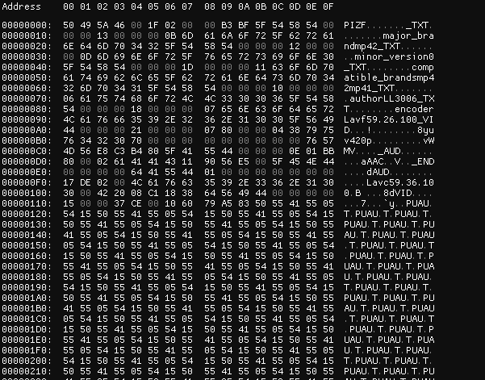
A peek at the files

Slide 4
Intended solution: Idea
Integrate a decoder for the PIZF format in libavformat (ffmpeg)
This is hinted to by the mentions to Lavf59.26.100 (libavformat) as the encoder metadata section of the file data
This will allow you to transcode & remux a video with a single ffmpeg command, but you’ll have to write some lines of C.

Slide 5
Intended solution:
constants
// Constants (could also go in a separate file)
#define PIZF_MAGIC MKTAG('P', 'I', 'Z', 'F')
#define PIZF_TXT MKTAG('_', 'T', 'X', 'T')
#define PIZF_AUD MKTAG('_', 'A', 'U', 'D')
#define PIZF_VID MKTAG('_', 'V', 'I', 'D')
#define PIZF_END MKTAG('_', 'E', 'N', 'D')
#define PIZF_DATA_AUD MKTAG('d', 'A', 'U', 'D')
#define PIZF_DATA_VID MKTAG('d', 'V', 'I', 'D')
#define PIZF_DATA_END MKTAG('d', 'E', 'N', 'D')
// More constants
const AVCodecTag ff_codec_pizf_video_tags[] = {
{ AV_CODEC_ID_MJPEG, MKTAG('v', 'J', 'P', 'G') },
{ AV_CODEC_ID_H265, MKTAG('v', 'H', '6', '5') },
{ AV_CODEC_ID_H264, MKTAG('v', 'H', '6', '4') },
{ AV_CODEC_ID_MPEG4, MKTAG('v', 'M', 'P', '4') },
{ AV_CODEC_ID_WMV2, MKTAG('v', 'W', 'M', 'V') },
{ AV_CODEC_ID_VP9, MKTAG('v', 'V', 'P', '9') },
{ AV_CODEC_ID_AV1, MKTAG('v', 'A', 'V', '1') },
{ AV_CODEC_ID_NONE, 0 },
};
const AVCodecTag ff_codec_pizf_audio_tags[] = {
{ AV_CODEC_ID_AAC, MKTAG('a', 'A', 'A', 'C') },
{ AV_CODEC_ID_MP3, MKTAG('a', 'M', 'P', '3') },
{ AV_CODEC_ID_VORBIS, MKTAG('a', 'V', 'B', 'S')},
{ AV_CODEC_ID_FLAC, MKTAG('a', 'F', 'L', 'C')},
{ AV_CODEC_ID_OPUS, MKTAG('a', 'O', 'P', 'S')},
{ AV_CODEC_ID_NONE, 0 },
};
After cloning the ffmpeg repo, we can start by creating a pizfdec.c file in the libavformat folder, which will contain our decoder.
On the left I have an example implementation of the decoder
Here I’ve defined some constants that will come useful later. MKTAG is a macro that converts a fourcc in an integer (LE)

Slide 6
Intended solution:
demuxer & probe
#include "libavutil/pixdesc.h"
#include "libavutil/intreadwrite.h"
#include "avformat.h"
#include "internal.h"
... // Rest of program goes here
// Determine if a file is a PIZF file
static int pizf_probe(const AVProbeData* p) {
// Read 32 bits LE to int and compare with MAGIC
if (AV_RL32(&p->buf[0]) == PIZF_MAGIC)
return AVPROBE_SCORE_MAX;
return 0;
}
// Define demuxer properties
const AVInputFormat ff_pizf_demuxer = {
.name = "pizf",
.long_name = NULL_IF_CONFIG_SMALL("Pizza File"),
.extensions = "pizf,pizza",
.read_probe = pizf_probe,
.read_header = pizf_read_header,
.read_packet = pizf_read_packet,
};
Here I’ve added an AVInputFormat const which is the entry point ffmpeg will use when calling our demuxer.
This has to go to the end of the file, as we reference custom functions.
The first I’ve written is pizf_probe: this is called when ffmpeg wants to know if a file is a PIZF file.

Slide 7
Intended solution:
header
// Read PIZF file header
static int pizf_read_header(AVFormatContext *c) {
AVIOContext *pb = c->pb;
uint8_t stream_count;
uint16_t version;
uint32_t duration;
AVStream* streams[255];
avio_skip(pb, 4); // Skip magic
version = avio_rb16(pb); // Read version (TODO: check)
stream_count = avio_r8(pb);
duration = avio_rb32(pb); // Read duration
while (!avio_feof(pb)) { // Loop until end of file
uint32_t tag_type, tag_size;
uint64_t start;
tag_type = avio_rl32(pb); // Read tag type (LE)
tag_size = avio_rb32(pb); // Read tag size
start = avio_tell(pb); // Save position
switch (tag_type) {
case PIZF_AUD: ... // Wait for it
case PIZF_VID: ...
case PIZF_TXT: ...
case PIZF_END: return 0;
default: return AVERROR_INVALIDDATA;
}
}
return AVERROR_EOF;
}
The pizf_read_header function will be called once ffmpeg determines our file is indeed a PIZF file. Therefore magic bytes can be easily skipped.
By switching on the tag_type I’ll define add tag-specific parameters to the initialized stream list.
When reaching the _END tag, the function has terminated reading the header successfully

Slide 8
Intended solution:
header - AUD
case PIZF_AUD: {
uint8_t stream_id;
uint64_t extradata_size;
stream_id = avio_r8(pb);
// Initialize stream
streams[stream_id] = avformat_new_stream(c, 0);
streams[stream_id]->codecpar->codec_type =
AVMEDIA_TYPE_AUDIO;
// Read values
streams[stream_id]->codecpar->sample_rate = avio_rb16(pb);
streams[stream_id]->codecpar->bits_per_coded_sample = avio_r8(pb);
streams[stream_id]->codecpar->ch_layout.nb_channels = avio_r8(pb);
streams[stream_id]->codecpar->codec_tag = avio_rl32(pb);
streams[stream_id]->duration = duration;
// Find codec id
streams[stream_id]->codecpar->codec_id =
ff_codec_get_id(ff_codec_pizf_audio_tags,
streams[stream_id]->codecpar->codec_tag);
// Extradata stuff
extradata_size = tag_size - (avio_tell(pb) - start);
if (extradata_size > 0) {
// Initialize extradata
streams[stream_id]->codecpar->extradata =
av_malloc(extradata_size + AV_INPUT_BUFFER_PADDING_SIZE);
streams[stream_id]->codecpar->extradata_size = extradata_size;
// Read extradata
avio_read(pb,
streams[stream_id]->codecpar->extradata, extradata_size);
}
// PTS is always 32 bit, 1/1000
avpriv_set_pts_info(streams[stream_id], 32, 1, 1000);
break;
}
When reading the AUD header tag we initialize a new audio stream, read all values in the header and assign a codec.
This is done using the constants we defined earlier and the ff_codec_get_id function.
The extradata_size is all data that remains in this header. When it’s present we can add it to the codec parameters.

Slide 9
Intended solution:
header - VID
case PIZF_VID: {
uint8_t stream_id;
uint64_t extradata_size;
char format_name[16] = {0};
stream_id = avio_r8(pb);
// Init stream
streams[stream_id] = avformat_new_stream(c, 0);
streams[stream_id]->codecpar->codec_type = AVMEDIA_TYPE_VIDEO;
// Populate values
streams[stream_id]->codecpar->width = avio_rb32(pb);
streams[stream_id]->codecpar->height = avio_rb32(pb);
avio_read(pb, format_name, 16);
streams[stream_id]->codecpar->codec_tag = avio_rl32(pb);
streams[stream_id]->duration = duration;
// Find and set pixel format
streams[stream_id]->codecpar->format =
av_get_pix_fmt(format_name);
// Find codec id
streams[stream_id]->codecpar->codec_id =
ff_codec_get_id(ff_codec_pizf_video_tags,
streams[stream_id]->codecpar->codec_tag);
// Extradata stuff
... // (same as before, probably could’ve been a function)
// PTS is always 32 bit, 1/1000
avpriv_set_pts_info(streams[stream_id], 32, 1, 1000);
break;
}
The VID header case is much similar to the AUD, with the notable exception of pixel format
This is written as a null terminated string and can be transformed to an internal ffmpeg id with the av_get_pix_fmt function
PTS is Presentation Time Stamp, and it’s required to know when a frame is supposed to be shown. For this filetype the rate is constant at 1/1000 and the size is stored as a 32 bit integer

Slide 10
Intended solution:
header - TXT
case PIZF_TXT: {
uint32_t key_size, value_size;
char *key, *value;
// Find sizes
key_size = avio_rb32(pb);
value_size = tag_size - key_size - 4;
// Allocate space
key = av_malloc(key_size + 1);
value = av_malloc(value_size + 1);
// Read values
avio_read(pb, key, key_size);
avio_read(pb, value, value_size);
// Add terminator
key[key_size] = 0;
value[value_size] = 0;
// Write to metadata dict
av_dict_set(&c->metadata,
key,
value,
AV_DICT_DONT_STRDUP_KEY |
AV_DICT_DONT_STRDUP_VAL);
break;
}
Technically this is not needed as you could read the metadata needed to solve the challenge by hand.
But since it’s trivially easy to implement, it’s a nice feature that will automatically port the file metadata to any other format available in ffmpeg.
It’s important to subtract 4 when computing value_size as tag_size includes the space needed for the key_size parameter

Slide 11
Intended solution:
packet
// Read PIZF packet
static int pizf_read_packet(AVFormatContext *c, AVPacket *pkt) {
AVIOContext *pb = c->pb;
int ret;
uint32_t tag_type, pos;
pos = avio_tell(pb); // Save packet position
tag_type = avio_rl32(pb); // Get tag type
switch (tag_type) {
case PIZF_DATA_AUD:
case PIZF_DATA_VID: {
uint8_t stream_id;
uint32_t pts, size;
// Save values
stream_id = avio_r8(pb);
pts = avio_rb32(pb);
size = avio_rb32(pb);
// Initialize packet
ret = av_get_packet(pb, pkt, size);
// Write packet values
pkt->stream_index = stream_id;
pkt->pts = pts;
pkt->pos = pos; // Required
break;
}
case PIZF_DATA_END: ret = AVERROR_EOF;
default: ret = AVERROR_INVALIDDATA
}
return ret;
}
The read packet function is much simpler as both VID and AUD packets are the same.
The only thing to keep in mind is that ffmpeg wants to know the start position of the packet

Slide 12
Intended solution - Final steps
To register the codec:
In libavformat > allformats.c, we have to add
extern const AVInputFormat ff_pizf_demuxer;
While in libavformat > Makefile
OBJS-$(CONFIG_PIZF_DEMUXER) += pizfdec.o
To build ffmpeg:
$ ./configure --enable-libdav1d --enable-libx264
$ make -j10
$ sudo make install
Finally, to convert a file:
$ ffmpeg -i Pizza/Flag.pizza Flag.mp4
$ ffmpeg -i Pizza/Traditions.pizza Traditions.mp4
$ …

Slide 13
Semi-intended solution
What if I hate C and want to write a demuxer in python?
Writing a demuxer to separate the streams is very easy, the real challenge lies in how to properly decode/remux them.
Since there are many different codecs, I expect someone using this solution to manually handle all the different quirks each of them has
I still think it’s possible, just harder. Especially since it seems wmv has no way of knowing the end of packets (and it’s just weird and microsofty)

Slide 14
Flag
There 7 flag pieces in this challenge. Most of them are directly shown in the video with two notable exceptions:
Piece #4 is encoded as hex and written as a comment in the file metadata
Piece #6 is spelled out during the audio playback of the file
After successfully finding all the pieces you can rebuild the complete flag

Slide 15
Flag
flag{cu570m_f0rm4t5_4r3_n1c3_4nd_4ll_bu7_7h3_53cr37_1ngr3d13n7_15_l0v3!_76369}

Slide 16
Conclusion
Obscure file formats are evil
Old windows video codecs even more so
Sometimes (rarely, but sometimes) stuff is easier in C

Slide 17

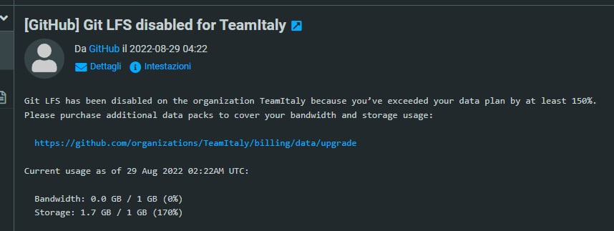
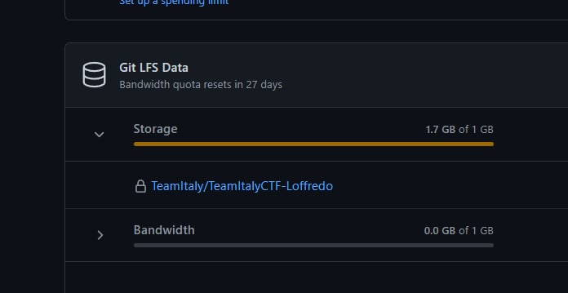
Story time
Is 1.7GB too big for a chall?
Also my nick is wrong in the challenge description 😥
So, for questions ask @ll3306

