Slide 1


TeamItaly CTF 2022
Challenge: FamilyRecipes
Category: Pwn
Author: Giulia Martino | @giulia

Slide 2
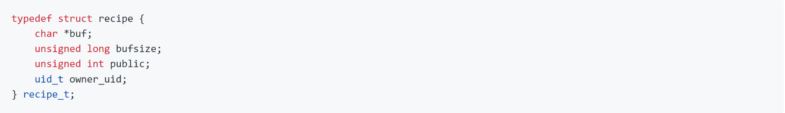
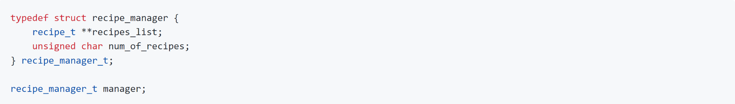
Introduction
Custom Linux kernel module to save recipes in kernel memory
Recipe structure:
Global variable to store all the recipe structures:

Slide 3
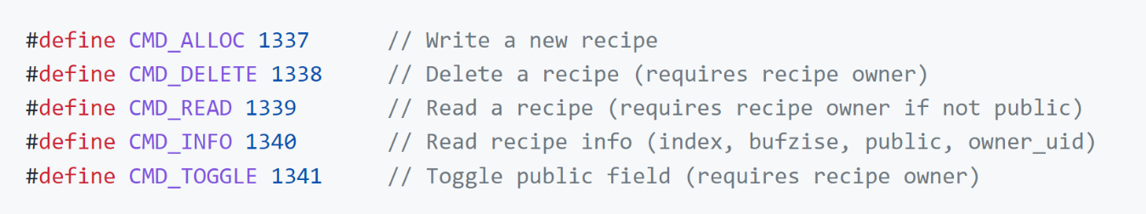
Introduction
Commands to interact with the recipes:
The user is provided with a shell inside a vm with normal user privileges.
The module is already loaded in the kernel.
The flag is at /flag.txt, readable only with root privileges.
Goal: get root and read the flag from the filesystem.

Slide 4
Introduction - Setup
The user is provided with several attachments:
initramfs.cpio.gz: packed root file system of the emulated system.
bzImage: kernel image (Linux Kernel 5.19.0).
chall.c: module source code.
run.sh/run.py: scripts to run the challenge locally.
README.md: readme file.

Slide 5
Vulns
Integer overflow on manager.num_of_recipes, which is an unsigned char and can be set to zero by just adding 256 new recipes.
Use-After-Free on manager.recipes_list. When the list is not empty and the user allocates a new recipe, the krealloc function is called to expand the memory area that stores the list:
If manager.num_of_recipes is overflowed to 0, the 2nd parameter will be 0 too, and the pointer manager.recipes_list will be freed [krealloc docs].

Slide 6
Solution
After the free, the variable manager.recipes_list still holds the pointer to the just freed memory area. If we find a way to allocate and write in that location, we can corrupt the old recipe pointers to make them point to an arbitrary location.
The kernel memory is divided in fixed size caches: our freed memory is in the kmalloc-2k cache (sizeof(recipe_t *) * 255 = 2040).
The challenge sets a maximum size for the recipe buffer, so we cannot allocate a recipe big enough to end up in that cache.
We can use a kernel structure msg_msg.

Slide 7
Solution
The msg_msg struct is used by the kernel for IPC. It is allocated when a process posts a message inside the kernel.
48 bytes header + variable length message content. We can end up in the kmalloc-2k cache by using a message content > 976 bytes (so that the struct is big enough not to fit in kmalloc-1k).
Next slide shows the manager.recipes_list memory area:
before the 256th krealloc call
right after
after message allocation

Slide 8
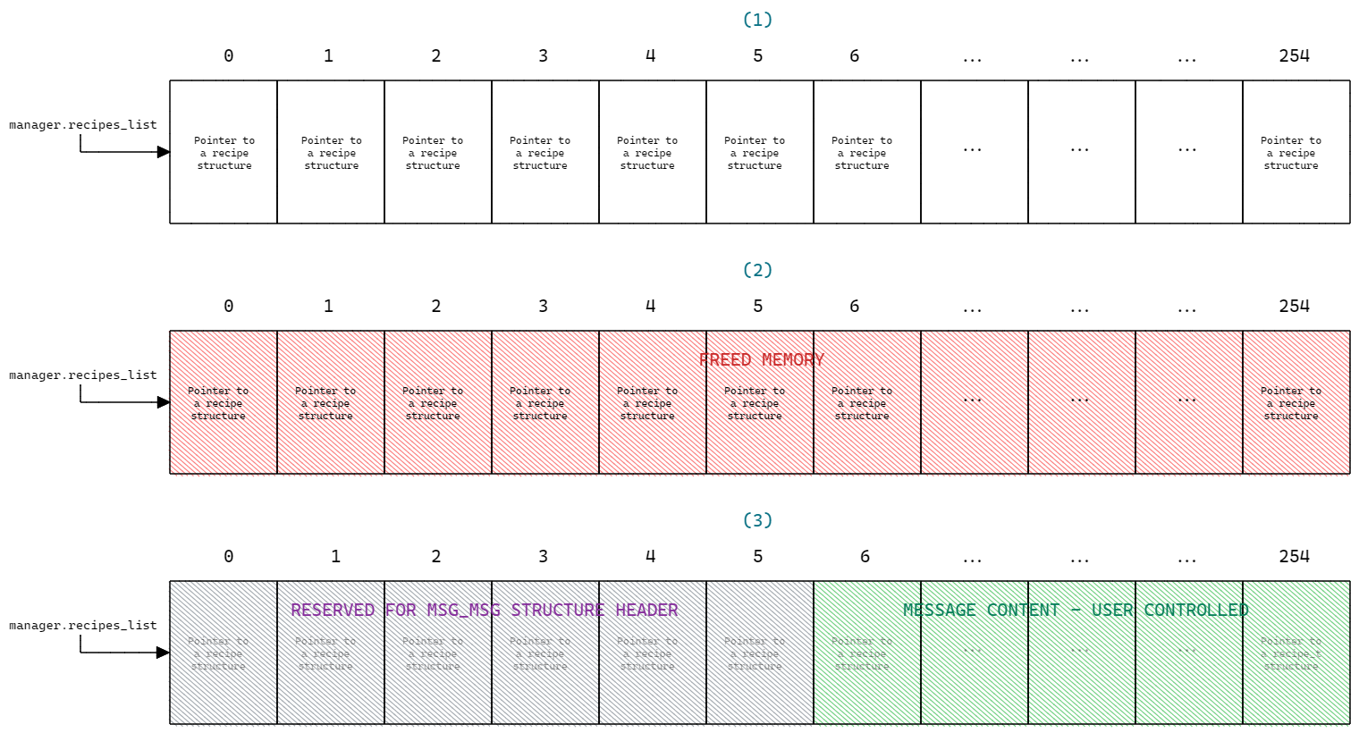
Solution
The pointer at the index 6 will be the first completely controlled by us.

Slide 9
Solution - Read primitive
Read primitive
The command CMD_INFO retrieves info about the recipes, by dereferencing one of the pointers of the array and reading some of the info about the recipe (bufize, public, owner_uid).
The owner_uid parameter is at offset 0x14 from the start of the structure.

Slide 10
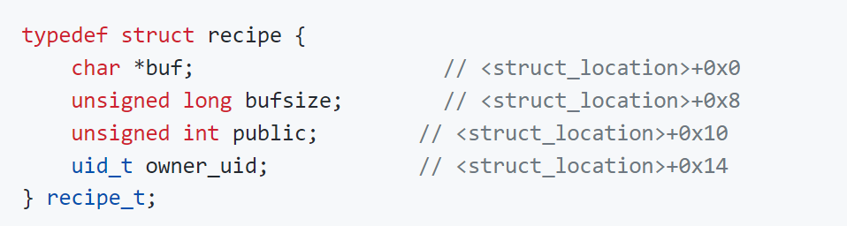
Solution - Read primitive
Read primitive
The command CMD_INFO retrieves info about the recipes, by dereferencing one of the pointers of the array and reading some of the info about the recipe (bufize, public, owner_uid).
The owner_uid parameter is at offset 0x14 from the start of the structure.

Slide 11
Solution - Read primitive
Read primitive
The command CMD_INFO retrieves info about the recipes, by dereferencing one of the pointers of the array and reading some of the info about the recipe (bufize, public, owner_uid).
The owner_uid parameter is at offset 0x14 from the start of the structure.
If we set the 6th pointer of the recipes list to point to <desired_address>-0x14, the desired address and the owner uid param will be aligned and the CMD_INFO will give us the integer found at the desired address.

Slide 12
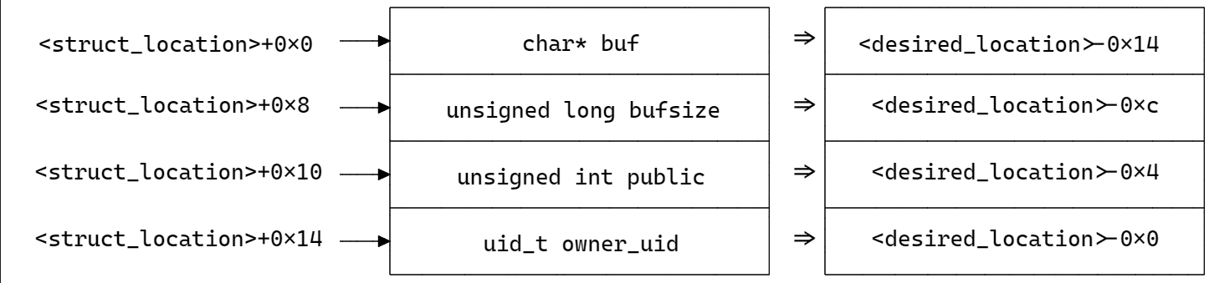
Solution - Read primitive

Slide 13
Solution - Write primitive
Write primitive
The command CMD_TOGGLE toggles between 0 and 1 the field public of the recipe.
It is at offset 0x10 from the start of the structure.

Slide 14
Solution - Write primitive
Write primitive
The command CMD_TOGGLE toggles between 0 and 1 the field public of the recipe.
It is at offset 0x10 from the start of the structure.

Slide 15
Solution - Write primitive
Write primitive
The command CMD_TOGGLE toggles between 0 and 1 the field public of the recipe.
It is at offset 0x10 from the start of the structure.
If we set the 6th pointer of the recipes list to point to <desired_address>-0x10, the desired address and the owner uid param will be aligned and the CMD_TOGGLE will write 0/1 at the desired location.

Slide 16
Solution - Write primitive
Write primitive
NB: the CMD_TOGGLE is constrained. A user can actually toggle the public field only if they are the owner of the recipe => the current process’ uid must be equal to the one saved inside the recipe.
The owner_uid field is right after the public field, and they are both integers.
If the write primitive wants to read at <desired_address>, then it must be <desired_address>+0x4 = current_process_uid.

Slide 17
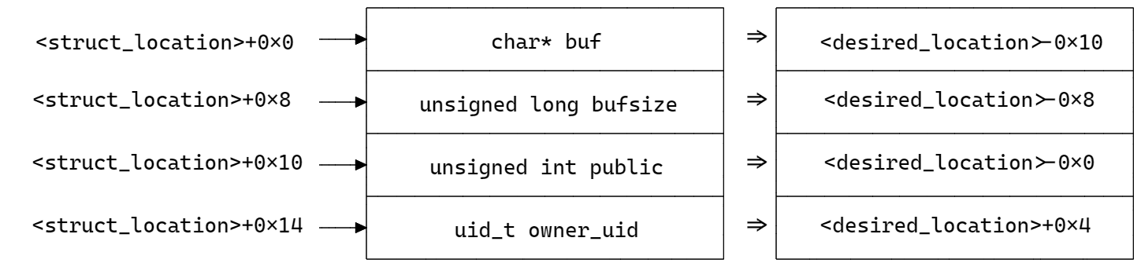
Solution - Write primitive

Slide 18
Solution - Traversing tasks list
The kernel stores all the information about all its tasks inside its memory in a linked list of task_struct structures.
Each of them also contains the info about the credentials of the corresponding userland process (uid, gid, …).
The global variable init_task contains a pointer to the first task in the list.
We start by using this variable to read the first task in the list and check if its pid is equal to the current process’ one.
If yes, we stop. If not, we use the next pointer inside this struct to jump at the next item in the list, going on this way until the current task is found.

Slide 19
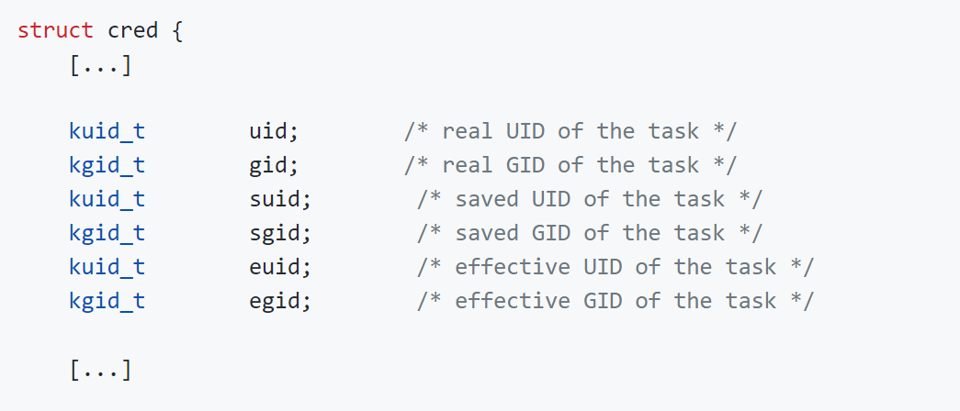
Solution - Overwriting creds
Once found the current process’ task, we use the write primitive to override the credentials with 0, to obtain root. This is how the creds are stored inside the kernel memory:
All the credentials are equal to 1000 when the challenge is started.

Slide 20
Solution - Overwriting creds
All the credentials have type kuid_t/kgid_t which are just structs wrapping integer values.
We could try to overwrite all the credentials, but as we said, the write primitive is constrained. We can just override the credentials whose following one is equal to the current process’ uid (1000).
Note that the current process’ uid used for the check is exactly the first credential in the credentials structure.

Slide 21
Solution - Overwriting creds
Before uid is overwritten, to overwrite the (i)th credential, the (i+1)th must be equal to 1000.
After uid is overwritten, to overwrite the (i)th credential, the (i+1)th must be equal to 0.
The gid field must be equal to 1000 when the uid field is overwritten.
A possible solution consists in just overriding uid and euid to get root.

Slide 22
Note - Finding the offsets
In order to use the arbitrary read to traverse the tasks list, we need to know which are the offsets of the fields we want to read inside the task_struct (i.e. pid, next pointer, credentials structure).
The offsets vary basing on the kernel version, and computing them by reading the source code is very hard because the task_struct contains several nested structures.
Workaround: since the kernel was compiled without the structure layout randomization (see writeup for more details and a general workaround) we can use the offsetof macro to make the module compute them for us.

Slide 23
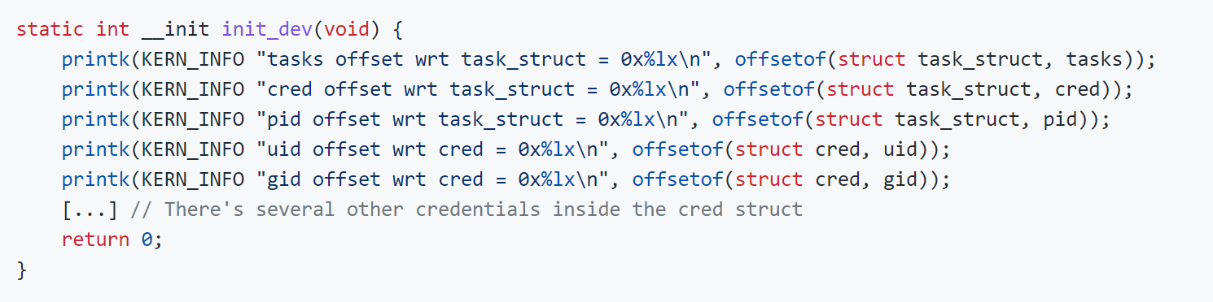
Note - Finding the offsets
Build the kernel source code to obtain the headers for the task_struct. This is necessary cause we need to rebuild the module.
Modify the kernel module source code to just make it use the macro and print the offsets.

Slide 24
Note - Finding the offsets
Build the kernel source code to obtain the headers for the task_struct. This is necessary cause we need to rebuild the module.
Modify the kernel module source code to just make it use the macro and print the offsets.
Rebuild the module and execute the challenge. Since the module is automatically inserted, just examine dmesg command output to read the output printed by the init_dev function and get the offsets.

Slide 25
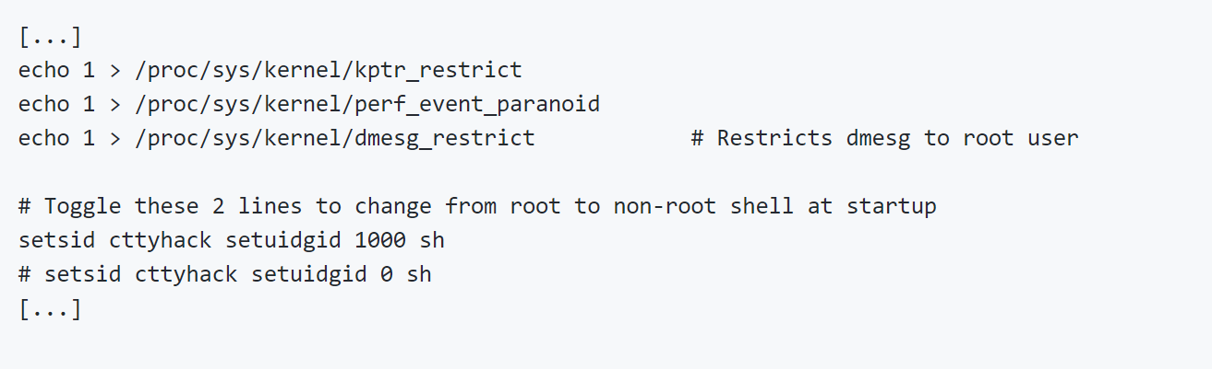
Note - Init config file
The access to the dmesg command is limited to the root user by the init config file /etc/init.d/rcS which can be edited unpacking and then repacking the rootfs.
Either comment the dmesg restriction or start the vm execution as root.

Slide 26
Conclusion
flag{g0d_bl3ss_gr4ndm4s_4nd_p3st0}

