Slide 1


TeamItaly CTF 2022
Challenge: Flag Proxy
Category: Web
Author: Giovanni Minotti <Giotino>

Slide 2
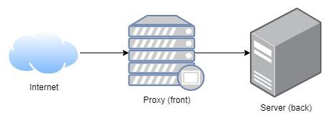
Introduction

Slide 3
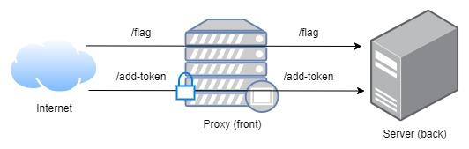
Introduction

Slide 4
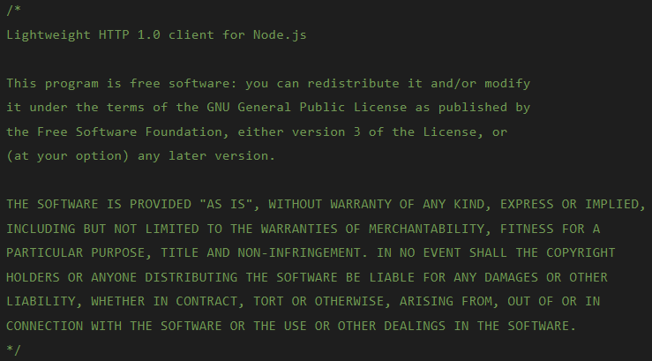
Introduction

Slide 5
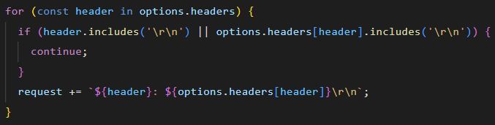
Vulnerability

Slide 6

Vulnerability

Slide 7
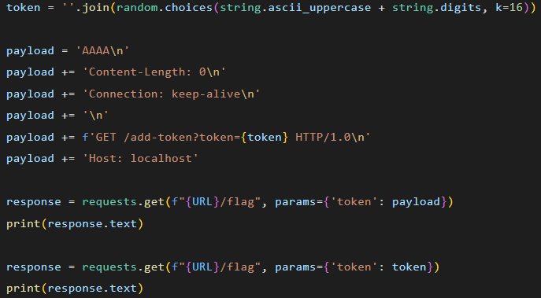
Exploit

Slide 8
Story time
Expectation (dev environment)

Slide 9
Story time
Reality (prod environment)

Slide 10
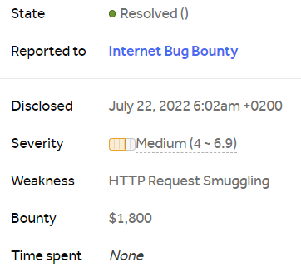

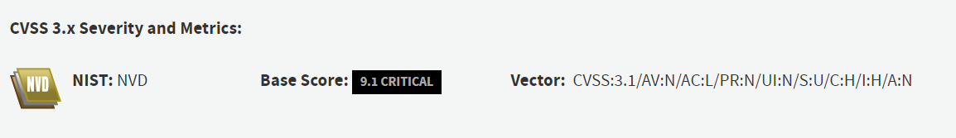
Story time

Slide 11

Story time

Slide 12
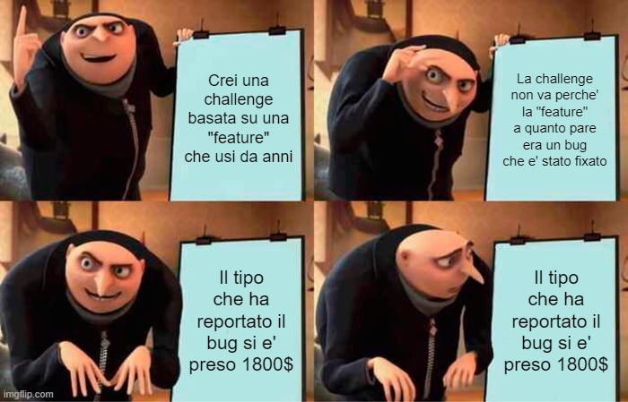
Conclusion

Slide 13

Conclusion

Slide 14
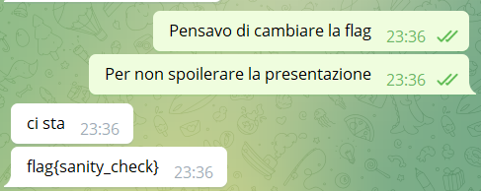
Bonus content

