Slide 1


TeamItaly CTF 2022
Challenge: GPOCS
Category: Crypto
Author: Kien Tuong Truong (@kientuong114)

Slide 2
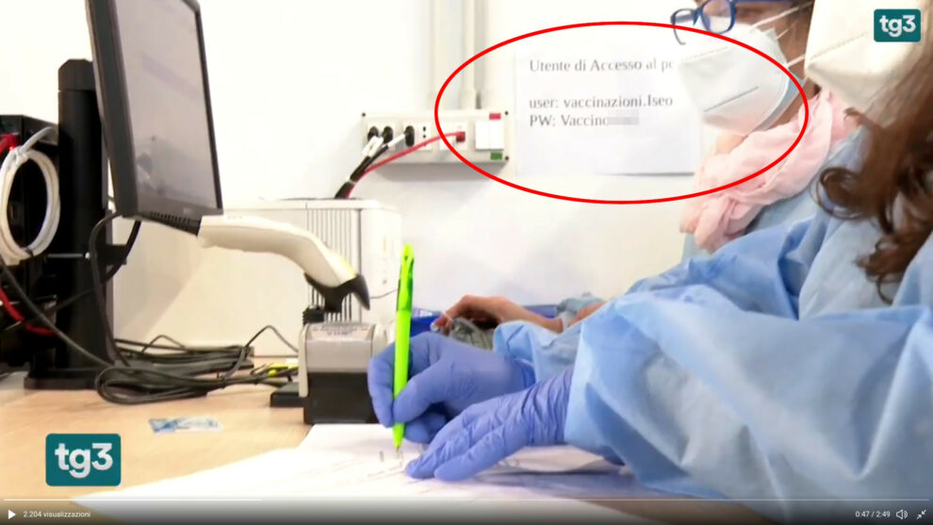
Introduction
G
P
O
C
S
eneratore di
arole d’
rdine
rittograficamente
icure
For non-Italians: “Generator of Cryptographically Secure Passwords”

Slide 3

Introduction
Our national GPOCS tries to celebrate the beauty of our nation by generating Italian-themed passwords:
words.txt
Lambrusco
Mozzarella
Amatriciana
Orecchiette
…
12 words
Select two words¹
and join them
Orecchiette-Amatriciana
[1] Can be the same word, in total 12² = 144 passwords

Slide 4

Introduction
You are given 8 queries to a decryption oracle
Orecchiette-Amatriciana
scrypt
ChaCha20-Poly1305.Decrypt()
Ciphertext
Ok!
Decryption Failed!

Slide 5
Introduction
At any time you can submit your guess. If wrong, the entire game exits.
If right… do it again for 19 more rounds!
8 queries and 144 passwords? For 20 rounds? How can you test all passwords?
Can you even win?

Slide 6
Vuln
Intuition: what if we could try multiple passwords with one attempt?
ChaCha20-Poly1305 is not key-committing:
Given a set of keys {K₁,...,K_{n}}
We can find a ciphertext c that decrypts correctly under every key
Idea: do binary search over the key space

Slide 7
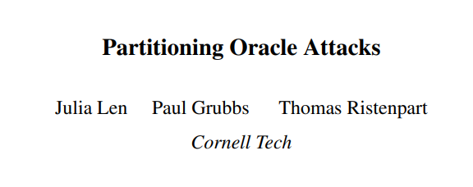
Vuln - The paper
Paper by Len et al. 29/11/20 (USENIX 2021)

Slide 8

Vuln - Creating Splitting Ciphertexts
How easy is it to create these sort of ciphertexts? (Splitting ciphertext)
On the one hand, pretty hard
On the other, Google helps by describing a fast implementation

Slide 9
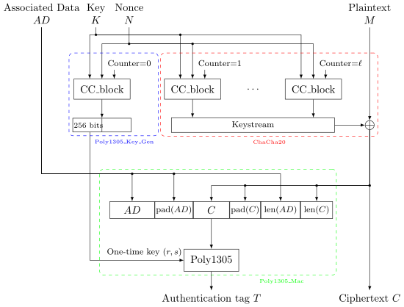
Vuln - ChaCha20-Poly1305

Slide 10

Vuln - Poly1305
Find ctxt such that the MAC tag is the same for all keys (r_{i},s_{i}):
Poly1305(r₁, s₁, ctxt) = Poly1305(r₂, s₂, ctxt) = … = Poly1305(r_{n}, s_{n}, ctxt)
Where: (Gaspare make a LaTeX template next time pls)
And m_{i} is the padded i-th block of the message (ciphertext): the message is split into 16-byte chunks and a 0x01 is appended. This means that each m_{i} must lie in [2¹²⁸; 2¹²⁹-1]. In other words, each m_{i} is close to the middle of the interval.

Slide 11

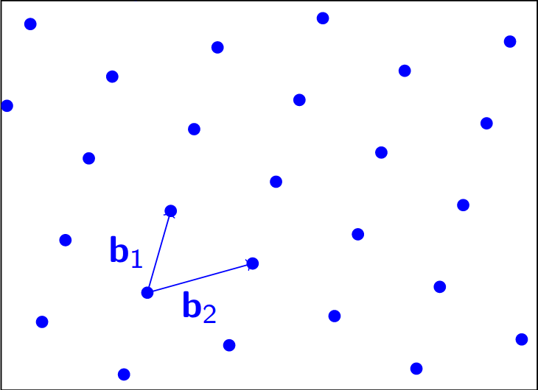
Vuln - Lattice Reduction Magic
In short: use polynomial interpolation and reduce to a lattice problem (the Closest Vector Problem, CVP) in order to get a splitting ciphertext.
K₁ →(r₁,s₁)
K₂ →(r₂,s₂)
…
K_{n} →(r_{n},s_{n})
ciphertext

Slide 12
Vuln - Solving the CVP
However, the CVP is NP-Hard!
For small sizes it can be solved exactly…
But for the binary search, an exact solution is too expensive to find :(

Slide 13

Vuln - Approximate CVP
We must find an approximate solution
How?
meme found by accident

Slide 14
Vuln
Convert the CVP instance to a SVP (Shortest Vector Problem) instance through Kannan Embedding
Solve SVP approximately (Works very well for a good choice of M, the Kannan embedding constant) using LLL
Win!

Slide 15
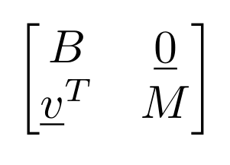
Vuln - CVP to SVP
Kannan Embedding
(See e.g. Galbraith’s “Mathematics of Public Key Cryptography”, Chapter 18)
Convert the CVP instance to a SVP (Shortest Vector Problem) instance through Kannan Embedding
Solve SVP approximately (Works very well for a good choice of M) using LLL
Win! (After some binary search code…)
Solving CVP on L(B) for vector v can be done by solving SVP on the lattice with basis matrix:

Slide 16
Conclusion - Flag
flag{c4n_1_us3_fd1sk_t0_p4rt1t10n_my_k3ys?}

Slide 17
Conclusion
When using authenticated encryption, remember that commonly used ciphers are not key-committing
Usually not important, but some real-world protocols have been broken (OPAQUE and Shadowsocks)
Thanks for listening! Questions?

