Slide 1


TeamItaly CTF 2022
Challenge: Alice's Adventures in Goland
Category: Rev
Author: Simone Petroni @timetravel3

Slide 2
Introduction
The challenge was written in Go, statically compiled, stripped and without debug information. The binary presents questions, which the right combination of answers will print the flag.

Slide 3
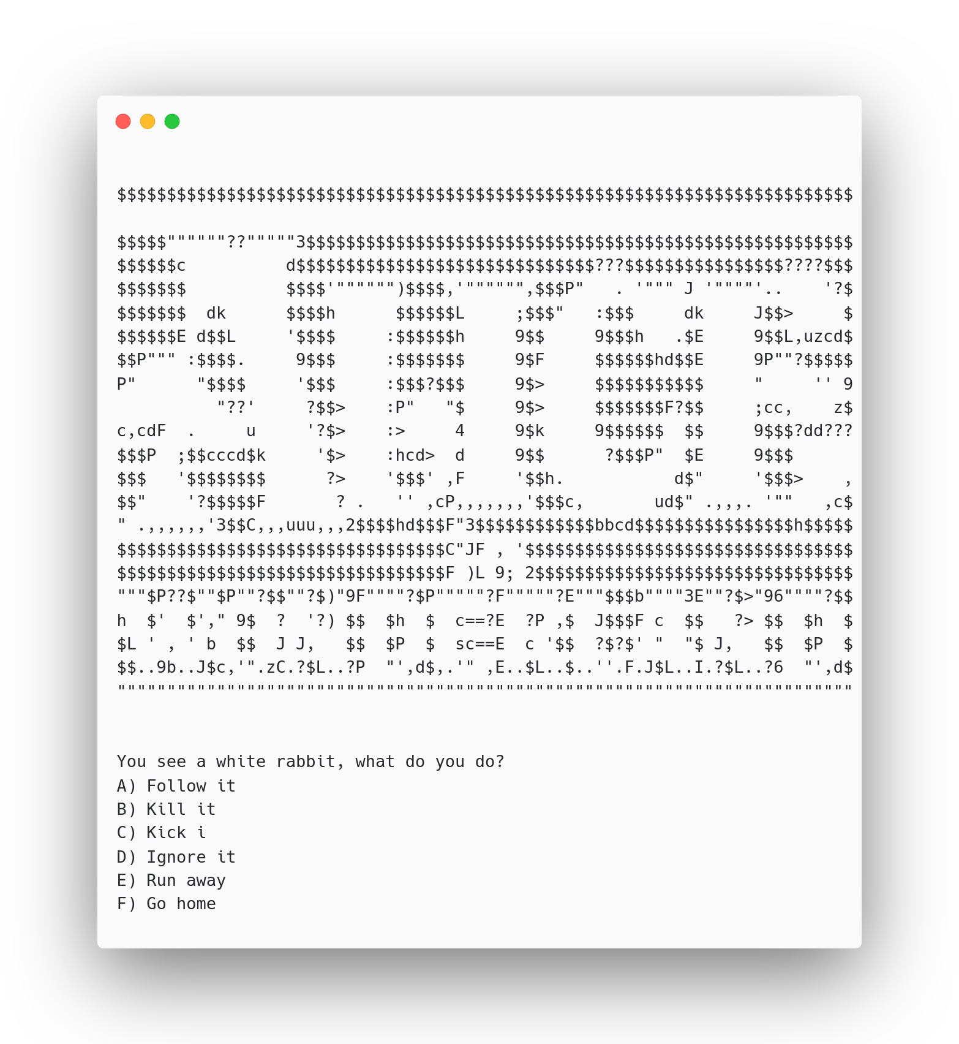
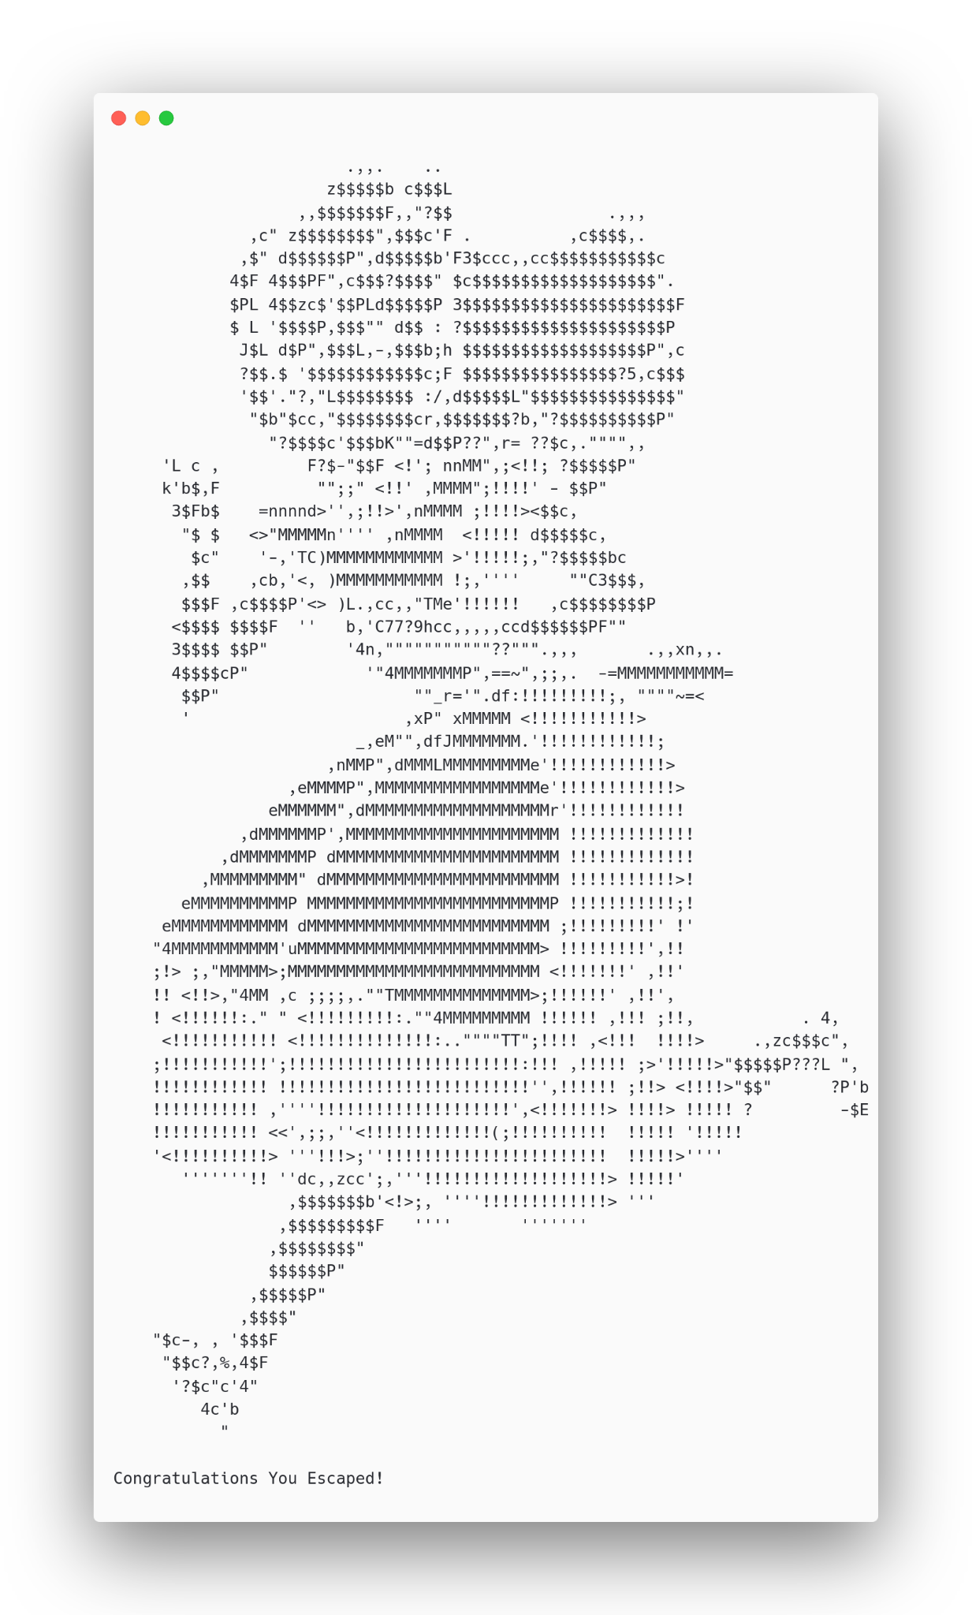
Challenge preview

Slide 4
Vuln
The binary as already said is statically compiled, stripped, and without any debug information, so function names are not present, but since there still is the .gopclntab (The version of Go I used is recent >= 1.2) section it is possible to recover function names, and this makes the decompiled much more readable. Multiple already written scripts exists for Ghidra, IDA, and Binary Ninja. There is a few that i personally tested.

Slide 5
Scripts to recover function names
https://github.com/getCUJO/ThreatIntel/blob/master/Scripts/Ghidra/go_func.py (Ghidra)
https://github.com/mandiant/GoReSym (IDA)

Slide 6
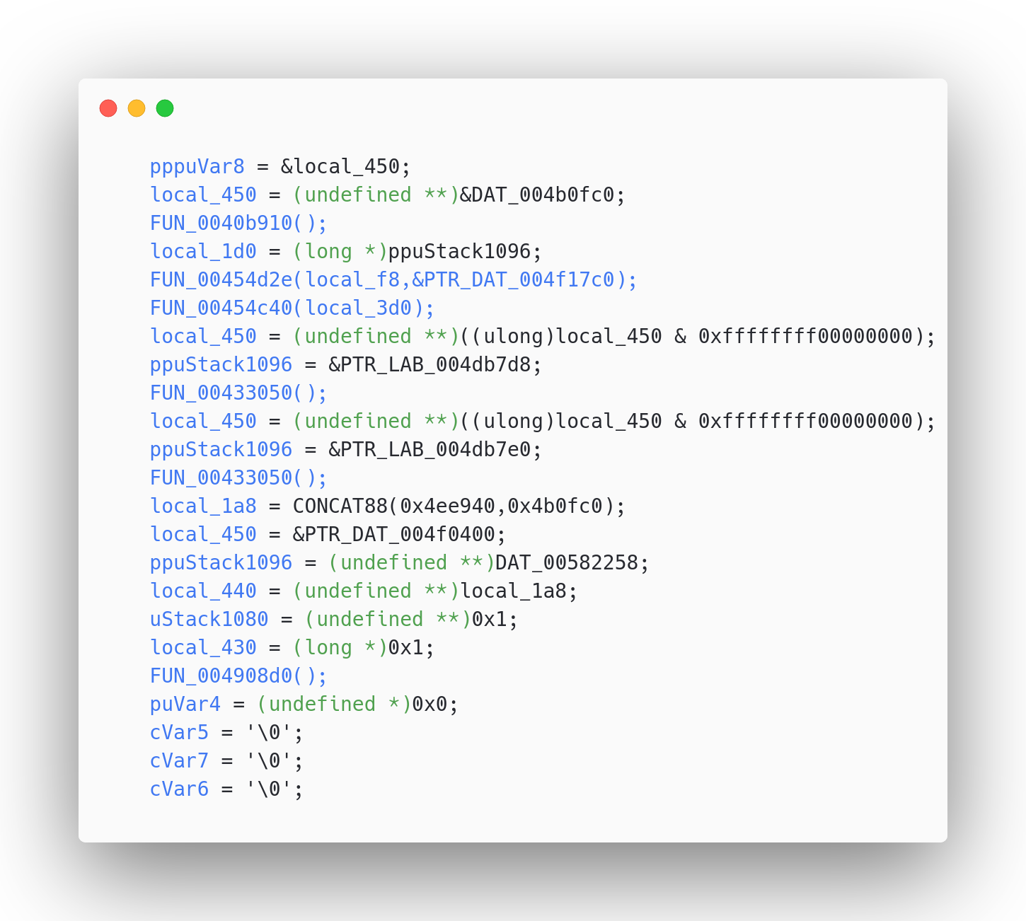
Decompiler after scripts execution

Slide 7
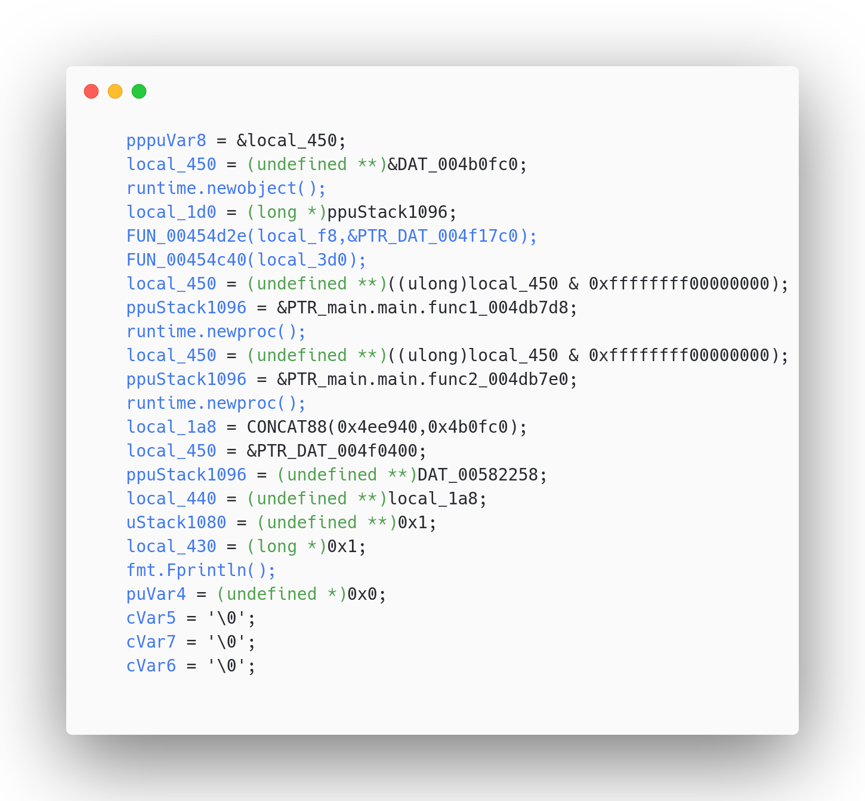
Decompiler after scripts execution

Slide 8


Slide 9
Decompiler after scripts execution

Slide 10
Strings in Go
To improve more the decompiled, you can use script to identify strings within functions since a string in Go is not simply NULL-terminated, but is a struct which has only two members a pointer to the length and a pointer to the array of character. Recent version of IDA since version 7.4, do this automatically, but Ghidra has difficulties and uses CONCAT88(len, ptr) without showing the string, so it needs scripts to detect them correctly, here are a few.

Slide 11
Scripts to recover stack strings
https://github.com/getCUJO/ThreatIntel/blob/master/Scripts/Ghidra/find_dynamic_strings.py
https://github.com/getCUJO/ThreatIntel/blob/master/Scripts/Ghidra/find_static_strings.py

Slide 12
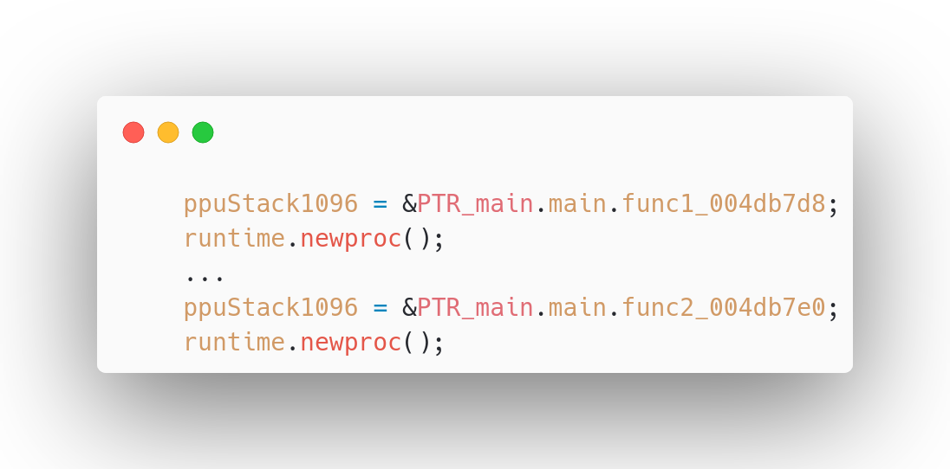
Goroutines
Ghidra and older versions of IDA has difficulties detecting function parameters because go has its own calling convention, but it is easily guessable what are the parameters by looking at the assembly. Here are two calls to runtime.newproc which means the binary runs goroutines. By looking at func1 and func2 you can see they are just anti-debugging functions to make debugging more annoying 🤌.

Slide 13
Anti-Debugging

Slide 14
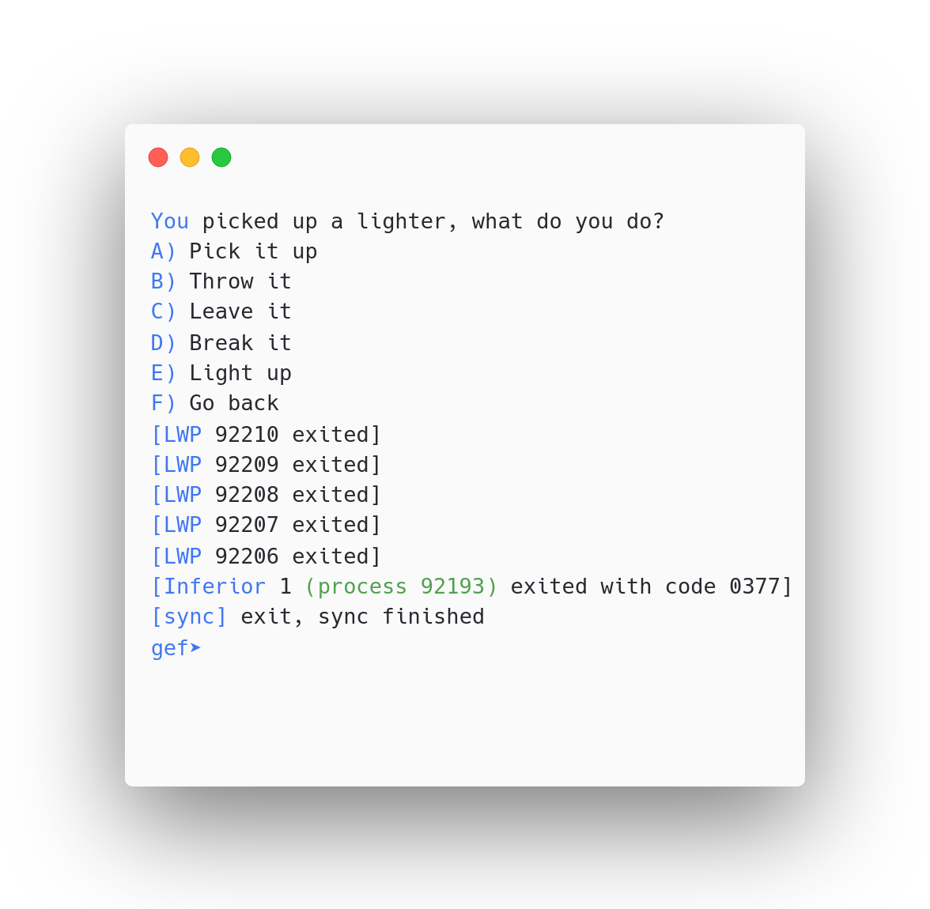
Anti-Debugging
Timeout

Slide 15
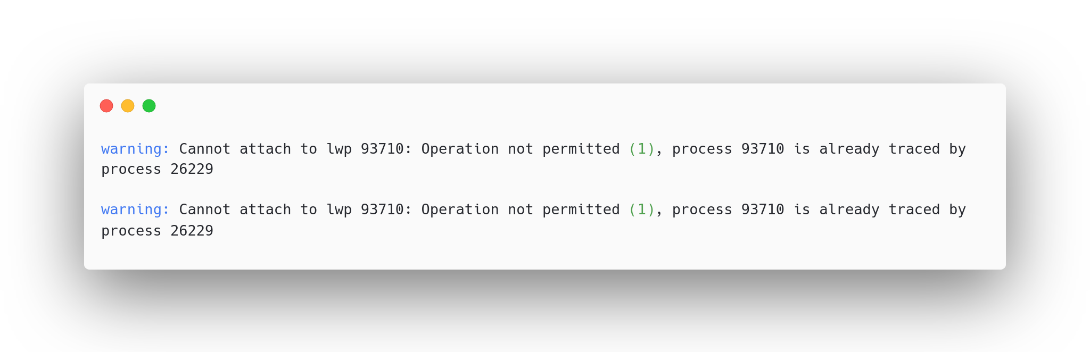
Anti-Debugging
Timeout
Random PTRACE_ME

Slide 16

Anti-Debugging
Timeout
Random PTRACE_ME

Slide 17
Conclusion
The challenge to determine the right combination of answers used a three-dimensional 8x8x8 maze, and depending on the answer the user gave the player moved within this maze (6 answers each for every axes and direction). To win the user had to reach coordinate (7,7,7) beginning at (0,0,0). The maze data is on the stack, at first it may seem high entropy random data but the program basically uses the parity of each byte to determine where a user can move (if the byte is odd it is a valid position, otherwise it is not and the program exits). Multiple solution do exist.

Slide 18
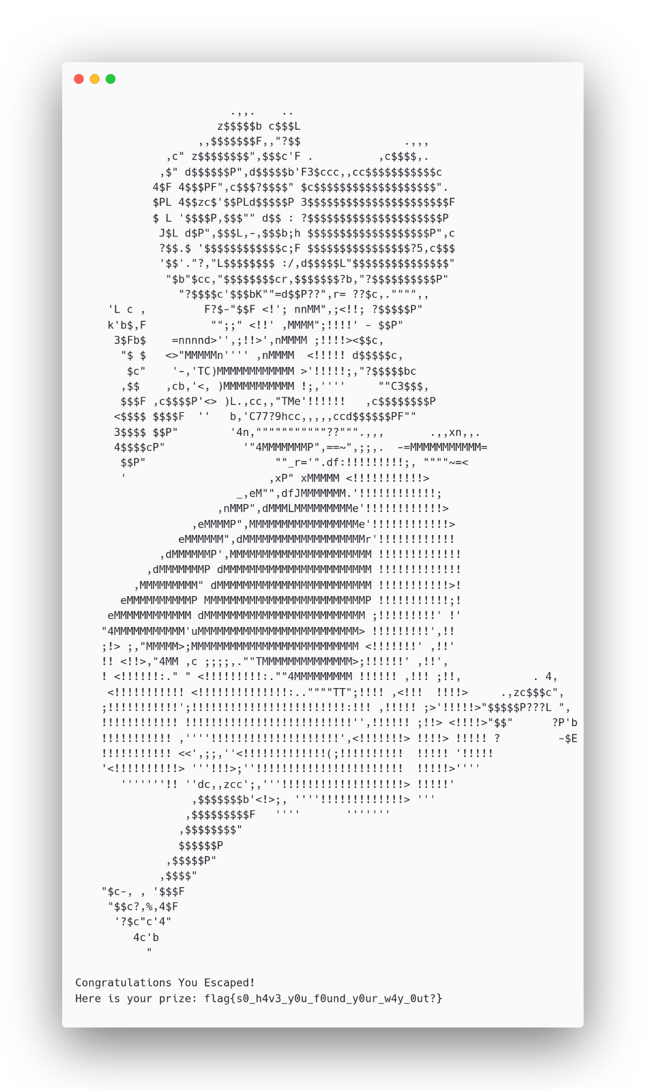
Flag
flag{s0_h4v3_y0u_f0und_y0ur_w4y_0ut?}
GG @Matte23

