Slide 1


TeamItaly CTF 2022
Challenge: Lazy platform
Category: crypto
Author: Mattia Lorenzo Chiabrando @mattiabrandon

Slide 2
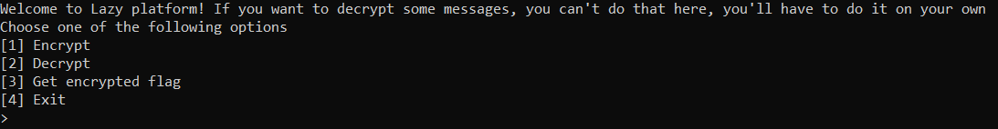
Introduction
The challenge presents as an oracle with the decryption disabled, with the possibility to encrypt any message with AES-CBC and get the ciphertext of the encrypted flag.

Slide 3
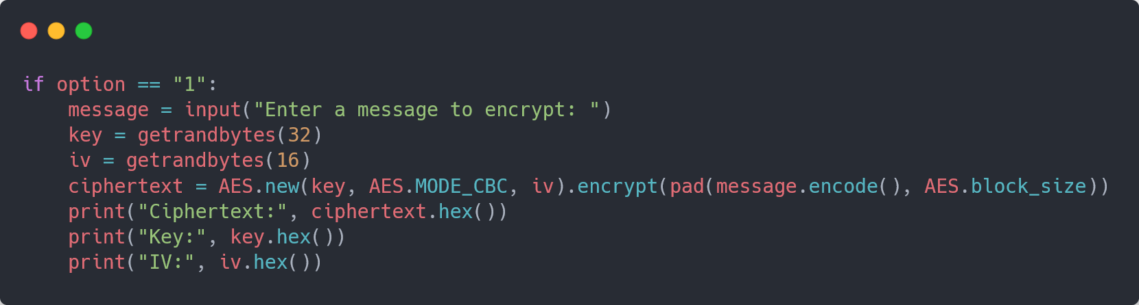
Introduction
When the encryption is called with any text, it gives as response the resulting ciphertext and the key and IV used for the AES-CBC encryption.

Slide 4
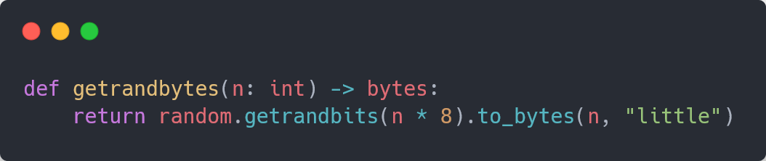
Use of Python’s random module
The thing to notice in this challenge is that every time we call getrandbytes, this function calls random.getrandbits, that is not a CSPRNG, as it is simply an implementation of MT19937, hence the results can be predicted having enough data.

Slide 5
Use of Python’s random module
We can use the python’s randcrack module to break the Mersenne Twister, so we need 624 integers (624 * 32 = 19.968 bits) generated from the Mersenne Twister to predict new values. We can get them by encrypting some messages and feed the cracked the bytes used to generate the key and the IV, that are respectively 32 and 16 for each message, hence (32 + 16) * 8 = 384 bits, so we need to encrypt 19.968 / 384 = 52 messages to shift MT’s state and finish feeding the cracker’s state.

Slide 6
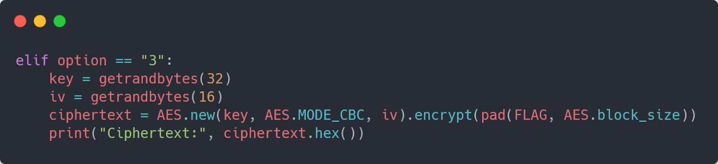
Use of Python’s random module
Finally, we can get the flag’s ciphertext from the remote service and predict the values that have been used from the server for the key and the IV with our cracked, then simply decrypt the ciphertext and get our flag.

Slide 7
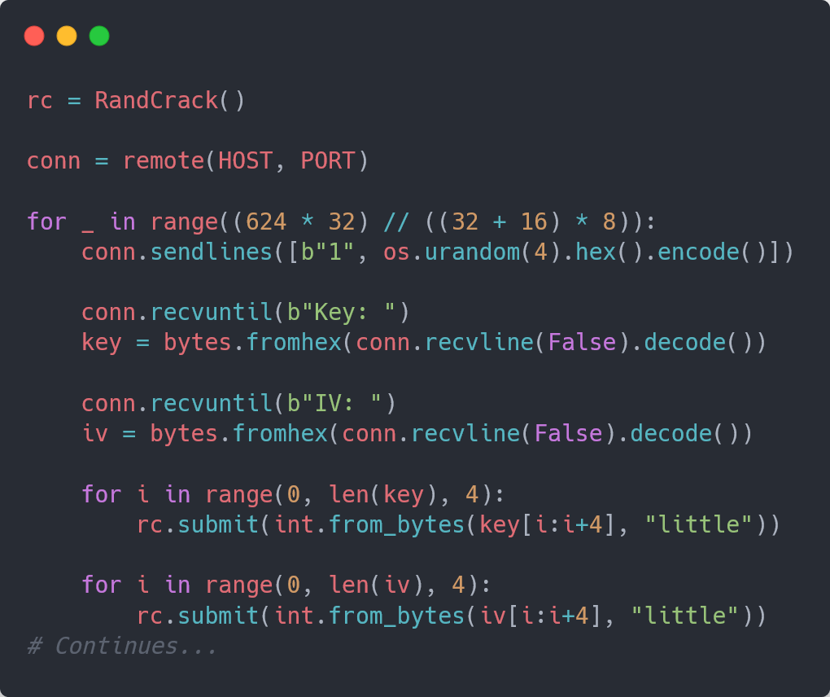
Use of Python’s random module

Slide 8
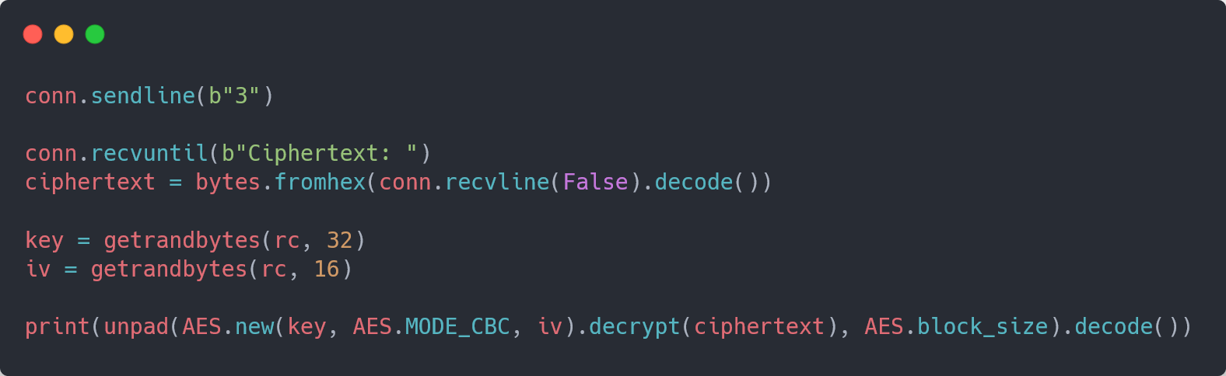
Use of Python’s random module

Slide 9
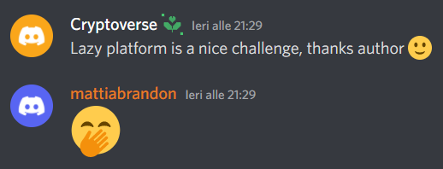
Conclusion
Never use non-cryptographic functions for cryptographic purposes and always appreciate the sanity checks.

