Slide 1


TeamItaly CTF 2022
Challenge: Mario’s Metaverse Marketplace
Category: pwn
Author: Mario Del Gaudio @hdesk

Slide 2
Introduction
What's a better CTF challenge than an half-finished, buggy software?
Of course an half-finished, buggy software that lets you create NFTs! No guarantees
Btw I forgot the private key to `flag.txt`, can you retrieve that for me?

Slide 3
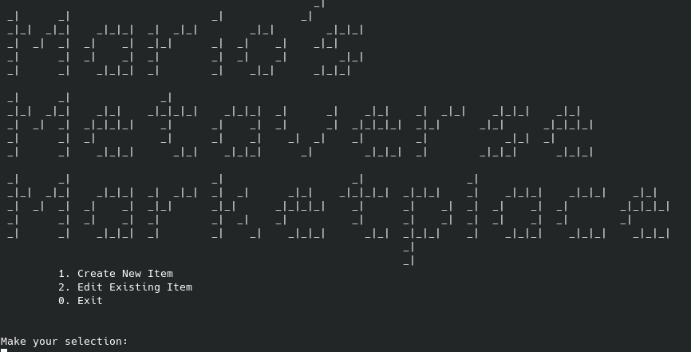
Introduction

Slide 4
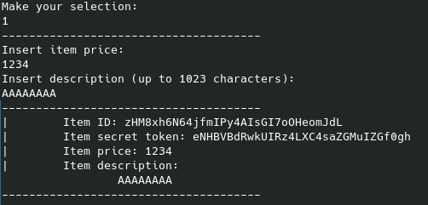
Introduction

Slide 5
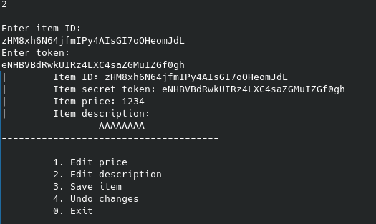
Introduction

Slide 6
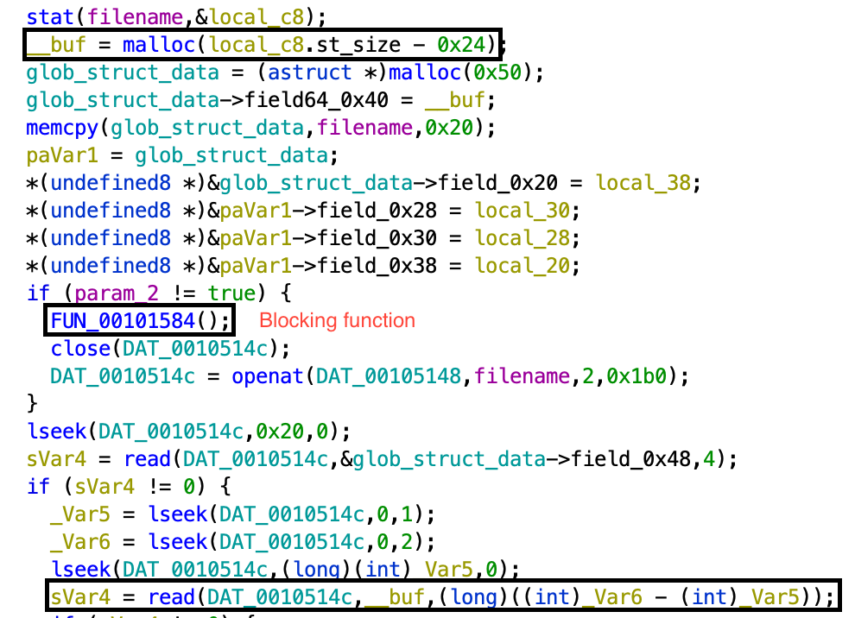
Vuln

Slide 7
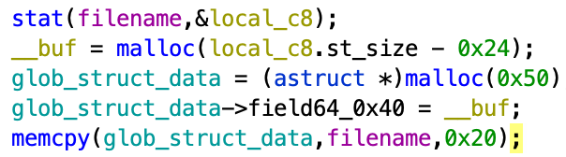
Vuln

Slide 8
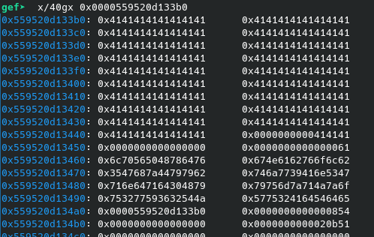
Vuln

Slide 9
Conclusion
You can write "../../../../../../../../flag.txt" in the open item structure (file name field), then use the included function to reload and show the flag.

Slide 10
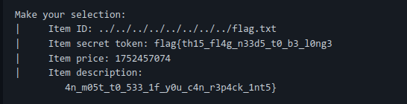
Conclusion

