Slide 1


TeamItaly CTF 2022
Challenge: Red Saffron
Category: Web
Author: Stefano Alberto @xatophi

Slide 2
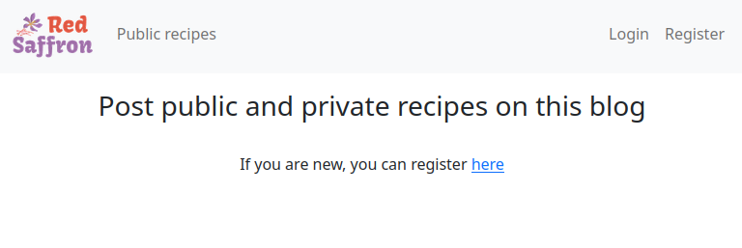
Introduction

Slide 3
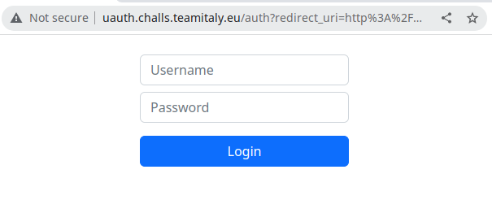
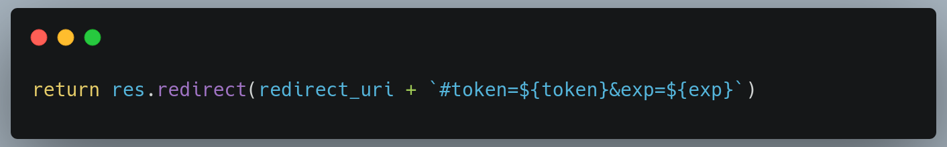
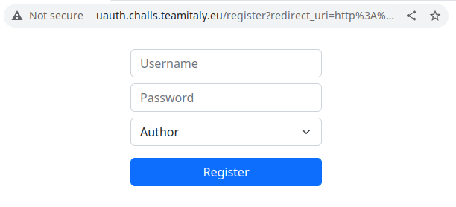
Introduction

Slide 4
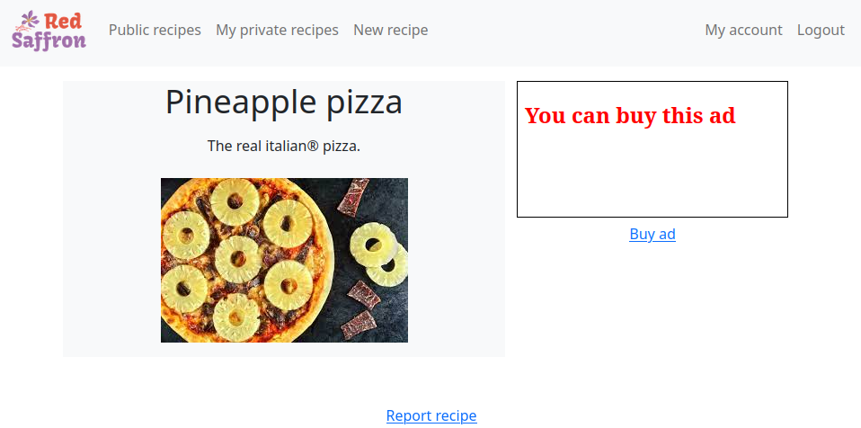
Introduction

Slide 5
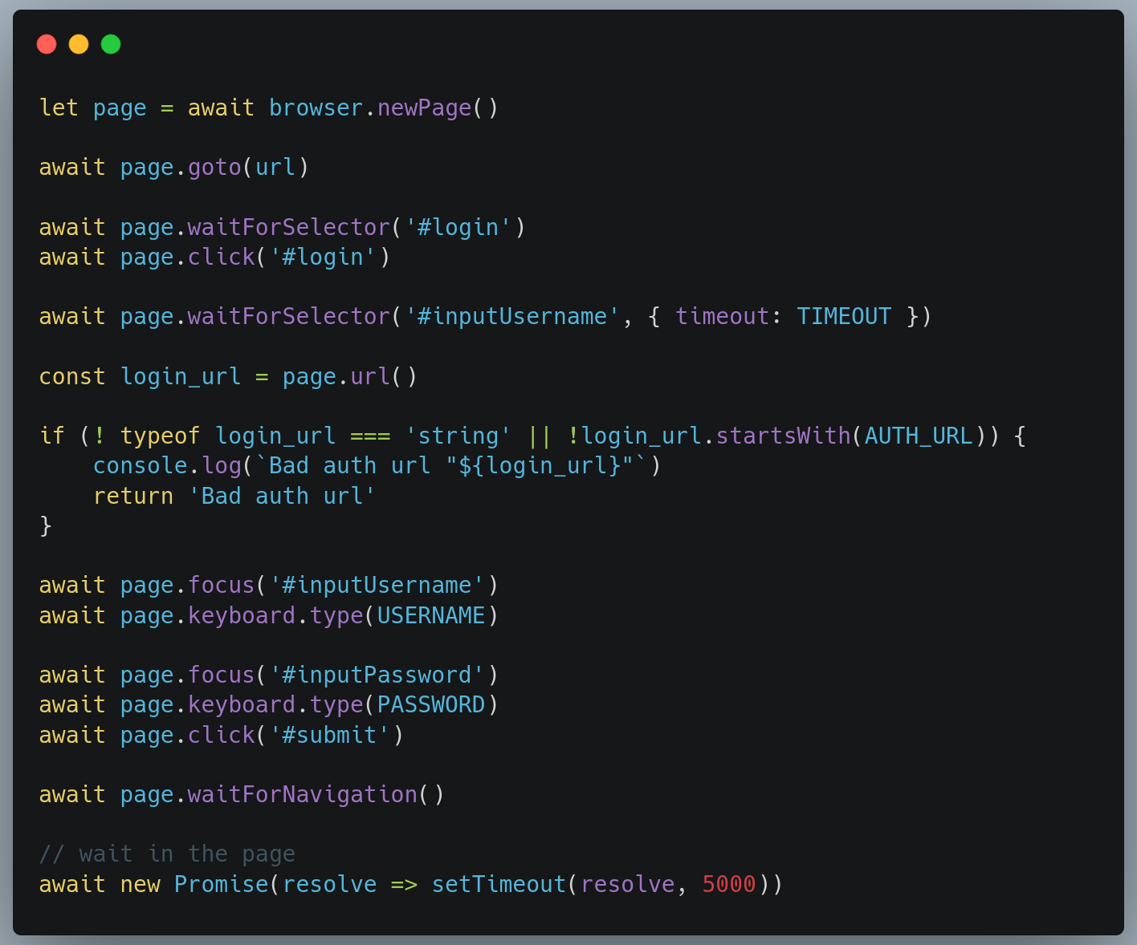
Bot
Steps
visit recipe
click login button
wait for the input form
check if it’s the right domain
login with the admin credentials
wait 5 seconds on the page

Slide 6
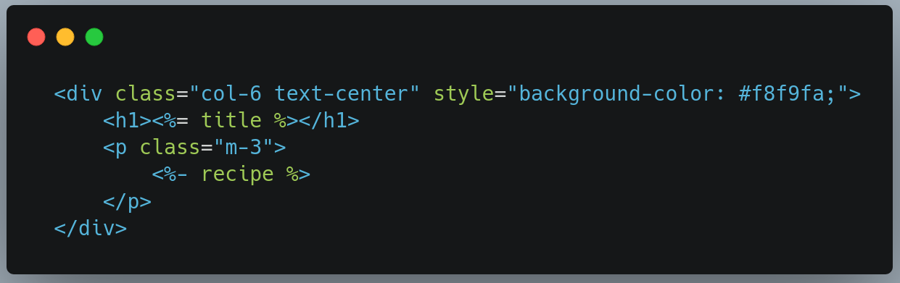
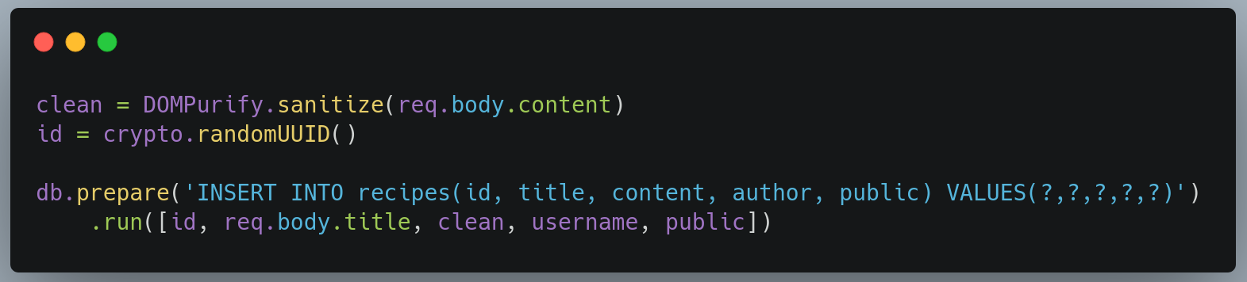
Recipe

Slide 7
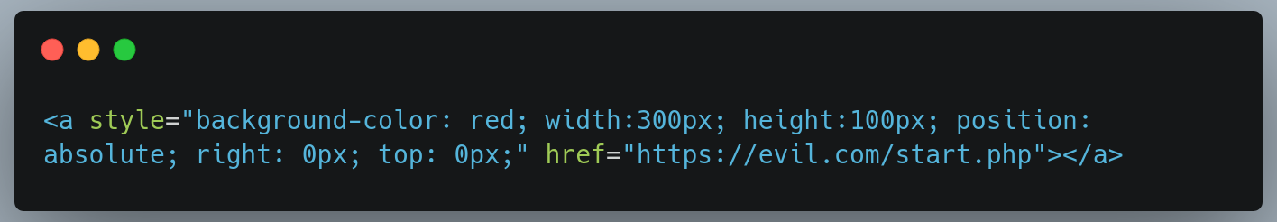
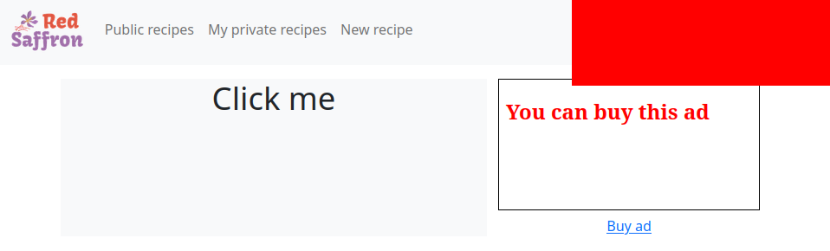
Redirect

Slide 8
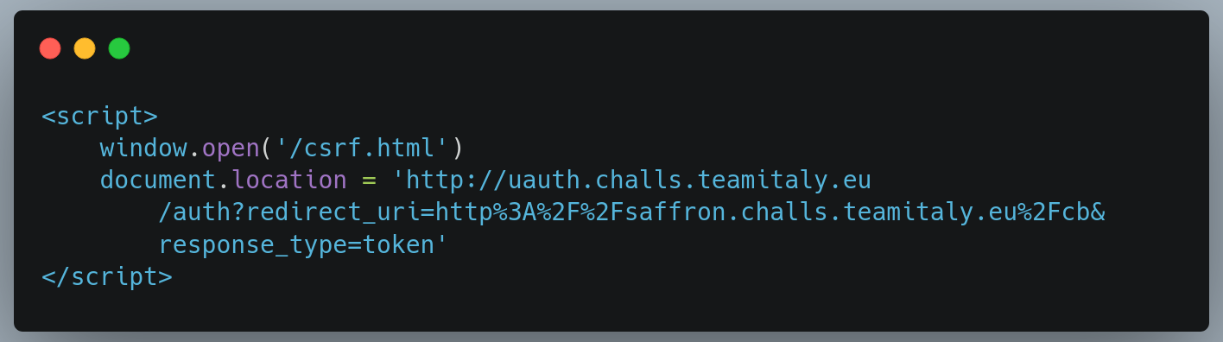
CSRF

Slide 9
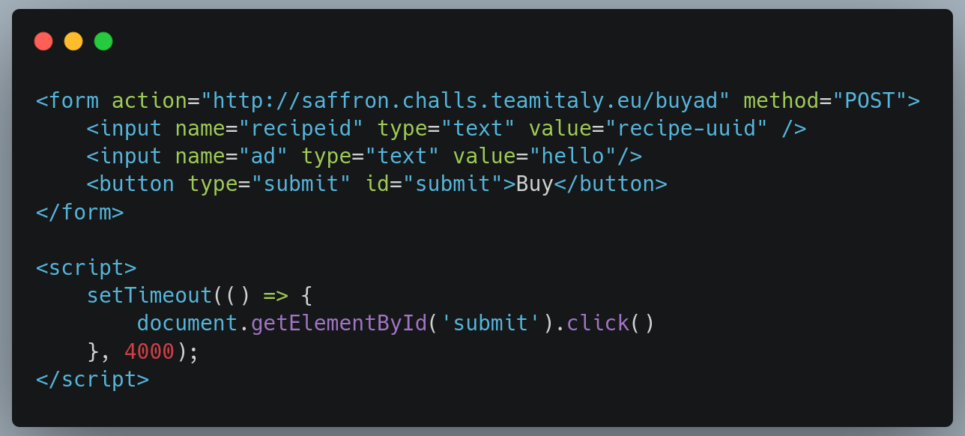
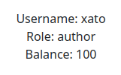
CSRF

Slide 10
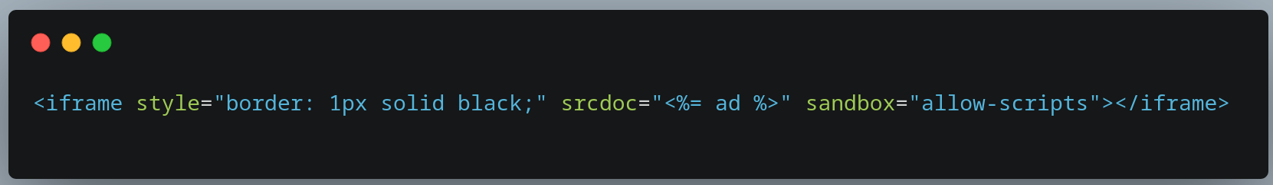
Ad

Slide 11
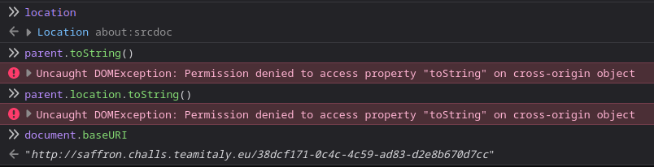
Sandbox

Slide 12
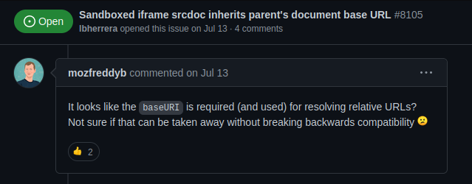
Sandbox

Slide 13



How do we buy an ad?

Slide 14
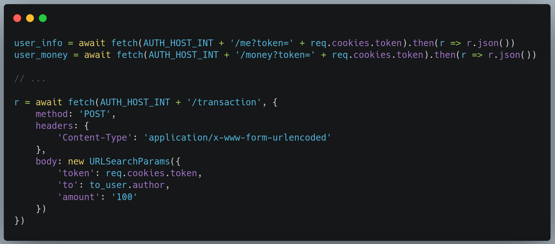
/buyad

Slide 15
Race condition
user_info
user_money

Slide 16
Authentication service

Slide 17
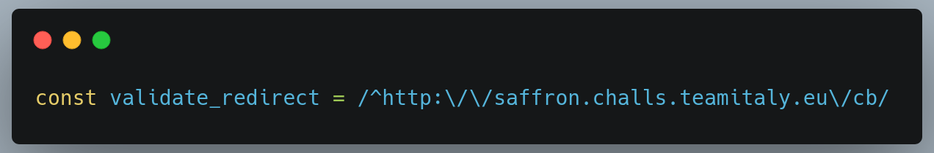
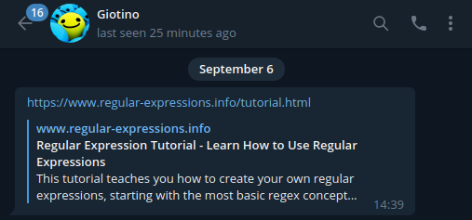
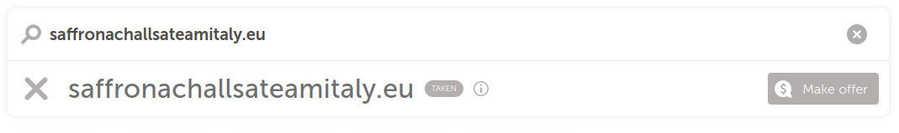
redirect_uri check

Slide 18
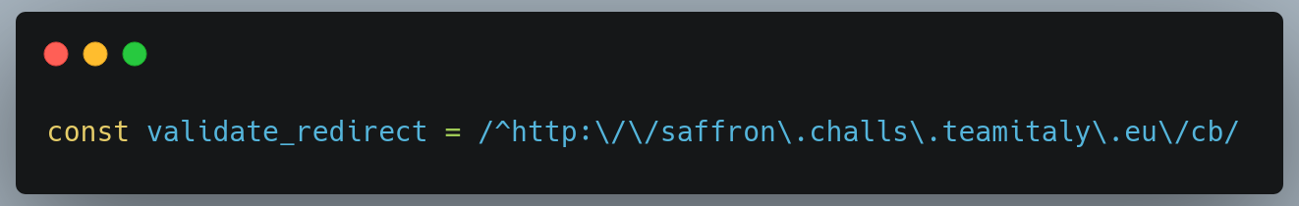
redirect_uri check

Slide 19
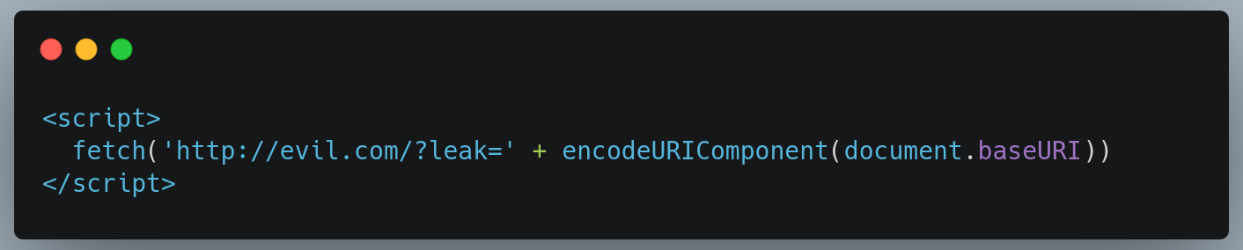
Buy the ad
Create a post with id that starts with “cb”
Buy the ad exploiting the race condition with a payload to leak baseURI
Redirect the bot to leak a valid admin token

Slide 20

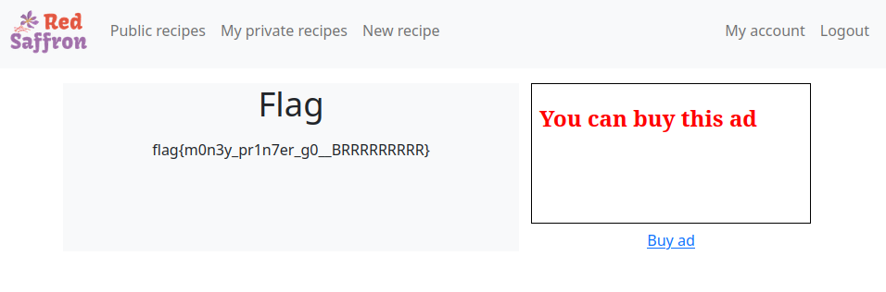
Profit

Slide 21
Conclusions
Javascript is broken
Browsers are broken

Slide 22
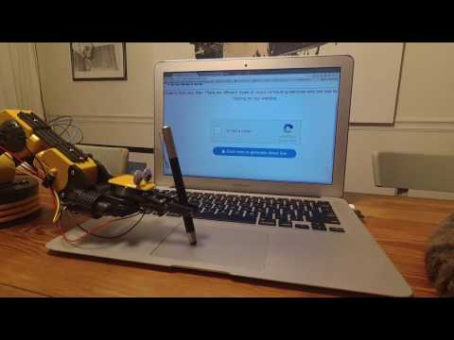
Conclusions
Javascript is broken
Browsers are broken
Bots click like humans
Don’t assume regex are right

