Slide 1
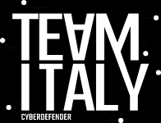

TeamItaly CTF 2022
Challenge: Safe Pizza Orders
Category: Pwn
Author: Domingo Dirutigliano | DomySh

Slide 2
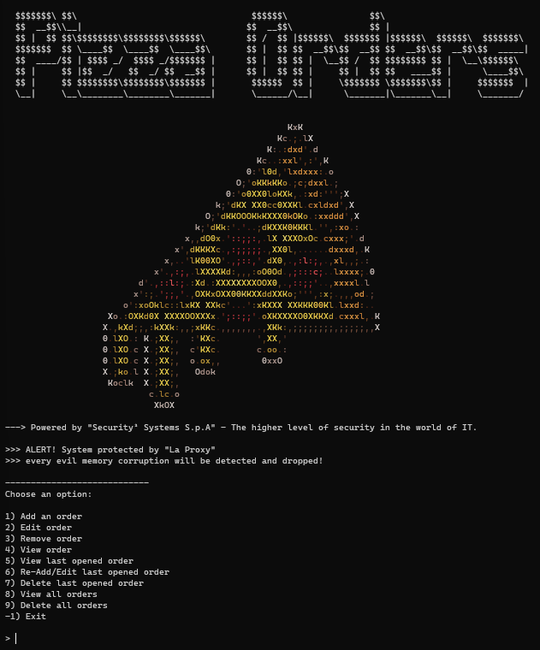
Introduction
Once connected to the challenge we see the following menu that offers different functionalities to manage a list of orders memorized in the platform

Slide 3
Introduction
The interface allows to add, remove and edit an order. The orders are identified by a number, and the max number of orders is 20.
It’s important look at the last functions that allows to add, remove and edit a note referring to the last used note.

Slide 4

Introduction
An order is composed by the name of who ordered and a description of the order (so how many pizzas, the various flavours on them etc…)

Slide 5
Introduction
In the banner printed initially, there is an alert that advise you about a security system activated on the service. “La proxy” is a TCP proxy that filters the connection between the binary and the user. No more details are given about this security system, but in the challenge attachments there is the source code available, so reading it you can understand how and what it does.

Slide 6
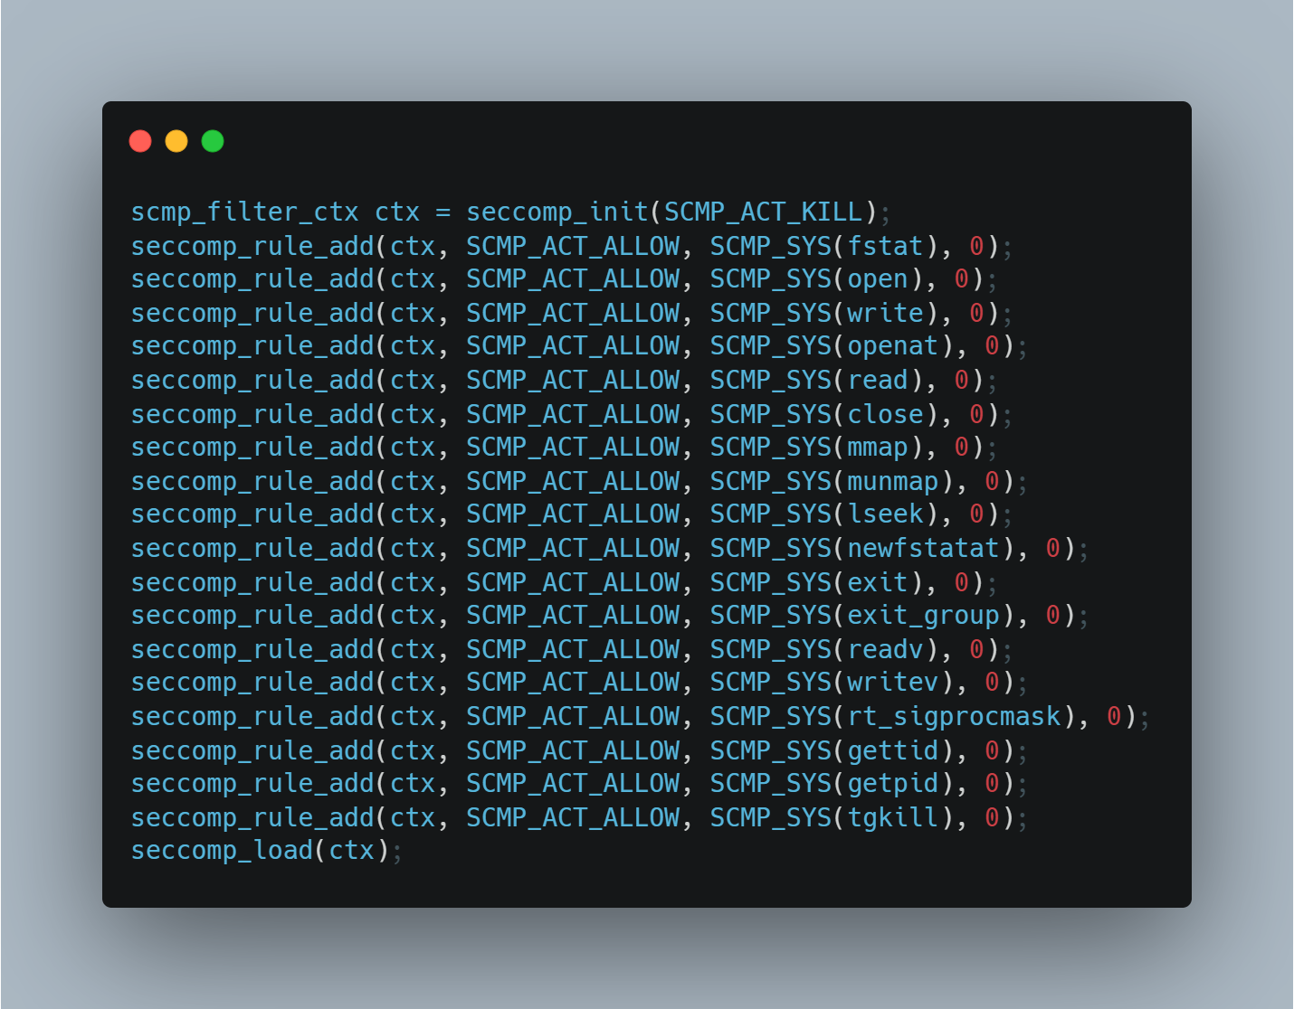
Introduction - Seccomp
This is the policy applied using the c code above, and this will made available only some syscall which are: fstat, open, write, openat, read, close, mmap, munmap, lseek, newfstatat, exit, exit_group, readv, writev, rt_sigprocmask, gettid, getpid, tgkill

Slide 7
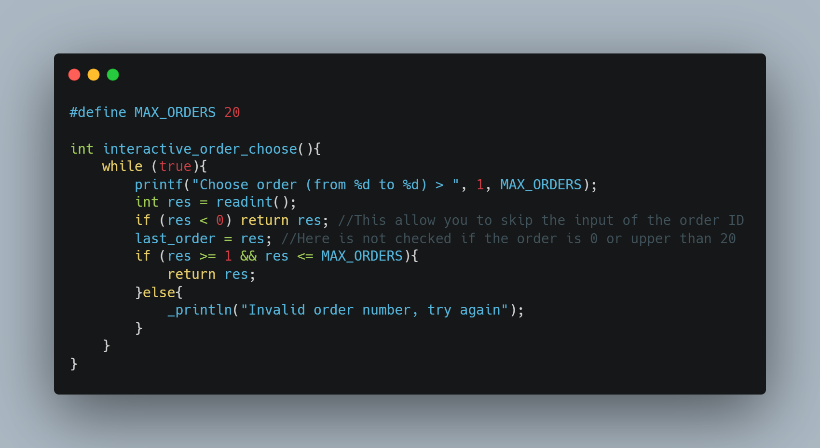
Vulns - Arbitrary last_order index
looking at how is composed this function, you can easily choose an arbitrary value of last_order global variable, putting first the id 0, and after this a negative number.
After this operation last_order will be set to 0, and you will be able to access to the order 0 using the specific function in the menu that use last_index as input and deactivate the security function.
#define SAFETY_ON (orders[0] != NULL && orders[0]->content[0] == '1')
This is what made security functions on, so just removing order 0, you will be able to deactivate the safety mode

Slide 8
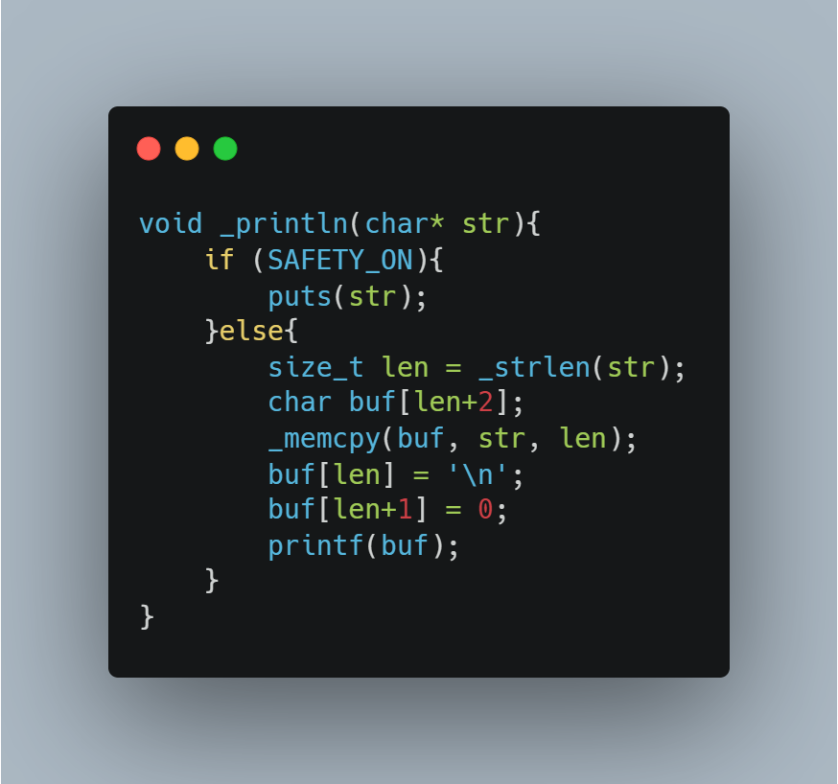
Vulns - Arbitrary last_order index

Slide 9
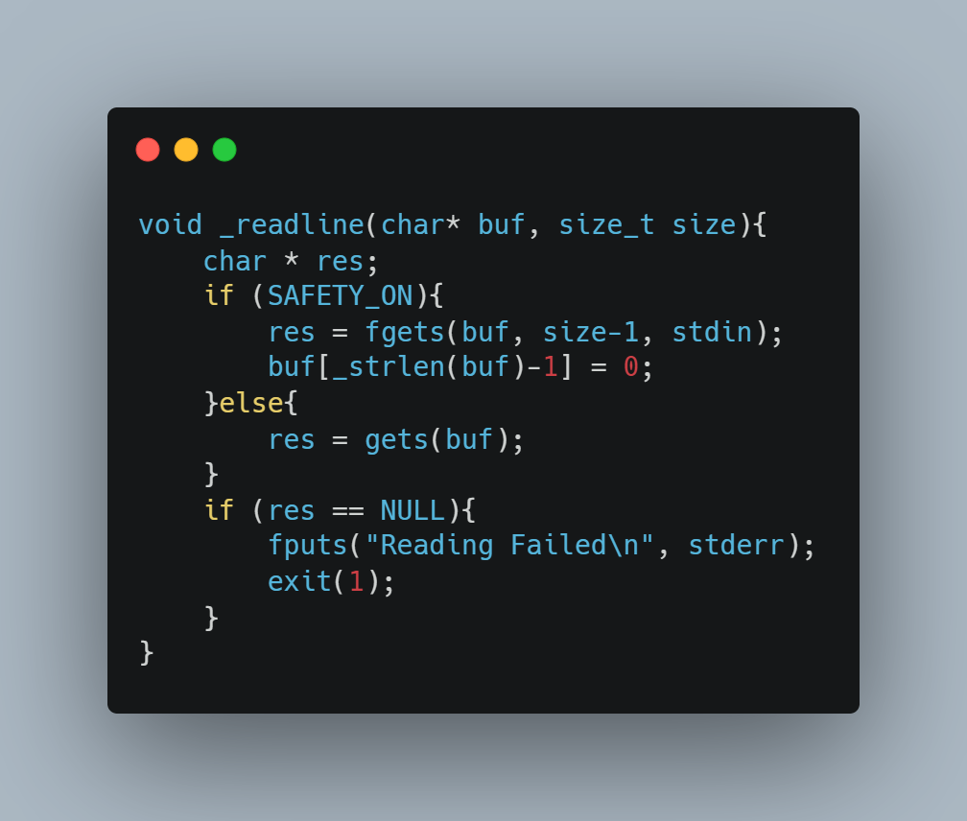
Vulns - Arbitrary last_order index

Slide 10
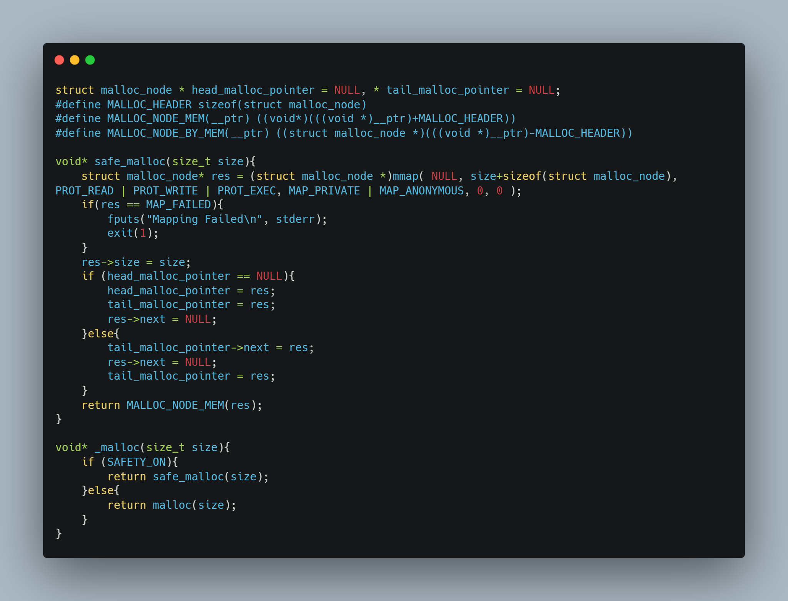
Vulns - RWX memory malloc
the safe version of malloc uses directly the mmap primitive to allocate heap memory. This is ok (too slow, but ok), except the fact that the permission given to this memory location exceed the "normal" permissions given to the heap. Setting `PROT_READ | PROT_WRITE | PROT_EXEC` the memory mapped will be executable, and this helps you a lot during exploitation. The design of the new malloc function is not thought to be vulnerable, and there aren't overflow available because \_strncpy is always safe (in both versions).

Slide 11
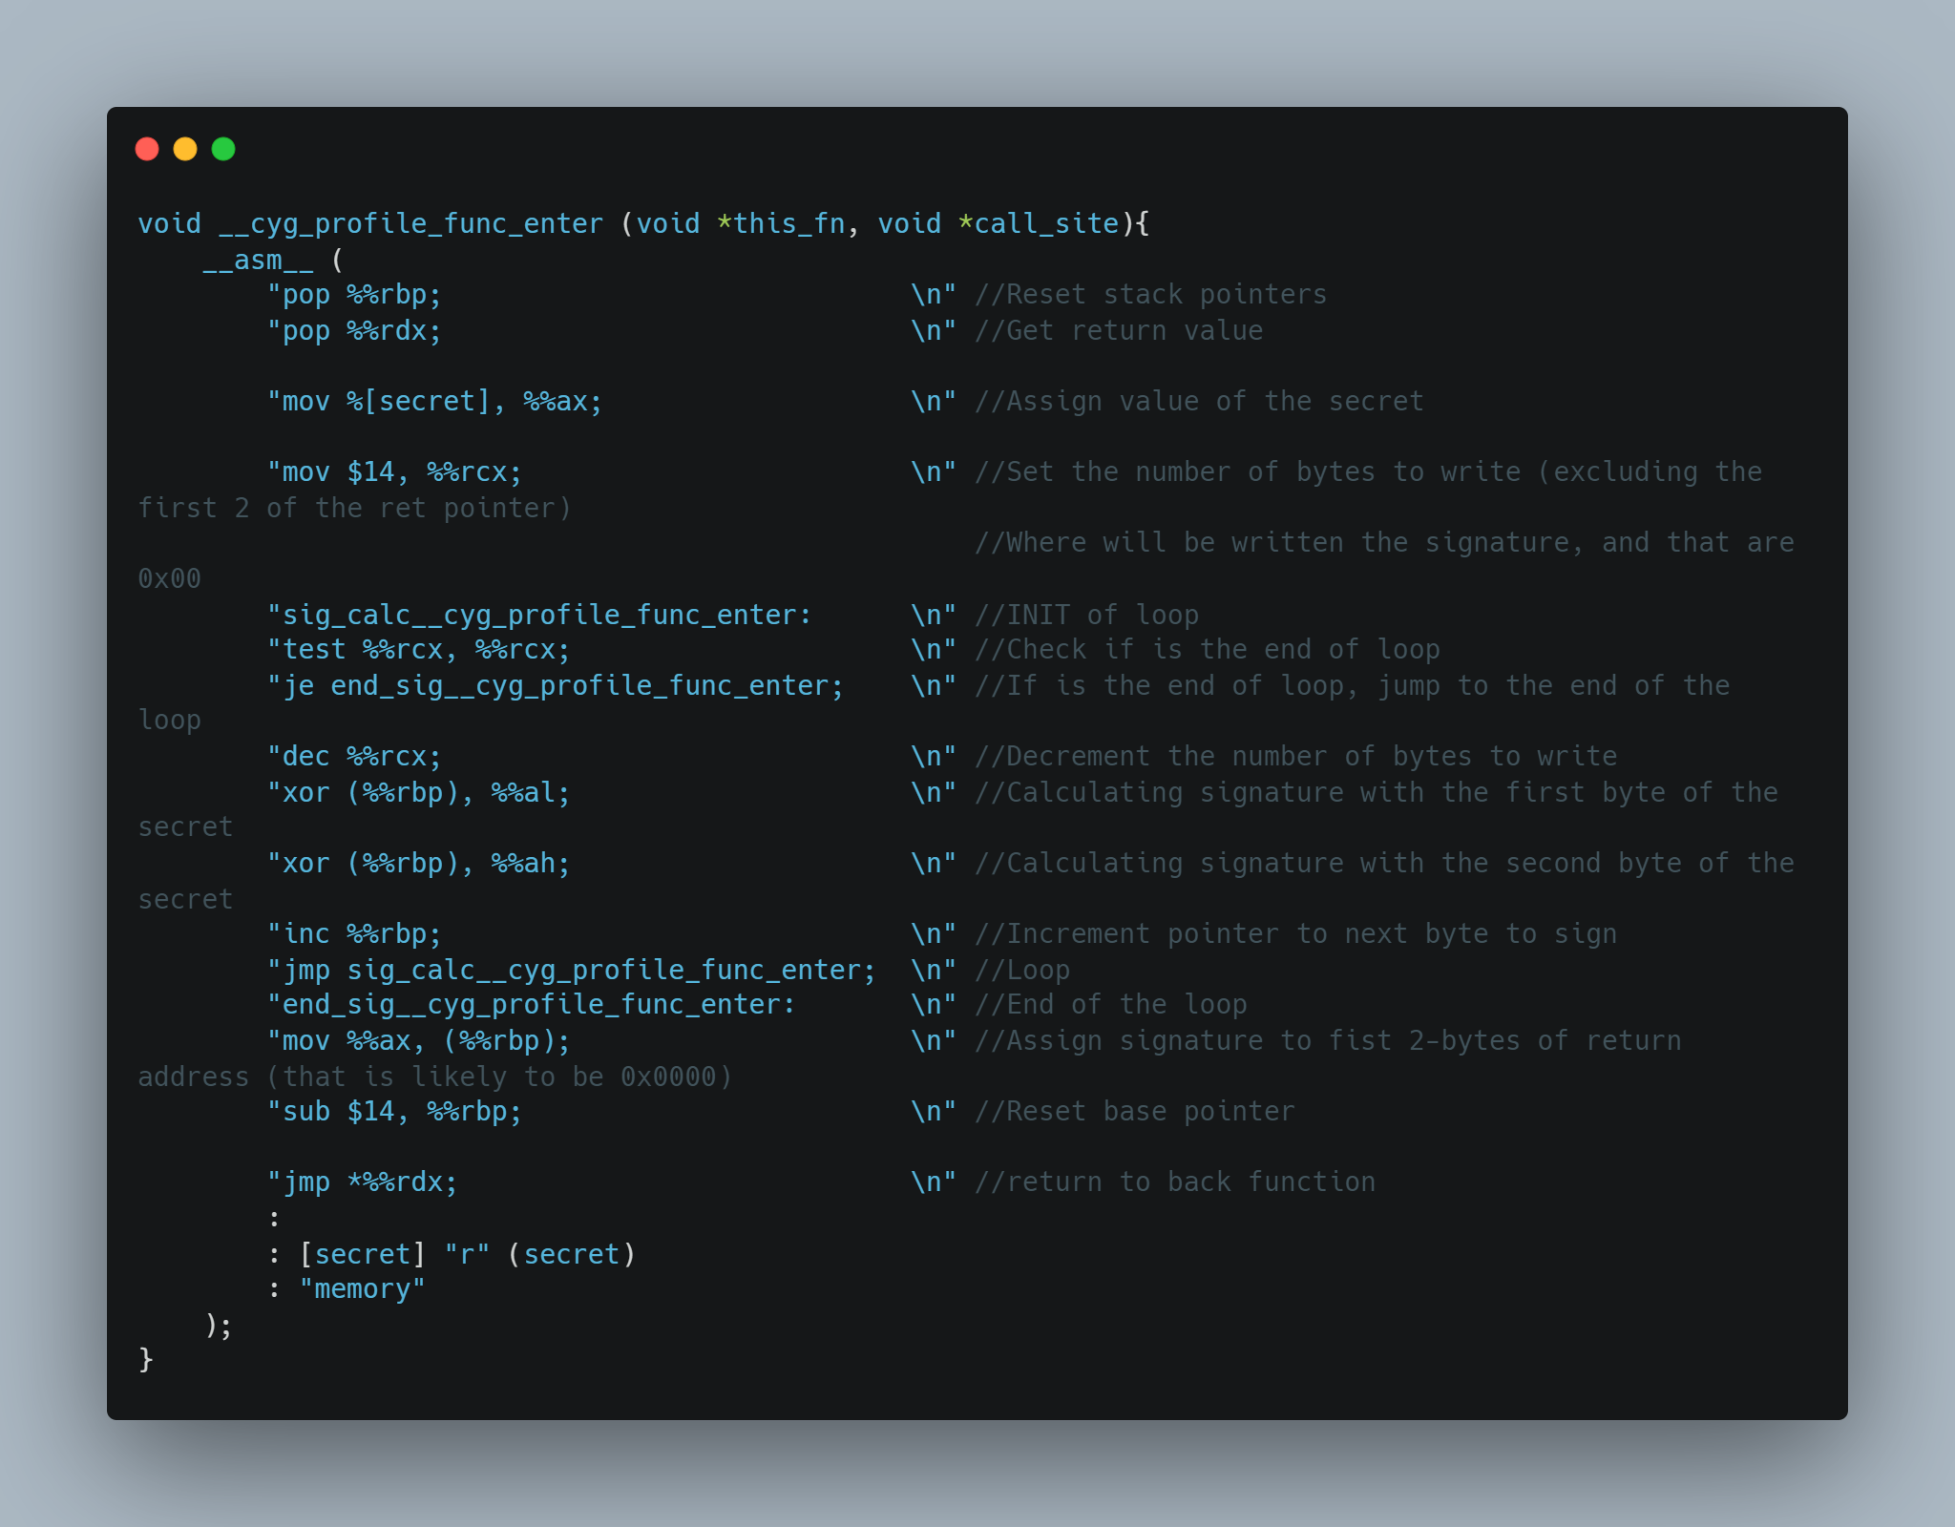
Vulns - "Stack Signature"
In this binary there is a custom additional security check, that through a xor of the base pointer, the return address in the stack and a secret of 2 bytes, sign these data creating a signature value, that is checked at the end of every function.
This is how the signature is created and stored (in the first 2-bytes of the return address).
This security system is not meant to be breakable, so to bypass it you need to calculate the secret and set the correct signature:
the only fault is the way the signature is calculated, allowing the leak of the secret in an easier way than a bruteforce. The use of bruteforce to bypass this security check is not meant as a solution (The PoW should avoid this possibility at all).

Slide 12
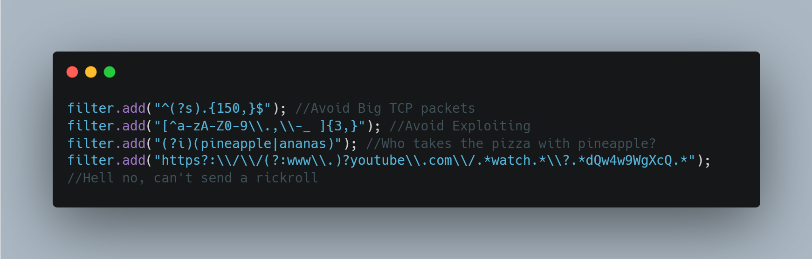
Vulns - "La proxy"
"La proxy" is a real TCP proxy written using the boost library, that use the ios loop to manage efficiently all the requests to forward to real TCP server. Uses pcre2 c library (through a [c++ wrapper](https://github.com/jpcre2/jpcre2)) to filter TCP requests.
The proxy itself doesn't contain any software vulnerability, but looking at the way it works, you can easily bypass his filtering action. In fact, the proxy analyses specifically the TCP packets and not the TCP flux. This means that to bypass the limit of 3 consecutive "non standard" character filter (That is this one: `[^a-zA-Z0-9\.,\-_ ]{3,}`) you can send small sequence of these characters: for instance, if you need to send 0xdeadbeef, you could send first 0xdead and after 0xbeef, the binary will receive the merged string but the proxy won't filter that.

Slide 13
Conclusion - Exploit
The steps to solve the challenge are:
Bypass the proxy by creating a method to send small TCP packets
Create a shellcode that read and print the file without using illegal syscalls, and insert this in an order
Activate “unsafe mode”
use the printf vuln to get the stack (leak the signature and the canary)
Calculate the secret by xor
Build the buffer overflow and execute the shellcode

