Slide 1


TeamItaly CTF 2022
Challenge: Schei Checker
Category: Web
Author: Jacopo Di Pumpo <shishcat>

Slide 2

Introduction
This challenge is a web app which displays updated Italian Lira cryptocurrency prices.
Source code is available for download, and it is necessary to solve the challenge.
The flag is only accessible on the administration panel.

Slide 3


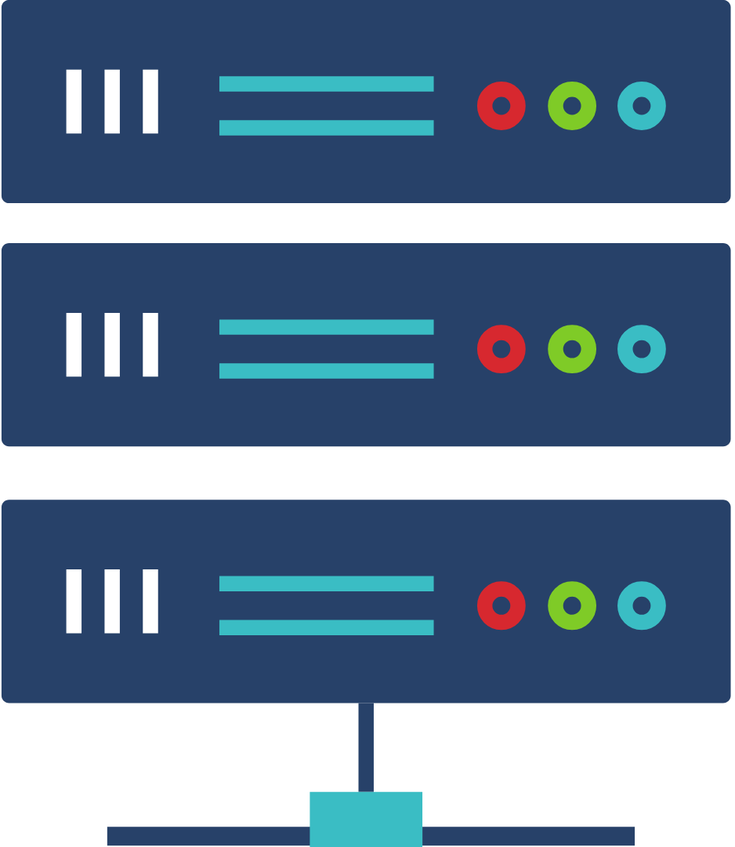
Vuln
http://challenge:39393/pricesAPI/getPrice?url=/prices
http://pricescache/prices
http://challenge:39393/pricesAPI/getPrice?url=@site/prices
http://pricescache@site/prices
Looking at the network requests to pull the prices, we can see that it includes the full path of the price endpoint to be proxied by the backend. This feature can be turned into SSRF: since the server doesn’t postpend / to the URL, we can perform the HTTP basic authentication trick, sending @site as URL will make the server connect to site instead of the pricescache server, and pass pricescache as Authentication header.

Slide 4
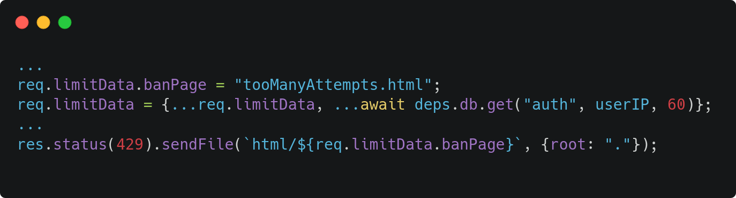
Vuln
Analyzing the source code, we can see that there is a banning mechanism to prevent bruteforce of the admin password, whenever a client tries to login several times in a short time, the client IP will be registered into Redis as a banned user, and the ban page will be served. Since the filename of the banpage is put inside an object with data pulled from the DB, we could override the banpage and load any file from the project’s work directory if we get write access to Redis.

Slide 5
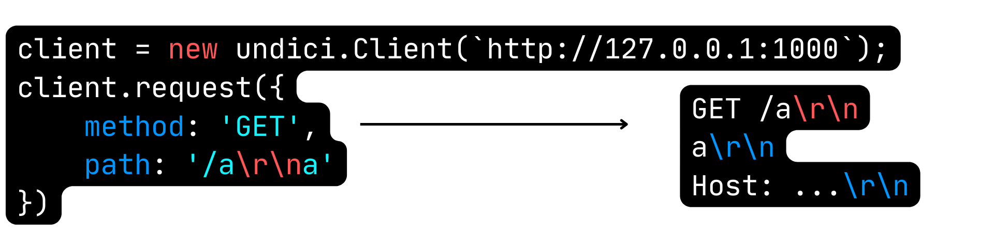
Vuln
CRLF injection in request path, method, and headers
The backend is using a version of the request library undici, which is vulnerable to a line injection vulnerability in the path.

Slide 6
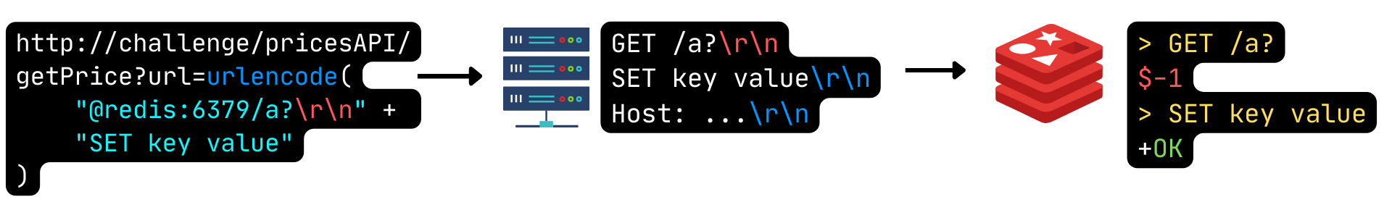
Vuln
We can use this vulnerability for Cross Protocol Scripting, using HTTP to communicate with Redis. The Redis protocol is very simple, plaintext TCP, each line is equivalent to a command, and any error, even in syntax, does not cause Redis to close the connection. So we can use CRLF Injection to send commands to Redis, and thus alter the backend database.

Slide 7
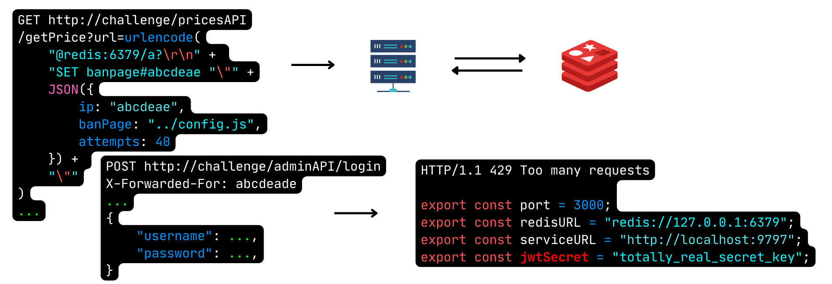
Exploit
Finally, to solve this challenge, we can use CRLF Injection to register a chosen banned IP into Redis, change the ban page to the server configuration file, and by making another authentication request to the backend, spoofing the X-Forwarded-For with the chosen IP, we get back the server configuration file, which includes the JWT, that we can use to forge the admin token, log in to the panel and get the flag.

