Slide 1


TeamItaly CTF 2022
Challenge: Spaghetti VM
Category: rev
Author: Gianluca Altomani <devgianlu>

Slide 2
Introduction
The challenge was inspired by a real-word JavaScript obfuscation solution. It implements a simple stack-based VM that has a small number of opcodes tailored to running the challenge.

Slide 3
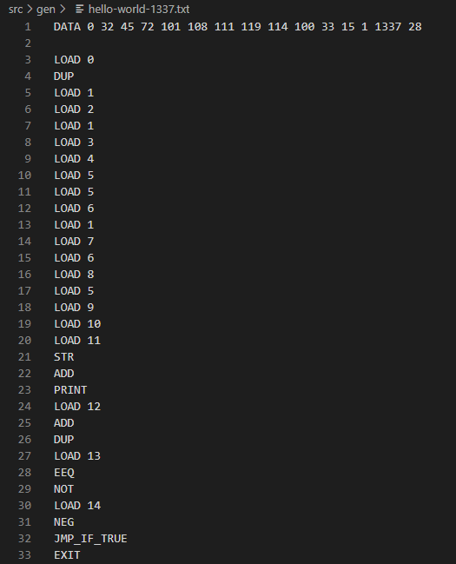
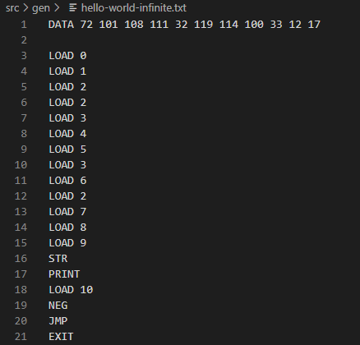
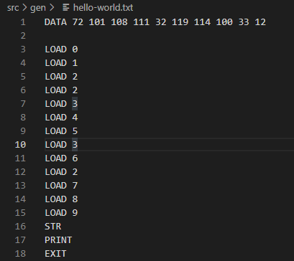
“Assembly” examples

Slide 4
From “assembly” to JS
The VM consists of these parts:
Data block (an array of integers)
Instructions block (an array of functions)
Program arguments block (an array of arrays of integers, wow!)
Program instructions block (an array of indexes inside the instructions block)
Execution block (a for loop)

Slide 5
Reversing
The fastest way to solve the challenge is by reversing it dynamically. The challenge won’t run if the code is formatted because it detects new line characters in the file. You can edit the file and then uglify it again to run it.
You can easily disable the self-check ability by removing the execution block from the nested VMs for ease of use.
At this point you could run a linear brute force by hooking what the flag characters is compared to with ===.

Slide 6
Reversing (that you don’t need)
Some hardcoded bytes are xored with a key derived by shifting some big hardcoded integers around in blocks of four. The check looks like this:
Load flag from sys.argv[2] and check length
Loop the flag length in blocks of 4 characters
Load two 32-bit magic values for this block and add them together
Check four characters in a random order by shifting the magic 0, 8, 16, and 24 bits to the right

Slide 7
Unintended
The challenge takes a few seconds to run because of all the self-checks that are running for some op codes. This makes the obfuscated code vulnerable to a side channel attack since the challenge is noticeably faster at failing the first character than the last one after you figured out the flag length (which is checked first).

Slide 8
Conclusion
A ~17k characters one liner in JavaScript is a good deterrent against people trying to solve your challenge. Why make it hard when you can scare them?

