Slide 1


TeamItaly CTF 2022
Challenge: Speaking with hands
Category: Rev
Author: Matteo Schiff <Matte23>

Slide 2
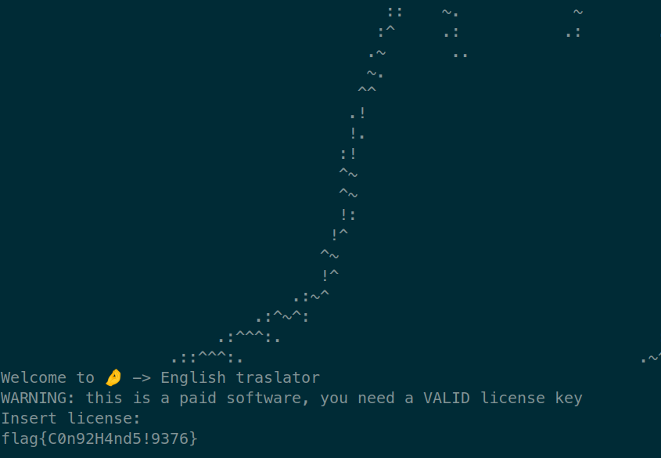
Introduction
An x86_64 ELF is given
Executable prompts for a license
If the inserted license is correct, it prints a flag

Slide 3
The license
The license is treated as a list of instructions
It should be 15 characters long
Some instructions can take the next character of the license as an argument
The assembly code mapped to the instructions is obfuscated

Slide 4
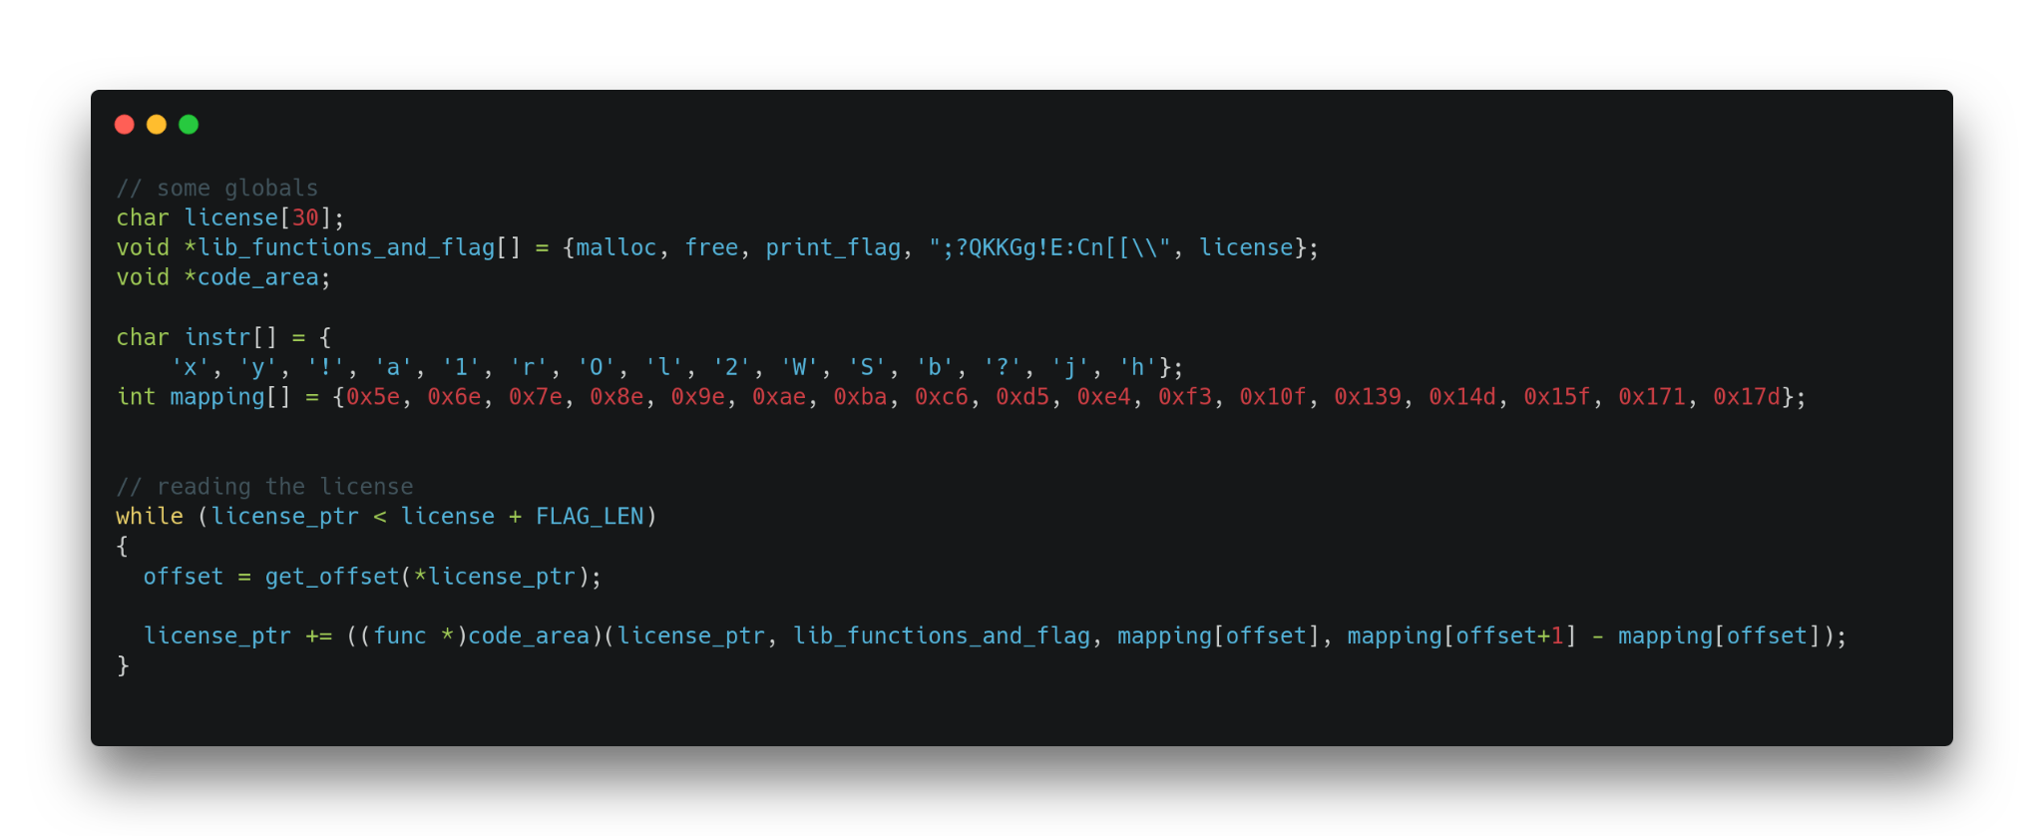
The license

Slide 5
Obfuscation
The relevant instruction, along with the obfuscator, are placed in a separated memory area
When required, each instruction is deobfuscated, executed and then obfuscated again
clear_byte = obfuscated_byte ^ (0x13371337 + offset)
where offset is the position of the byte relative to the beginning of the memory area

Slide 6
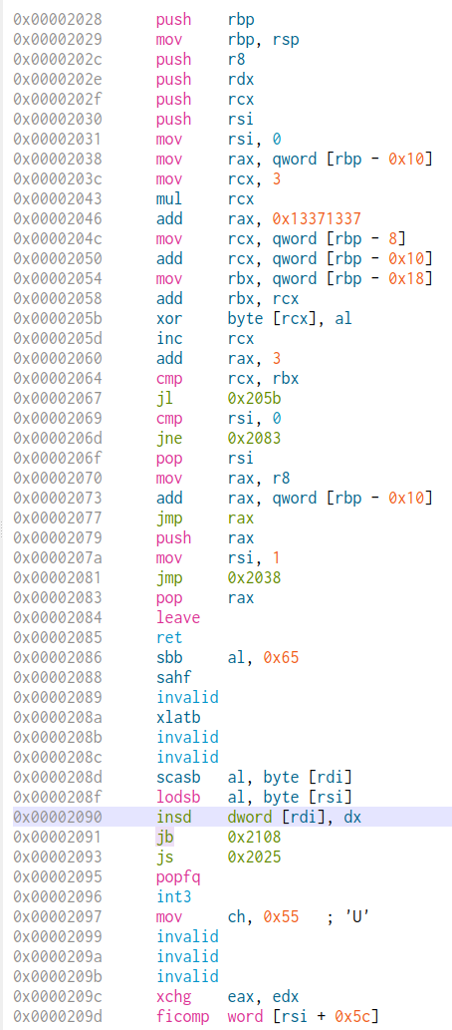
Obfuscation
Deobfuscator
Jump to deobf code
Obfuscator
Obfuscated
instructions

Slide 7
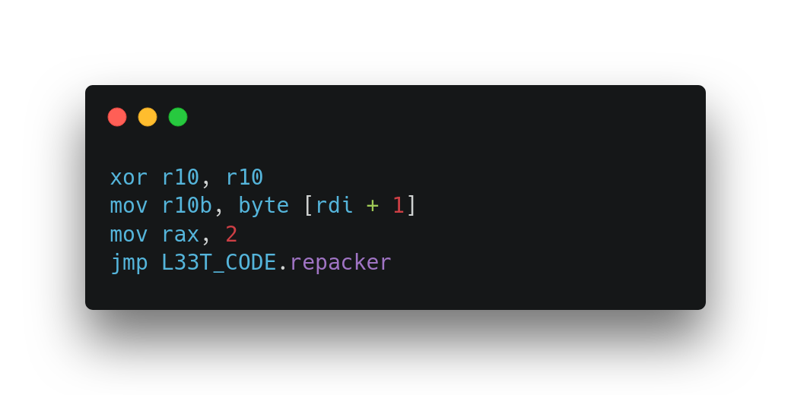
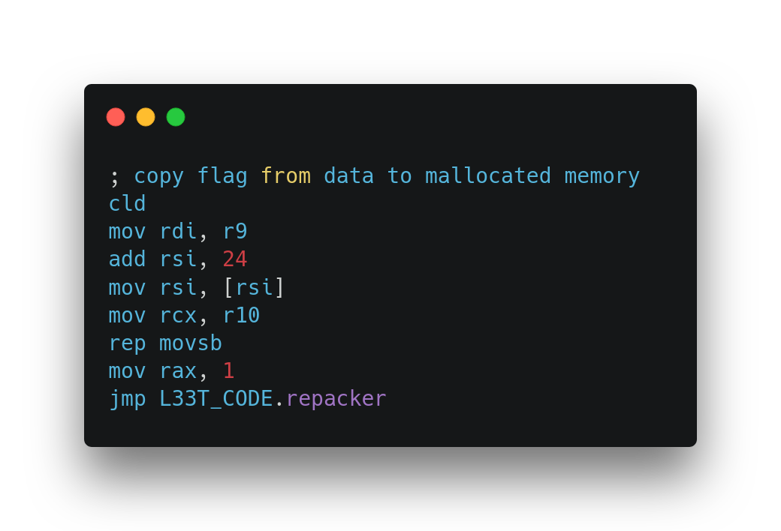
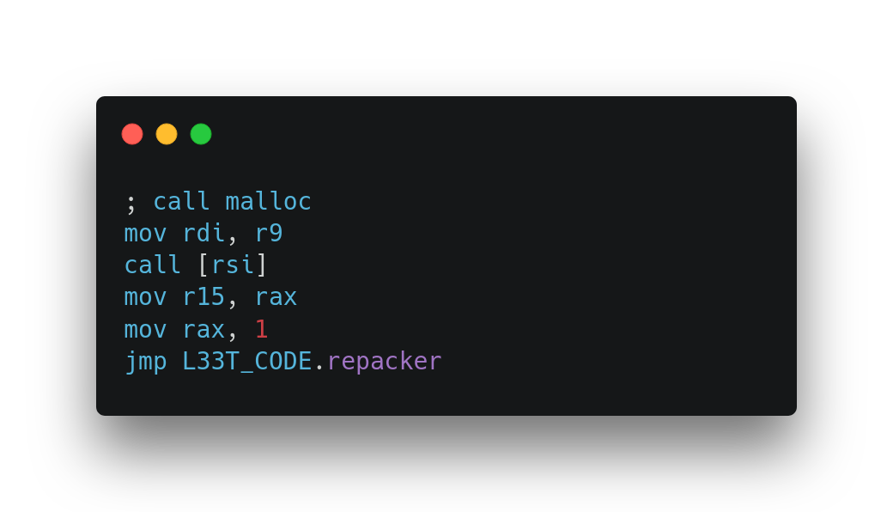
Some instructions
rsi: points to current license character
rdi: contains some pointers to malloc, free, print_flag + crypted flag
rdx: contains "function" offset
rcx: contains "function" size

Slide 8
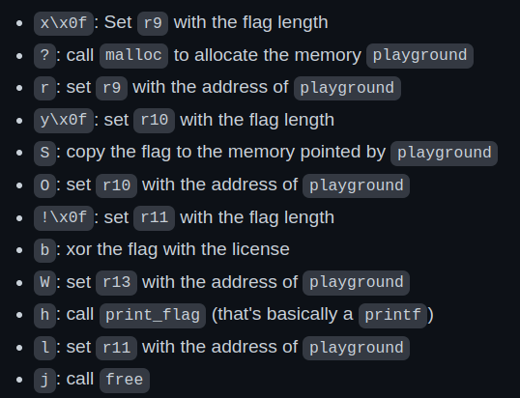
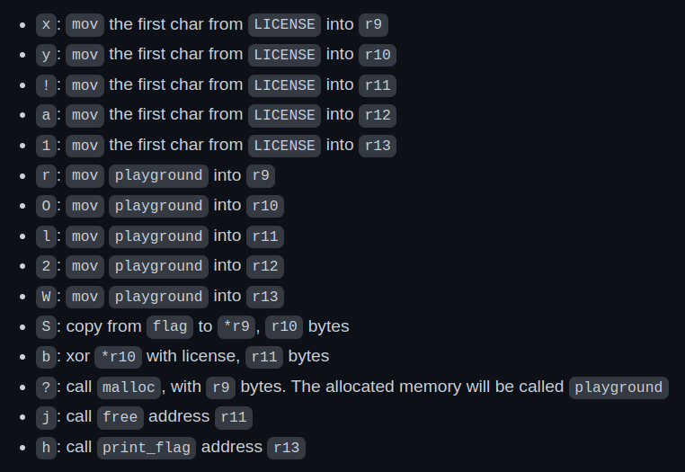
Deobfuscated code
Instructions to print the flag:
Char -> Instruction mapping:
License: x\x0f?ry\x0fSO!\x0fbWhlj

Slide 9
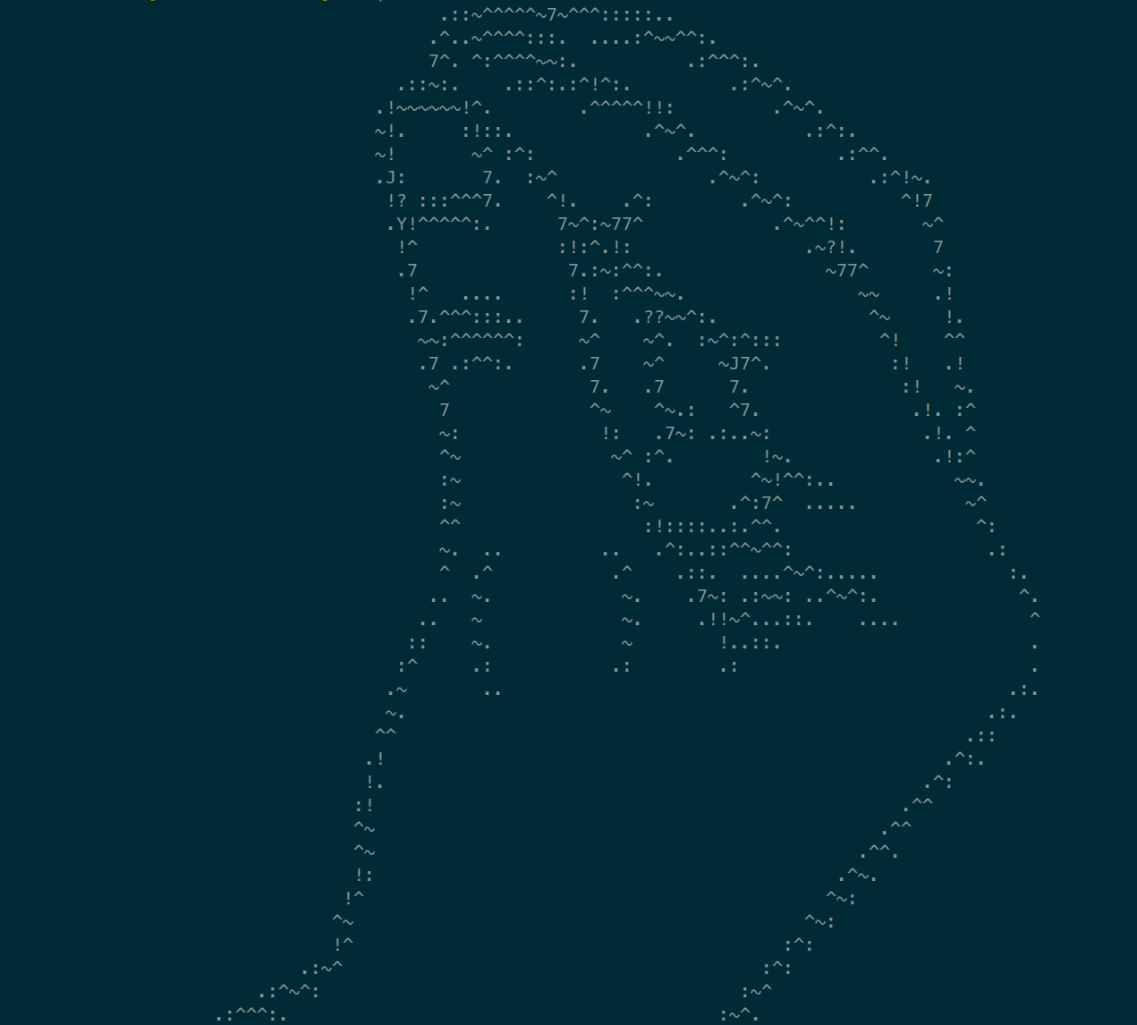
Conclusion
Try to deobfuscate the code
Reverse it
Build the correct license
Get the flag 🚩

