Slide 1


TeamItaly CTF 2022
Challenge: Missing-Half
Category: Crypto
Author: Elia Cal <Elius>

Slide 2
Introduction
A python script and a output file are given. The script uses a password (which is given) that is used by a redacted (before the edit) function. The challenge is to understand what the funcion did and to reverse it.

Slide 3
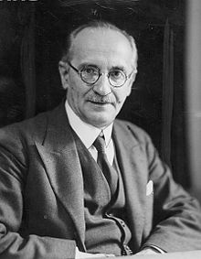
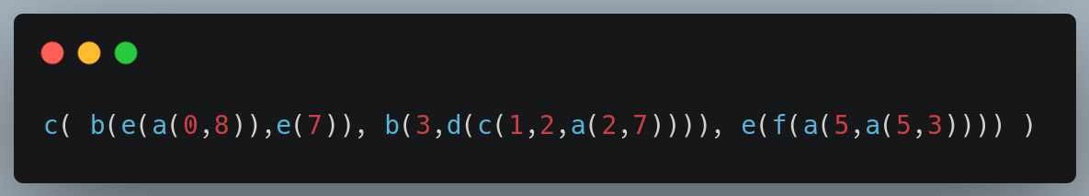
Vuln
REDACTED
The name hinted to Jan Łukasiewicz, best known for polish notation
Combined with the name of the known functions we can work out the
original function (not really)
So “08ae7eb31227acdb553aafec” becomes

Slide 4
Vuln
First argument of c return 0 and sets random seed to e(7)
Second argument can be easily computed
(originally d was meant to be too slow to do so, but the solution to fast computing was given after the edit)

Slide 5
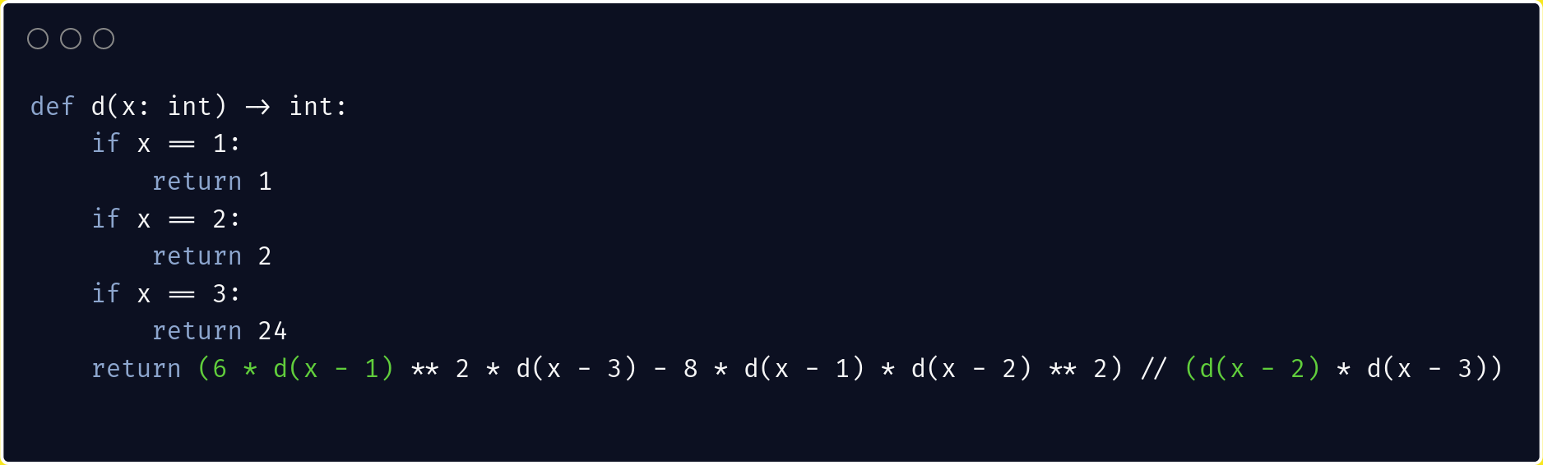
Vuln
Original d()

Slide 6
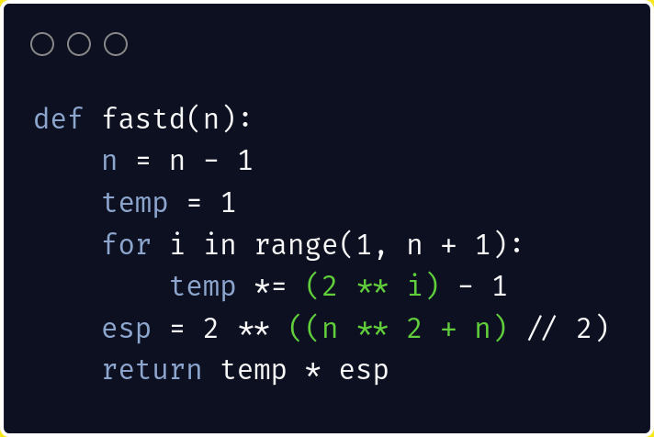
Vuln
Faster d()
From oesisA028365

Slide 7
Vuln
We need to reverse e(), we need to look at n using different bases:

Slide 8
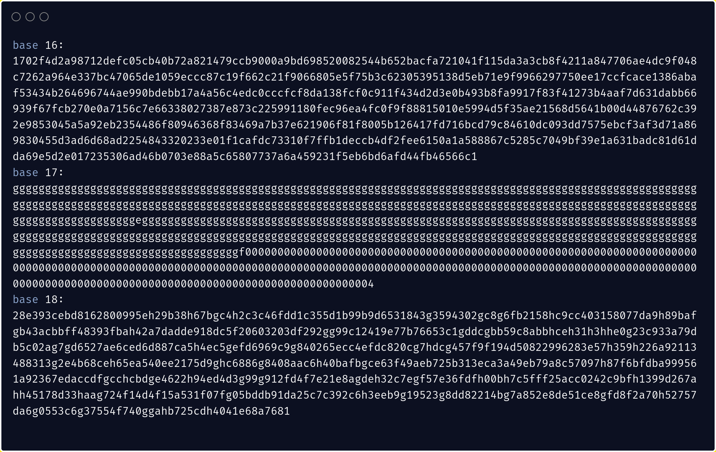
Vuln
Under base 17, it looks similar to the product of mersenne prime number. Which means that p, q must be in the form 17*k-2 with k small (< 1000) so easily bruteforceable.

Slide 9
Conclusion
We have found both input and output of the f() function, a simple xor will give us the flag

