Slide 1


TeamItaly CTF 2022
Challenge: kreap
Category: pwn
Author: Carlo Collodel @collodel

Slide 2
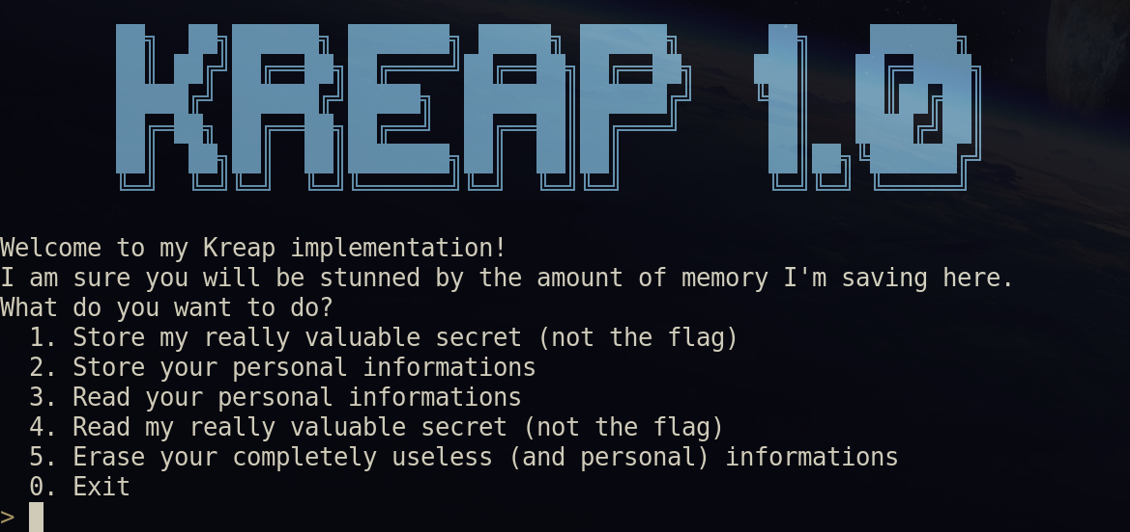
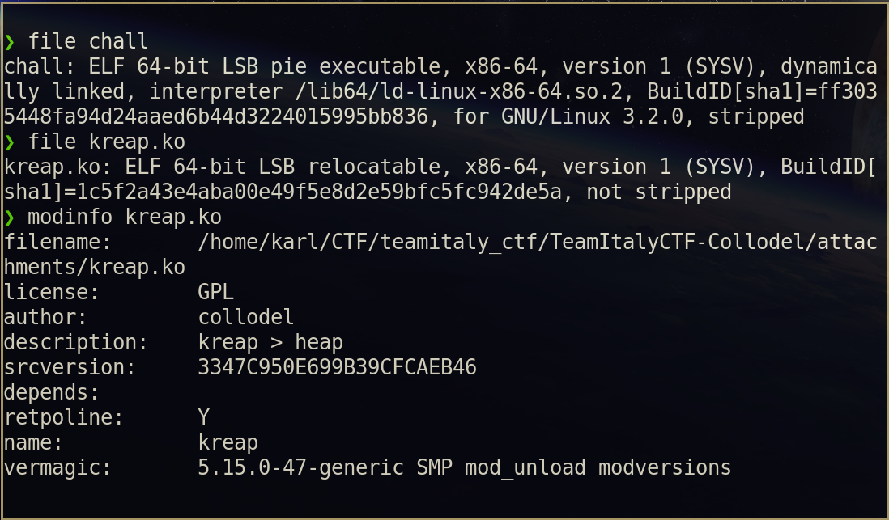
Introduction
We are given a 64-bit ELF (stripped) and a kernel module (not stripped?).
Let’s assume we did some reverse engineering.
P.S. you have to thank gcc on Ubuntu that didn’t __randomize_layout for some reason

Slide 3
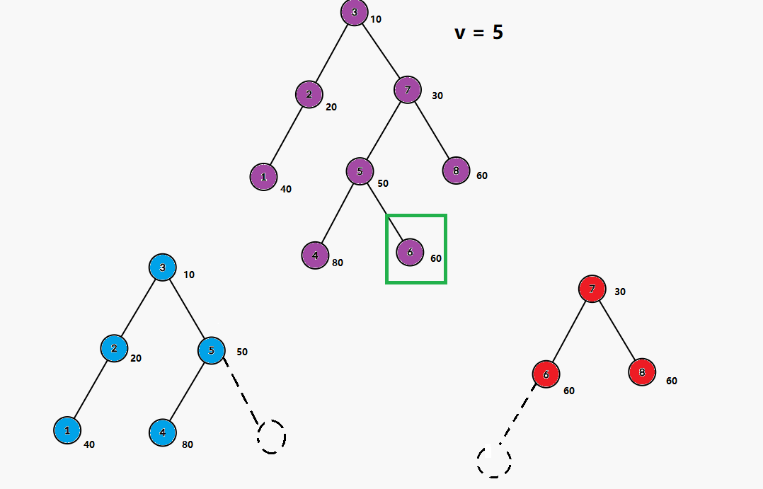
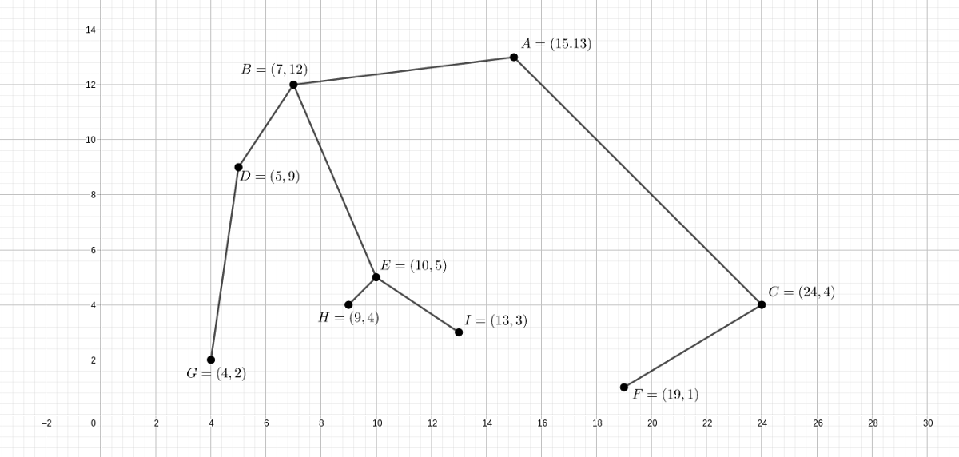
Treaps (spreading some culture)

Slide 4
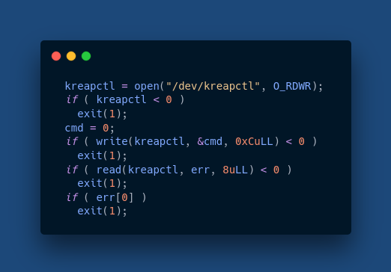
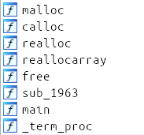
Reversing stripped chall
We can spot some heap-related functions re-defined:

Slide 5
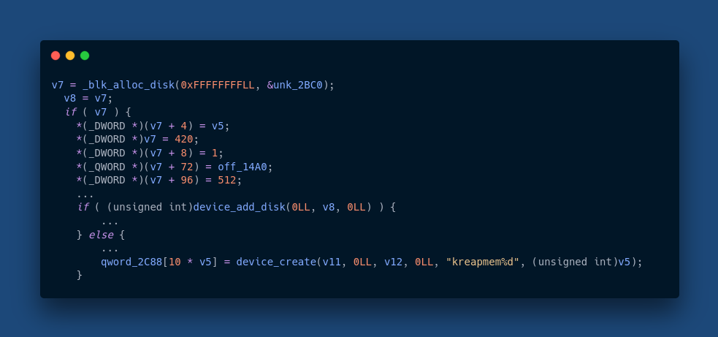
Reversing unstripped module
Let’s skip every initialization and module related stuff and check what file_operations do on kreapctl (open).

Slide 6
Reversing unstripped module
Let’s skip every initialization and module related stuff and check what file_operations do on kreapctl (read).
(uninteresting)

Slide 7
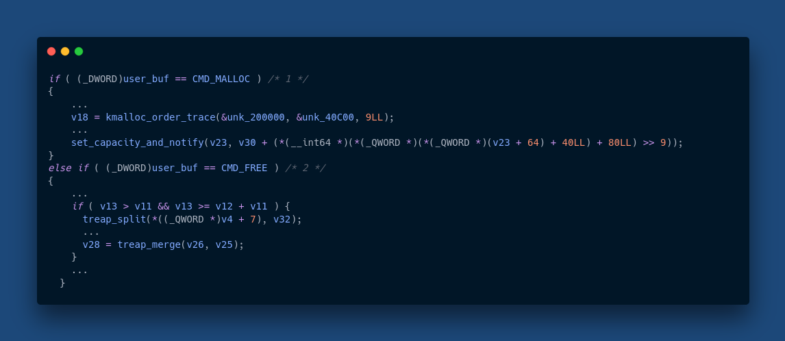
Reversing unstripped module
Let’s skip every initialization and module related stuff and check what file_operations do on kreapctl (write).

Slide 8
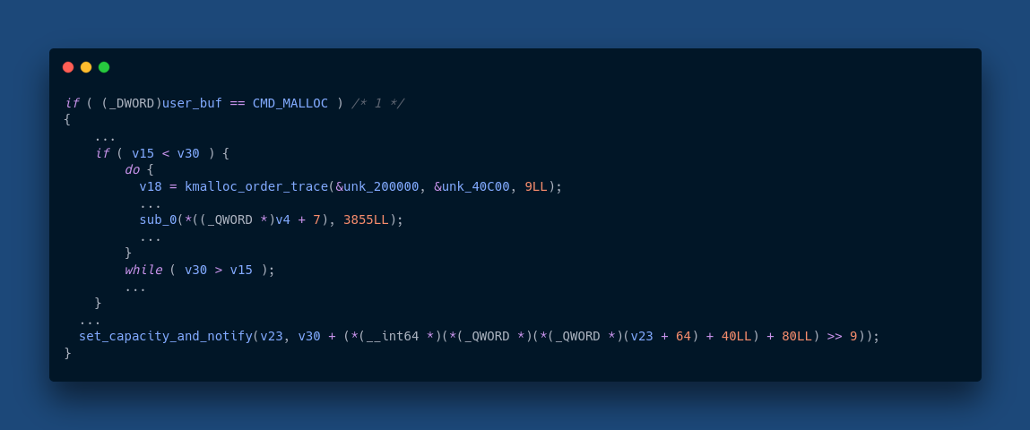
Malloc code

Slide 9
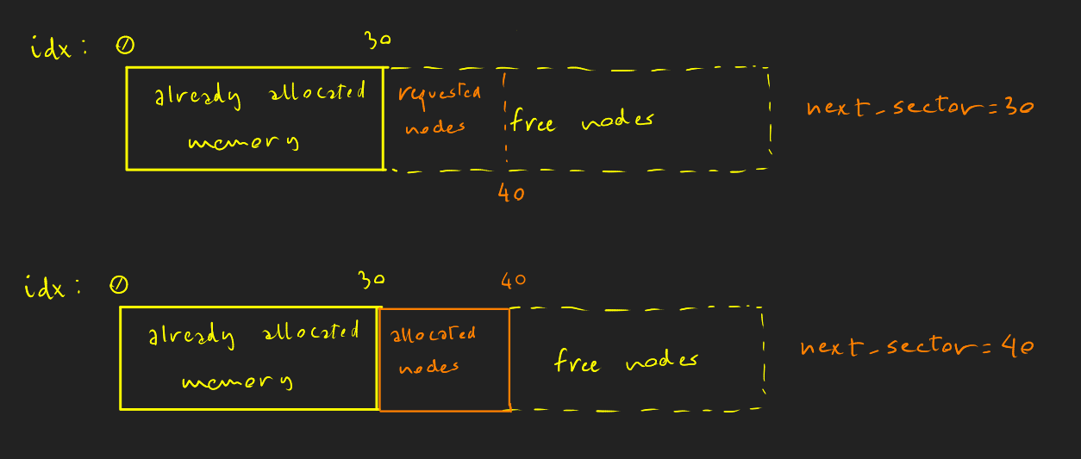
Malloc
When the malloc command is issued to the kernel module, some treap nodes are allocated by incrementing a “next_sector” variable.

Slide 10
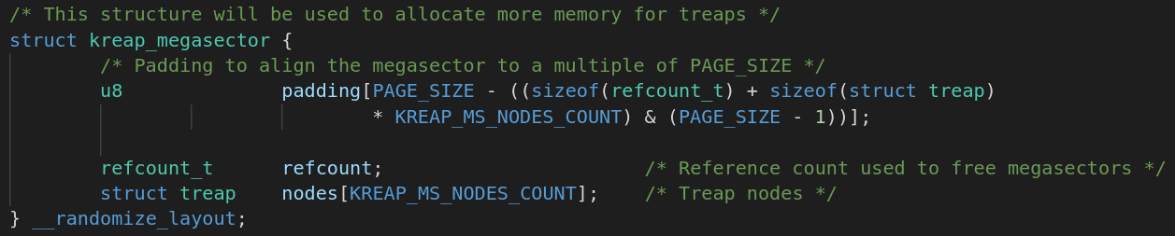
Megasectors
Also, when there aren’t enough available nodes for a malloc, a “megasector” is allocated with kmalloc. The megasector struct stores a refcount (to avoid use-after-free or double free) and 3855 treap nodes. The total memory allocated is 2 MB.

Slide 11
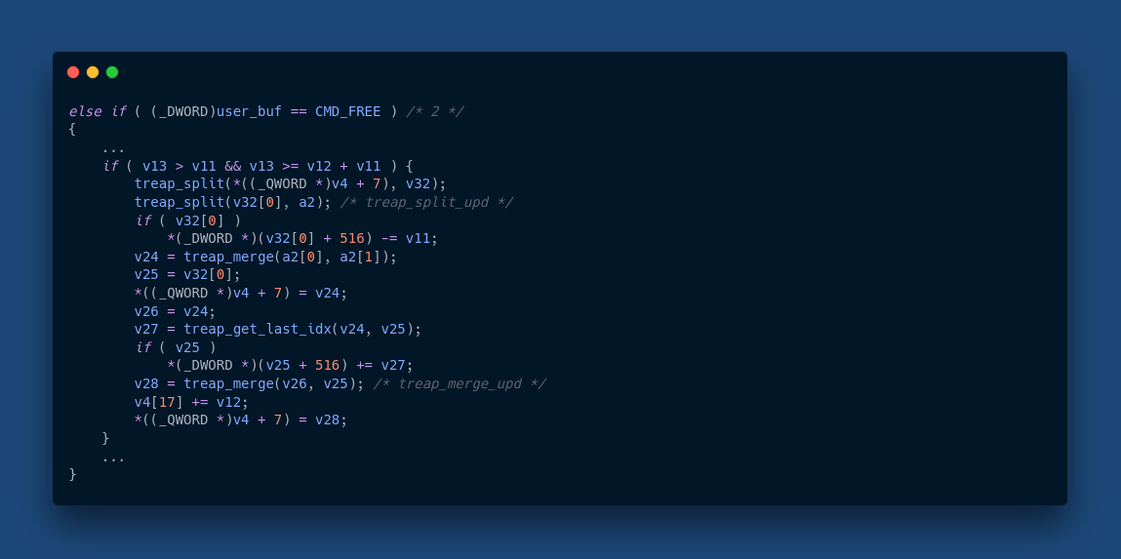
Free code

Slide 12
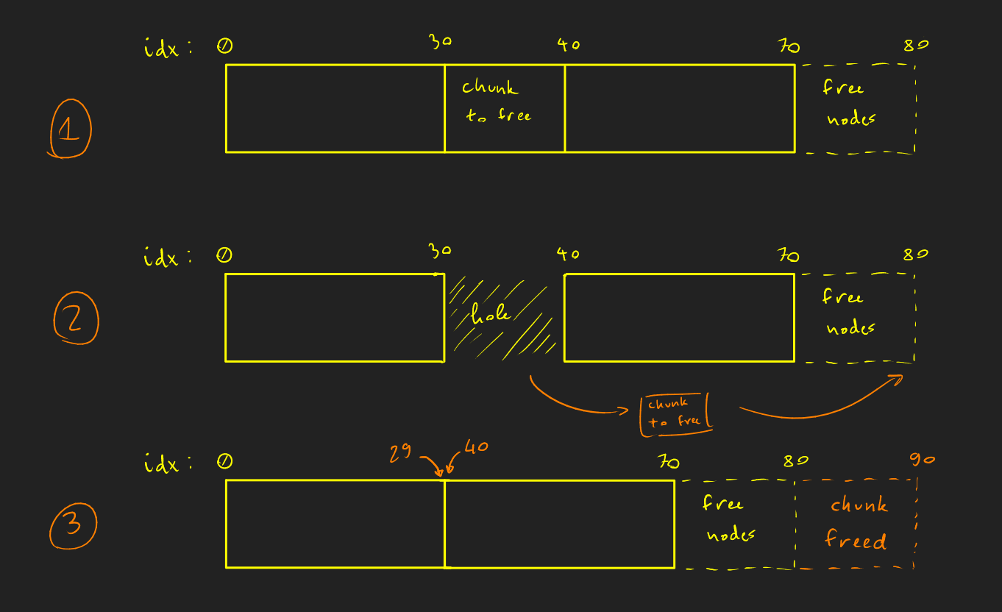
Free (a contiguous chunk)
The treap is split on the boundaries, then appended to the end of the treap (the “free area”).
During this splits, a “pseudohole” is left where the chunk used to be to avoid invalidating other indexes.

Slide 13
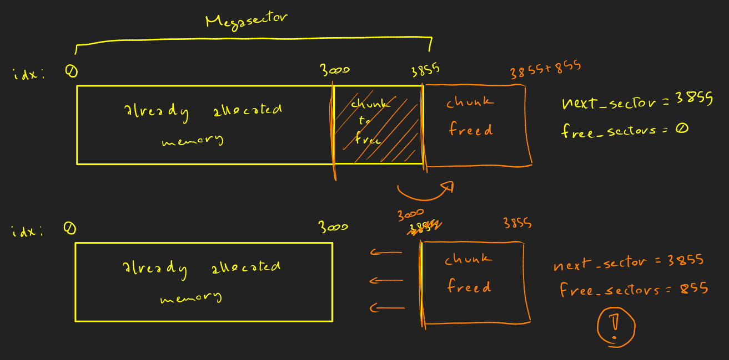
Free?
We split and preserve the indexes between the nodes before and after a freed chunk, but we append the freed chunk to the free memory: what if there is no other free memory?

Slide 14
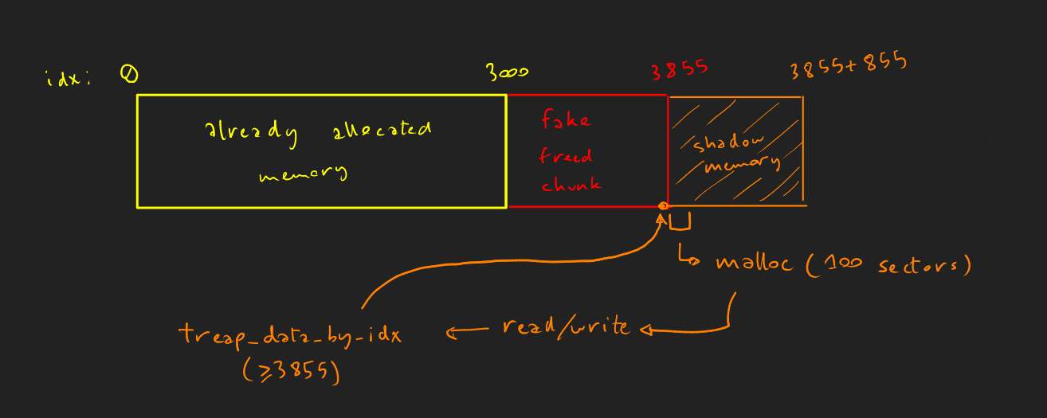
Fake Free?
Every read/write in nodes > 3855 operates on the same node!

Slide 15
Overwrite!
We can overwrite an already allocated chunk with the flag!
But will we be able to read it?

Slide 16
Spoiler: PAGE CACHE!

Slide 17
Page Cache
The kernel doesn’t “waste time” reading from block devices when data is already in RAM (if DAX is not available, which is the case for the kreap module).
Two options:
Allocate so many nodes that the page will eventually be freed (kreap part 2?).
Another vulnerability! :)

Slide 18

Yet another vulnerability
In the chall executable file, the implementation of realloc is the following:
size is in bytes, while the data before ptr is in sectors, so only old_size/512 bytes max are effectively copied.
Fun fact: this vulnerability was not intended to be in the challenge initially.

Slide 19
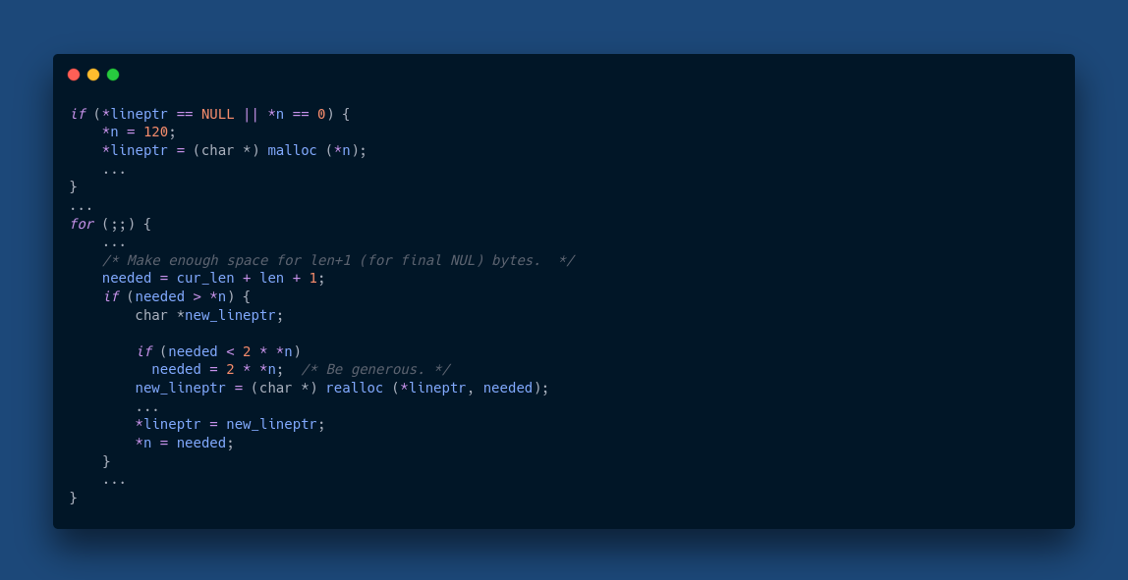
Exploit idea
Since getline() uses realloc, we can force a reallocation by inputting a large enough string, this way the memory not copied will be left uninitialized and we will be able to read the string!

Slide 20
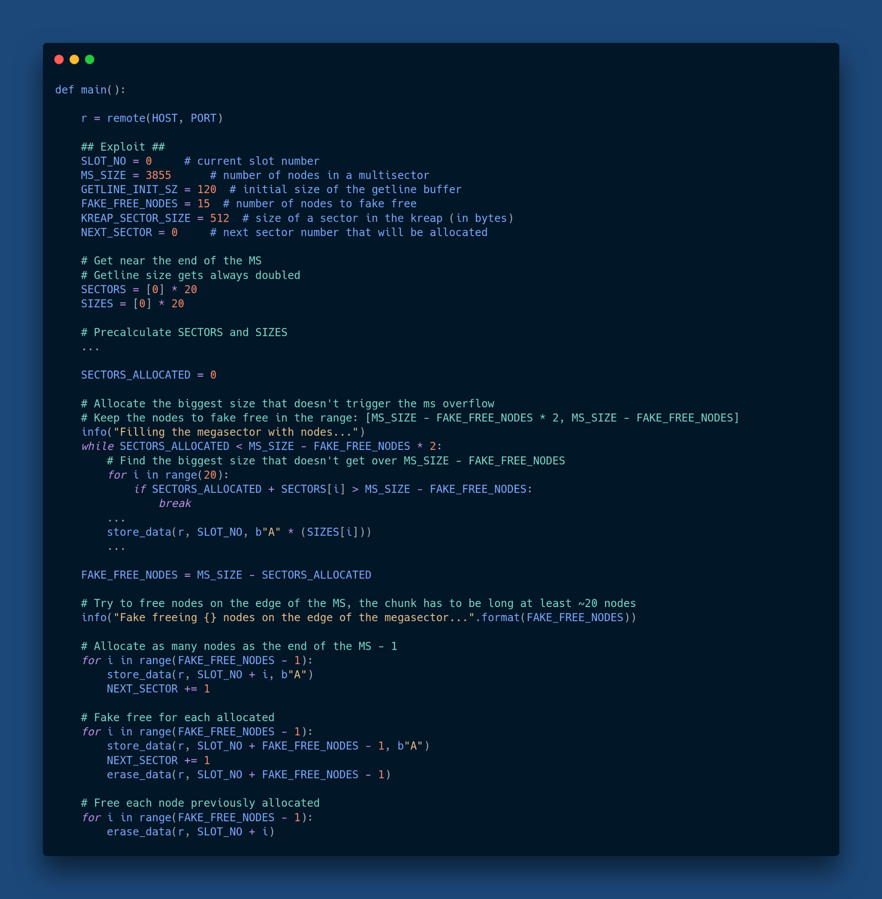
Exploit code

Slide 21
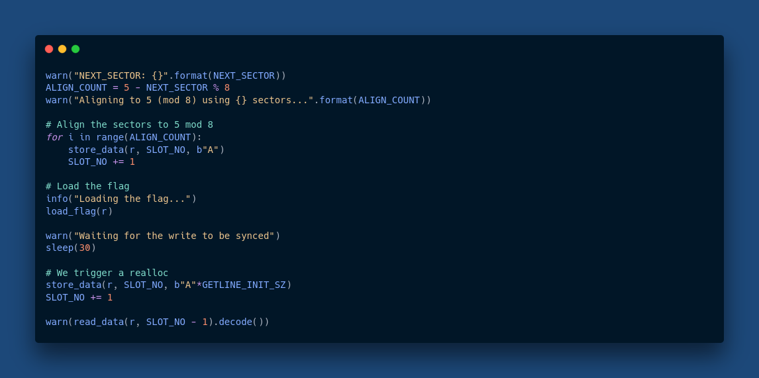
Exploit code

Slide 22
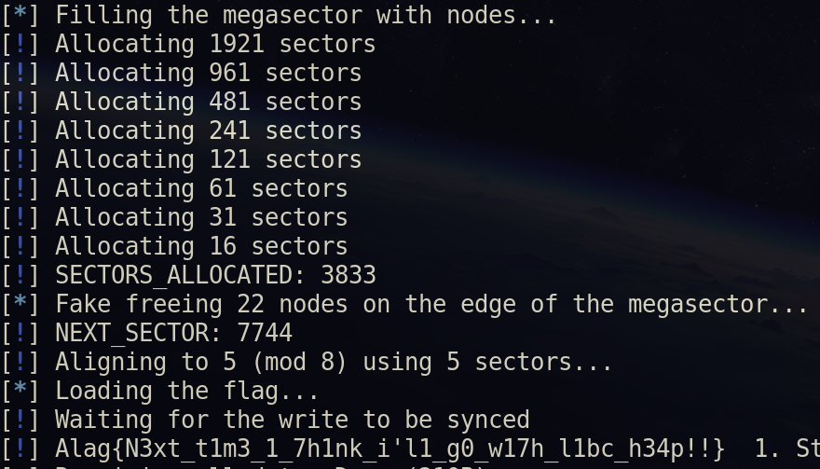
Running Exploit!
*After some hours writing the exploit*
*After aligning pages correctly*
*After waiting for the kernel to syncronize the writes…*

Slide 23
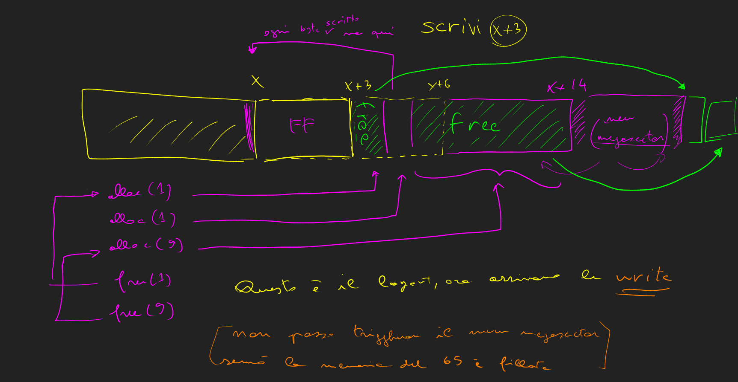
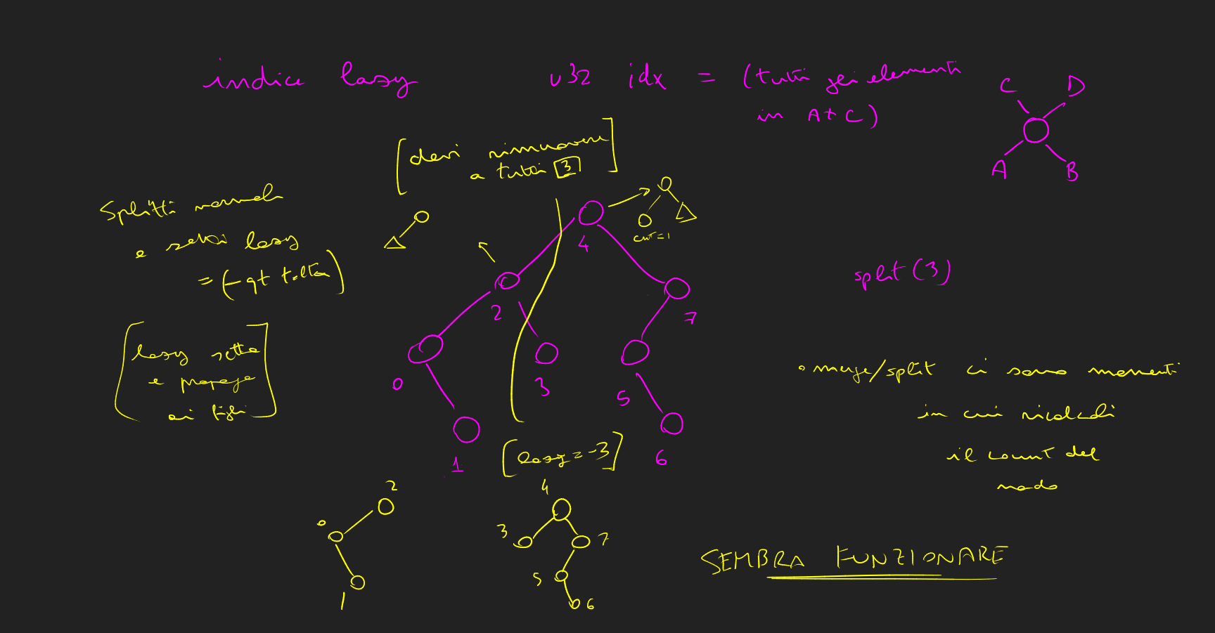
Thank you! <3
Source: some random gibberish from my notes

