Slide 1
JedSet
Clever Crow Consulting LLC

Slide 2
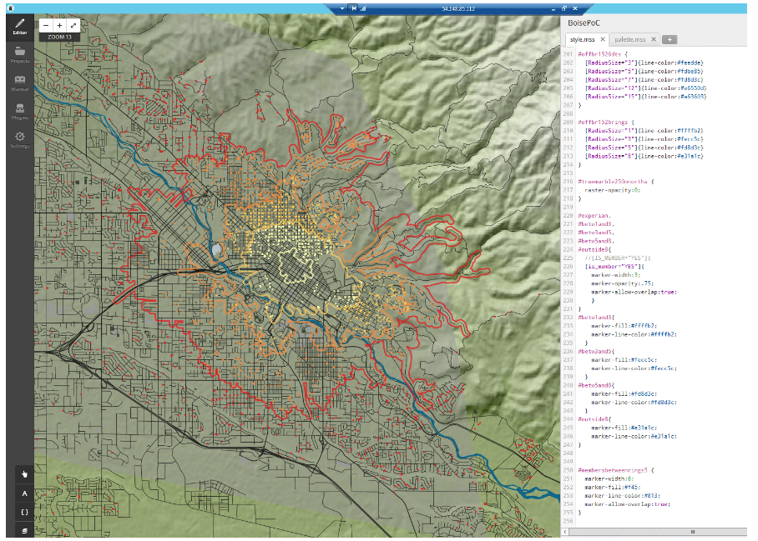
A primer on web mapping
https://github.com/clever-crow-consulting/Tableau_Background_Maps
http://www.slideshare.net/dandye/wherecamptb-ignite

Slide 3
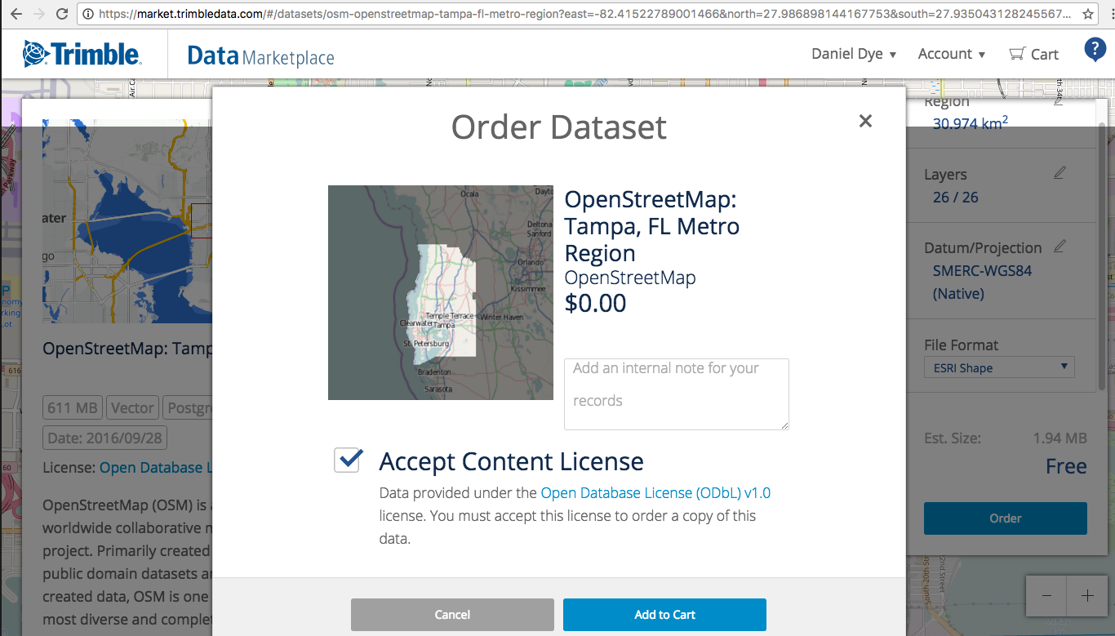

Slide 4
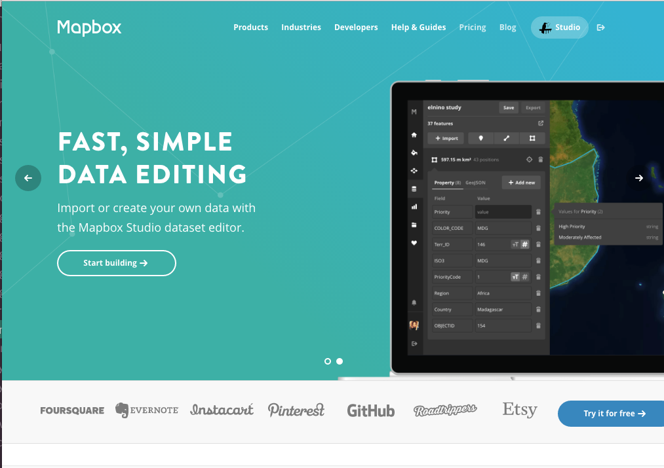

Slide 5
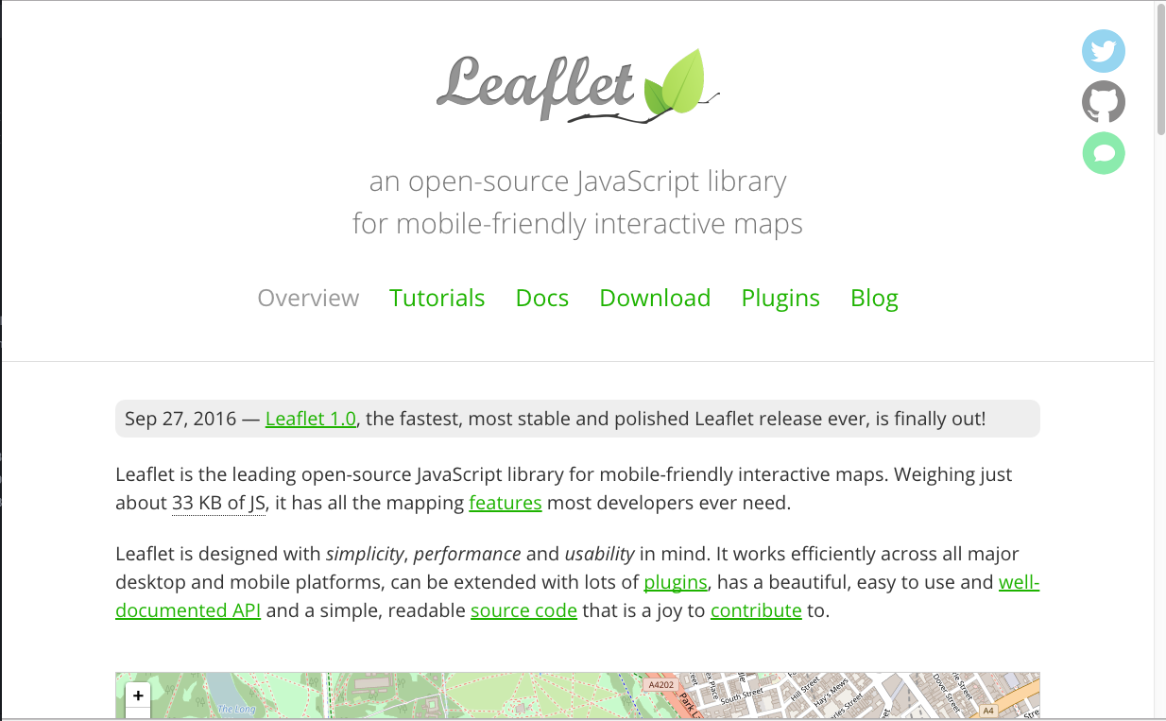

Slide 6
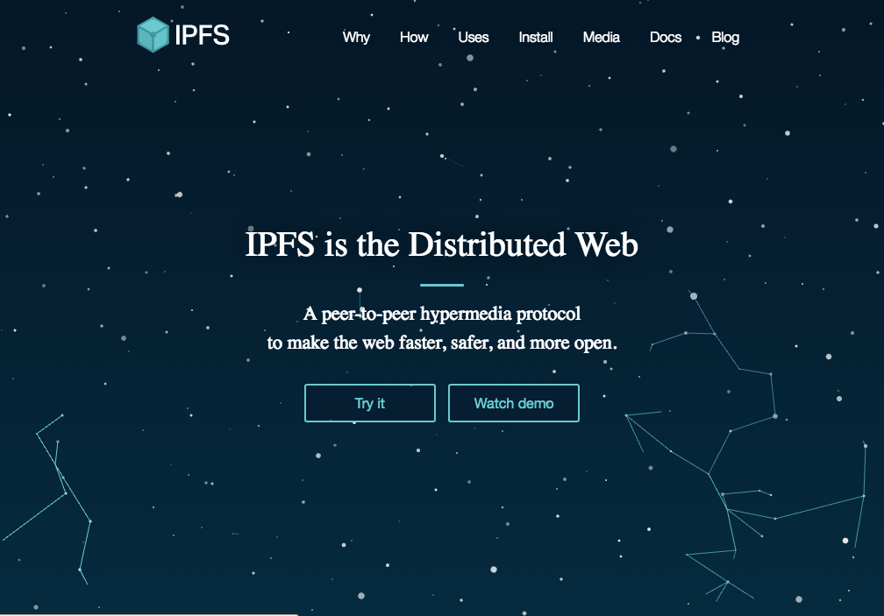

Slide 7
Live Demo
[546]ddye@corax:MapBox$ pwd
/Users/ddye/Projects/JedSet/MapBox
https://github.com/ipfs/examples/tree/master/examples/ipns
Mutable Data Problem and the InterPlanetary Naming System (ipns)
[504]ddye@corax:JedSet$ ipfs name resolve QmesYARR72Wgmm6TuhW8itcY82jeDr39NyWowteoreTgkb
/ipfs/QmZoqRcfXXVvQBgMWyJUSEy5uwqAodwSdDwRQpAo3Z3qux
[503]ddye@corax:JedSet$ dig ipfs.corvusintel.com txt
; <<>> DiG 9.8.3-P1 <<>> ipfs.corvusintel.com txt
;; global options: +cmd
;; Got answer:
;; ->>HEADER<<- opcode: QUERY, status: NOERROR, id: 53351
;; flags: qr rd ra; QUERY: 1, ANSWER: 1, AUTHORITY: 2, ADDITIONAL: 2
;; QUESTION SECTION:
;ipfs.corvusintel.com. IN TXT
;; ANSWER SECTION:
ipfs.corvusintel.com. 600 IN TXT "dnslink=/ipfs/QmesYARR72Wgmm6TuhW8itcY82jeDr39NyWowteoreTgkb"
http://gateway.ipfs.io/ipns/ipfs.corvusintel.com

