Slide 1
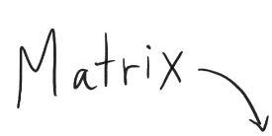
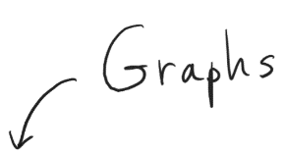
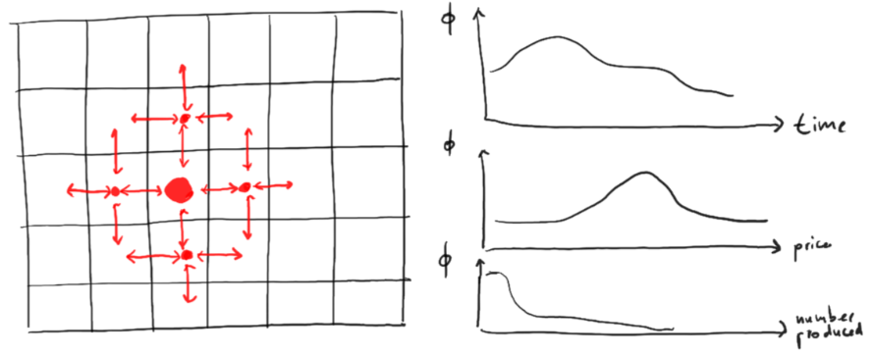
Fashion Trends Spreading in Society
In order to optimize the profit of selling a certain product in a social system, what sensitive marketing parameters have to be implemented and adjusted to achieve this goal?
Research Issue
Mechanism of the distribution of products in economy
Usefulness vs. trendiness
Research Strategy
Definition of a response variable ɸ = ɸ(t, p, n, …)
Definition of the interactions between people:
  Cellular automata
  P = P(t, p, n, …)
Implications and Significance
Comprehend the trends of fashion
Implementation of strategy to optimize profit
Distinguishing between need and desire

