Slide 1



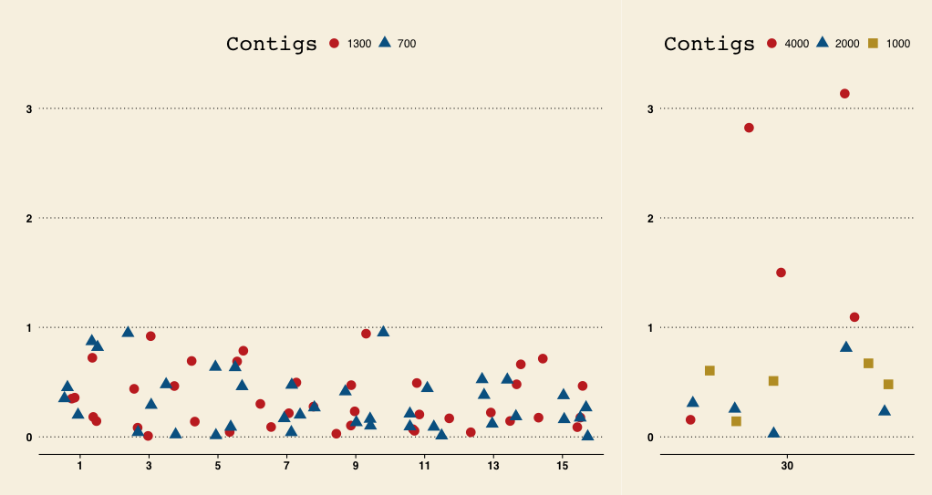

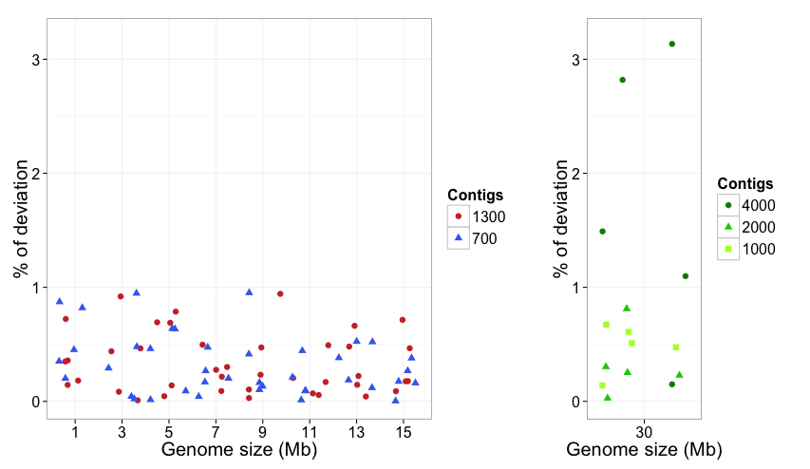
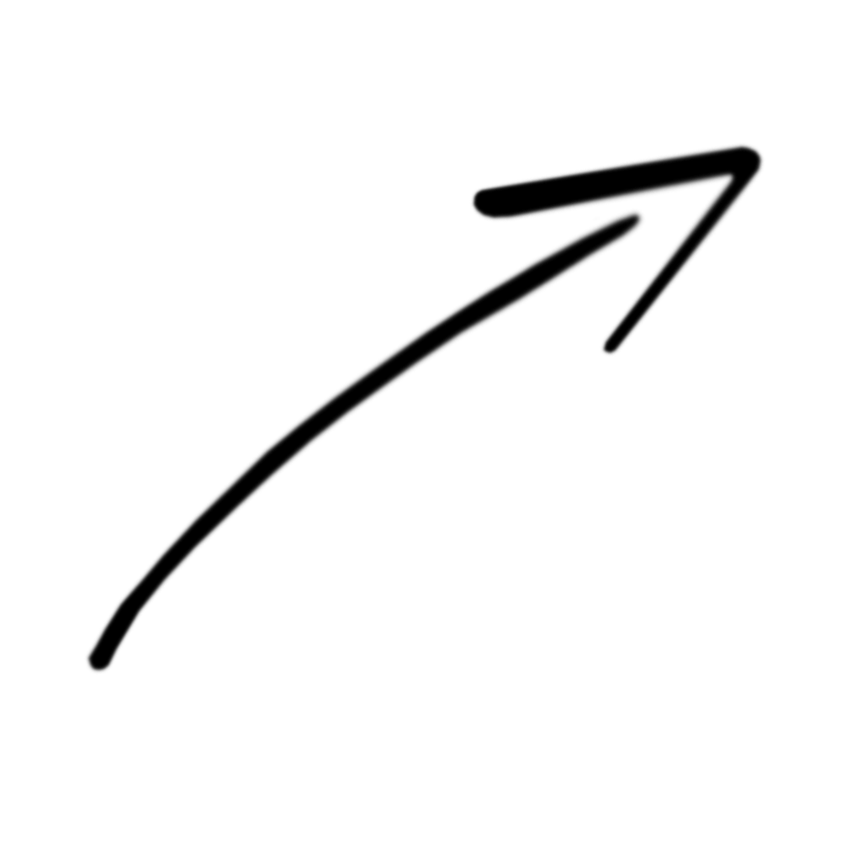


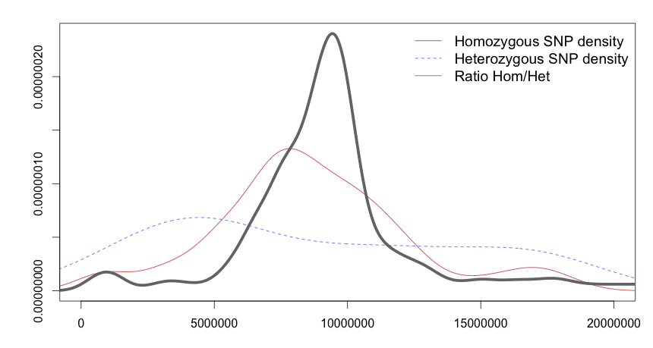
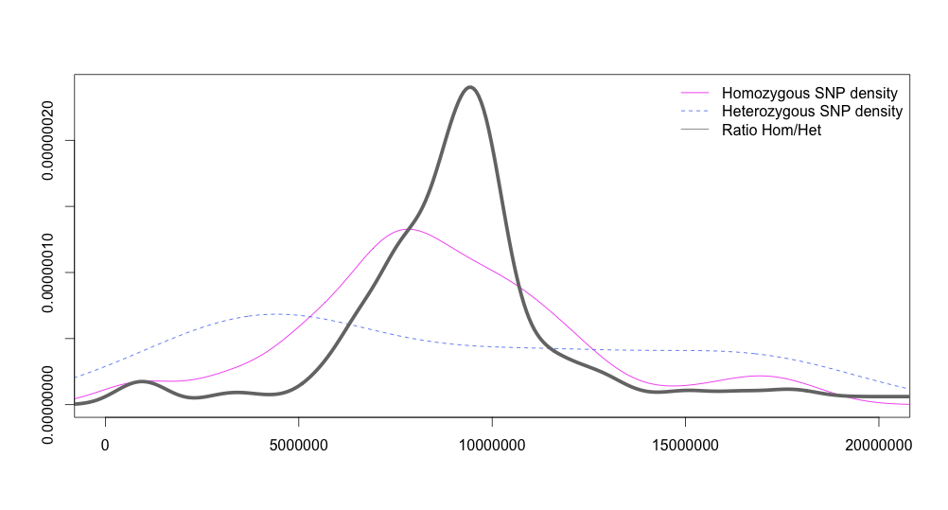
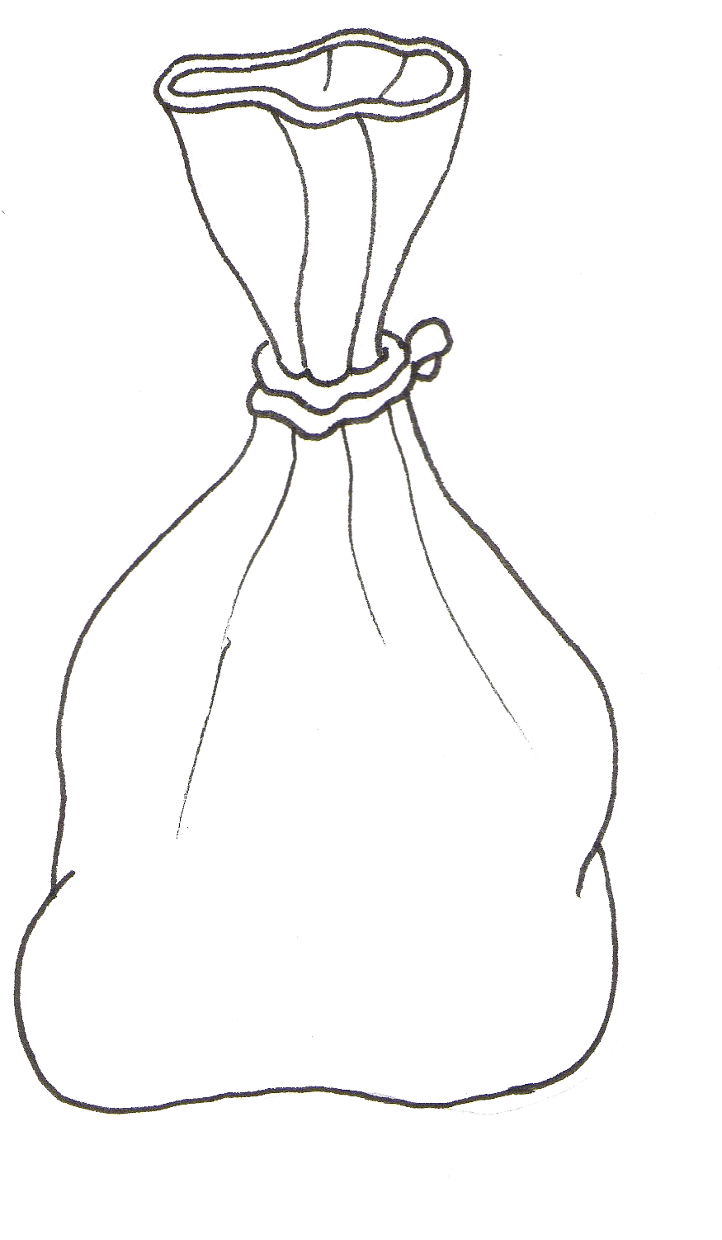
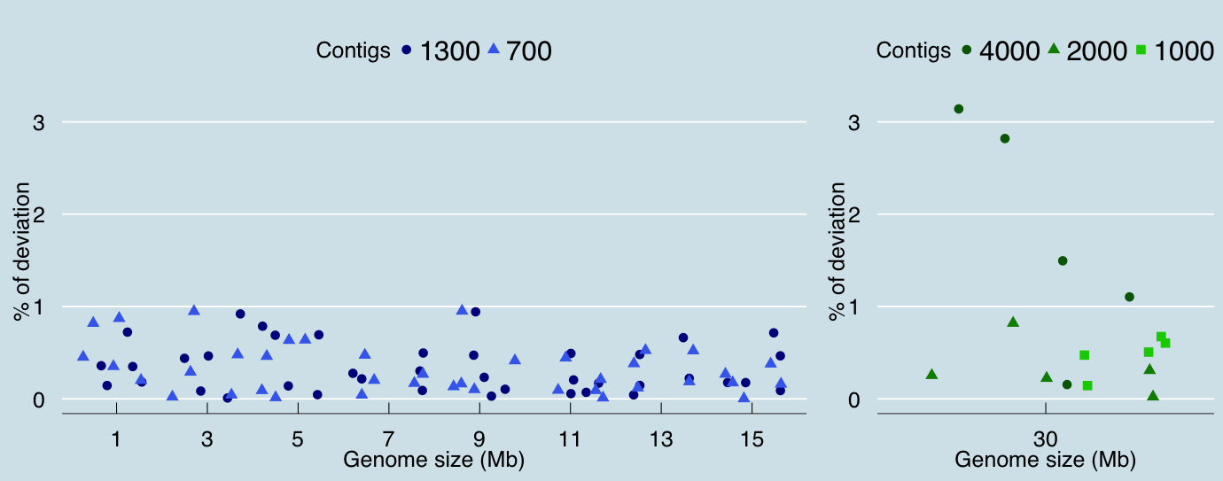
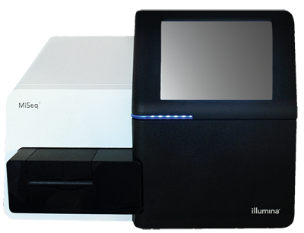
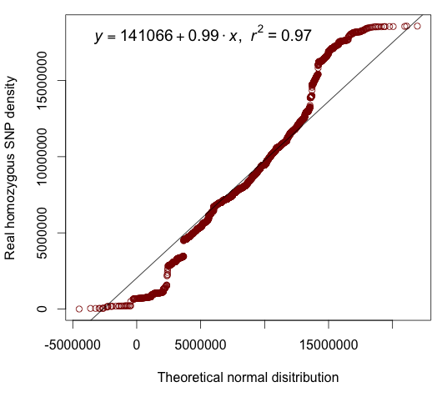
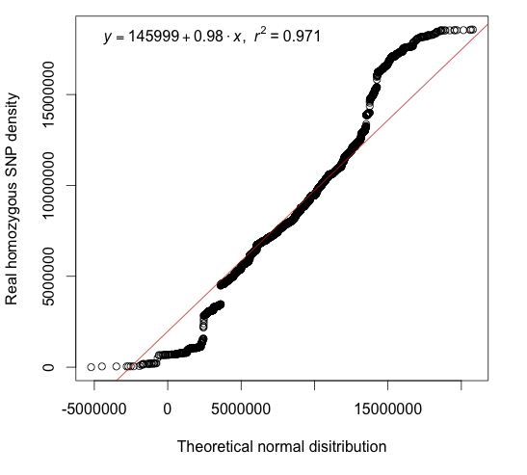
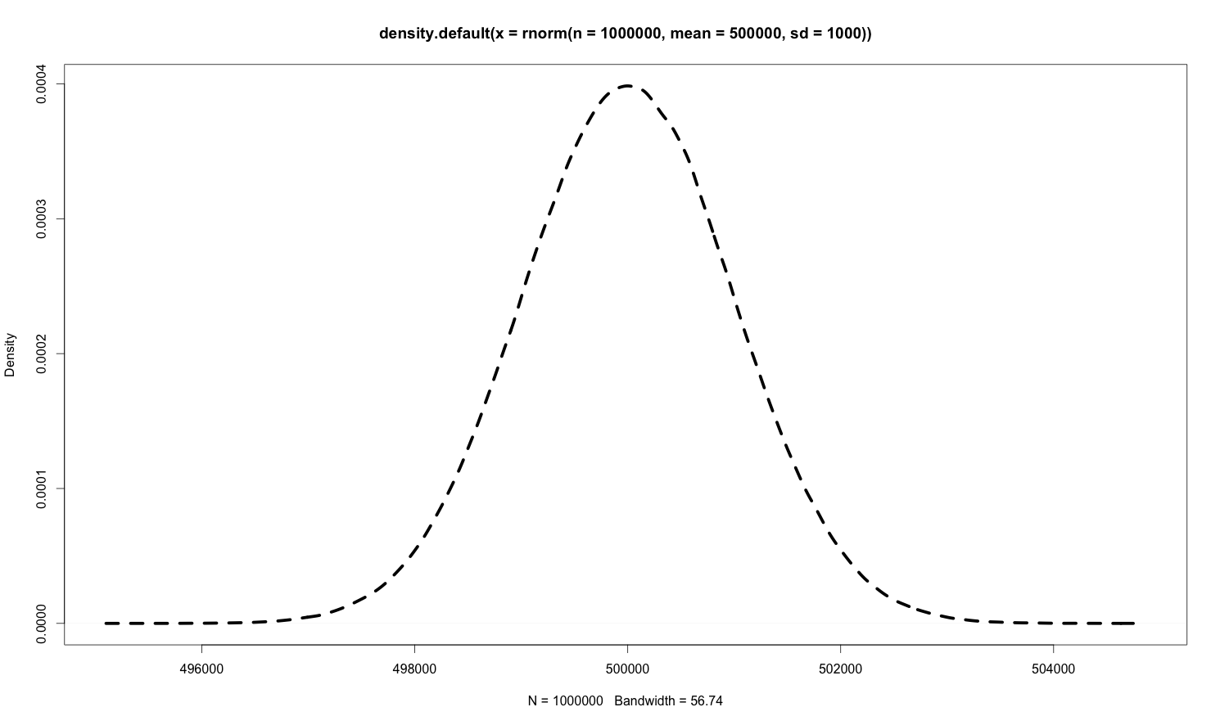

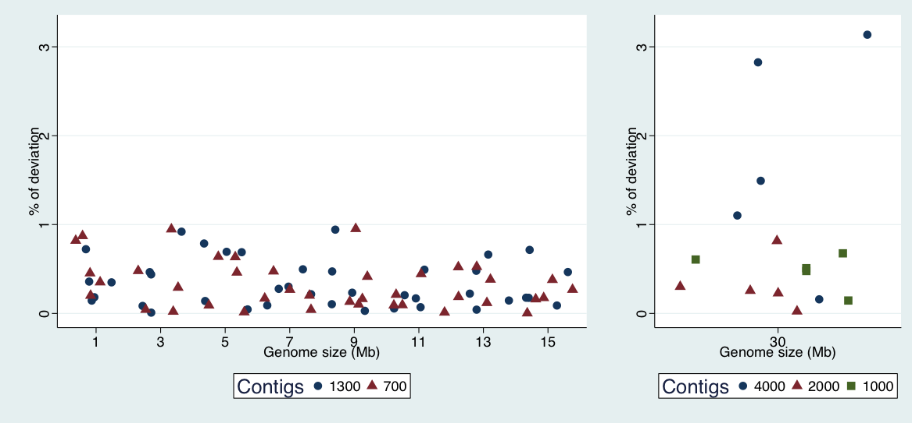
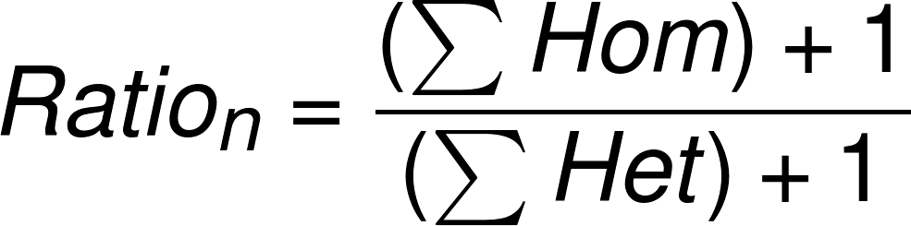
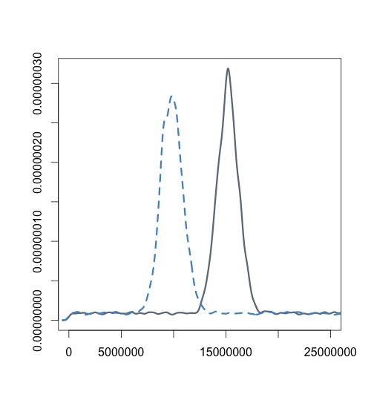
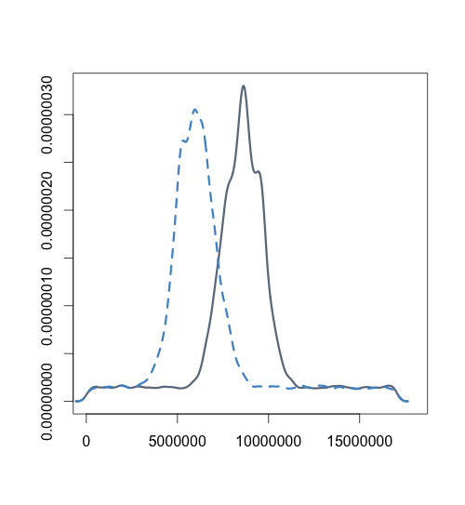
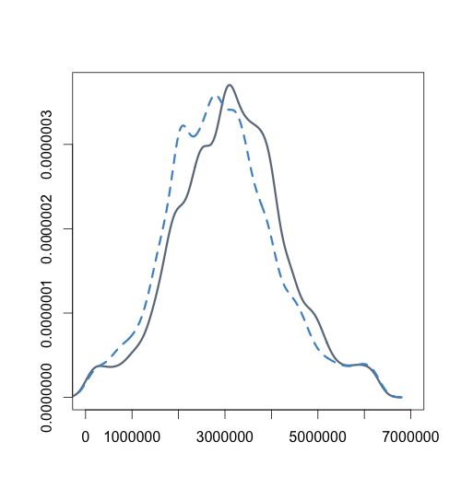
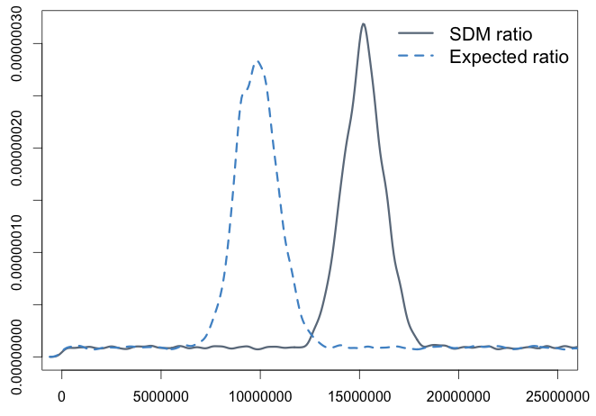
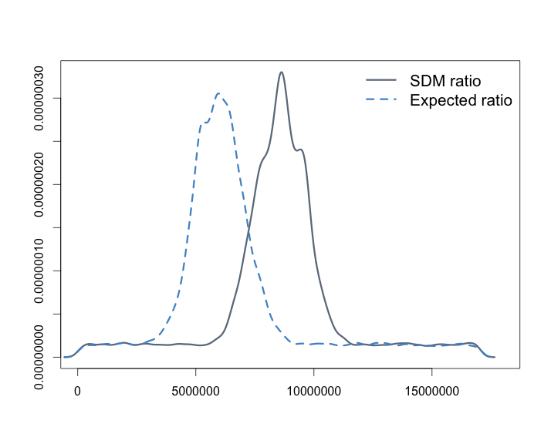
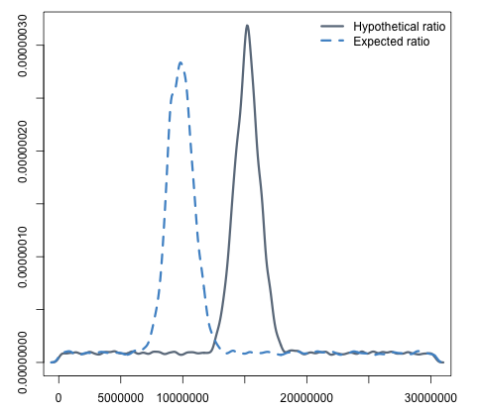
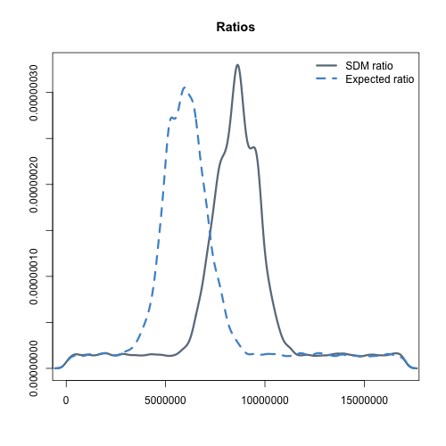
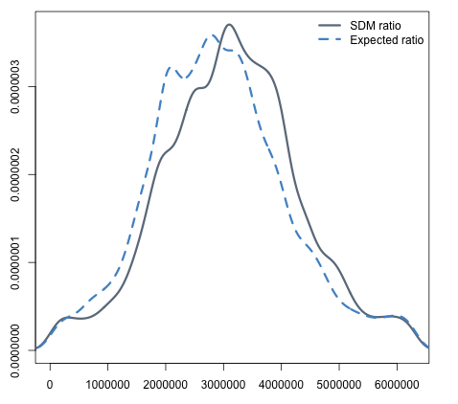
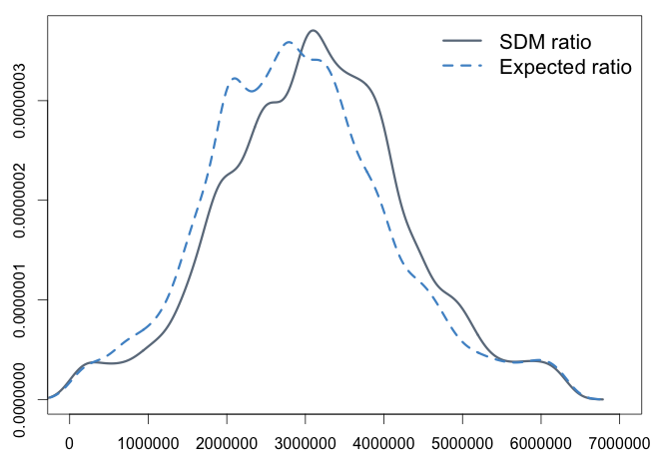
Identification of genomic regions carrying a causal mutation in unordered genomes
I'm a predoctoral intern at The Sainsbury Laboratory doing Bioiformatics in Team MacLean.
/pilarcormo/
SNP_Distribution_method
Pilar Corredor Moreno, Ghanasyam Rallapalli, Carlos A. Lugo, Dan MacLean
The Sainsbury Laboratory, Norwich, UK
@PilarCorMo
Pilar.Moreno@tsl.ac.uk
EMS
Motivation
SNP density plots revealed the homozygous SNP linkage around the causative mutation causing a high homozygous to heterozygous ratio signal where the mutation is located
Mutant
x
Mapping line
Forward genetic screens have been a fundamental strategy to find genes involved in biological pathways in model species. Mutagenized individuals with a phenotype of interest are isolated and a recombinant mapping population is created by back-crossing to the parental line or out-crossing to a polymorphic ecotype.
The recombination frequency between the causal mutation and nearby genetic markers is low, so the alleles of these genetic markers will co-segregate with the phenotype-altering mutation while the remaining unlinked makers segregate randomly in the genome. Hence, allele distribution analysis can uncover these low recombinant regions to identify the location of the causal mutation.
Traditional genetic mapping is a work intensive and time-consuming process but recent advances in high-throughput sequencing (HTS) have greatly accelerated the identification of mutations underlying mutant phenotypes in forward genetic screens. In the last few years, researchers have developed user-friendly tools for mapping-by-sequencing, yet they are not applicable to organisms with non-sequenced genomes.
Forward genetic screens have been a fundamental strategy to find genes involved in biological pathways in model species. In these a population is treated with a mutagen that alters the DNA of individuals in some way, then individuals with a phenotype of interest are isolated from a mutagenized population and a recombinant mapping population is created by back-crossing to the parental line or out-crossing to a polymorphic ecotype [@Etherington:2014]. The recombinant population obtained from that cross will segregate for the mutant phenotype and individuals showing the mutant phenotype will carry the causal mutation, even if the genomic location is unknown. The recombination frequency between the causal mutation and nearby genetic markers is low, so the alleles of these linked genetic markers will co-segregate with the phenotype-altering mutation while the remaining unlinked makers segregate randomly in the genome [@Schneeberger:2014aa]. Hence, the allele distribution analysis can unhide these low recombinant regions to identify the location of the causal mutation. This process of genetic analysis is often referred to as bulk segregant analysis (BSA) [@Michelmore:1991aa].
Traditional genetic mapping is a work intensive and time-consuming process but recent advances in high-throughput sequencing (HTS) have greatly accelerated the identification of mutations underlying mutant phenotypes in forward genetic screens. Several methods as SHOREmap [@Schneeberger:2009], [@Sun:2015], NGM [@Austin:2011] or CandiSNP [@Etherington:2014] based on bulked-segregant analysis of F2 progeny have succeed in the mutant identification in *Arabidopsis thaliana*. All these methods depend on an assembled reference genome and cannot be used in species for which a reference genome is not available. Some alternative solutions as using reference sequences of related species have been proposed [@Wurtzel:2010], [@Livaja:2013aa], but these need low sequence divergence and high levels of synteny between the mutant reads and the related reference sequence and this has restained the application of this approach [@Schneeberger:2014aa],[@Nordstrom:2013aa].
Substantial effort is being made to sequence many species but reasonable completion of a sequence remains expensive and time-comsuming, and fragmented draft genomes present certain limitations in use for mutation mapping in many circumstances.
We propose SDM (SNP Distribution Method), a fast causative mutant identification method based on a simple reference-free contig assembly that allows the detection of candidate causative SNPs. Instead of relying on a genome comparison, we focus on the SNP linkage around the causal mutation and analyse the SNP distribution to identify the chromosome area where the putative mutated gene is located. SDM does not rely on previously known genetic markers and can be used on extremely fragmentary genome assemblies, even down to the level of long reads.
F1
F2
NGS
Homozygous SNPs are normally distributed around the causal mutation!
Contig assembly
We used a set of unordered contigs and the ideal SNP distribution as starting point for SDM. We created
SNP calling
Causative mutation identification without a reference genome
SNP Distribution Method
Modelling
Model genomes are useful to help us developing our method and identifying its limitations. By using idealised SNP distributions, we can predict where a mutation is going to be located and estimate the deviation of SDM from this expected position. A normal distribution was used for the homozygous SNPs while heterozygous SNPs followed a uniform distribution. We created different model genomes based on Arabidopsis thaliana chromosome 1. We tested the effect of genome length and contig size on SDM performance.
SNPs per contig in VCF file
Contigs in FASTA file
Input
The SNP Distribution Method (SDM) is an approach for fast causative mutant identification based on a simple reference-free contig assembly that allows the detection of candidate causative SNPs. Instead of relying on a genome comparison, it focuses on the SNP linkage around acausal mutation and analyses the SNP distribution to identify the chromosome area where the putative mutated gene is located.
Calculate homozygous to heterozygous SNP ratio on each contig
Pre-SDM filtering step
If the filtering step is required, the threshold astringency is provided as an integer (1, 5, 10, 20). Each integer represents the percentage of the maximum ratio below which a contig will be discarded.
Discard contigs with a ratio below a given percentage of the maximum ratio
Options
>1% maximum ratio
>2% maximum ratio
>10% maximum ratio
>20% maximum ratio
Normalise homozygous SNP density by contig length
SDM
We define the homozygous to heterozygous SNP ratio on contig n as:
Options
>1% maximum ratio
>2% maximum ratio
>10% maximum ratio
>20% maximum ratio
Sort contigs by their SNP density based on a normal distribution
3.5
4
2
2.5
1.5
Contigs that are located furtheraway from the causal mutation have a constant homozygous SNP density due to recombination. The low ratio in these regions is used as a filter to focus on the genomic region where the mutation is likely to be found. Contigs with a ratio falling below a given percentage of the maximum ratio will be discarded.
5
1
1.5
1
Filter contigs with a ratio falling below 1% of the maximum ratio
while a value of 20 is more astringent will discard those contigs with a ratio falling below 20% of the maximum ratio.
o
Prioritized candidate contigs carrying the causal mutation
Comparison of theoretical ratio
and SDM ratio
FASTA file with the suggested contig order
Output
1%
2%
20% of the model genome
Take home
1
1.5
2
4
5
3.5
2.5
1.5
1
50% of the model genome
Forward genetic screens are very useful to identify genes responsible for particular phenotypes.
Homozygous SNPs are normally distributed in the mutant genome of back-crossed and out-crossed individuals. We defined a theoretical SNP distribution used by SDM to identify the genomic region where the causative mutation is located.
SDM does not rely on previously known genetic markers and can be used on extremely fragmented genome assemblies, even down to the level of long reads.

