Slide 1

Introduction to Galaxy
Galaxy is an open, web-based platform for integrating computing tool for accessible, reproducible, and transparent computational biological research.
Galaxy is a scientific workflow system.
Can installed in local computer, network server computer or cloud server computer
Usegalaxy.org
Usegalaxyp.org

Slide 2
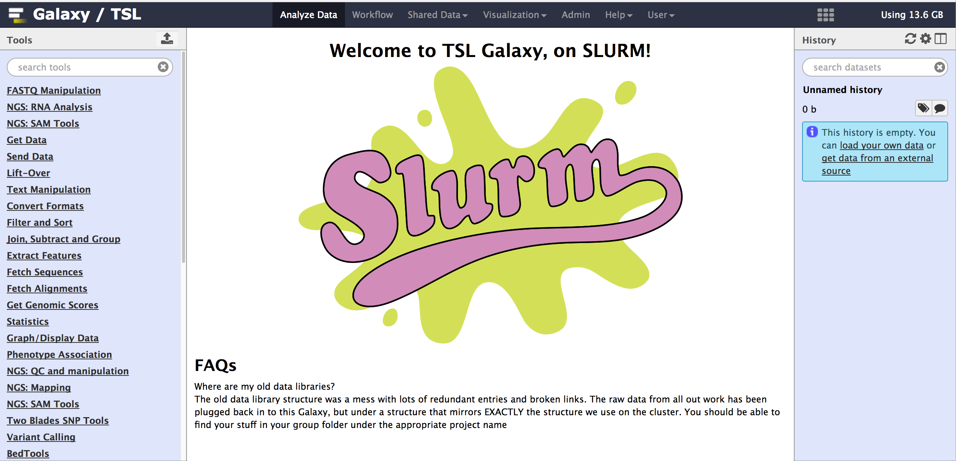
TSL Galaxy Web Interface

Slide 3
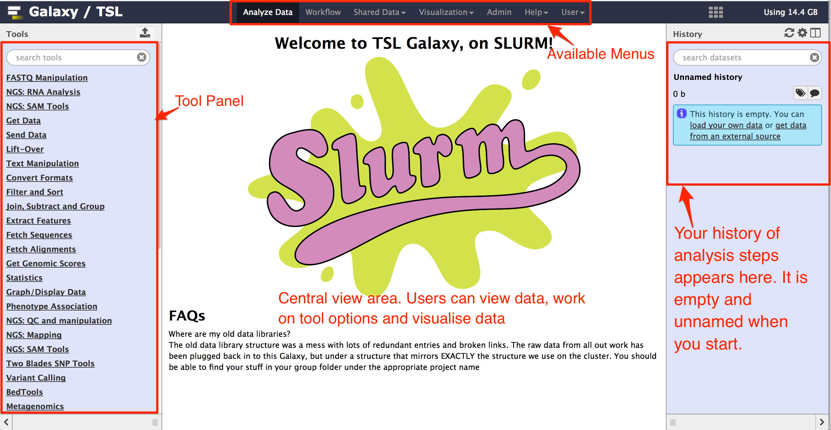
TSL Galaxy Web Interface

Slide 4
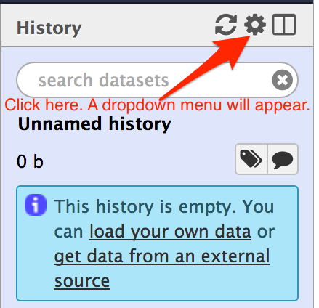
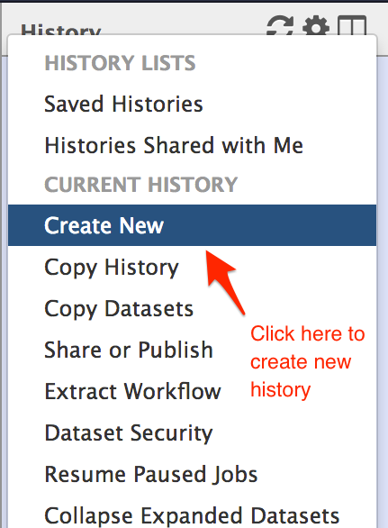
Create a History
1
2

Slide 5
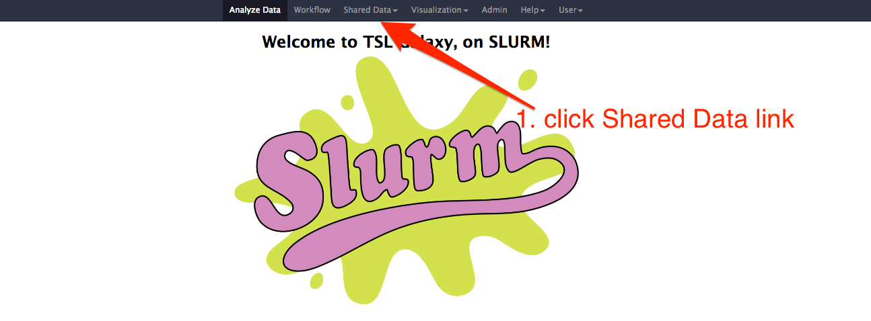
Upload built-in dataset

Slide 6
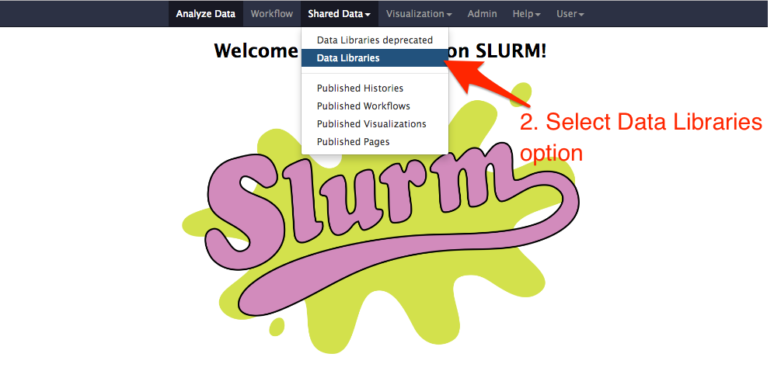

Slide 7
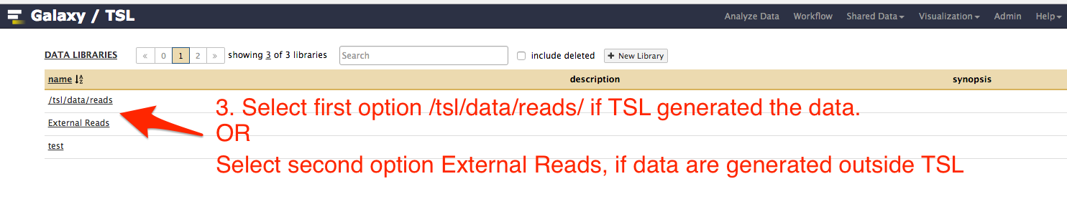

Slide 8
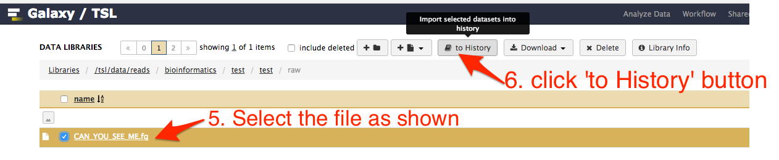

Slide 9
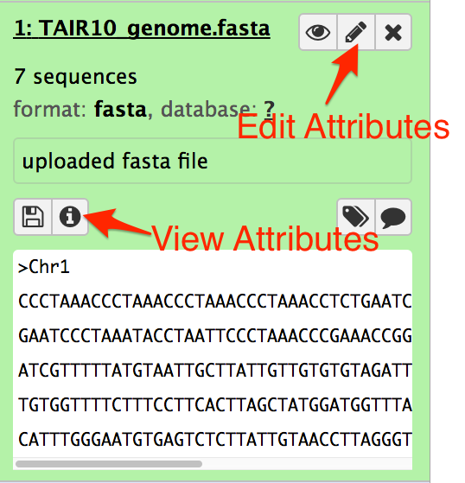
Data Attributes
Data attributes are the information related to the data.
You can view and edit the attributes.

Slide 10
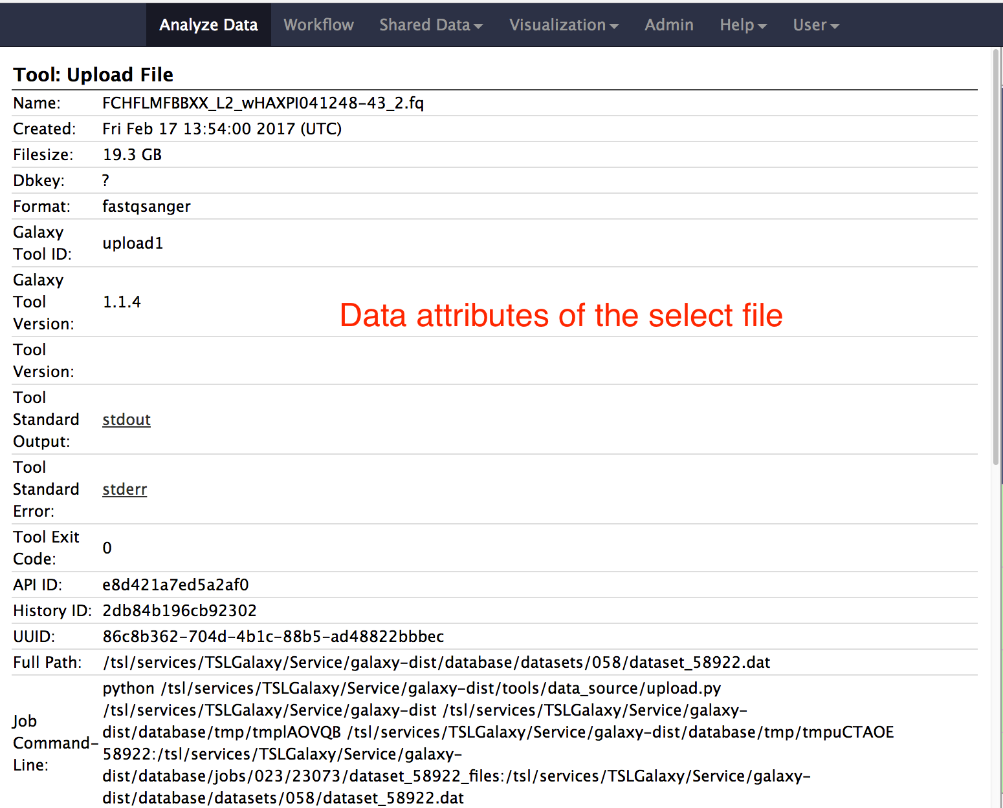
Click view attributes of a dataset. Information are shown as below.

Slide 11
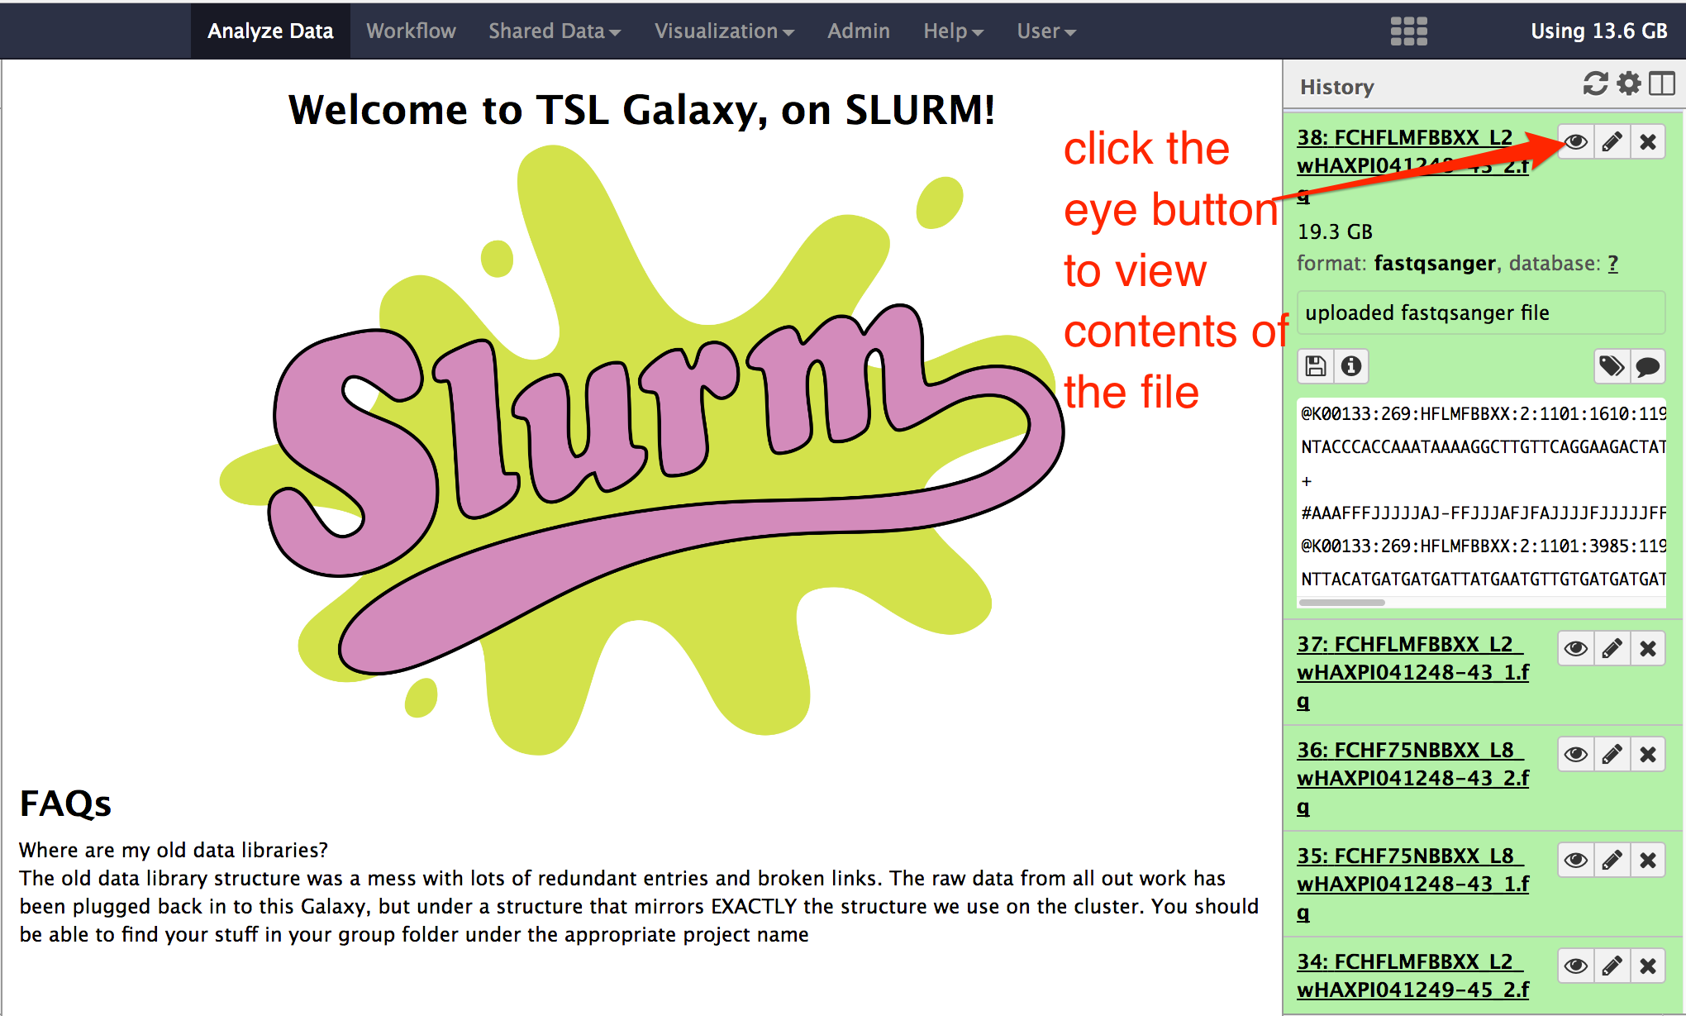
View file contents

Slide 12
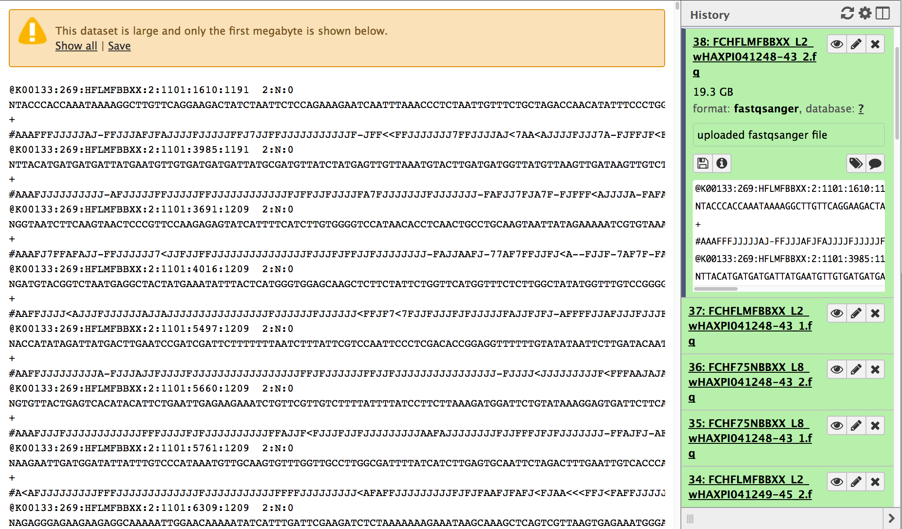
If the file is large, only the first 1 MB of dataset is displayed.

Slide 13
FASTQ Grooming
FASTQ grooming means converting quality score encoding.
FASTQ sanger format is the standard encoding now.
For more information about other encodings, check here:
https://en.wikipedia.org/wiki/FASTQ_format#Encoding

Slide 14
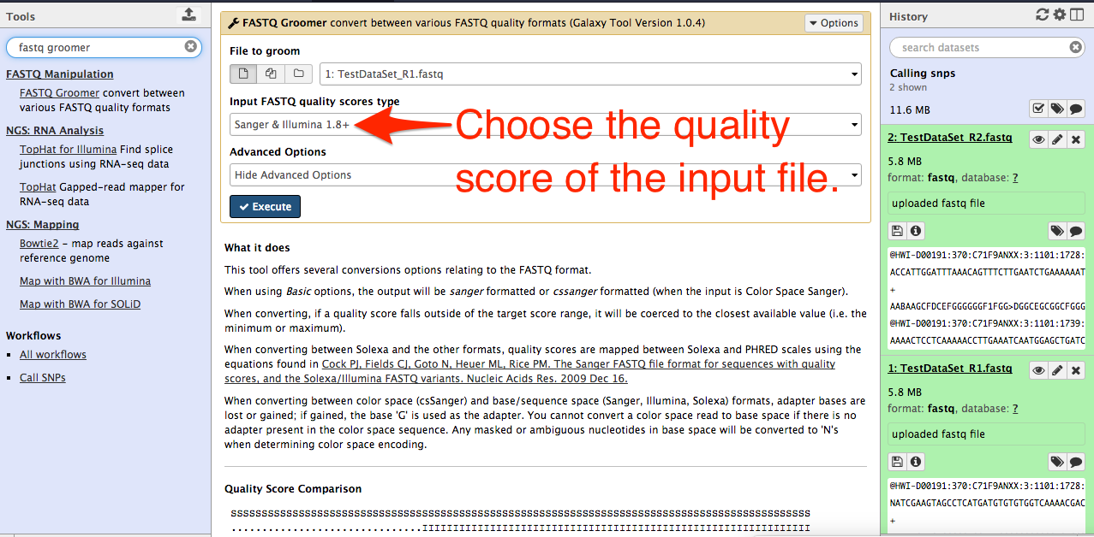
Select or search FASTQ groomer tool in tool panel
In the form, select FASTQ file to groom
Execute

Slide 15
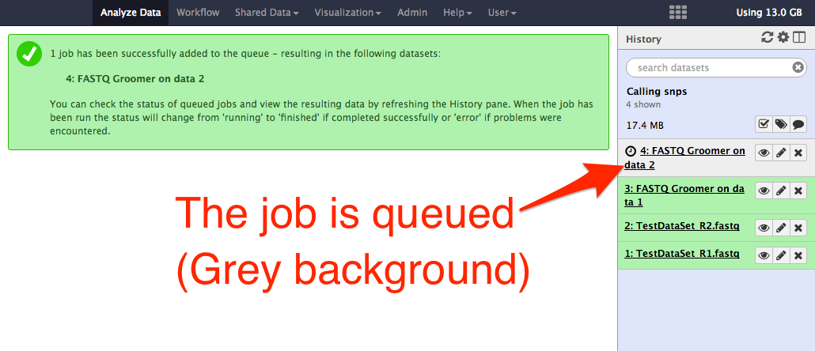
When job is executed, the request goes to HPC cluster.
The job gets queued (grey background)
The job undergoes processing (yellow background)
The job processing completes (green background)
If job fails, the background color changes to red.

Slide 16
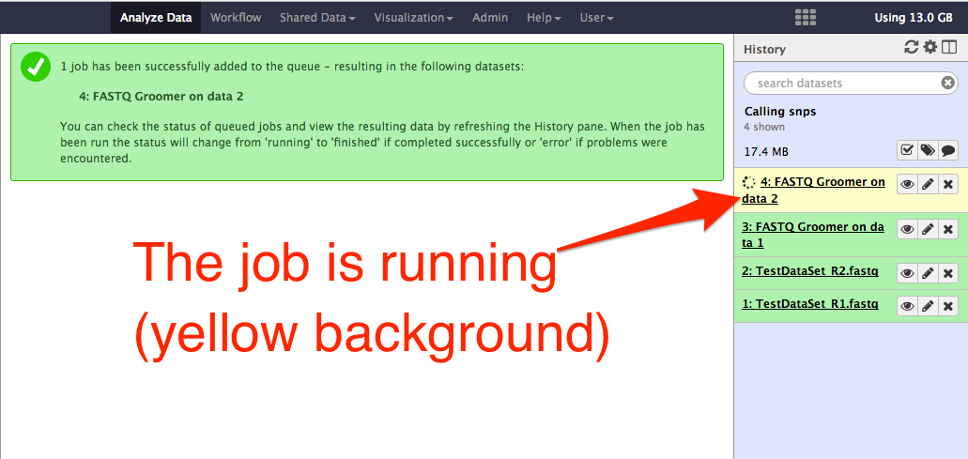

Slide 17
