Slide 1
Pre-presentation on
Using Machine Learning Models to Classify Pneumonia from X-Ray Images
● Supervisor ●
● Team Member ●
Tasnim Zahan
Assistant professor
Department of CSE
North East University Bangladesh
Md. Abdul Mutalib (190303020001) Shahriar Hussain (190303020008)
Kopil Das (190303020009)

Slide 2
01
Introduction
02
Methodology
CONTENTS
03
Discussion
04
Reference

Slide 3
01
Introduction

Slide 4




Introduction
Pneumonia
Challenges
Pneumonia is the fourth leading cause of death worldwide, and COVID-19 has highlighted the importance of accurately diagnosing pneumonia.
Access to healthcare professionals who can diagnose pneumonia from X-ray images is a challenge in many parts of the world, creating significant inequality in access to healthcare.
Pneumonia Detection
Improve Healthcare Equity
This Template Is Designed By Zuo An,It Will Help You Make You Report Easy And Fast.
This Template Is Designed By Zuo An,It Will Help You Make You Report Easy And Fast.

Slide 5
02
Methodology

Slide 6
Methodology
On going work:
Image Preprocessing
SVM Classifier
Naive Bayes Classifier
Transfer Learning Based Classifier
Future work:
CNN Classifier

Slide 7
Data Set
Used chest X-ray scan datasets from Kaggle (5856 images)
Split data into training(4099 images), validation(878 images), and testing sets(879 images)

Slide 8
Image preprocessing
Images resized into 100 x 100
Converted RGB to Gray Scale
Data augmentation
Data augmentation is the processess of artifically increasing the size of a traning dataset.
Transformations:
Random Flip
Rotation
Translation

Slide 9
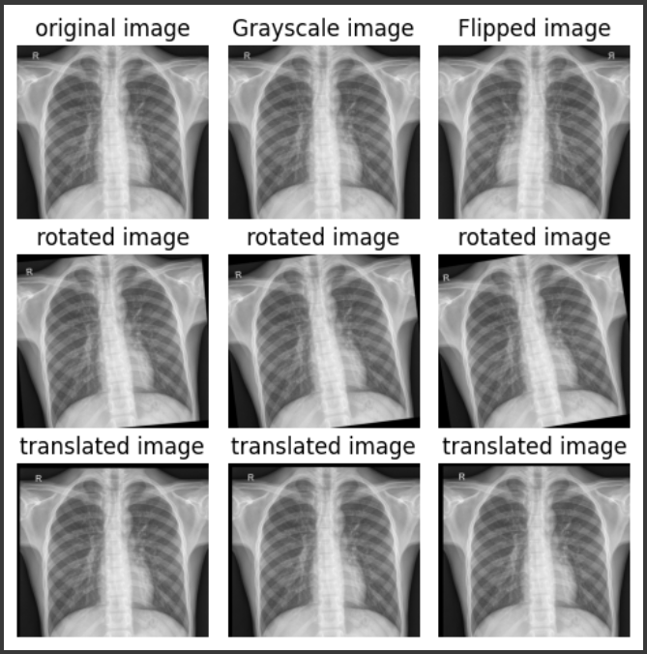
Augmented Images

Slide 10
03
Discussion

Slide 11
Transfer Learning Based Classifier
Transfer learning is a technique where a pre-tranied model is used.
Pre-tranied model
DenseNet 161

Slide 12
Naive Bayes Classifier
Dataset pre-processing: grayscale conversion and image resizing to 100 x 100 pixels
Naive Bayes requires feature extraction for image classification
Two techniques were experimented with: DCT and LBP
DCT is commonly used in image compression

Slide 13
SVM Classifier
SVM model is commonly used for classification
We wiil use three kernels: linear, degree 3 polynomial, and radial basis function (rbf).
SVMs find a line/hyperplane that separates data points of both classes, with the widest margin to the nearest data points of each class.
We will use DCT, HOG, LBP as a feature extraction technique to fit the model

Slide 14
04
References

Slide 15
References
Lerner, A., O'Rahilly, O., & den Otter, J. (2021). Using Machine Learning Models to Classify Pneumonia from X-Ray Images. Retrieved from [https://cs229.stanford.edu/proj2021spr/report2/81999851.pdf].
Kundu, Rohit, et al. "Pneumonia detection in chest X-ray images using an ensemble of deep learning models." PloS one 16.9 (2021): e0256630.
Zhou, Changjian, et al. "COVID-19 detection based on image regrouping and ResNet-SVM using chest X-ray images." Ieee Access 9 (2021): 81902-81912.
Park, Dong-Chul. "Image Classification Using Naive Bayes Classifier." International Journal of Computer Science and Electronics Engineering (IJCSEE) 4, no. 3 (2016).
Huang, Gao, et al. "Densely connected convolutional networks." Proceedings of the IEEE conference on computer vision and pattern recognition. 2017.

