Slide 1
“X-ray and Eye-disease Image Prediction System”
Supervisor:
Tasnim Zahan
Assistant professor
Department of CSE
North East University Bangladesh
Team Member:
Md. Abdul Mutalib (190303020001) Shahriar Hussain (190303020008)
Kopil Das (190303020009)

Slide 2
Presentation Outline
Previous work.
Another Dataset
Support Vector Machine
Model description
Normalization
Web Application

Slide 3
Previous work on Pneumonia dataset
Our three models | It’s accuracy
Naïve Bays | 83.97%
SVM | 76.44%
Transfer Learning | 88.54%

Slide 4
Another Dataset
About eye-disease dataset
4217 images from Kaggle.
It has 4 classes
Normal
Cataract
Diabetic retinopathy
Glaucoma
Divided it into three categories
Training(80%)
Validation(10%)
Test(10%)

Slide 5
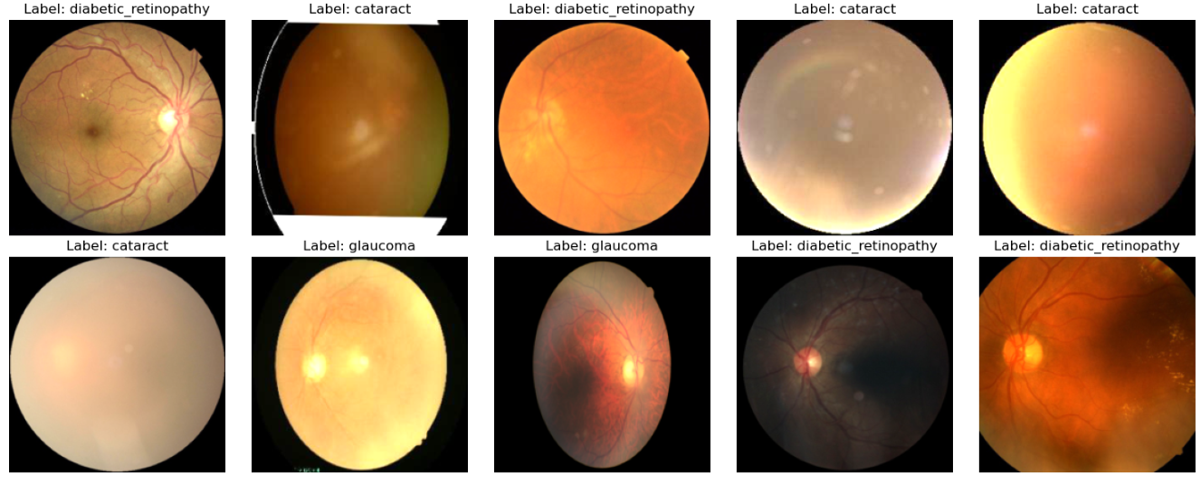
Eye-Disease dataset images Before preprocessing

Slide 6
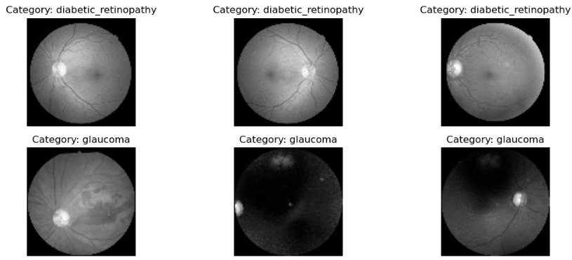
Eye-Disease dataset images Before preprocessing

Slide 7
Support Vector Machine
SVM model is commonly used for classification
It can handles binary and multi-class problems.
SVMs find a line/hyperplane that separates data points of both classes, with the widest margin to the nearest data points of each class.
We will use HOG, LBP as a feature extraction technique to fit the model

Slide 8
Feature Extraction Method-1: HOG
HOG-Histogram Oriented Gradient
Captures shape and edge information in images
Divides image into cells and computes gradient orientations
Parameters: orientations, pixels per cell, cells per block, transform square root, normalize
Constructs feature vector representing local patterns and textures
Accuracy 78.29%

Slide 9
Feature Extraction Method-2: LBP
LBP-Local Binary Pattern
Compares pixel intensities within local neighbouring pixels
Encodes comparisons as binary patterns
Constructs histograms of binary patterns for texture representation
Accuracy 71.36%

Slide 10
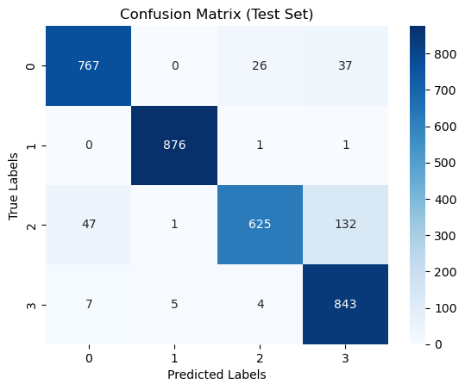
Confusion Matrix of HOG

Slide 11
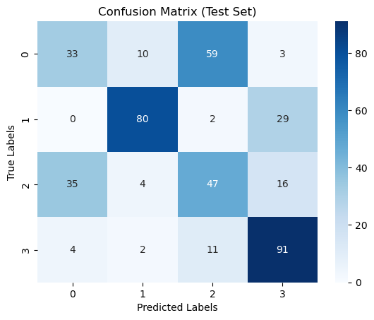
Confusion Matrix of LBP

Slide 12
Integration With Web Application
Our models seamlessly integrates with our Streamlit-based web application.
This integration enhances the application's versatility, allowing users to choose between different machine learning models for disease predictions.

Slide 13
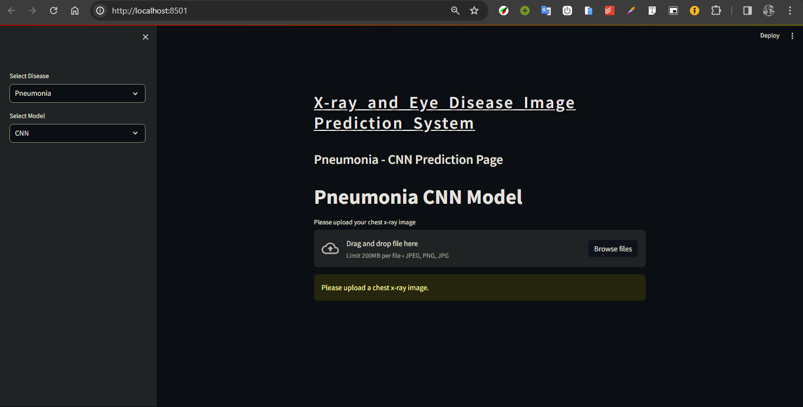
Screenshots of our Application

Slide 14
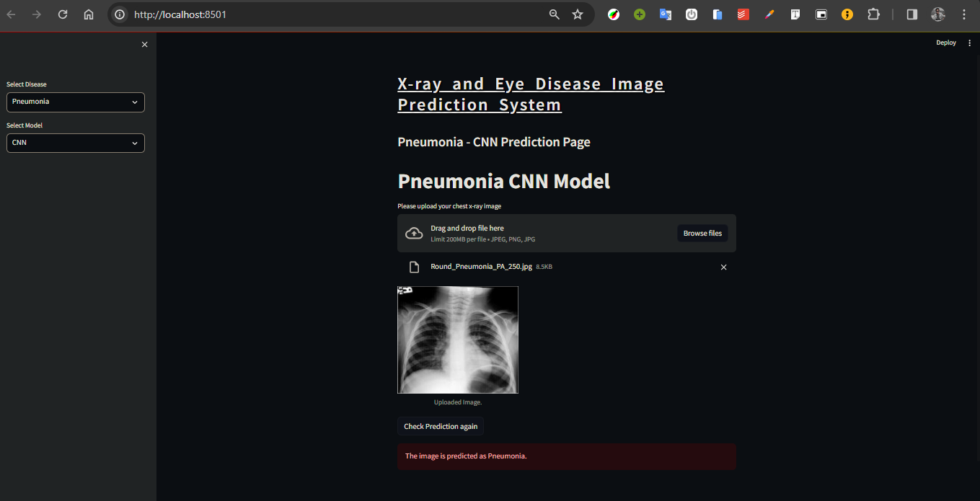
Screenshots of our Application

Slide 15
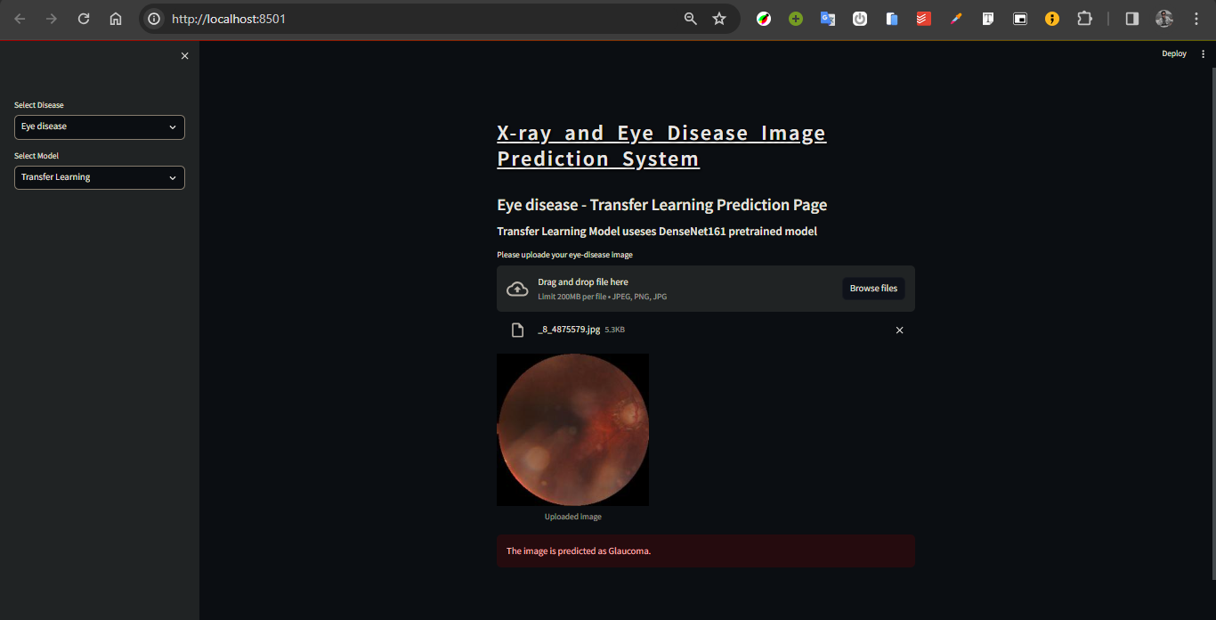
Screenshots of our Application

Slide 16
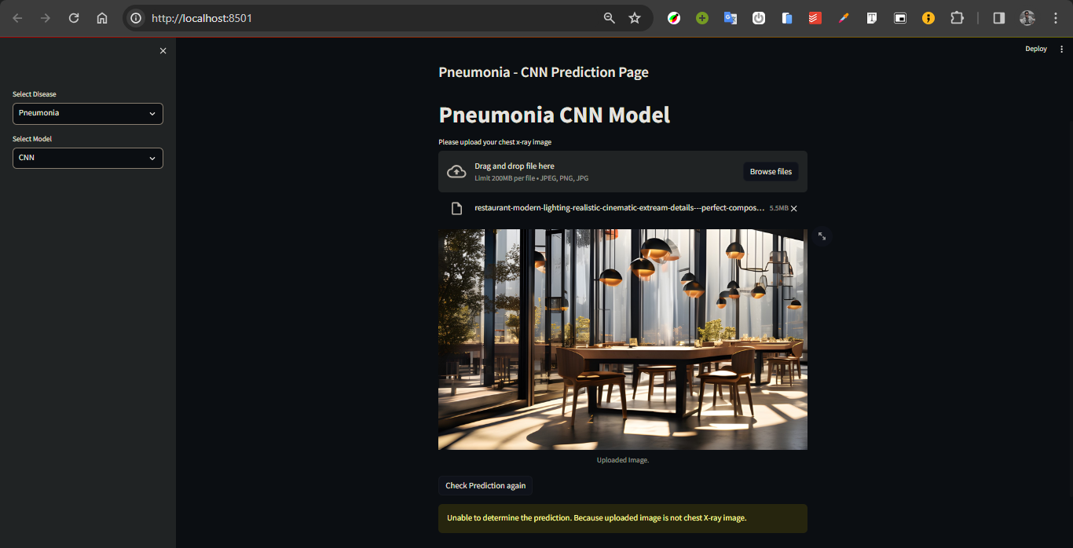
Screenshots of our Application

Slide 17
References
[1]Caselles V., Lisani L., Morel M., and Sapiro G., “Shape Preserving Local Contrast Enhancement,” in Proceedings of International Conference Image Processing, pp. 314 317, 1997.
[2]Chen, S.D., Ramli, A.R., “Contrast enhancement using recursive mean-separate histogram equalization for scalable brightness preservation”, IEEE Trans. on Consumer Electronics, vol. 49, no. 4, pp. 1301–1309, 2003.
[3] R.C. Gonzalez and R.E. Woods. Digital Image Processing. Prentice Hall, Upper Saddle River, New Jersey, EUA, 3nd edition, January 2008.
[4]Ain, Qurat-ul, et al. "Bayesian classification using DCT features for brain tumor detection." International Conference on Knowledge-Based and Intelligent Information and Engineering Systems. Berlin, Heidelberg: Springer Berlin Heidelberg, 2010.
[5].Park, Dong-Chul. "Image Classification Using Naive 287 Bayes Classifier." International Journal of Computer 288 Science and Electronics Engineering (IJCSEE) 4, no. 289 3 (2016)
[6]Huang, G., Liu, Z., Van Der Maaten, L. and Weinberger, K.Q., 2017. Densely connected convolutional networks. In Proceedings of the IEEE conference on computer vision and pattern recognition (pp. 4700-4708).
[7]Wang, K., Jiang, P., Meng, J., & Jiang, X. (2022). Attention-based DenseNet for pneumonia classification. IRBM 43: 479–485.
[8]NASSIH, B., AMINE, A., NGADI, M., & HMINA, N. (2019). “DCT and HOG Feature Sets Combined with BPNN for Efficient Face Classification.” Procedia Computer Science, 148, 116-125
[9]Babaqi, T., Jaradat, M., Yildirim, A.E., Al-Nimer, S.H. and Won, D., 2023. Eye Disease Classification Using Deep Learning Techniques. arXiv preprint arXiv:2307.10501.

Slide 18
Thank You

