Slide 1
Technology Company Layoffs (2022-2023) Analysis
-By Team Neural Network
INSIGHTS

Slide 2

PRESENTERS
Our Team
Abdulafeez Adefabi
Ebenmosi Iyela
OTHER ACTIVE MEMBERS
LEADS
Ajaero Solomon | Blessing Ukpai
Nidhey Shah | Sunday James
Gloriah Munyao | Christiana Otoboh
Faith Were
Team Lead- Bronch Mukami
Ass.Team Lead- Dipeolu Ayomide
Query Analyst- Pragati Thakur

Slide 3
Topics of Discussion
01
02
03
Problem Statement and objective
Existing Solutions
Dataset Description
04
05
06
Our Approach
Exploratory Data Analysis
Conclusion

Slide 4
Problem Statement and Objectives
Problem Statement
Objectives
The aim of this project is to use this data to gain insights on technology company layoff trends and make informed decisions. From Amazon, Microsoft, Google to Wayfair, the technology industry is currently shaken by massive layoffs since mid-2022.
The objective is to use Data Analysis and address these following questions:
Total layoffs per month and year?
How the IPO company status affected the layoffs?
Which 5 industries were most and least affected by the layoffs?
Which companies were most and least affected by the layoffs?
Which locations had the most and fewest layoffs?

Slide 5
Existing Solutions
Solution-1
Solution-2
One of the layoff case studies uses R-programming to focus on the percentage of workers laid off. While the case study provided solid statistical analysis, the dataset has more category-type variables, hence the approach does not provide proper answers to our challenges.
Other case studies used Python and Tableau to conduct data exploration and analysis. However, the data is inconsistent and was not correctly supplied with relevant options, making the study weak.

Slide 6





DataSet Description
DATA SOURCE
https://www.kaggle.com/datasets/salimwid/technology-company-layoffs-20222023-data
QUALITY
The data has unclear values for total count of laid off people for many Different Companies.
COLLECTION
The Data was collected Since Mid June-2022. For different Months.
FEATURES
A CSV file with
Number of Instances: 489
Number of Attributes: 9

Slide 7
Our Approach
Data Preprocessing
Data Transformation
Data Transformation
Data Quality
Data Collection
Data Cleaning
Due to inconsistency and unclear entries web scraping was done and another dataset was used with the kaggle dataset
After Data Transformation we have 1068 Fields which is double of initial record which increases the quality of data and consistency
Getting CSV File from Kaggle platform
Checking Missing Values, converting time frames, as well as checking Data Quality.

Slide 8
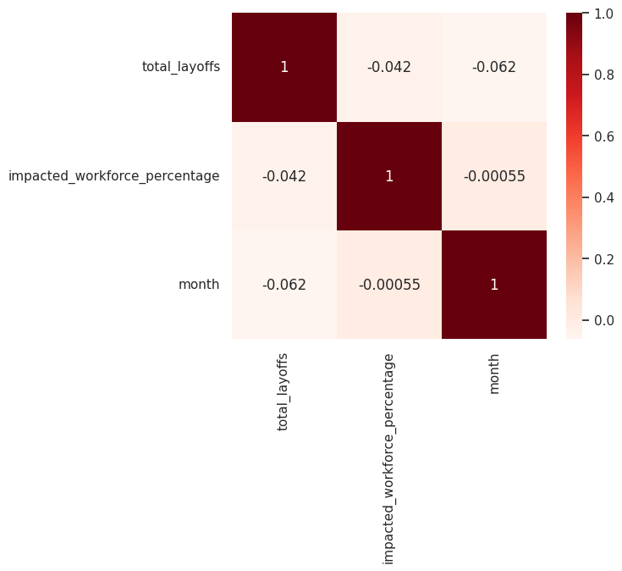
Exploratory Data Analysis
Correlation
Data Visualisation
Dashboard
A heat Map was plotted to find correlation among different attributes but no Correlation was found
To better understand the insights gained we made a dashboard using POWERBI .
Depending on different attributes to find effect of one on another different Bar plots were used.
From the heatmap Above, it can be seen that there is neither a positive nor a negative correlation between the variables.

Slide 9
Total layoffs per month and year?
Question-1
How the IPO company status affected the layoffs?
Question-2
Which 5 industries were most and least affected by the layoffs?
Question-3
Questions that were addressed during EDA
Question-4
Which companies were most and least affected by the layoffs?
Question-5
Which locations had the most and fewest layoffs?
Question-6
What is the Average trend Analysis of Layoffs?

Slide 10
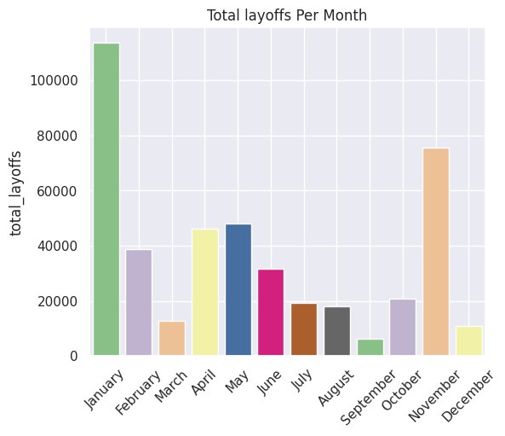
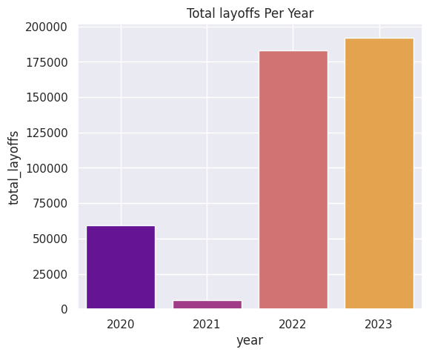
This illustration depicts total layoffs by month, with January having the largest amount of layoffs according to the study.
The bar chart below is used to determine the year in which most Employees were laid off. We can see that 2023 had the highest number of layoffs.

Slide 11
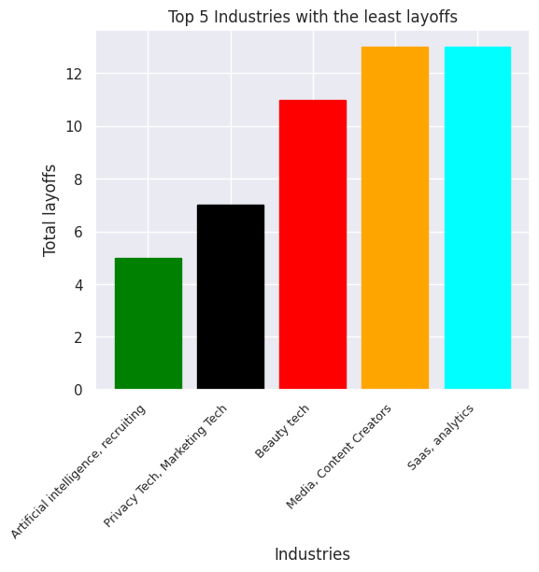
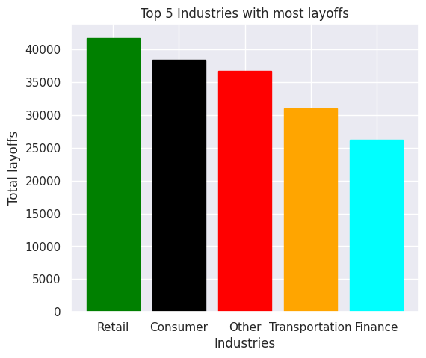
We can see from the chart that the Artificial Intelligence industries had the fewest layoffs in the sample with only 5 individuals laid off, as well only 7 workers were laid off in the Privacy and Marketing Tech.
The illustration shows that layoffs have had a severe impact on the Retail industry, affecting around 41774 people.

Slide 12
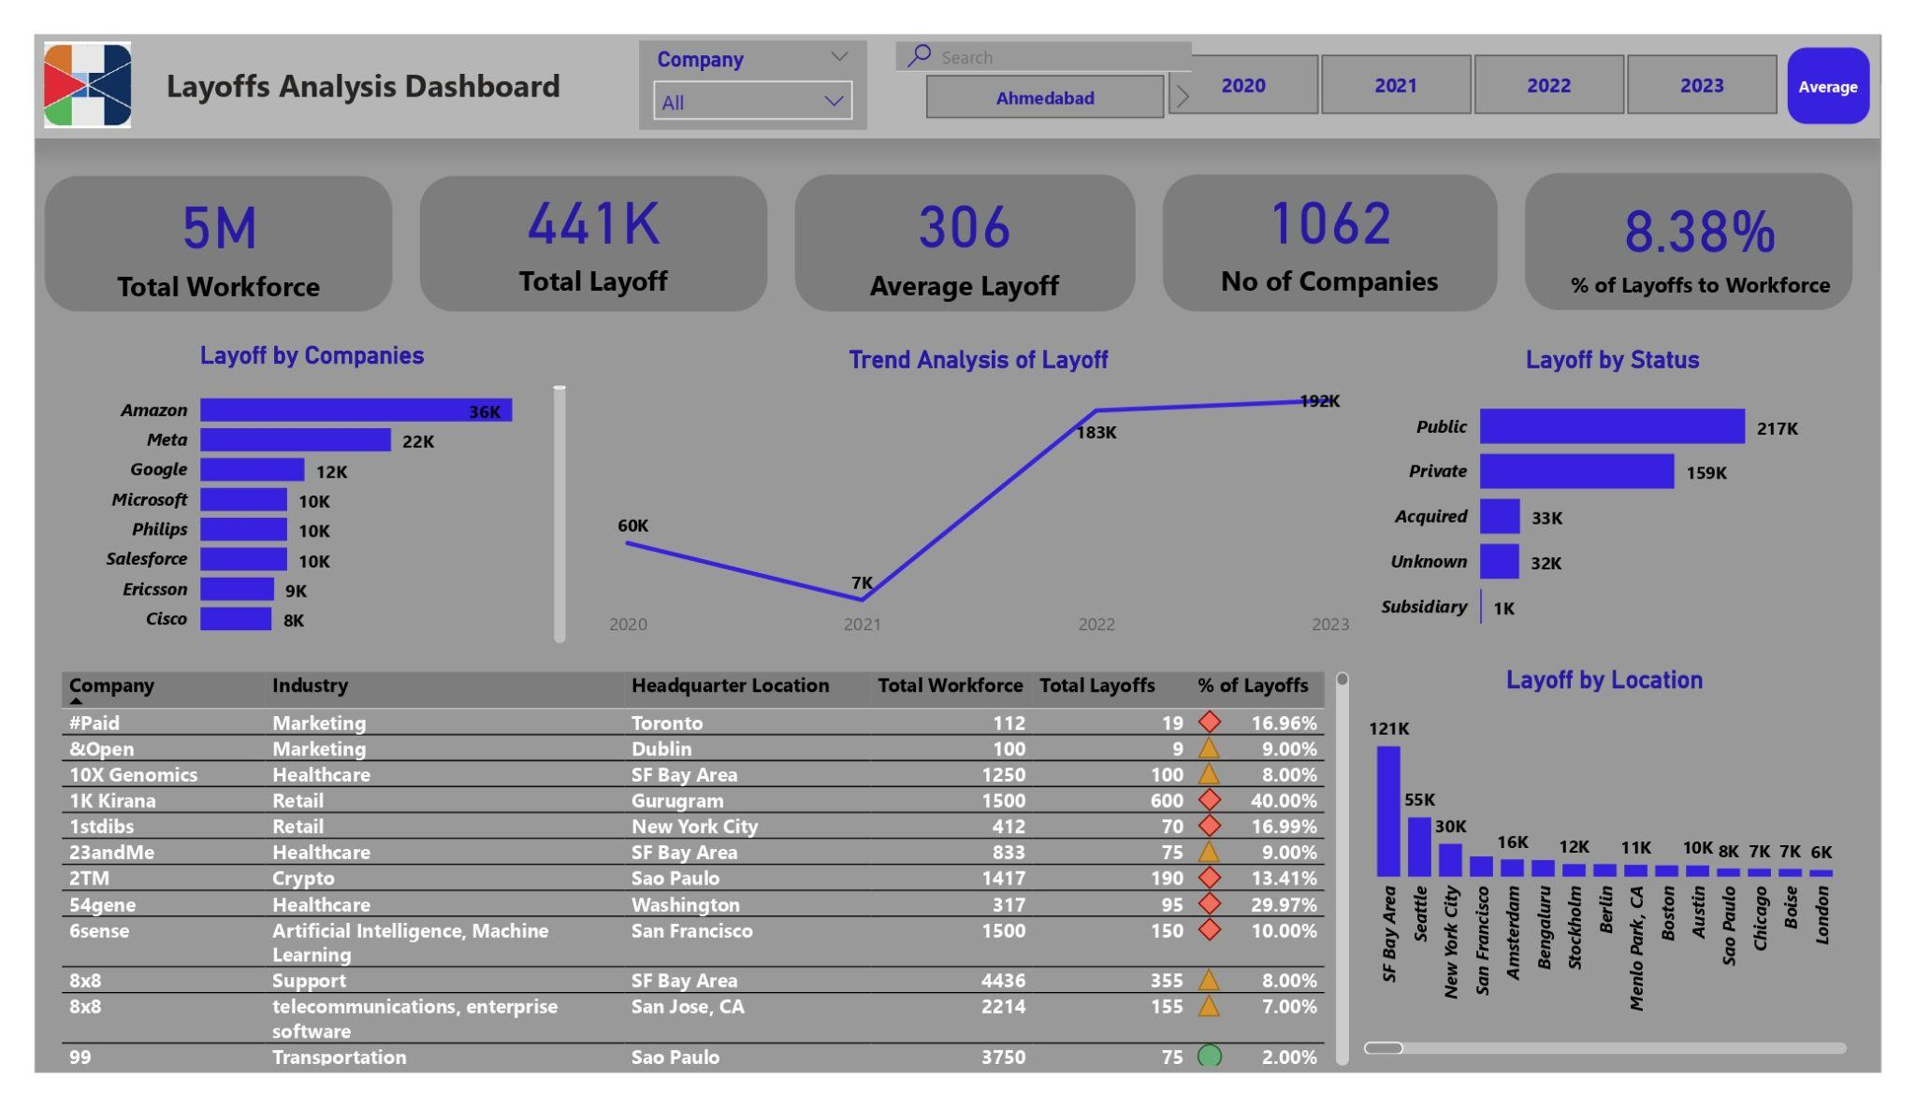
Power Bi Dashboard

Slide 13
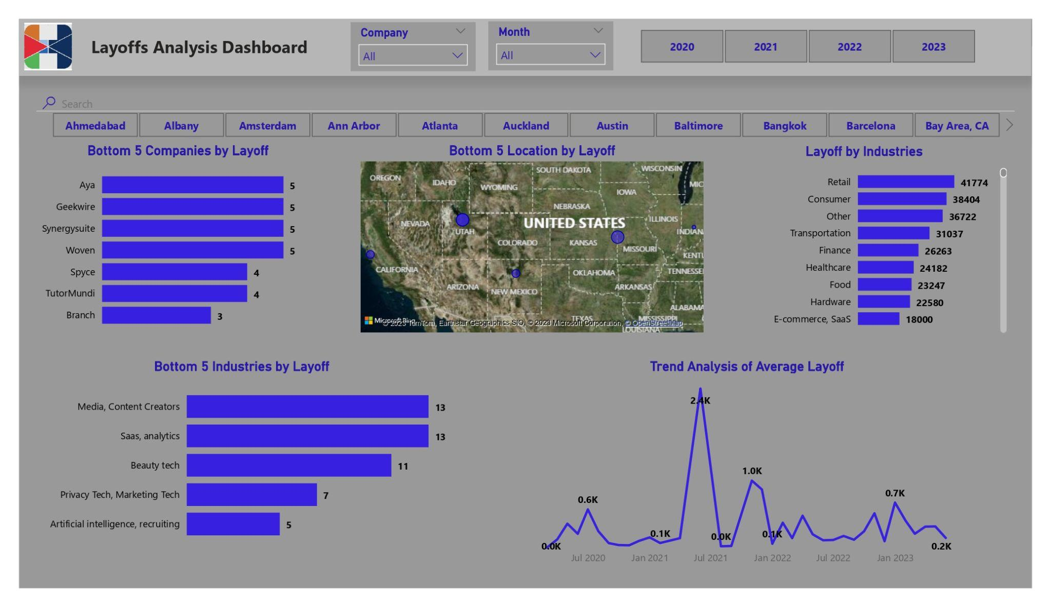

Slide 14




Conclusion
The conclusion from our analysis across all the years from 1062 companies analyzed is:
January is the month with the most layoffs, with a total of 114,000
The year with the highest layoff is 2023, with a total of 192,000
The average layoff per month is between 120 - 700, depending on the month
Amazon is the company with the most layoffs of 36,000
Branch is the company with the fewest layoffs of 3
SF Bay Area is the location with the highest number of layoffs of 121,000
Boise is the location with the lowest number of layoffs of 7,000
We recommend that further data collection is to be done so as to later on we will be able to have a target variable for prediction purposes.

Slide 15
THANK YOU!
COMMENTS
Where could we improve?

