Slide 1
GAME “FALLING EGGS” TEAM “NEW ORLEANS”
Lubomir Gojchev
Genoveva Ivanova
Aneliq Stoilova
Iliana Vachkova – she gave up

Slide 2
Short description
“Falling Eggs” is a funny game intended for 5 – 6 years old children.
Your task is to catch as you can eggs and chicks. The game stops if you collect
all falling eggs and chicks or you reach 25 points. But you have to watch out
for falling rocks because you will lose 3 points.

Slide 3
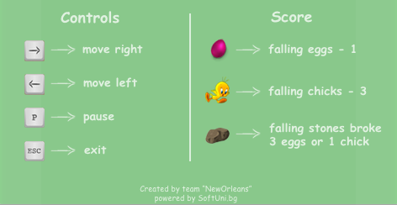
Gameplay

Slide 4
Technical description
This game is written in Java. It has one hero – Rabbit, who
must collects as he can eggs and chicks. Rabbit has to watch
out for falling rocks. To start the game does not need to do
anything except start the file FallingEggs.jar and press play
button. Have fun!

