Slide 1
GAME “FALLING EGGS” TEAM “NEW ORLEANS”
Lubomir Gojchev
Genoveva Ivanova
Aneliq Stoilova
Iliana Vachkova

Slide 2
Short description
“Falling Eggs” is a funny game intended for 5 – 6 years old children.
Your task is to catch as you can eggs and chicks. The game stops if you collect
all falling eggs and chicks or you reach 25 points . But you have to watch out
for falling rocks because you will lose 3 points.

Slide 3
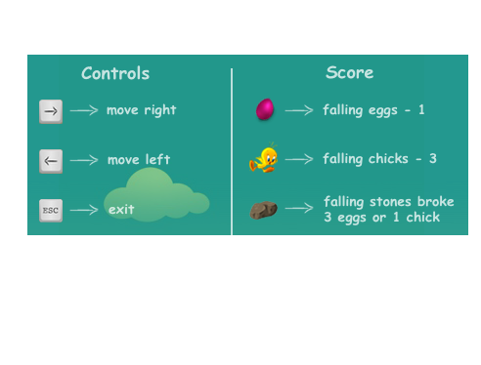
Gameplay

Slide 4
Technical description
This game is written in Java. It has one hero – Rabbit, who must collects as he
can eggs and chicks. Rabbit has to watch out for falling rocks.

