Slide 1
TEAM “NEW ORLEANS”
Java Fundamentals
March 2016
Teamwork defense

Slide 2

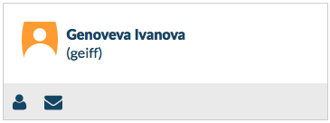
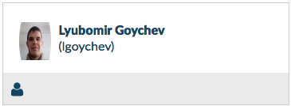

TEAM MEMBERS:
Java Fundamentals
March 2016

Slide 3


Teamwork Resources:
Java Fundamentals
March 2016
https://github.com/TeamNewOrleans/Project_Java_Game

Slide 4

“Falling Eggs”

Slide 5
“Falling Eggs”
DEMO

Slide 6
Game Description:
Funny game intended for 5 – 6 years old children.
Your task is to catch as you can eggs and chicks.
You win if you collect all falling eggs and chicks.
But watch out for falling rocks, because you will lose points.

Slide 7
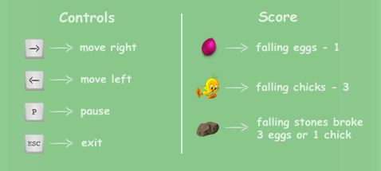
How to play:

Slide 8
Technical description:
This game is written in Java.
To start the game just start the file FallingEggs.jar, press play button and Have a fun!

