Slide 1

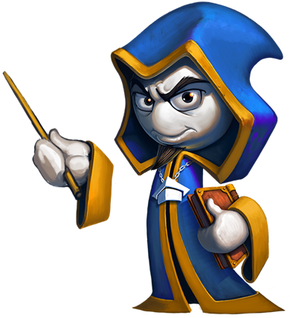
Monster Invasion!
Advanced Java Team Project
Advanced Java
Teamwork
Team “Nozdormu"
Software University
http://softuni.bg

Slide 2

Table of Contents
Teamwork obstacles
Known bugs and difficulties
Future plans
Live demo
Questions

Slide 3

Why did we choose Space Invaders?
Relatively easy to make
Covers most topics in the Advanced Java course
Excellent opportunity to implement graphic interface
Leaves room for modifications

Slide 4

Teamwork obstacles
Writing quality code for the others to understand
Dividing the project into different tasks
Assigning the tasks between team members
Getting things done on schedule
Working cooperatively
Agreeing on game concepts

Slide 5
Future plans
Creating a bigger map, with more resources and objects
Adding quests
Adding more enemies
Adding different character classes
Adding skills and talents
Implementing a leveling system
Possibly migration to JavaFX

Slide 6
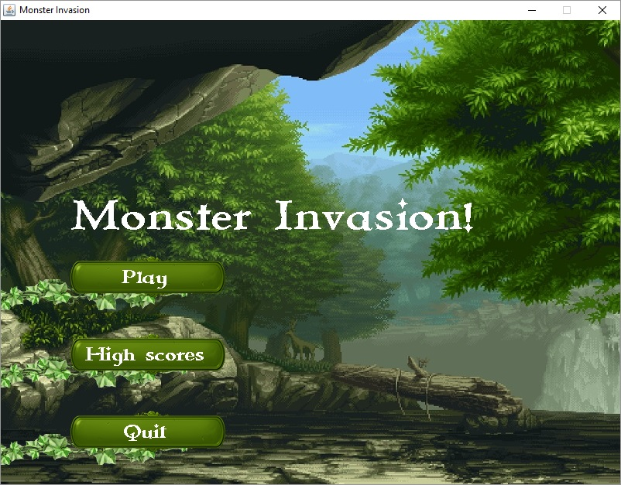
Monster Invasion!
Live Demo

