Slide 1
Big Data Analysis World Happiness
TEAM OREO:
KOMILJON YULDASHEV - 12230144
BEGON ELIOTT - 12230078
COSTE FELIX - 12230200
JAFAR SAIDOV - 12194931

Slide 2




Methodology. Tools Applied

Slide 3
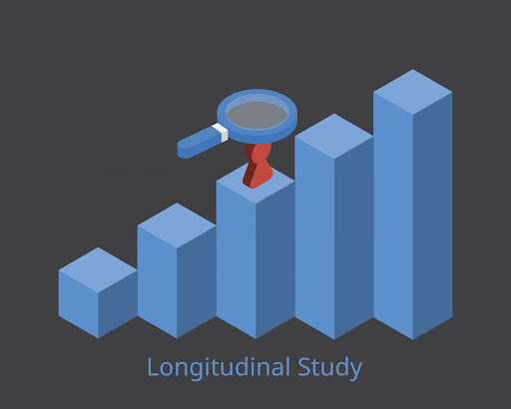

Methodology. Goals and Objectives
Patterns Factors Longitudinal analysis Correlations

Slide 4

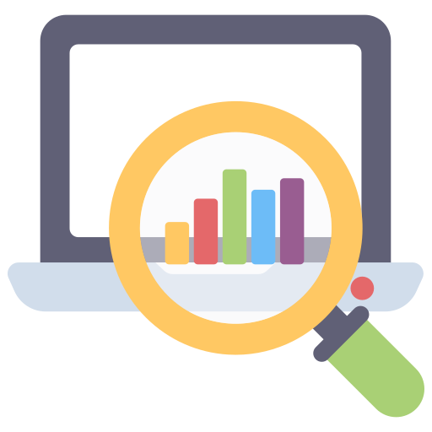
Methodology. Data Evaluation and Visualization
Time Series Analysis (analysis across years)
Clustering (grouping happiness trends of countries into specific types)
Descriptive Statistics
Tableau Dashboards
Excel Charts

Slide 5



Data Sources
2015-2019

Slide 6
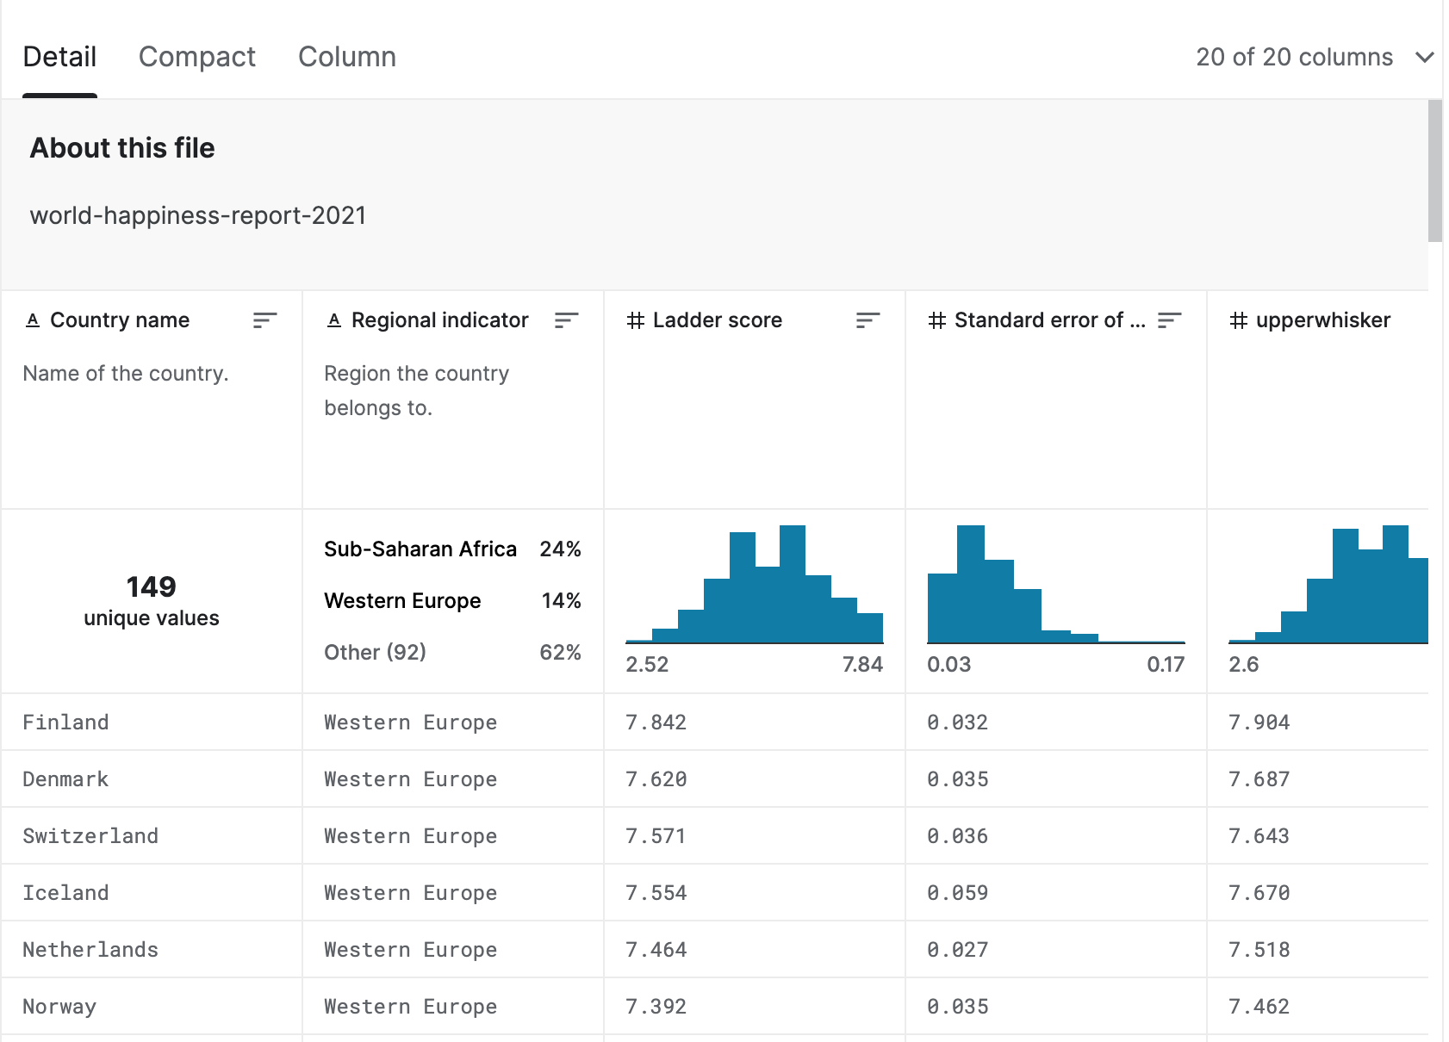
Data Sources
Country
Freedom
Health
Region
Trust
Generosity
Variables
in Dataset
Family
GDP per capita
Happiness score

Slide 7




Analytical Strategies
Trends
Patterns
Comparison analysis using side-by-side representations
Sentiment Analysis
Topic Modeling
Text Generation
Charts and tables based on Tableau visualizations
Correlation coefficients using the “corrcoef()” function

Slide 8
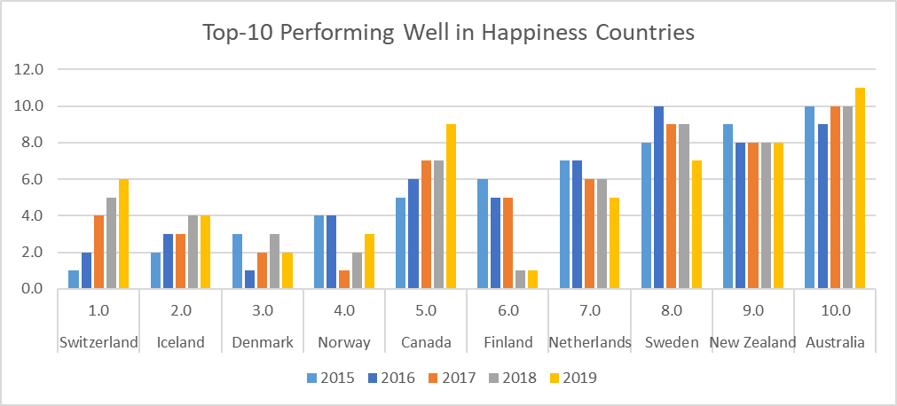
Findings and Conclusions
Overall Happiness Trends
Relatively Stable Happiness
Overall Decreasing Happiness
Overall Increasing Happiness
Main Factors impacting Happiness Rank:
GDP per Capita
Freedom
Health (Life Expectancy)
Generosity
Trust (Government Corruption)
Social Support

Slide 9
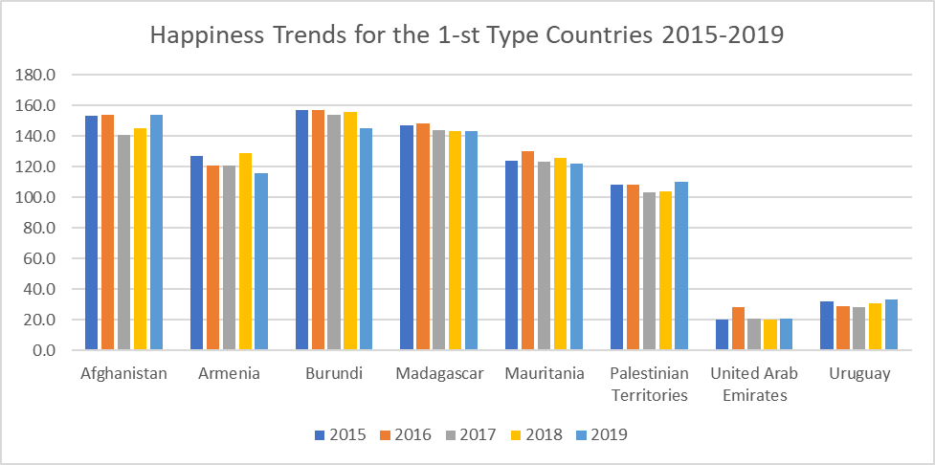
Findings and Conclusions
Sample of Relatively Stable Ranking Countries

Slide 10
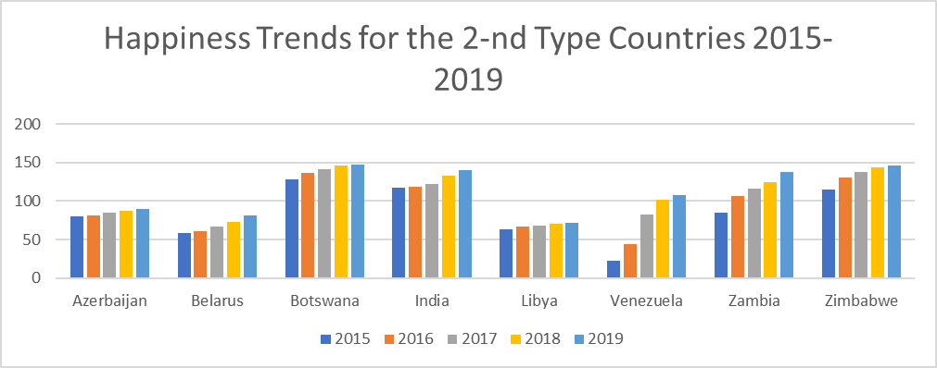
Findings and Conclusions
Sample of Countries with Overall Decreasing Happiness

Slide 11
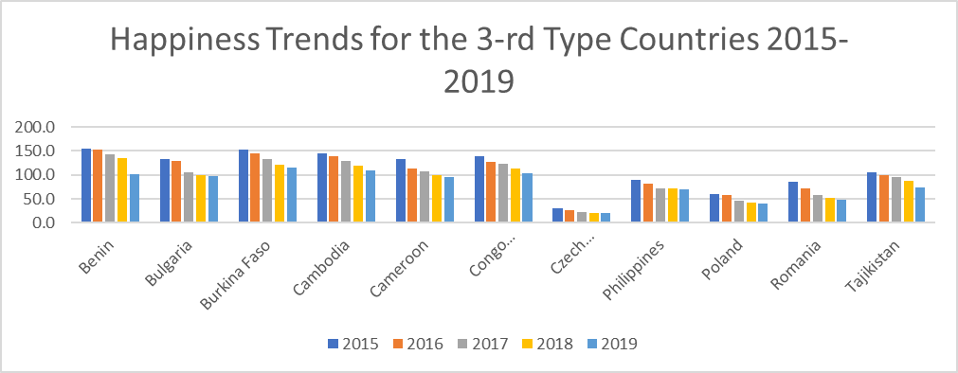
Findings and Conclusions
Sample of Countries with Overall Increasing Happiness

Slide 12
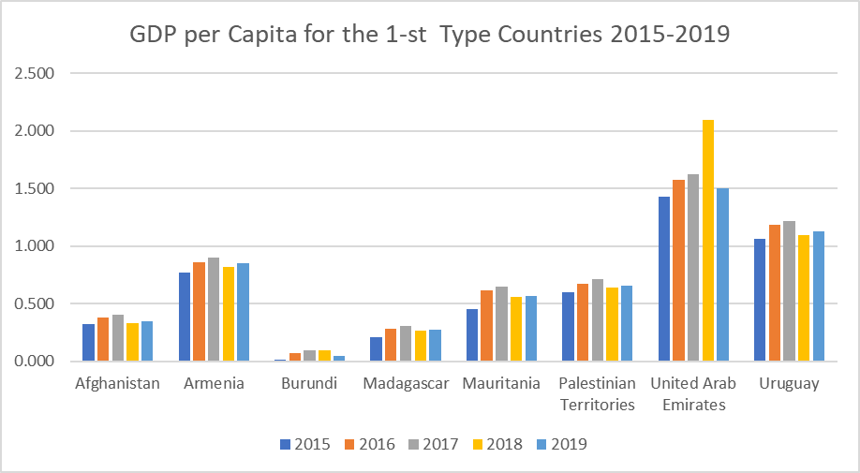
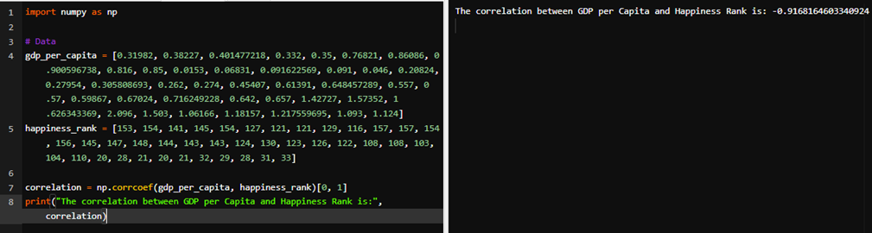
Findings and Conclusions. Analysis Example

Slide 13
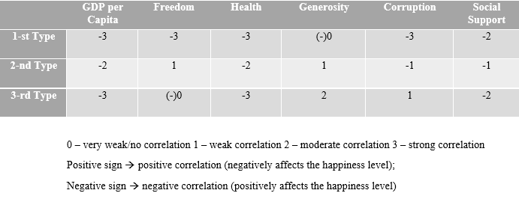
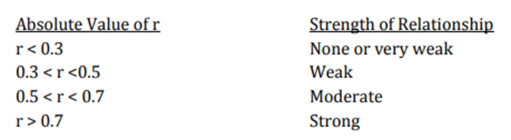
Findings and Conclusions. Interpretation of Results
Correlations Table:

Slide 14

Findings and Conclusions. Observations
Can the countries shift from one type to another?
Strongly Correlated Variables
Factors that have little or no correlation
Multiple factors interaction
External variables and context

Slide 15



Applications
Governments and Policymakers Comparative researches Worldwide advancement

Slide 16

Faced Challenges. Tableau
Connection and Integration of Data Sources
Data Preparation
Designing Visualizations
Performance Optimization
Sharing and Collaboration

Slide 17
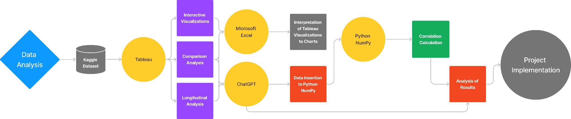
Summary. Flow Chart

