Slide 1
TEAM OREO Project proposal
Members:
Komiljon Yuldashev - 12230144
Begon Eliott - 12230078
Coste Felix - 12230200
Jafar Saidov - 12194931

Slide 2

SELECTED use-case: STUDENTS’ ACADEMIC PERFORMANCE
Welfare of Students
Educational Policy
Parental Involvement
Teacher Training
Research and Development

Slide 3
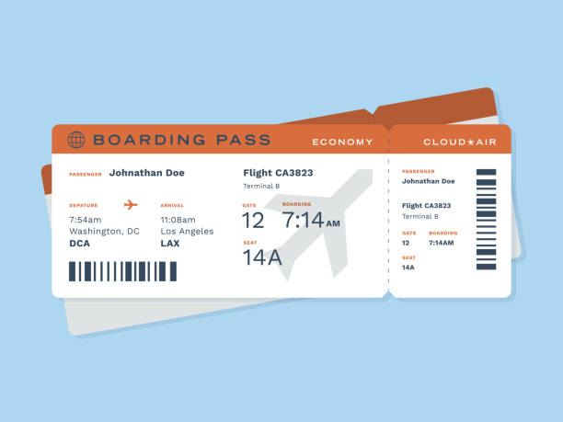
Selected use-case: airplane tickets prices
Consumer Behavior
Economic Analysis
Business Strategy

Slide 4

Selected use-case: world happiness
Understanding Well-being
Policy Implications
Cross-cultural Comparison

Slide 5
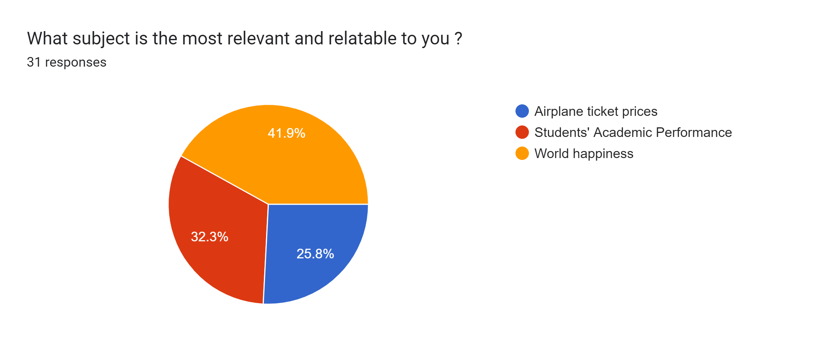
Survey analysis

Slide 6
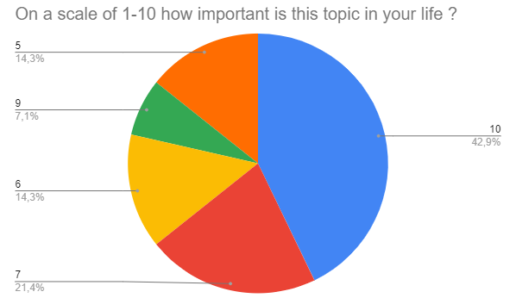
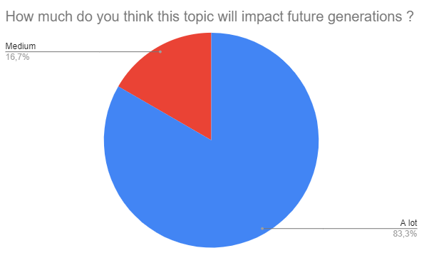
Survey results: world happiness

Slide 7



Data analysis tools
Clean and transform data
Finding patterns
Finding correlations
Visualize data

Slide 8
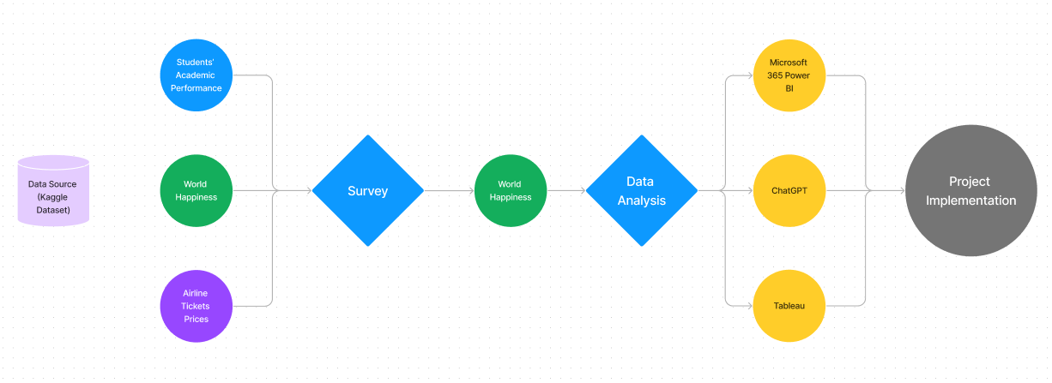
Action plan

