Slide 1
the project
SOCIAL NETWORK
the team
QUINCE
Idmitrov Димитър Димитров
StrahilRuychev Страхил Руйчев
Nadia.Hristova Надя Христова
pepster Пламена Георгиева
Asyamincheva Ася Минчева

Slide 2
Resources
Team QUINCE
SOCIAL NETWORK
GITHUB https://github.com/TeamQuince
AZURE http://quince-network.azurewebsites.net/
TRELLO https://trello.com/b/Rzl42343/quince

Slide 3
Technologies
ASP.NET Web API framework
MS SQL & Entity Framework
Azure
Cloud

Slide 4
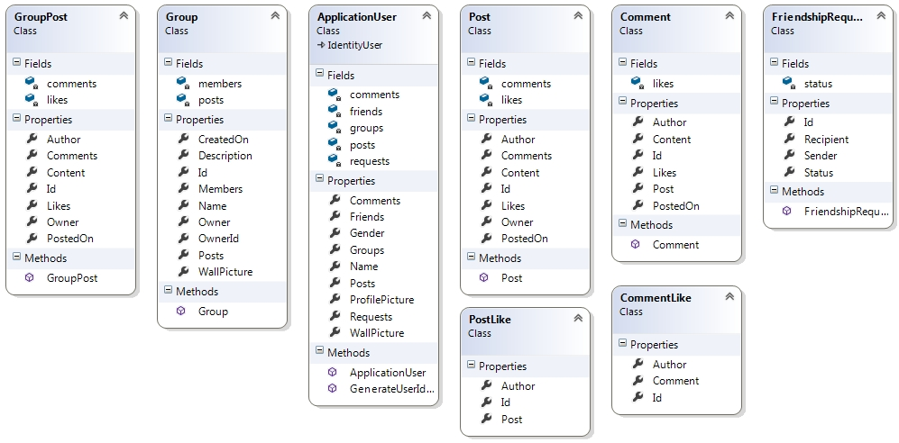
DB Models Class Diagram

Slide 5
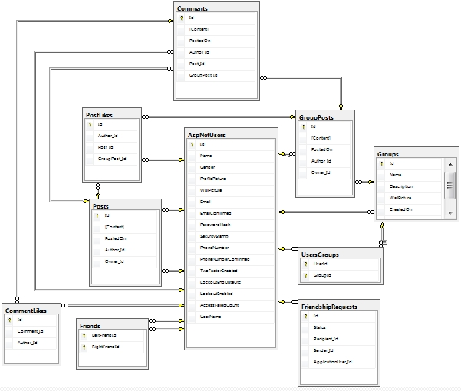
DB Diagram

