Slide 1
TIC TAC TOE Software Development Project
TEAM REDACTED -- Preliminary Report
Sean Cary [Secretary], Tuan Dang [SQA], Xuan Nguyen [SQA],
Robert Rabel [Team Lead], Patrick Ramirez [SQA]

Slide 2


Recapping decisions
Preferred development platform:
Easily and efficiently handles the requests of our clients
Good for rapid implementation, to allow for quicker iteration and improvement
Easily make changes and export new builds, allowing for more efficient testing
Preferred version control:

Slide 3
Continued Communication & Collaboration
Outside face-to-face meeting
Helps to articulate and explain theoretical and implementation ideas
Google+
Maintaining contact
Organizing meetings
Git & Github
Sharing assets
Maintaining version control

Slide 4
CLASSES
UserInterface Class: a collection and sequence of menus and title screens
The player types are chosen
New, Returning, Guest, AI
Player names are entered and the value is save to be used by the player class
A.I. difficulty is chosen ( if applicable)
Determines which player goes first

Slide 5
CLASSES
Player Class:
Uses flags to determine which player will make the next move and alternates turns
Checks for players input (mouse click on an empty square)
Tells the Gameboard class which token to place into empty square
Creates game tokens from GameObject
Stores two arrays to keep track of win conditions (one per player)
Passes names and win/loss/draw to record keeping

Slide 6
CLASSES
PlayerClass Class:
Stores the two player shapes(X or O)
Uses flags to determine which player will make the next move and alternates turns
Checks for players input (mouse click on an empty square)
Tells the Gameboard class which token to place into empty square
Creates game tokens from GameObject
Passes names and win/loss/draw to record keeping

Slide 7
CLASSES
BoardSpace Class:
Comprised of 25 GameBoardPiece objects, aligned in a 5x5 grid
Stores coordinates of square - (row, column)
Receives input from the mouse, and if space is not flagged (as occupied)
Tells player class to make token
Places token into square
Flags square as occupied
Update win condition array for current player

Slide 8
CLASSES
History Class: keeps records of players’ names and win/loss/draw record
Uses a text file to store data for later use
Uses an array to store data per user
After a game is finished, the names of the two players are searched for
If the player’s name is found, their record is updated based on the result of the game
If not found, a new entry is made for that player and it’s record begins with the result of last game
Upon closing the game, the records updates are transferred to the record file

Slide 9
CLASSES
AIClass : Extends PlayerClass
Override getMove () function to automate the function
Ai easy , AI medium, AI Hard
All extend the AI class
Each class overides the getMove() funtion for varying degrees of difficulty

Slide 10
Classes
GameInfo class: Takes care of the in game User interface
Displays both players’ names
Highlights player name for current player turn

Slide 11
Use Cases
New user, wants to create a user name and play against Normal AI
Returning player, wants to play against Easy AI
New player, wants to play as a guest
Returning player, wants to check the high scores
Returning player, wants to play against another guest player

Slide 12
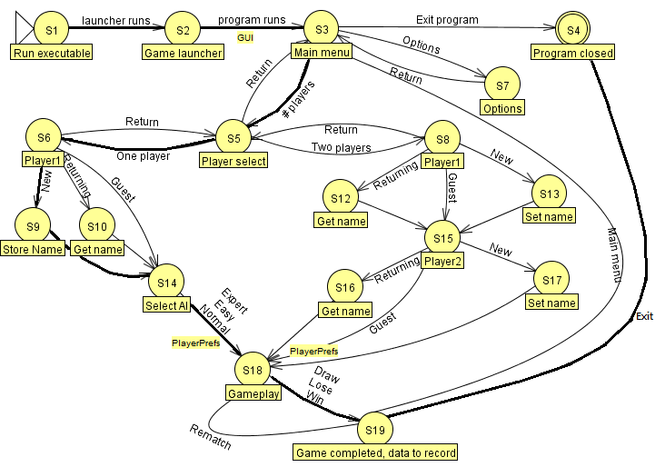
Detailed Use Case – New player v. Normal AI

Slide 13
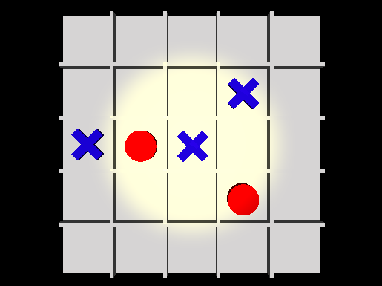
Initial build – target render, no gameplay

Slide 14
Preliminary Test Plan: Objectives
Find all flaws associated with software.
Ensure 90% reliability is achieved.
All testing is to be completed before final submission to client.
Ensure all requirements given by client is fulfilled.
Each document will be thoroughly tested before working on the next.

Slide 15
Preliminary Test Plan: Test Strategy
Software will be tested on various operating systems…
Windows, OSX, Linux
…and hardware configurations
Intel, AMD, Nvidia
Multiple test subjects will be utilized for beta release
Friends, family, avid gamers, non-gamers
All issues with software will be recorded and iterated upon

Slide 16
Preliminary Test Plan: Features to be Tested
GUI
Player v. Player
Player v. AI
Score Board
Resolution
Mouse Input

Slide 17
Next Steps:
Continue building, get to the feature-complete beta phase
Maintain communication
Keep realistic goals, while striving for the best product
Stay on track with the plan we have, but prepare for complications
Test, test, test

