Slide 1
Knowledge-based Information Retrieval:
A Work in Progress
Knowledge-based Systems
Research Group,
University of Texas at Austin

Slide 2
Shortcomings of Current IR Systems: Hard Questions
Query: Where does Al Qaeda operate?
➔rephrase as a Jeopardy-style question:
“what are Pakistan, Indonesia, and Spain?”
➔the query needs to (partially) match the answer
Query: Which terrorist groups are organized like
Al Qaeda?
➔retrieve information on the structure of Al Qaeda,
identify unique descriptors, and form new query
➔the query needs to (partially) match the answer

Slide 3
Shortcomings of Current IR Systems:
Hard Questions
Query: How does drug use cause terrorism?
Structure of the query is lost:
  How does terrorism cause drug use ?
  What drug causes the use of terrorism ?
  What causes terrorism to use drugs ?
agent
buyer
seller
Terrorist-
Organization
agent
Drug-Use
Drug-User
Drug-Purchase
Terrorism
possesses
possesses
$
$
enables
Drug-Use
causes
Terrorism

Slide 4
Digital Libraries vs. the Internet
The Collection:
  Small, focused, non-redundant
The Users:
  Sophisticated, demanding
The Administrators:
  Knowledgeable librarians, researchers, and analysts

Slide 5
Knowledge-based IR vs Q/A
Infeasible to convert a library into a KB for autonomous Q/A
We’re advocating building “half a KB”:
  one capable of indexing documents, but not answering questions
  a hybrid between a KB’ed Q/A system and a library’s IR system
Three types of KB’s required
  KB of general domain knowledge
  KB summary of each document in the archive
  KB expression of each query

Slide 6
KB of General Domain Knowledge
Built and maintained by the administrators of the digital library
Example: Anthrax as a BW Agent
  Anthrax acquisition
  Anthrax preparation
  Anthrax weaponization
  Anthrax delivery

Slide 7
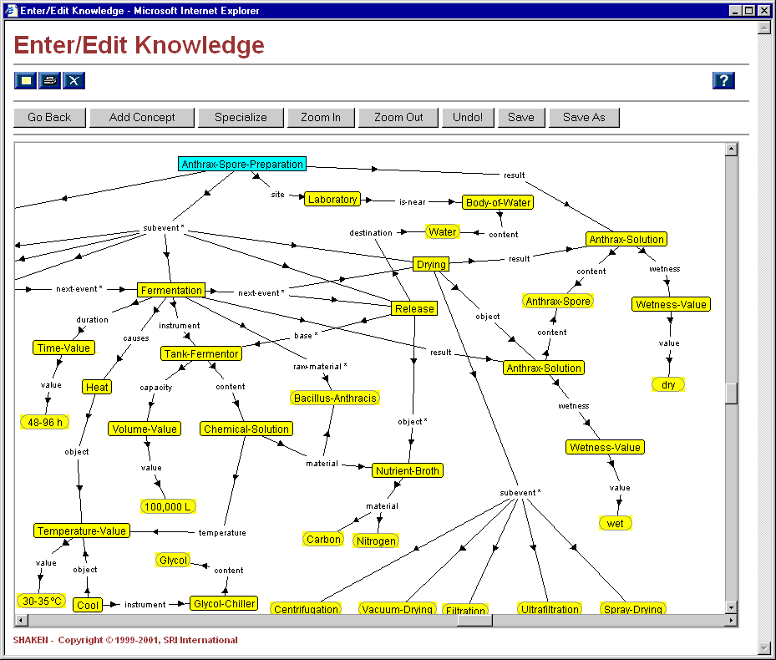
Domain KB

Slide 8
KB Summary of each Document
A small KB summarizing a document’s main content; keywords plus KB structure
Grafts onto the Domain KB (which supplies background left implicit in the document)
Not
  a semantic markup of the document
  extracted automatically from the document
example document

Slide 9
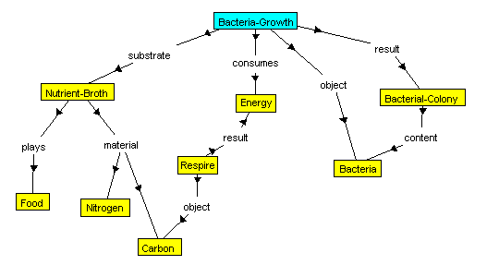
KB Summary of each Document

Slide 10
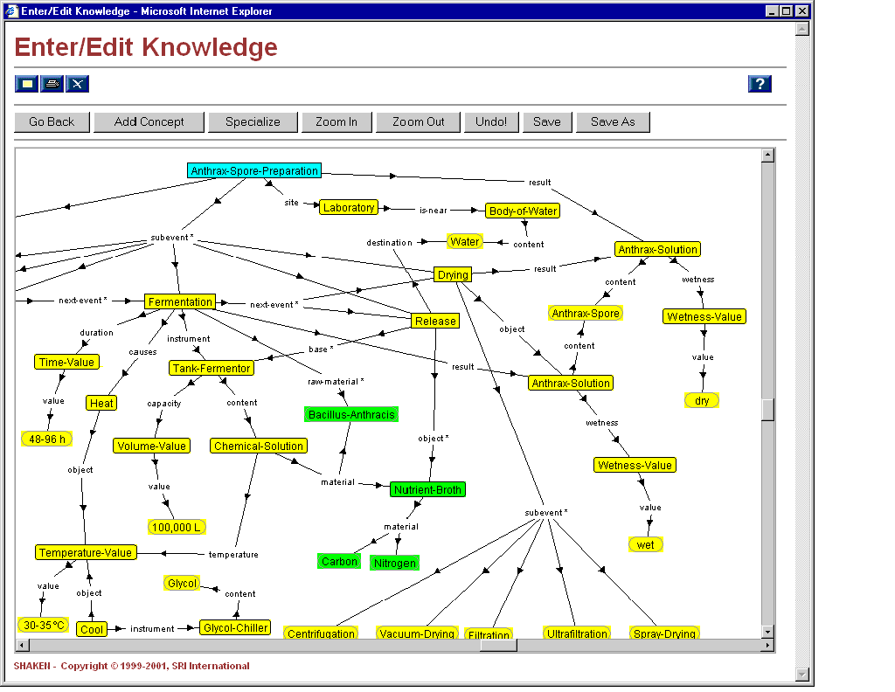

Slide 11
KB Expression of each Query
User starts by selecting a subgraph of the domain KB and the document KB’s, then adds concepts and relations, as needed
Examples of Queries:
  In producing Anthrax spores, how is the carbon in the chemical solution containing Bacillus Anthracis involved?
  In a terrorist cell, we’ve discovered a tank fermentor containing carbon and nitrogen. What might be its purpose?

Slide 12
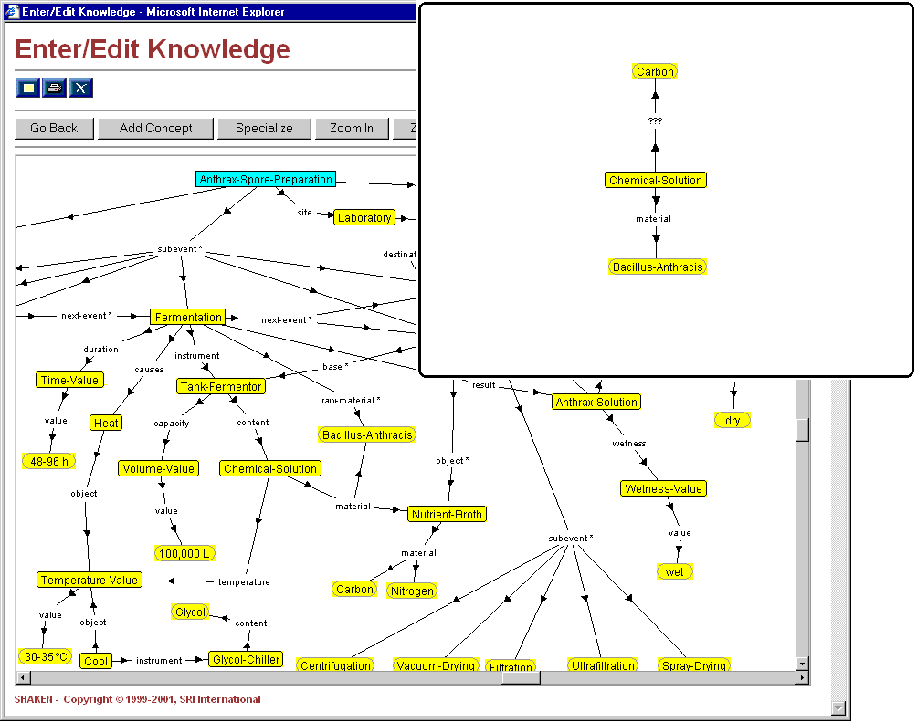
Query: In producing Anthrax spores, how is the
carbon in the chemical solution containing
Bacillus Anthracis involved?
Notes:
Our matcher performs a match in two steps. It first tries to match up two concepts via a direct semantic match (i.e. matching things that line up). It then applies a series of tranformation operators to the portions of the cmap that could not be matched up semantically.
Some of the tranformation operators are morphing, semantic edit, and graph completion.
Furthermore, the overall retrieval process is a cycle of match and intergrate (i.e. incorporate (graft) what is matched to the initial input knowledge).

Slide 13
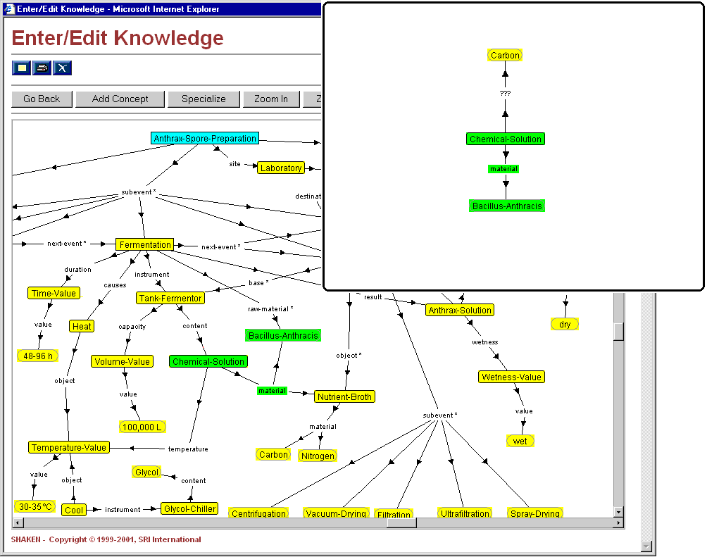
Notes:
Result of applying a semantic match.

Slide 14
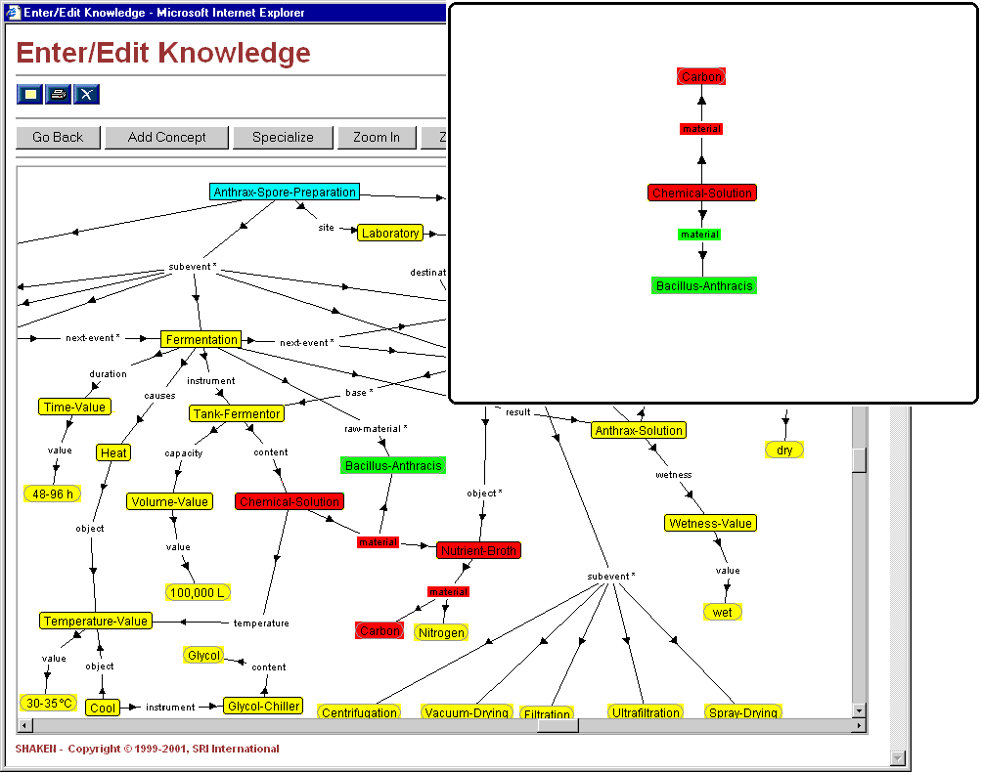
because material is transitive
Notes:
Application of a semantic edit transformation operator.

Slide 15
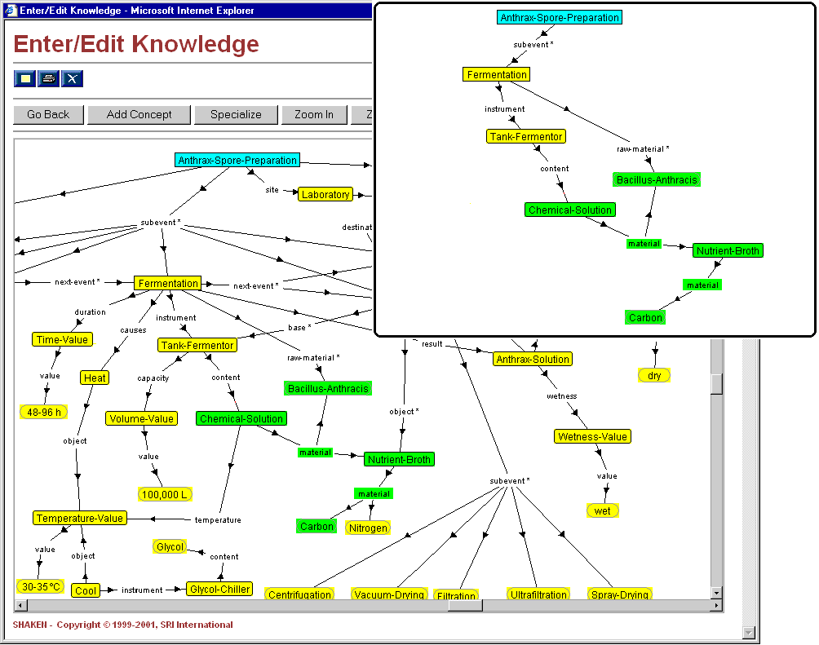
indexes the
previous
document
Notes:
Result of applying a semantic edit. At this point, the match is complete. Document #1, which contains more information on nutrient broths and the role that carbon plays is retrieved and returned to the user.
Note: The algorithm will, at this point, integrate the input knowledge with the match result (the resulting cmap is the one shown in the insert on the upper right hand corner) and perform the match again to see if anything else in the KB applies. Nothing else applies in this case.

Slide 16
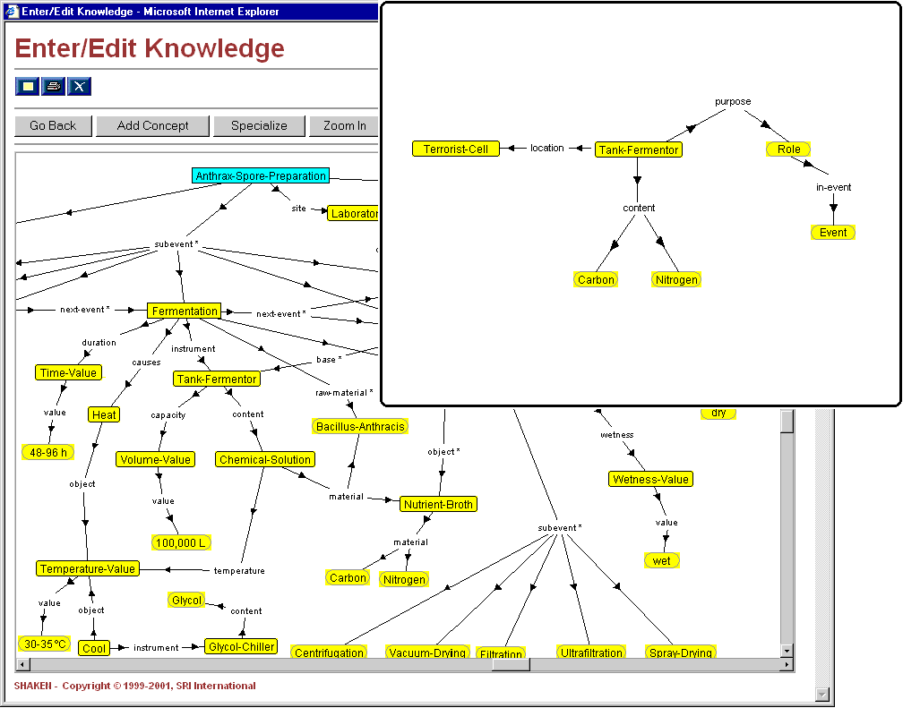
Query2: In a terrorist cell, we've discovered a tank
fermentor containing carbon and nitrogen.
What might be its purpose?

Slide 17
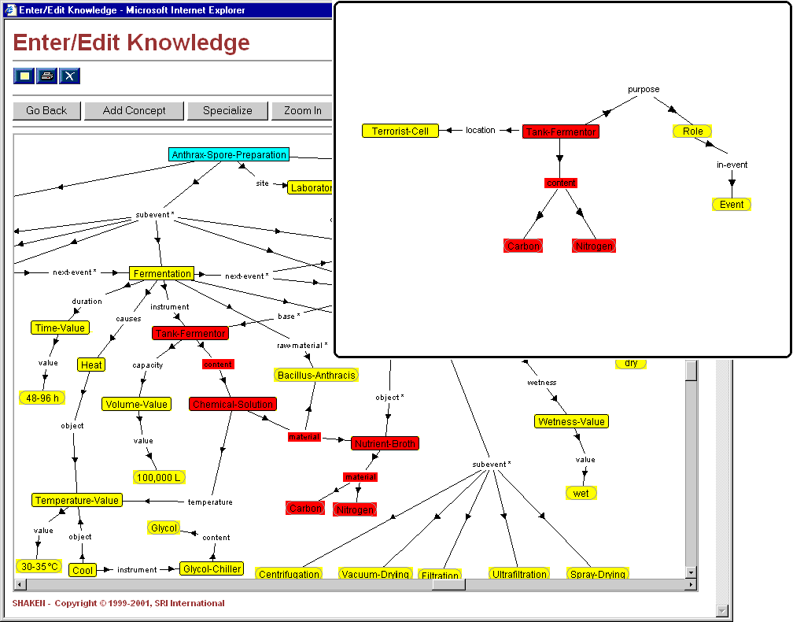
because material is transitive and
using axioms relating content and material
Notes:
Application of a semantic edit transformation operator.

Slide 18
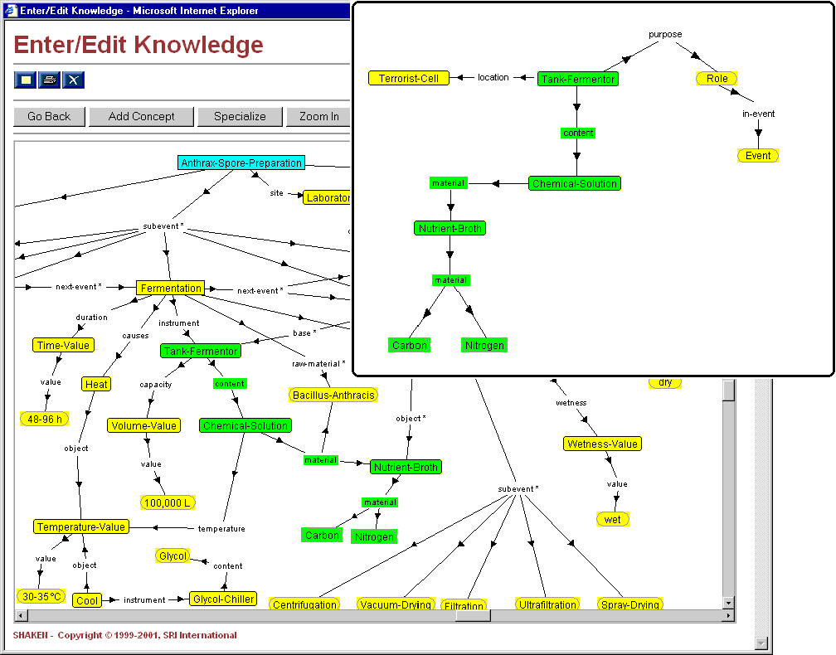
Notes:
Result of applying a semantic edit.

Slide 19
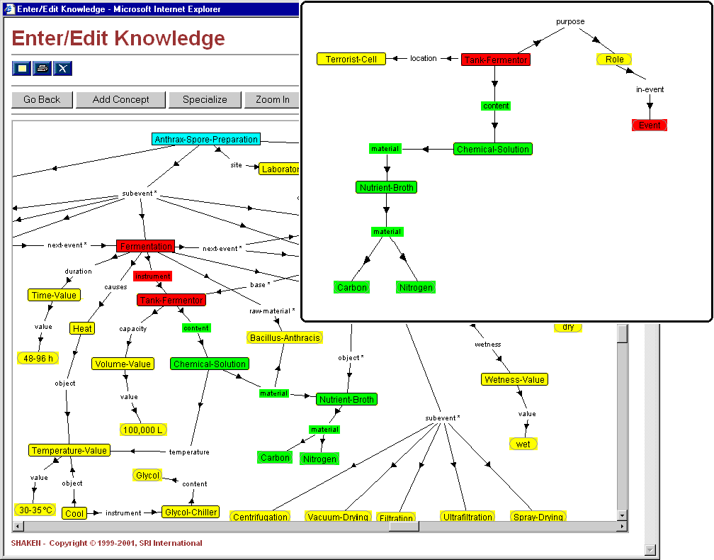
Notes:
Application of a graph completion operator.

Slide 20
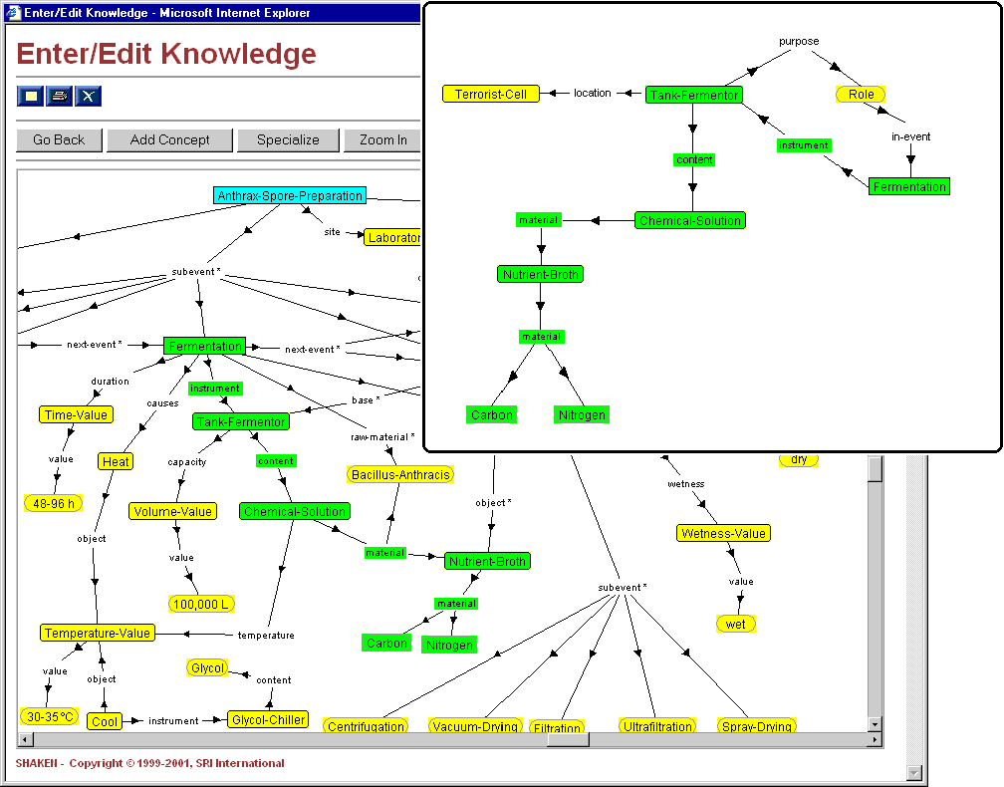
Notes:
The result of performing a graph completion operation. At this point, the match with anthrax spore preparation is complete, and the relevant documents will be returned. Furthermore, the match results will be integrated (i.e. incorporate what's been matched to the input knowledge, upper right hand corner), and the match process will be performed again to see if anything else in the KB can be matched.

Slide 21
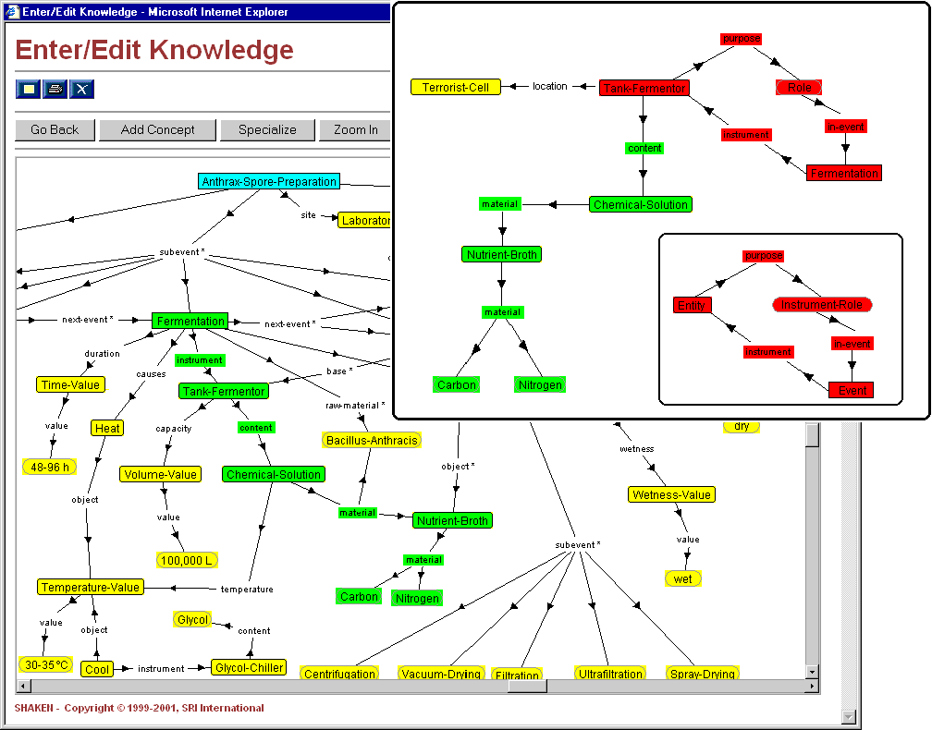
Notes:
By performing the match again, we find a match with Instrument-Role through a direct semantic match.

Slide 22
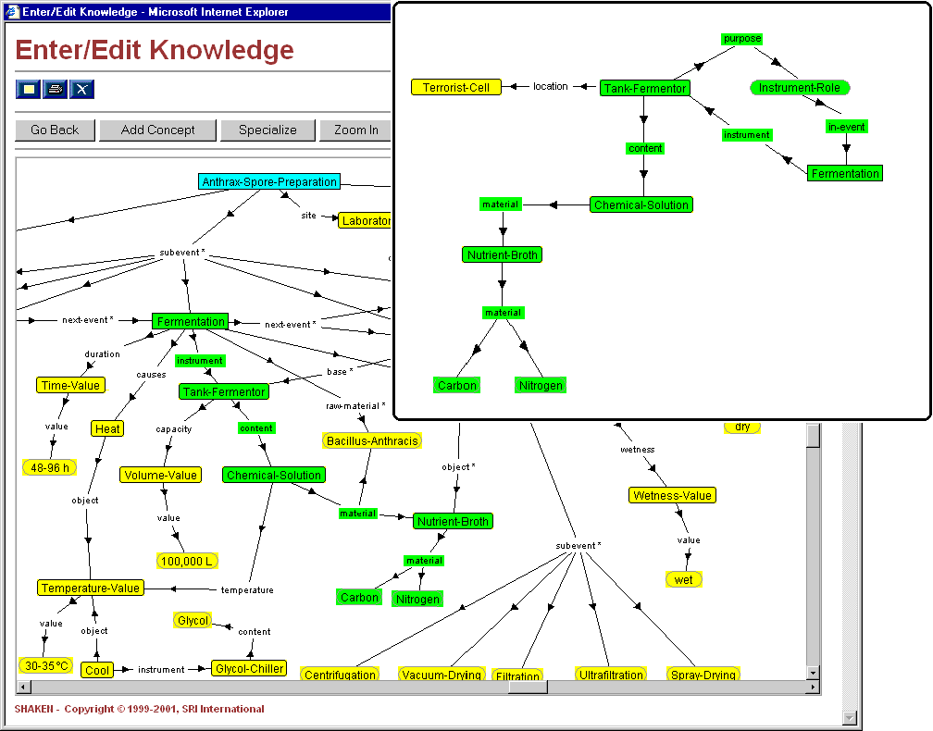
This graph may index
documents, e.g. of
terrorist cells using
fermentors.
Notes:
The final match result.

Slide 23
A Component Library
a small hierarchy of reusable, composable, domain-independent knowledge units (“components”)
  Entities, Actions, States, Roles, Values
a small vocabulary of relations to connect them

Slide 24
Requirements
coverage
  what are some domain-independent concepts?
access
  how can SMEs find the components they need (and buy into them)?
semantics
  what knowledge is encoded in components?
  how are components composed?
  what additional knowledge is inferred through their composition?

Slide 25
Coverage
small number of components covering a wide range of generic concepts
  general enough that the small number is sufficiently broad
  specific enough that users are willing to make the abstraction from a domain concept to a component
  intuitive/usable… yes!
  elegant, philosophically appealing, computationally friendly… ehnh :-7

Slide 26
Access
browsing the hierarchy top-down
WordNet-based search
  all components have hooks to WordNet
  climb the WordNet hypernym tree with search terms
  assemble: Attach, Come-Together
  mend: Repair
  infiltrate: Enter, Traverse, Penetrate, Move-Into
  gum-up: Block, Obstruct
  busted: Be-Broken, Be-Ruined
documentation

Slide 27
Semantics
axiomatize the concepts
axiomatize the relations
specify the behavior of composition
  additional inferencing possible from the composition beyond the semantics of the components/relations

Slide 28
Evaluation
Can DomEs learn to use the library to encode domain knowledge?
Can sophisticated knowledge be captured through composition of components?

Slide 29
Evaluation
train Biologists for two weeks
have the Biologists encode knowledge from a college-level Biology textbook using our tools
supply end-of-the-chapter-style Biology questions
have the Biologists pose the questions to their knowledge bases and record the answers
evaluate the answers on a scale of 0-3
qualitatively evaluate their KBs

Slide 30
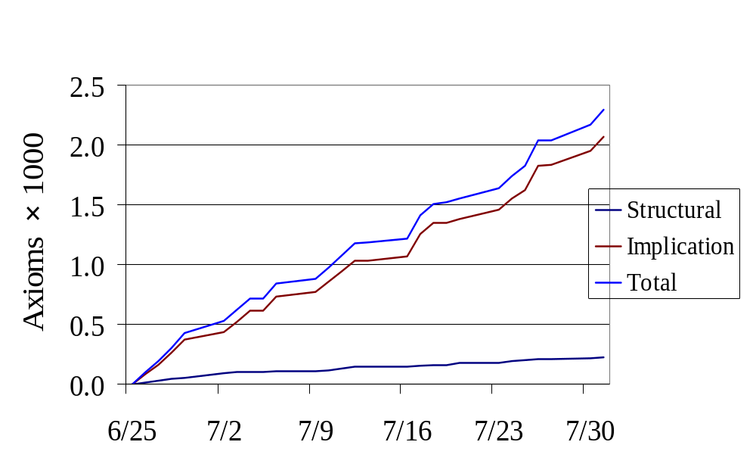
Evaluation — Productivity

Slide 31
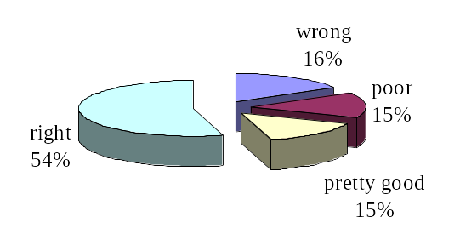
Evaluation — Question Answering

