Slide 1

A Library of Generic Concepts for Composing Knowledge Bases
Ken Barker, Bruce Porter @ UTAustin
Peter Clark @Boeing

Slide 2
“Normal people don’t have the skills or the time to build knowledge bases”
-- anonymous knowledge engineer
c. last week

Slide 3
Our Goal
to get domain experts build knowledge bases in their area of expertise directly
  build a KB without writing axioms
  build a KB through the instantiation and composition of existing knowledge building blocks

Slide 4
Our Project
even domain-specific representations contain repeated abstractions
so build a library consisting of
  a small hierarchy of reusable, composable, domain-independent knowledge units (“components”)
  a small vocabulary of relations to connect them

Slide 5
A Library of Components
small
easy to learn
easy to use
broad semantic distinctions (easy to choose)
allows detailed pre-engineering

Slide 6
Outline
Library requirements
Library construction/contents
Composition
Evaluation

Slide 7
Requirements
coverage
  what are some domain-independent concepts?
access
  how can SMEs find the components they need (and buy into them)?
semantics
  what knowledge is encoded in components?
  how are components composed?
  what additional knowledge is inferred through their composition?
Library requirements
Library construction/contents
Composition
Evaluation

Slide 8
Coverage
small number of components covering a wide range of generic concepts
  general enough that the small number is sufficiently broad
  specific enough that users are willing to make the abstraction from a domain concept to a component
  intuitive/usable… yes!
  elegant, philosophically appealing, computationally friendly… ehnh :-7
Library requirements
  coverage
  access
  semantics
Library construction/contents
Composition
Evaluation

Slide 9
Access
browsing the hierarchy top-down
WordNet-based search
  all components have hooks to WordNet
  climb the WordNet hypernym tree with search terms
  assemble: Attach, Come-Together
  mend: Repair
  infiltrate: Enter, Traverse, Penetrate, Move-Into
  gum-up: Block, Obstruct
  busted: Be-Broken, Be-Ruined
documentation
Library requirements
  coverage
  access
  semantics
Library construction/contents
Composition
Evaluation

Slide 10
Semantics
axiomatize the concepts
axiomatize the relations
specify the behavior of composition
  additional inferencing possible from the composition beyond the semantics of the components/relations
Library requirements
  coverage
  access
  semantics
Library construction/contents
Composition
Evaluation

Slide 11
Library Construction
draw from related work
  ontology design/knowledge engineering
  linguistics
    semantic primitives
    case theory, discourse analysis, NP semantics
draw from English lexical resources
  dictionaries, thesauri, word lists
  WordNet, Roget, LDOCE, corpora, etc.
Library requirements
Library construction/contents
Composition
Evaluation

Slide 12
Library Contents
actions — things that happen, change states
  Enter, Copy, Replace, Transfer, etc.
states — relatively temporally stable events
  Be-Closed, Be-Attached-To, Be-Confined, etc.
entities — things that are
  Substance, Place, Object, etc.
roles — things that are, but only in the context of things that happen
  Container, Catalyst, Template, Vehicle, etc.
Library requirements
Library construction/contents
Composition
Evaluation

Slide 13
Library Contents
relations between events, entities, roles
  agent, donor, object, recipient, result, etc.
  content, part, material, possession, etc.
  causes, defeats, enables, prevents, etc.
  purpose, plays, etc.
properties between events/entities and values
  rate, frequency, intensity, direction, etc.
  size, color, integrity, shape, etc.
Library requirements
Library construction/contents
Composition
Evaluation

Slide 14
Composition
semantics of Entities, Events and Roles +
semantics of relations allow for new inferences through composition
  context-dependent rules
  “definitions”
  simulation with STRIPS-like operators
Library requirements
Library construction/contents
Composition
Evaluation

Slide 15
Composition
MRNA-Transport
  “MRNA is transported out of the cell nucleus into the cytoplasm”
Library requirements
Library construction/contents
Composition
Evaluation

Slide 16
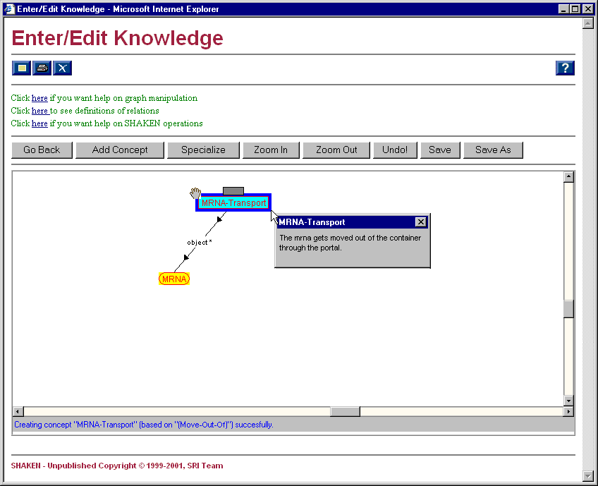
Notes:
This sequence of screen shots shows some of the kind of knowledge stored in components. It also shows how connecting components can result in extra knowledge being asserted through inferencing.
The example is MRNA-Transport, which we’ve defined as a kind of Move-Out-Of. Nodes with red outline and red text show knowledge that the user supplied. On this slide, the user has defined MRNA-Transport and supplied the knowledge that MRNA is the object of the MRNA-Transport.
The definition that shows in the popup is not from the documentation, it’s the text-gen slot on MRNA-Transport. The definition suggests that there’s more to this concept than what appears on the screen. We can get at the rest by showing the expanded version of MRNA-Transport…

Slide 17
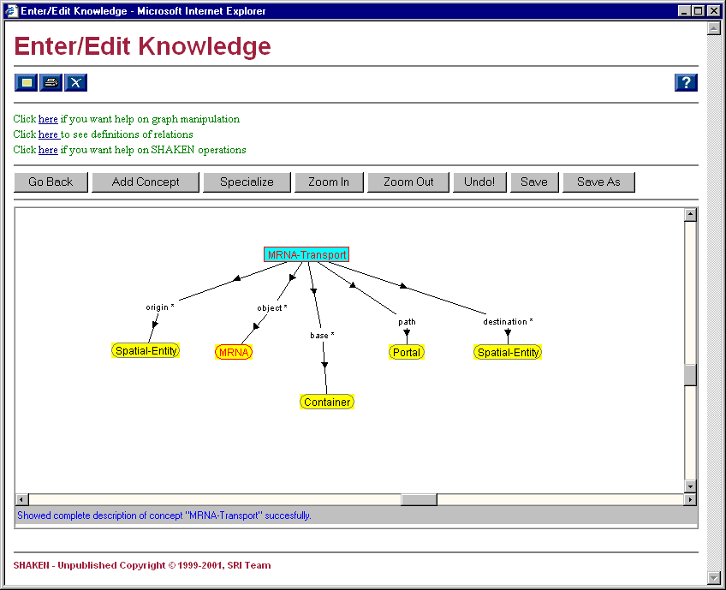
Notes:
Here is the other information that was hidden. Note that none of this was added by the user, it all comes from the Move-Out-Of component. In fact, there’s more than what’s shown here. Move-Out-Of also specifies relationships between the container that the object moves out of and the portal it moves through…

Slide 18
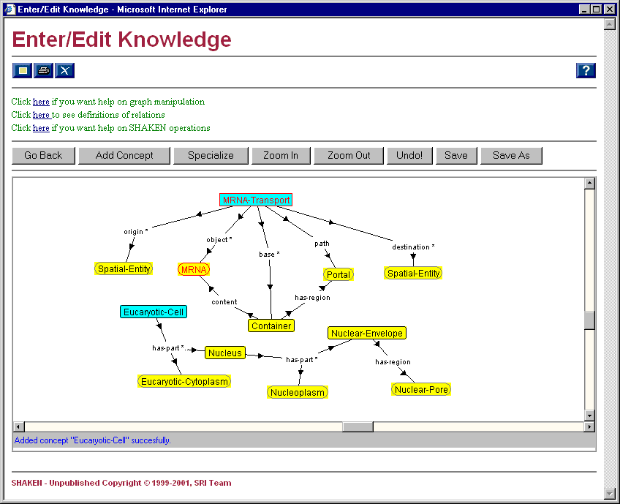
Notes:
By expanding the Container node we see that the Portal the MRNA moves through is a region of the Container. We also see that the MRNA is currently contained in the Container.
This slide also shows a new component that we’ve added: Eucaryotic Cell (only Eucaryotic Cells have nuclei). All of the knowledge related to the Eucaryotic Cell is in the Biology pump-priming we put in for the summer trials. Here the user has to specify that the Container the MRNA is moving out of is the Nuclear Envelope. The user does this by dragging the Nuclear-Envelope node on top of the Container node…

Slide 19
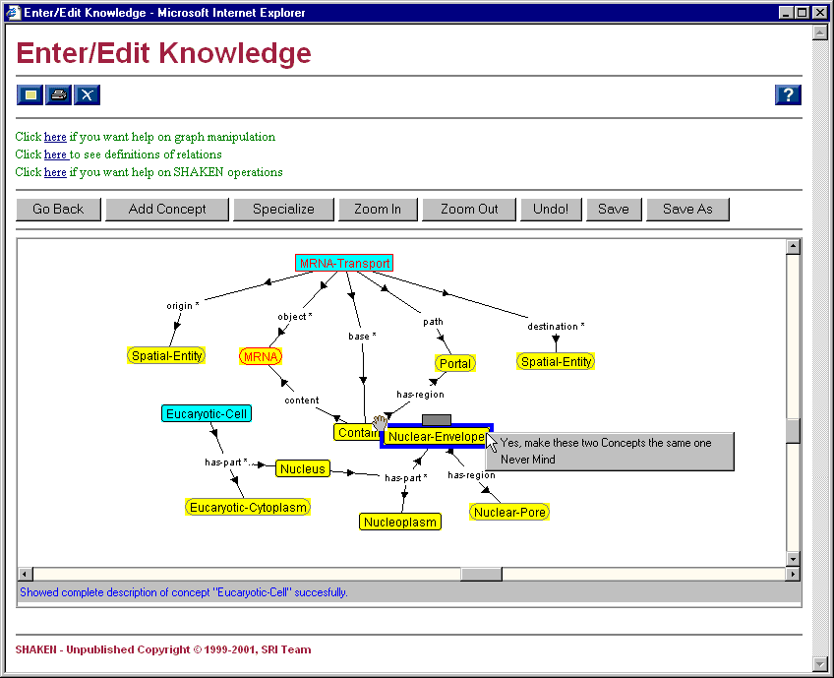
Notes:
Having dragged the Nuclear-Envelope node on top of the Container node, SHAKEN asks if the intention is to make these two things one and the same…

Slide 20
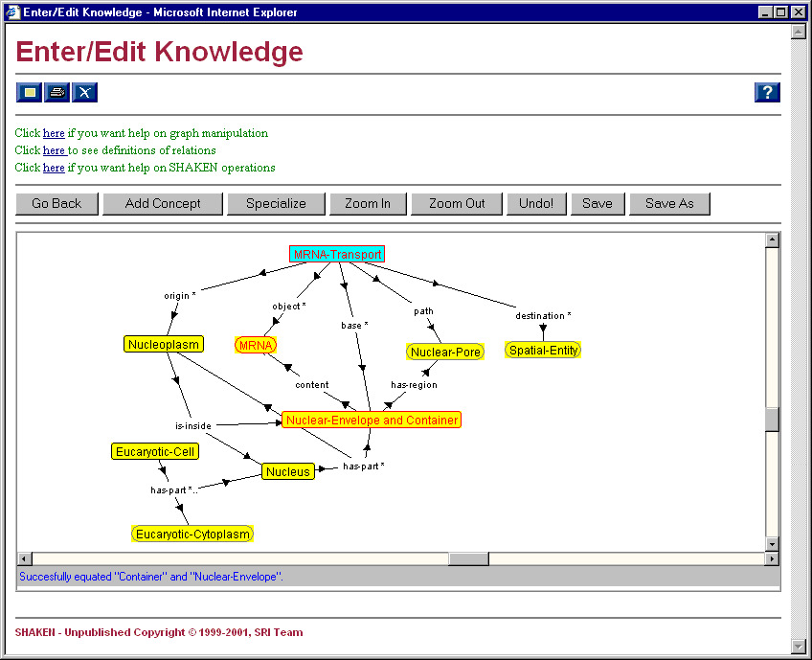
Notes:
By making Nuclear-Envelope one and the same, we see a single new node “Nuclear-Envelope and Container”, meaning that Nuclear-Envelope is playing the role of container in this scenario.
The second thing to notice is that SHAKEN inferred that the Nuclear-Pore region of the Nuclear-Envelope is the Portal region of the Container. It also inferred that the origin of the Transport is the Nucleoplasm (but only after you ask it to show the abridged descripion of Nucleoplasm). Finally, the existing knowledge (from pump-priming) that the Nucleoplasm is inside the Nuclear-Envelope is consistent with the requirement that the origin of a Move-Out-Of is inside the container.
The only thing left to do is specify that the MRNA is moving into the cytoplasm by unifying Eucaryotic-Cytoplasm with the destination of the Transport…

Slide 21
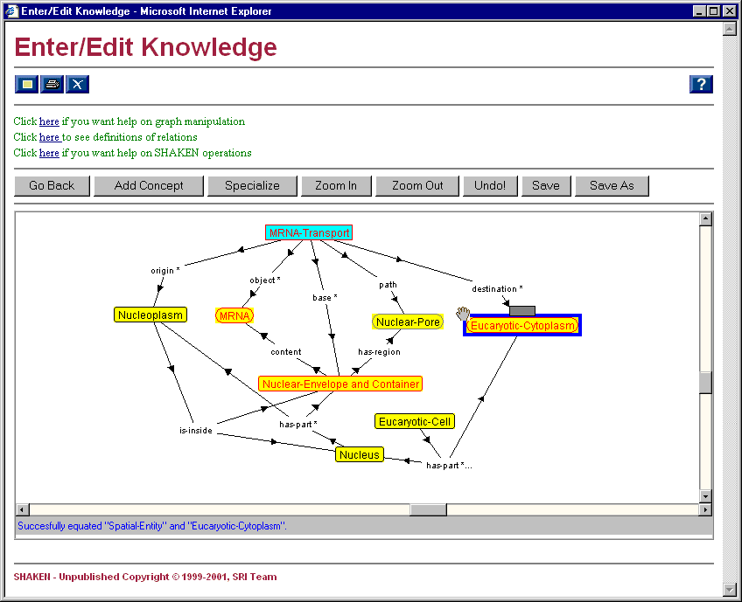
location
Notes:
Having specified the Eucaryotic-Cytoplasm as the destination of the Transport, SHAKEN’s simulator (which we’ll see later) will be able to infer that after the MRNA is transported out of the nucleus, its new location will be the Eucaryotic-Cytoplasm. This will not be shown as an arc on this static representation on this screen.
(This example was particularly effective because we chose Nuclear-Envelope as the Container and not Nucleus. It’s not quite reasonable to expect our users to do the same. One of our Y2 projects is to allow the user to specify the Nucleus as Container, but figure out that the Nuclear-Envelope part of the Nucleus is more appropriate in this case. We’ve been referring to this as one of many kinds of “loose speak” that we’re investigating).

Slide 22
Evaluation
Can DomEs learn to use the library to encode domain knowledge?
Can sophisticated knowledge be captured through composition of components?
Library requirements
Library construction/contents
Composition
Evaluation

Slide 23
Evaluation
train Biologists for two weeks
have the Biologists encode knowledge from a college-level Biology textbook using our tools
supply end-of-the-chapter-style Biology questions
have the Biologists pose the questions to their knowledge bases and record the answers
evaluate the answers on a scale of 0-3
qualitatively evaluate their KBs
Library requirements
Library construction/contents
Composition
Evaluation

Slide 24
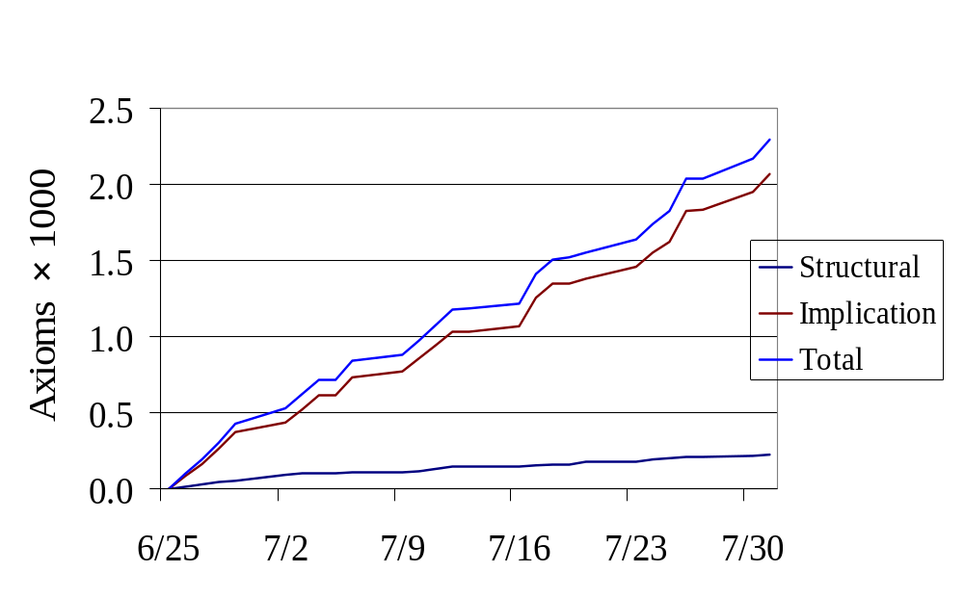
Evaluation — Productivity
Library requirements
Library construction/contents
Composition
Evaluation

Slide 25
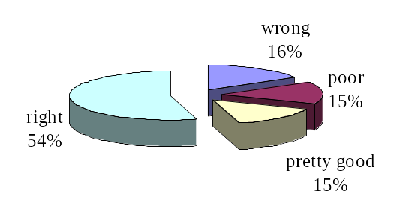
Evaluation — Question Answering
Library requirements
Library construction/contents
Composition
Evaluation

Slide 26
Evaluation — Anecdotal
“A list of perhaps ~50-100 [relations] would cover 95% of the assertions needed to describe any process in cell/molecular biology.”
“Cognitive Transparency … the Movement model in KM’s component library.”
“It changed the way I think about Biology.”
Library requirements
Library construction/contents
Composition
Evaluation

Slide 27
What’s Next?
it’s easy, but is it sufficient?
more components
  roles, property values, compound actions
more semantics
  richer process language, default knowledge, more context
more domains

Slide 28
Questions
Why do you think this is the “right” way?
Surely you don’t believe you’ve found The Primitives.
You haven’t shown that your library is useful for anything except the one task that is the context under which it was developed.
You admit that the library is not complete. How will you know when it is?
Axiom counting is meaningless. I need to see compelling quantitative evaluation.

