Slide 1
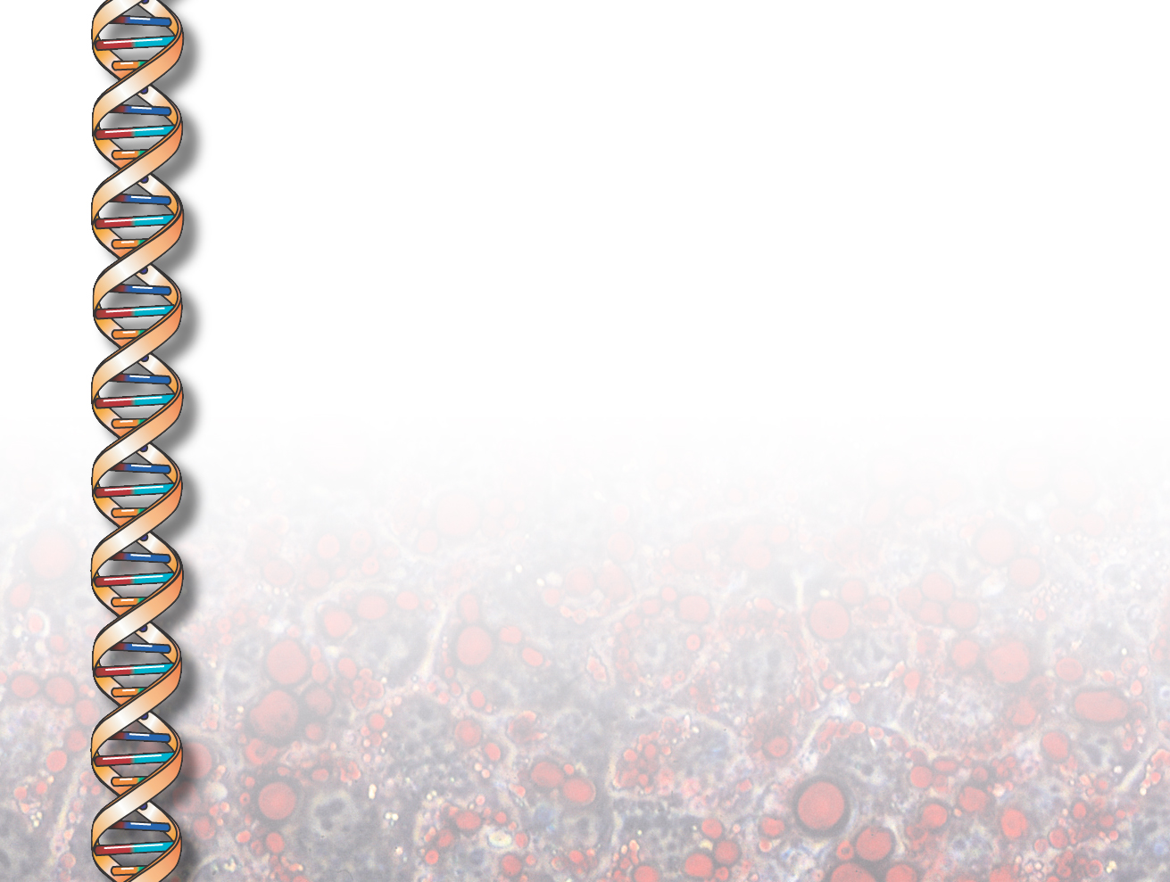
Knowledge Entry as the Graphical Assembly of Components
Peter Clark, John Thompson (Boeing)
Ken Barker, Bruce Porter (Univ Texas at Austin)
Vinay Chaudhri, Andres Rodriguez, Jerome Thomere,
Sunil Mishra (SRI International)
Yolanda Gil (ISI)
Pat Hayes, Thomas Reichherzer (Univ W Florida)

Slide 2
Goals and Context
Problem: difficult for domain experts to enter knowledge into KBs directly
Goal: Create tools supporting this
Context:
  Part of DARPA’s Rapid Knowledge Formation project
  Focus on domain knowledge (cf. problem-solving)
  Full system (SHAKEN) includes tools for:
  Knowledge entry; testing, analysis, and debugging; question-answering; analogical reasoning.
  Application domain: cell biology

Slide 3
Hypotheses and Approach
Knowledge entry = “assembling pre-built representational components” (rather than “writing axioms”)
  Complex axioms already pre-built in the KB
Can present and manipulate these representations graphically
  Presentation: dialog in terms of examples
  Manipulation: only need support a small number of “connection” axiom types (rather than full FOL)

Slide 4
The Knowledge Entry Process
User’s goal: Create/edit a representation of a concept
User’s activities:
  Locate and display relevant components from library
  Connect & extend them to create new representation
  Save the result
  Test & ask questions about the new concept

Slide 5
Displaying axioms using examples
To present axioms about a concept C,
  user doesn’t see the raw axioms directly
  Rather, user sees an example I of C
    Sees a graph of ground facts about I (computed from the axioms)
    ground facts are comprehensible and graphable
User builds new concept by interacting with this and other examples

Slide 6
Displaying axioms using examples
New concept: Virus-Invasion (a type of event)
SME adds a Penetrate subevent
Rules (logic)
∀x isa(x,Penetrate) → ∃y,z isa(y,Traverse) ∧ isa(z,Breach) ∧ subevent(x,y) ∧ subevent(x,z).
∀x,y isa(x,Penetrate) ∧ agent(x,y) → isa(y,Tangible-Entity).
∀x,y,z isa(x,Penetrate) ∧ subevent(x,y) ∧ isa(y,Breach) ∧ subevent(x,z) ∧ isa(z,Traverse) → next-event(y,z).
∀w,x,y,z isa(x,Penetrate) ∧ subevent(x,y) ∧ isa(y,Breach) ∧ agent(y,z) ∧ agent(x,w) → w = z.
∀x,y,z isa(x,Penetrate) ∧ subevent(x,y) ∧ isa(y,Traverse) ∧ path(y,z) → isa(z,Portal).
….

Slide 7
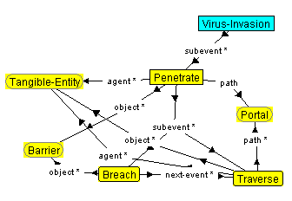
Displaying axioms using examples
New concept: Virus-Invasion (a type of event)
SME adds a Penetrate subevent
Rules as applied to an example

Slide 8
Connecting and Extending the Model
The user manipulates instances in the graph, using four types of graphical action
  specialize, add, connect, unify
Each action generates a rule
  Initial rule applies just to the example being viewed
  A generalization algorithm generalizes the rule to hold for all instances of the concept being built

Slide 9

Graphical Action 1: Specialize
Synthesizing the axiom:
“Tangible entity 1 is a virus”
→ “In this virus invasion, the thing penetrating is a virus”
→ “In all virus invasions, the thing penetrating is a virus”

Slide 10
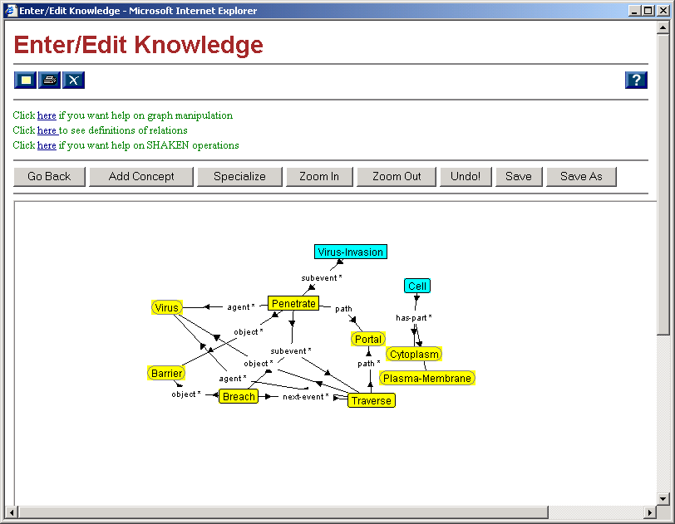
Graphical Action 1: Specialize

Slide 11
Graphical Action 2: Add
Synthesizing the axiom:
“In this virus invasion, there is a cell participant.”
→ “In all virus invasions, there is a cell participant.”

Slide 12
Graphical Action 2: Add

Slide 13
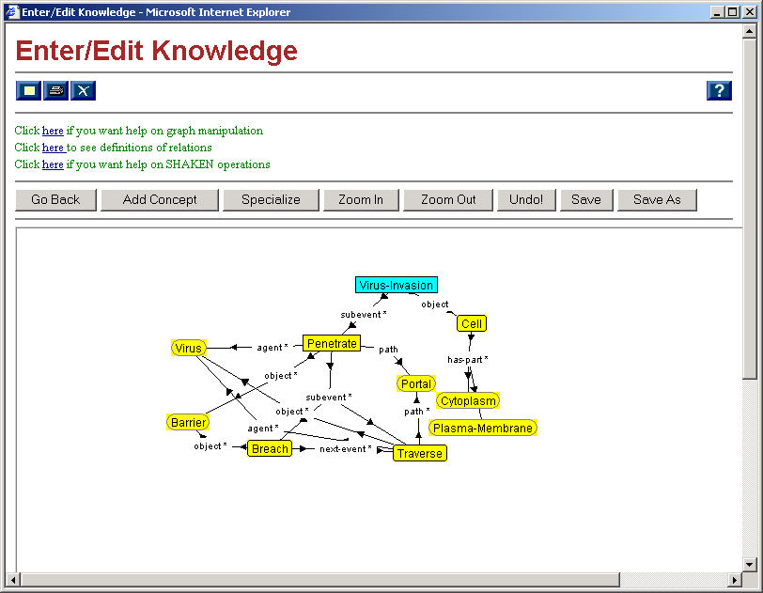
Graphical Action 3: Connect
Synthesizing the axiom:
“In this virus invasion, the object is the cell participant.”
→ “In all virus invasions, the object is the cell participant.”

Slide 14
Graphical Action 4: Unify

Slide 15
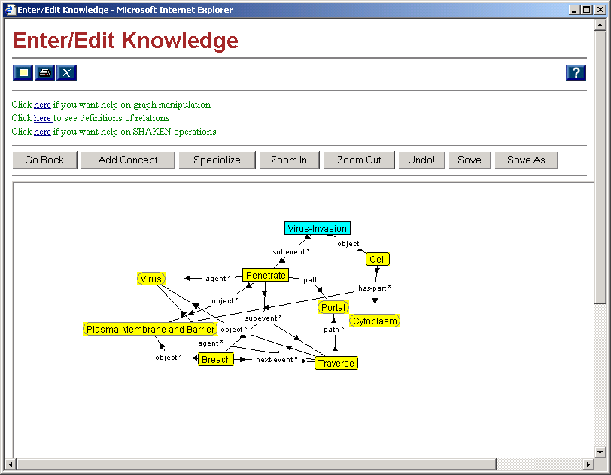
Graphical Action 4: Unify

Slide 16
Graphical Action 4: Unify
Synthesizing the axiom:
“Barrier 1 = Plasma Membrane 2”
→ “In this virus invasion, the object of the penetrate…
→ “In this virus invasion, the object of the penetrate = the plasma membrane part of the cell.”
→ “In all virus invasions, the object of the penetrate = the plasma membrane part of the cell.”

Slide 17
(Demonstration)

Slide 18
Evaluation and Lessons Learned
Large-scale trials in June and July 2001
4 biology students used system for 4 weeks
Their goals:
  Encode 11-page subsection on cell biology
  Create and debug representations
  Test system on large set of test questions
    High-school level difficulty
    Generally “reading comprehension” style

Slide 19
Results
All users able to grasp the basic approach
Built representations for
  ~450 biological concepts
  Size 1 to >100 (!) nodes
  Axioms created: 1408, 567, 1296, 921

Slide 20
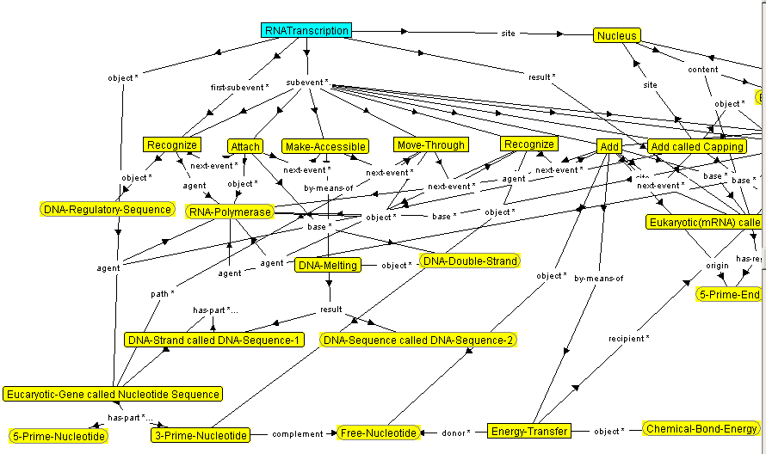
Example graph by end user

Slide 21
Results
All users able to grasp the basic approach
Built representations for
  ~450 biological concepts
  Size 1 to >100 (!) nodes
  Axioms created: 1408, 567, 1296, 921
Answer quality on test questions:
  ~2 (“mostly correct”) on scale 0-3
    (1.74 on all questions, 2.24 on questions attempted)
System rated “useful” and “easy” to use

Slide 22
Results (cont)
A lot of knowledge encoded…
But a lot of knowledge not encoded.
  Pre/post conditions for actions
  Richer process models (e.g., repetitive events)
  Negative information (e.g., <x> doesn’t happen)
  Locational/spatial information (e.g., shape)
  Changes with time (e.g., state at end of process)
  Uncertainty (e.g., “typically”, “usually”, “mainly”, “most”)

Slide 23
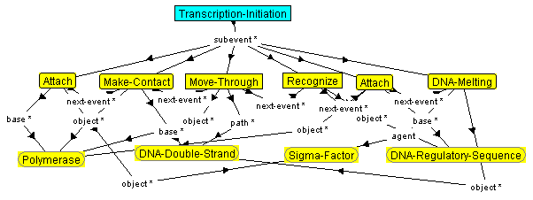
Example:
Original:
“In bacteria, RNA polymerase molecules tend to stick weakly to the bacterial DNA when they make a random collision with it; the polymerase molecule then slides rapidly along the DNA…”
Encoding:
Encoding:

Slide 24
Example:
Original:
“In bacteria, RNA polymerase molecules tend to stick weakly to the bacterial DNA when they make a random collision with it; the polymerase molecule then slides rapidly along the DNA…”
Encoding:
Encoding:

Slide 25
User errors
Hope: Pre-built representations guide users, reduce errors
But: users still made mistakes, e.g.:
  Indirect/incorrect reference
    “DNA” vs. “DNA strand” vs. “subsequence”
  Missing coreferences
    “attach to RNA; remove nucleotide sequence [of that RNA]”
  Overgenerality/missing context
    “All polymerases have a sigma factor”
    “Genes contain exons”
  Misuse of case roles
    “polymerase is the instrument of copying”

Slide 26
Multiple Viewpoints
System: assumes a single representation of concept
But: Users sometimes created multiple representations
  DNA as
    sequence of genes and non-genes
    Sequence of nucleotide pairs
    Pair of DNA strands
  Multiple views of a process
    Which actions to include/ignore
Need a better way of handling viewpoints

Slide 27
System’s Reasoning
Users were sometimes annoyed/confused at SHAKEN’s own inferencing (!)
Need better ways to
  Regulate when system’s inferencing occurs
  Explain why it is happening

Slide 28
Summary and Conclusion
Key Points:
  Knowledge entry = “component assembly”
  Graphical interface based on
    dialog in terms of examples
    claim that a limited set of axiom types is adequate
Key Results:
  It (really!) works!
  …but…
    Some knowledge not captured
    Some mistakes still made
    Viewpoints not well handled

Slide 29
(end)

Slide 30
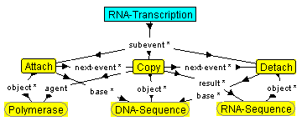
(Very simple) example graph…

Slide 31
Example:
Original:
“In bacteria, RNA polymerase molecules tend to stick weakly to the bacterial DNA when they make a random collision with it; the polymerase molecule then slides rapidly along the DNA…”
Encoding:
make contact
“(In bacteria), RNA polymerase molecules (tend to) stick (weakly) to the bacterial DNA (when they make a random collision with it); the polymerase molecule then slides (rapidly) along the DNA…”
moves

Slide 32
Results (cont)
A lot of knowledge encoded…
But a lot of knowledge not encoded.
  Simple attribute values (e.g., sizes)
  Equational information (e.g., rates wrt time)
  Temporal relations (e.g., simultaneous)
  Pre/post conditions for actions
  Richer process models (e.g., repetitive events)
  Sequences (e.g., nucleotide sequences)
  Negative information (e.g., <x> doesn’t happen)
  Locational/spatial information (e.g., shape)
  Changes with time (e.g., state at end of process)
  Uncertainty (e.g., “typically”, “usually”, “mainly”, “most”)

