Slide 1
Representing Roles and Purposes
James Fan¹, Ken Barker¹, Bruce Porter¹, Peter Clark²
¹ University of Texas at Austin
² Boeing Company
Notes:
Building large KB, encountering diff knowledge, how we’ve chosen to deal w/ this rep issue, and our methodology, literature survey, corpus study, engineering solution.

Slide 2
Background on RKF Project
Text book challenge problem
One of the problems is how to deal with variety of types of knowledge, not just partonomy or taxonomy
Some of them are obvious: entities and events
Some of them are less obvious: entities and roles
Notes:
the role issue rises from the Rapid Knowledge Formation project
Sme encode a KB from a college textbook w/ lil training in KE
Separate RKF from TKCP

Slide 3
A role representation consists of those features of an entity that are due to its participation in some event.

Slide 4
Roles and Purposes
Examples:
  Fred is an employee at IBM.
  Fred is the gardener's employer.
  Grasshoppers are the favourite food of many birds.
  NADH is an important carrier of power in cells.
  This operator is a short region of regulatory DNA.

Slide 5
Intrinsic and Extrinsic Features
Extrinsic features describe an entity relative to other entities and events.[Smith and Medin81], [Barr & Caplan87], for example,
  salary (of an employee), nutritional value (of a food).
Intrinsic features describe an entity in isolation, for example,
  size (of an object), weight (of an object).
Intrinsic features always applicable; extrinsic features may not be applicable.
Notes:
In an effort to understand roles, we look at related research
Applicable – to the entity not to the role

Slide 6
Intrinsic and Extrinsic Features (Continue)
Conclusions:
  The distinction is important.
  The representation of a role consists of those extrinsic features of an entity that are due to its participation in some event.
  This motivates reifying roles.

Slide 7
Foundedness and Semantic Rigidity (due to Guarino)
Foundedness: Something is founded if it is defined in terms of relationships to other things.
Semantic Rigidity: Something is semantically rigid if its existence is tied to its class; that is if in ceasing to be of kind X, it ceases to be.

Slide 8
Distinguishing Roles and Entities (due to Guarino)
Semantic
Rigidity
Foundedness
Roles
Entities

Slide 9
Distinguishing Roles and Entities
Food is Founded: The properties of food, such as eaten-by and nutritional-value, are extrinsic features of the entity filling the role of food. They relate that entity to others participating in the eating event, such as the eater, and they are applicable only in that context.
Notes:
Guarino offers two criteria

Slide 10
Distinguishing Roles and Entities [Guarino92]
Food lacks Semantic Rigidity: For example, a grasshopper is food when eaten by a bird, but when it is no longer considered food, it is still a grasshopper.
Notes:
(i.e. Its primary class membership)

Slide 11
Distinguishing Roles and Entities
Person is not Founded: The properties of a person, such as age and sex, are intrinsic features. They are defined independently of other entities and events.
Person has Semantic Rigidity: when a person ceases to be a person, she ceases to be.

Slide 12
Finding Roles
Experiments:
  Extracted "-ee", "-er", "-or", "-ist" words from wordlist, sampled, and reviewed them using the foundedness and semantic rigidity criteria. 6% of nouns are roles.
  Reviewed the 3,000 most frequently used nouns in BNC. 6% of nouns are roles.
Notes:
Now we’ve convinced you the difference between roles & entities
But maybe rare, who cares

Slide 13
Examples
friend, minister, staff, student, teacher, manager, wife, worker, director, leader, doctor, player, husband, customer etc..

Slide 14
Representational Requirements for Roles
Role instances are created and destroyed dynamically, Fred’s job was eliminated.
Roles can be transferred between entities, John got Bill's job.
Multiple roles can be played by one entity, Fred is both an employer and an employee.
Entities of unrelated types can play the same role, Fred works for IBM and Lisa.

Slide 15
Ways to Represent Roles[Steimann00]
Simple label
Inheritance
Adjunct instance

Slide 16
I. Simple Label
A role is just a label denoting a participant in an event; it is not reified.
Example:
Pro:
  simple.
Con:
  Extrinsic features of the entities that are playing roles cannot be held by roles because roles are not reified.
IBM:
  size: 50,000
  agent-of: _Employ1
employer-of:
Fred:
  height: 5’10
  object-of: _Employ1
employee-of:

Slide 17
II. Inheritance
Roles are reified subtypes of entities.
Example.
Person
  age:
  sex:
  height:
  … …
subsumes
Employer
  NumOfEmployees:
  … …

Slide 18
II. Inheritance
Advantages:
  Roles are reified.
  An entity can play multiple roles through multiple inheritance.
  Roles are dynamically created/destroyed if a dynamic classification system is available.
Disadvantages:
  Paradox[Steimann00]
Employer
Employee
instance
instance
Fred

Slide 19
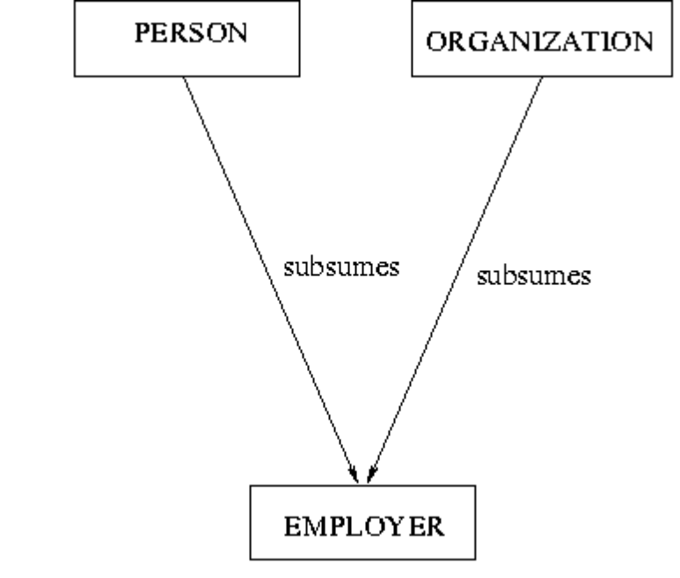
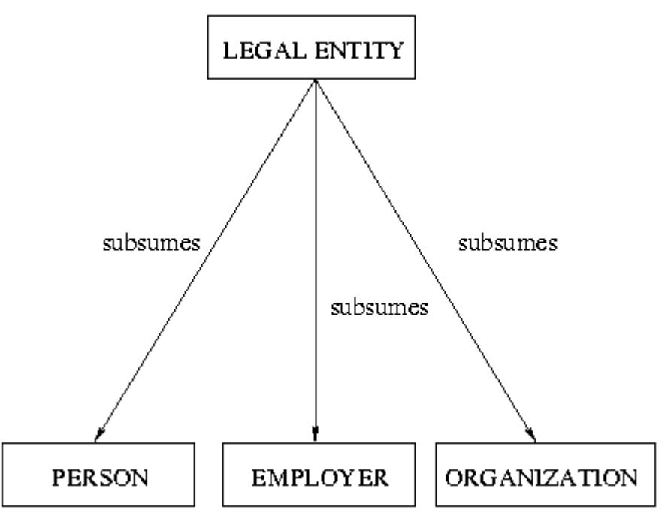
Paradox Due to Inheritance
But employers are not both person AND organizations!
But Employer is not sibling of Person or Organization!

Slide 20
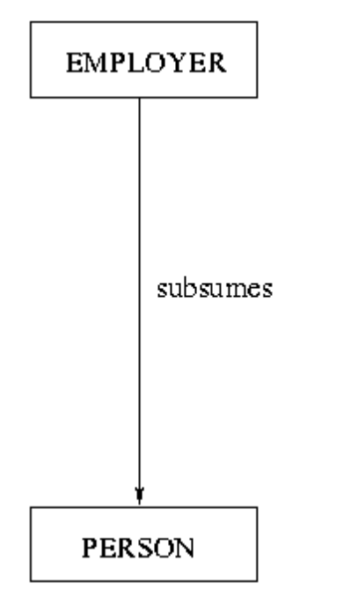
An Attempt to Salvage Inheritance
But, not every person is an employer!

Slide 21
Lessons From the First Two Approaches
Reifying roles allows extrinsic features to be associated with them.
Classes of roles and entities should not be related by subsumption.
Only instances of roles and entities are related.

Slide 22
III. Adjunct Instance
Adjunct: something joined or added to another thing but not essentially a part of it. [Merriam-Webster]
Instances of role types joined with instances of entity types.
Example:
entity
Fred
  age:35
  sex:male
  . . .
agent
event
_Employ3
plays
object
role
_Employer2
  NumOfEmployees:1
  . . .
TheGardener

Slide 23
FOL of the Previous Example
Person(Fred) ∧ Employer(_Employer2) ∧ Event(_Employ3) ∧ Person(TheGardener) ∧ agent-of(Fred, _Employ3) ∧ plays(Fred, _Employer2) ∧ object-of(TheGardener, _Employ3)

Slide 24
The Approach We Are Using
Based on adjunct instance approach.
Role hierarchy is separated from entity hierarchy.
Entity
Event
Role
Tangible
State
Agent
Intangible
Action
Instrument
Object
Be-Touching
Operator
Information
Move
Vehicle

Slide 25
A Representation for Roles
a Event
_Employ2
_Employ4
relation
agent
agent
an Entity
IBM
Bill
plays
plays
plays
a Role
_Employer3
_Employer4

Slide 26
Representing Purposes Using Roles
  Hammers are used to hit things.
The purposes of hammers are:
not an event
not an entity
but a way that an entity participates an event
  The shoe was used as a hammer.
Notes:
Exact usage/purpose hidden

Slide 27
A Representation for Purposes
an Entity
_Hammer1
_MyShoe
purpose
purpose
plays
a Role
a Hammer-Role
a Hammer-Role
in-event
in-event
The shoe was used as a hammer
an Event
a Hit
Hammers are used to hit things.

Slide 28
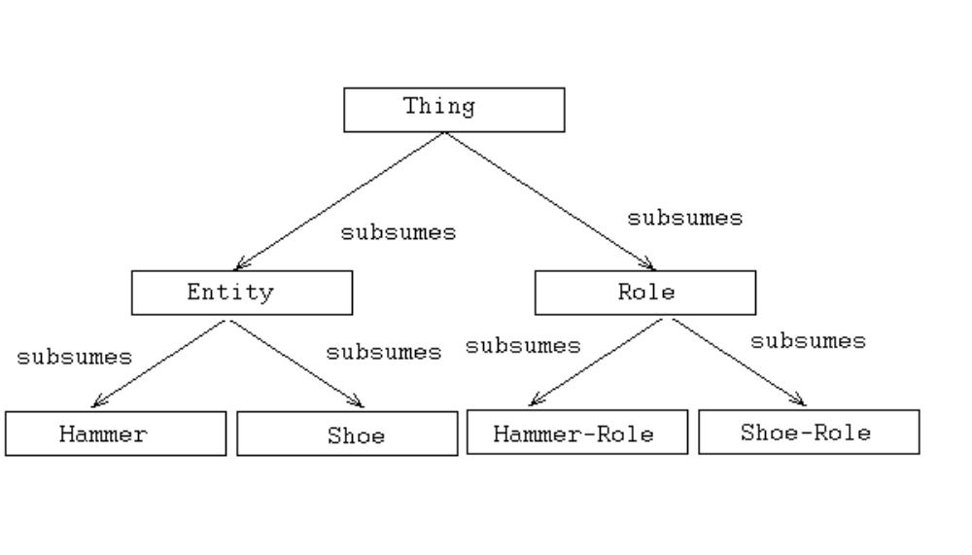
Duplication of Hierarchies

Slide 29
Non-reified Roles
For all x such that isa(x, Hammer) ⇒ exists y, z such that isa(y, Instrument) ∧ isa(z, Hammering) ∧ purpose(x, y) ∧ in-event(y, z)
Exists p, h such that isa(myShoe, Shoe) ∧ isa(h, Hammer) ∧ plays(myShoe, p) ∧ purpose(h, p)

Slide 30
Conclusion
Roles are different from entities:
  Entities are things that are.
  Roles are things that are but only in the context of things that happen.
A representation of roles needs to meet 4 requirements.
  Role instances are created and destroyed dynamically.
  Roles can be transferred between entities.
  Multiple roles can be played by one entity.
  Entities of unrelated types can play the same role.
Notes:
Remind goal

