Slide 1
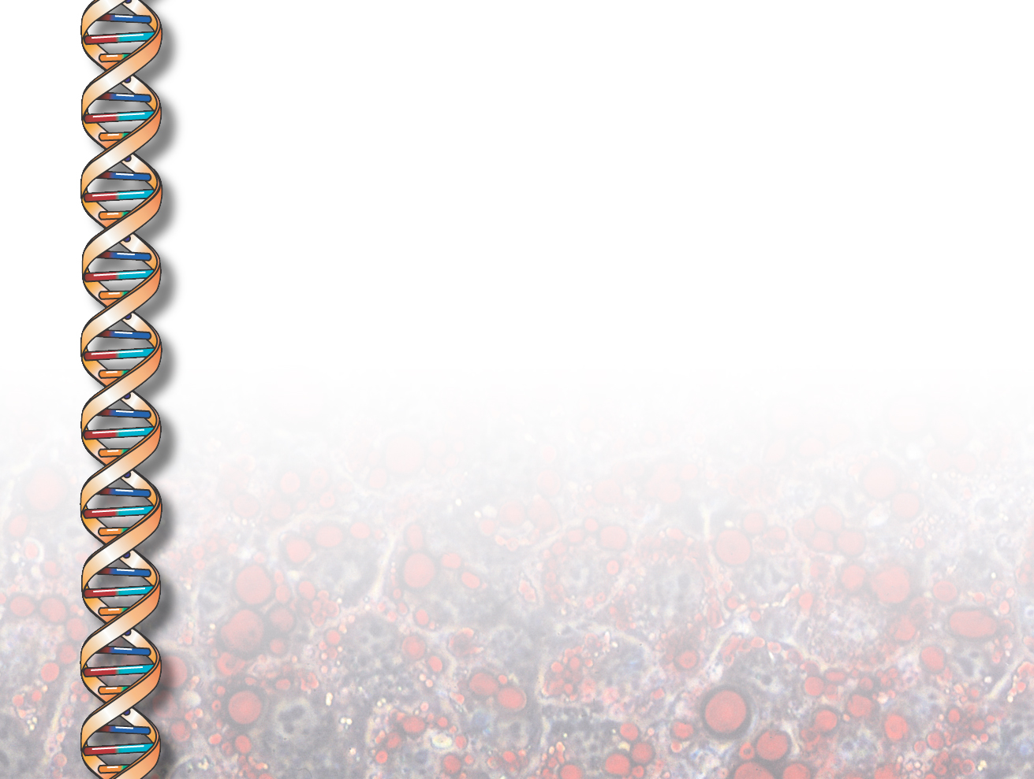
Technologies to Enable Biologists to Build Large Knowledge Bases on Human Anatomy and Physiology
Bruce Porter
Ken Barker
Art Souther
Department of Computer Science
University of Texas at Austin
Vinay Chaudhri
AI Center, Stanford Research Institute
Peter Clark
Math and Computing Research Center, Boeing

Slide 2
What’s in an Ontology?
lexicon to aid communication
  both for people and computers
cataloging system to organize a library
  a library of multi-media objects
meta-level schema for integrating databases
  so queries can be answered across databases
hierarchy of classes and instances
  supporting inheritance of general information
knowledge base for autonomous reasoning

Slide 3
What’s in an Ontology?
lexicon to aid communication
  both for people and computers
catalog system to organize a library
  library contains multi-media objects
meta-level schema for integrating databases
  so queries can be answered across databases
hierarchy of classes and instances
  supporting inheritance of general information
knowledge base for autonomous reasoning
“strong AI”

Slide 4
What is Autonomous Reasoning Good for?
answering questions that are unanticipated when the knowledge base is built
  why and what-if questions
  answers tailored to user’s interest and background
  superhuman performance
finding gaps and inconsistencies in the knowledge base
raising good questions

Slide 5
Knowledge Base Evolution
from expert systems to multifunctional knowledge bases:
  Mycin and Guidon
  broadening both the task and the domain

Slide 6
Large Multi-functional KB's can be Built
e.g. the Botany Knowledge Base
10 year construction effort by full-time domain expert and tools developers
contains 40,000 concepts and 160,000 facts
much more information available via inheritance and rules
performance goal: robust, expert-level ability to answer questions with good explanations

Slide 7
… and they can work well: e.g., for the task of generating descriptions
Q: What happens during embryo sac formation?
A: Embryo sac formation is a kind of female gametophyte formation. During embryo sac formation, the embryo sac is formed from the megaspore mother cell. Embryo sac formation occurs in the ovule.
Embryo sac formation is a step of angiosperm sexual reproduction. It consists of megasporogenesis and embryo sac generation. During megasporogenesis, the megaspore mother cell divides in the nucellus to form 4 megaspores. During embryo sac generation, the embryo sac is generated from the megaspore.

Slide 8
… and they can work well: e.g., for the task of generating descriptions
Q: What happens during embryo sac formation?
A: Embryo sac formation is a kind of female gametophyte formation. During embryo sac formation, the embryo sac is formed from the megaspore mother cell. Embryo sac formation occurs in the ovule.
Embryo sac formation is a step of angiosperm sexual reproduction. It consists of megasporogenesis and embryo sac generation. During megasporogenesis, the megaspore mother cell divides in the nucellus to form 4 megaspores. During embryo sac generation, the embryo sac is generated from the megaspore.
… but we need a better process

Slide 9
Enabling Domain Experts to Build Knowledge Bases
Why not use knowledge engineers instead?
  they are less concerned with the fidelity of the representations
  they lack the knowledge to simplify and abstract the knowledge thoughtfully
  they operate with sentence-level facts rather than domain-level theories
We envision extensive knowledge bases built by the distributed community of active scientists, and maintained by organizations like NSF, NIH, NLM.

Slide 10
Enabling Domain Experts to Build Knowledge Bases
Why not use knowledge engineers instead?
  they are less concerned with the fidelity of the representations
  they lack the knowledge to simplify and abstract the knowledge thoughtfully
  they operate with sentence-level facts rather than domain-level theories
We envision extensive knowledge bases built by the distributed community of active scientists, and maintained by organizations like NSF, NIH, NLM.
This will only work if domain experts can work
with familiar concepts and without writing axioms!

Slide 11
Our Approach
Building knowledge bases is a joint effort:
knowledge engineers build a library consisting of
  a small hierarchy of reusable, composable, domain-independent knowledge units (“components”)
  a small vocabulary of relations to connect them
knowledge engineers develop generic question answering methods, such as simulation
domain specialists build representations of fundamental concepts (“pump priming”)
domain experts build a KB through the instantiation and composition of components
supported by DARPA’s Rapid Knowledge Formation project

Slide 12
A Library of Components
small
easy to learn and use
broad semantic distinctions (easy to choose)
allows detailed pre-engineering of declarative executable models (Paul Cohen, Umass)
drawn from related work
  ontology design/knowledge engineering
  linguistics
    semantic primitives
    case theory, discourse analysis, semantics
  English lexical resources
    dictionaries, thesauri, word lists
    WordNet, Roget, LDOCE, corpora, etc.

Slide 13
Library Contents
actions — things that happen, change states
  Breach,Enter, Copy, Replace, Transfer, etc.
states — relatively temporally stable events
  Be-Closed, Be-Attached-To, Be-Confined, etc.
entities — things that are
  Substance, Place, Object, etc.
roles — things that are, but only in the context of things that happen
  Catalyst,Container, Template, Vehicle, etc.

Slide 14
Library Contents
relations between events, entities, roles
  agent, object, recipient, result, etc.
  content, part, material, possession, etc.
  causes, defeats, enables, prevents, etc.
  purpose, plays, etc.
properties between events/entities and values
  rate, frequency, intensity, direction, etc.
  size, color, integrity, shape, etc.

Slide 15
Access
browsing the hierarchy top-down
semantic search
  all components have hooks to WordNet
  climb the WordNet hypernym tree with search terms
  assemble: Attach, Come-Together
  mend: Repair
  infiltrate: Enter, Traverse, Penetrate, Move-Into
  gum-up: Block, Obstruct
  busted: Be-Broken, Be-Ruined

Slide 16
A Small Example
The software system is called SHAKEN
mRNA-Transport:
  “mRNA is transported out of the cell nucleus into the cytoplasm”

Slide 17
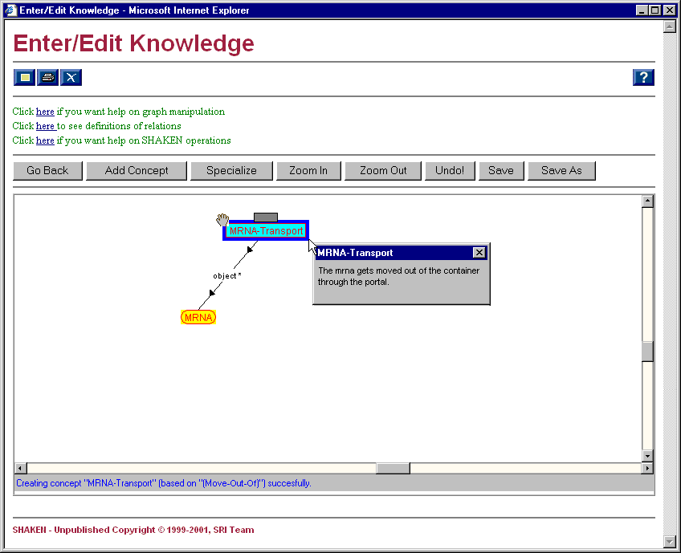
Notes:
This sequence of screen shots shows some of the kind of knowledge stored in components. It also shows how connecting components can result in extra knowledge being asserted through inferencing. Note that the SME has defined MRNA-Transport as a kind of Move-Out-Of.
The example is MRNA-Transport, which we’ve defined as a kind of Move-Out-Of. Nodes with red outline and red text show knowledge that the user supplied. On this slide, the user has defined MRNA-Transport and supplied the knowledge that MRNA is the object of the MRNA-Transport.
The definition that shows in the popup is not from the documentation, it’s the text-gen slot on MRNA-Transport. The definition suggests that there’s more to this concept than what appears on the screen. We can get at the rest by showing the expanded version of MRNA-Transport…

Slide 18
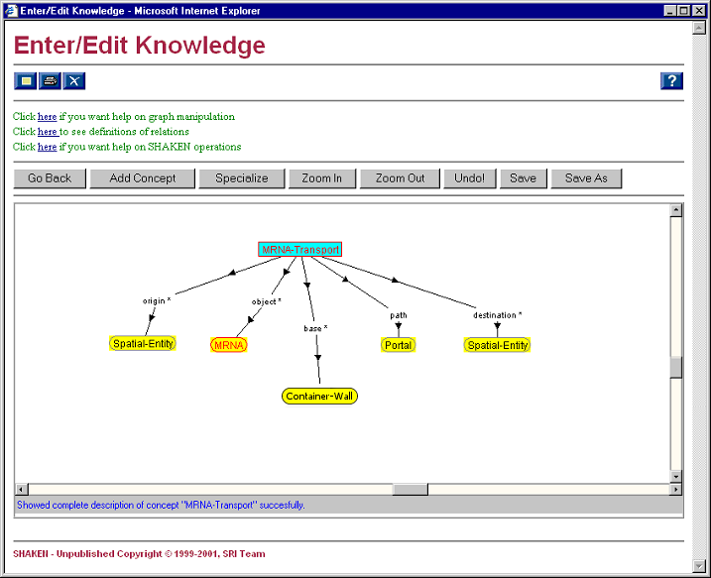
Notes:
Here is the other information that was hidden. Note that none of this was added by the user, it all comes from the Move-Out-Of component. In fact, there’s more than what’s shown here. Move-Out-Of also specifies relationships between the container that the object moves out of and the portal it moves through…

Slide 19
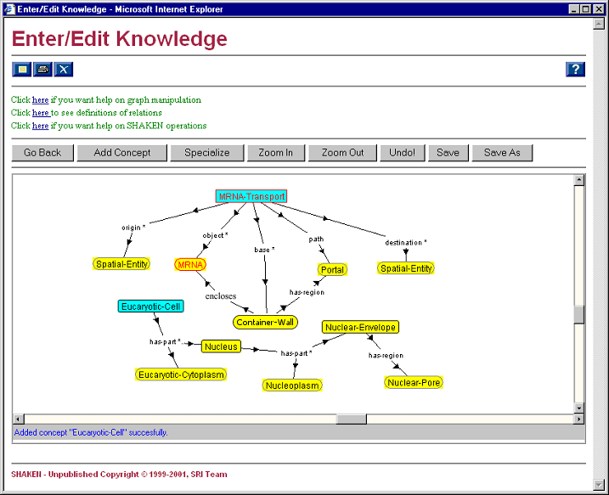
Notes:
By expanding the Container node we see that the Portal the MRNA moves through is a region of the Container. We also see that the MRNA is currently contained in the Container.
This slide also shows a new component that we’ve added: Eucaryotic Cell (only Eucaryotic Cells have nuclei). All of the knowledge related to the Eucaryotic Cell is in the Biology pump-priming we put in for the summer trials. Here the user has to specify that the Container the MRNA is moving out of is the Nuclear Envelope. The user does this by dragging the Nuclear-Envelope node on top of the Container node…

Slide 20
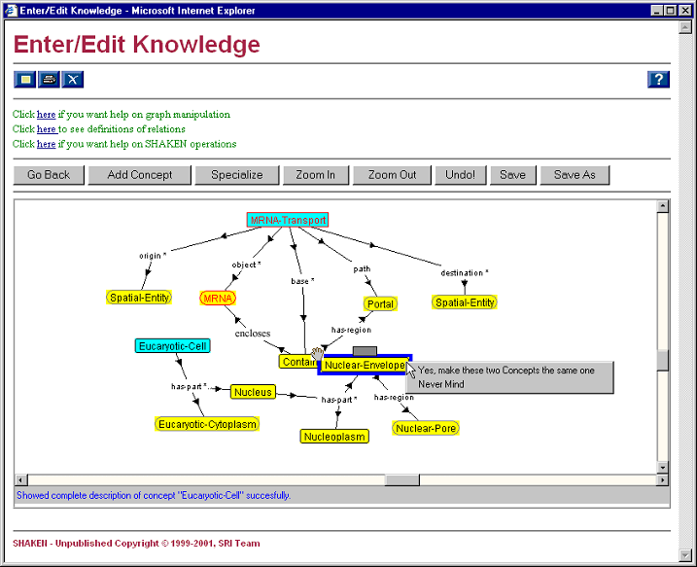
Notes:
Having dragged the Nuclear-Envelope node on top of the Container node, SHAKEN asks if the intention is to make these two things one and the same…

Slide 21
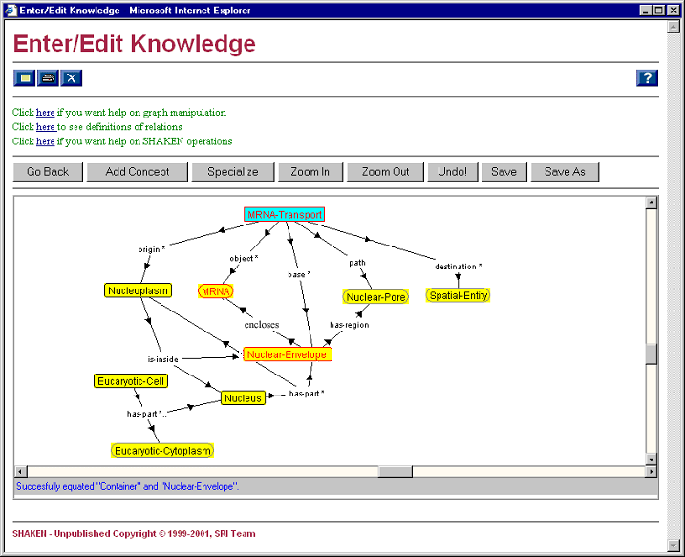
Notes:
The thing to notice is that SHAKEN inferred that the Nuclear-Pore region of the Nuclear-Envelope is the Portal region of the Container. It also inferred that the origin of the Transport is the Nucleoplasm (but only after you ask it to show the abridged descripion of Nucleoplasm). Finally, the existing knowledge (from pump-priming) that the Nucleoplasm is inside the Nuclear-Envelope is consistent with the requirement that the origin of a Move-Out-Of is inside the container.
The only thing left to do is specify that the MRNA is moving into the cytoplasm by unifying Eucaryotic-Cytoplasm with the destination of the Transport…

Slide 22
unify
Notes:
The thing to notice is that SHAKEN inferred that the Nuclear-Pore region of the Nuclear-Envelope is the Portal region of the Container. It also inferred that the origin of the Transport is the Nucleoplasm (but only after you ask it to show the abridged descripion of Nucleoplasm). Finally, the existing knowledge (from pump-priming) that the Nucleoplasm is inside the Nuclear-Envelope is consistent with the requirement that the origin of a Move-Out-Of is inside the container.
The only thing left to do is specify that the MRNA is moving into the cytoplasm by unifying Eucaryotic-Cytoplasm with the destination of the Transport…

Slide 23
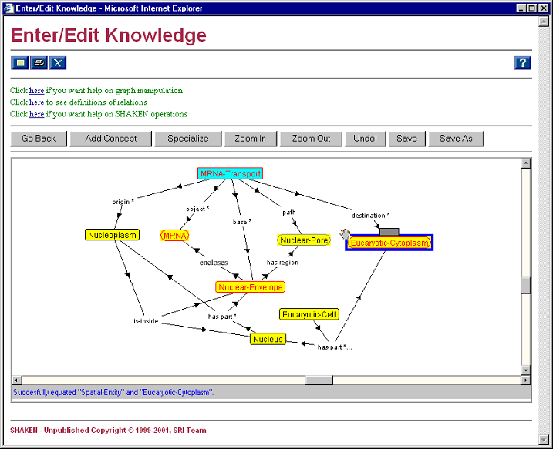
location
Notes:
Having specified the Eucaryotic-Cytoplasm as the destination of the Transport, SHAKEN’s simulator will be able to infer that after the MRNA is transported out of the nucleus, its new location will be the Eucaryotic-Cytoplasm. This will not be shown as an arc on this static representation on this screen.
(This example was particularly effective because we chose Nuclear-Envelope as the Container and not Nucleus. It’s not quite reasonable to expect our users to do the same. One of our Y2 projects is to allow the user to specify the Nucleus as Container, but figure out that the Nuclear-Envelope part of the Nucleus is more appropriate in this case. We’ve been referring to this as one of many kinds of “loose speak” that we’re investigating).

Slide 24
“Real KBs” are Significantly Larger
Here’s part of the representation of mRNA-Processing built by a biologist (Art)

Slide 25
Knowledge Types
Taxonomic:
  RNA Capping is-a-kind-of Attach
Partonomic:
  Eucaryotic Cell has-parts Nucleus, Mitochondrion
Causal:
  RNA Capping enables mRNA Export
Subevents:
  mRNA processing has-subevents RNA Capping, Polyadenylation, mRNA Splicing . . .
Temporal:
  RNA Capping occurs-before mRNA Export

Slide 26
Knowledge Types
Qualitative Influences:
  RNA Capping inhibits mRNA Degradation
Spatial Information:
  Eucaryotic Primary RNA Transcript has-region 5-prime UTR
Structural:
  Nuclear Envelope encloses mRNA
Telic:
  RNA polymerase has-purpose to be a Catalyst in Polyadenylation
Imagery:
  graphics and animation

Slide 27
Evaluation
Can Domain Experts learn to use the library to encode domain knowledge?
Can sophisticated knowledge be captured through composition of components?

Slide 28
Methodology
train biologists (4 graduate students) for six days
have them encode knowledge from a college textbook, Essential Cell Biology by Bruce Alberts
supply end-of-the-chapter-style Biology questions
have the biologists pose the questions to their knowledge bases and record the answers
have another biologist evaluate the answers on a scale of 0-3
qualitatively evaluate their KBs

Slide 29
Some Example Questions
What nucleotide base pairs with adenine in RNA?
How is uracil in RNA like thymine in DNA?
What is the relationship between thymine and uracil?
For a given bacterial gene, how are bacterial RNA and DNA molecules different?
Describe RNA as a kind of polymer.
What are the four bases/nucleotides of RNA?
What is the relationship between a DNA gene and its RNA transcription product?

Slide 30
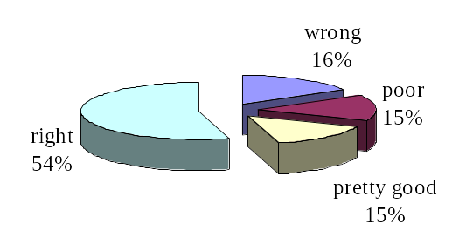
Evaluation — Question Answering

Slide 31
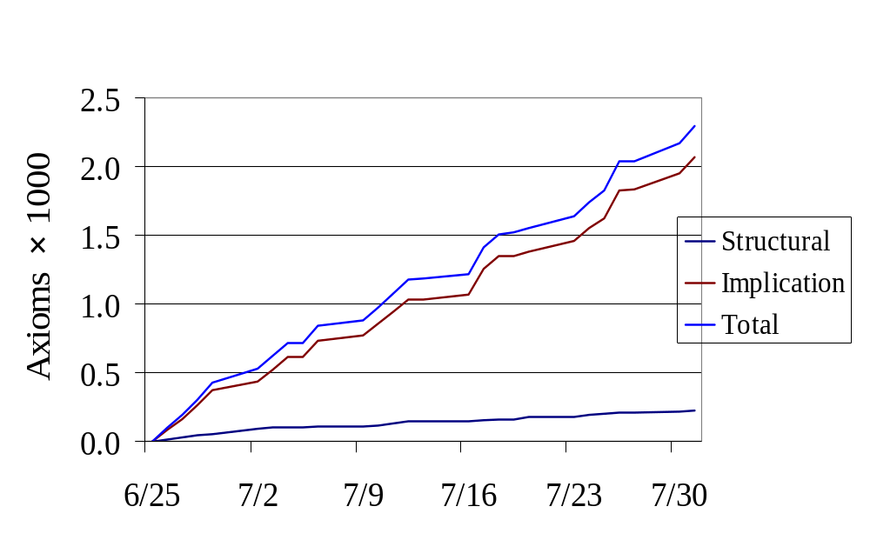
Evaluation — Productivity

Slide 32
Summary
Multi-functional knowledge bases can be built
… by domain experts, almost
… and they will be, with or without sound principles of ontological engineering
… and ontologists can significantly improve the results

Slide 33
Summary
Multi-functional knowledge bases can be built
… by domain experts, almost
… and they will be, with or without sound principles of ontological engineering
… and ontologists can significantly improve the results
Art and I would love to give you a demo!
Ask us how you can get a PC version of SHAKEN for research use

