Slide 1
Clarifying the Relationships among Ontologies, Context and System Realization and Efficacy
Jack Ring
Ontolog Summit 2018 Planning Session
10/11/2017

Slide 2
Agenda
Dialog prompts seeking solace for struggling systemists.
Greatly appreciate Ontolog, NIST NCOR, NCBO, IAOA, NC_ NITRD. And other authors of prior Summits. Also Barry Smith’s presentation in the 2017 Summit symposium and presentations by John Sowa and others in this 2018 thread.
This session will explore a different perspective. At the risk of hurting any participant’s feelings, let’s consider whether we are addressing a problem we know how to solve instead the one that is causing the trillion dollar losses --- inaccurate, inadequate, insecure and intransigent systems.
Let’s consider ontology as a way to synergize multiple stakeholders having diverse, conflicting views and viewpoints.

Slide 3
Caveat Emptor
Jack Ring
60+ years as system practitioner. Instrumental in enabling more than 50 advanced systems. Majority were successful. Bachelor in Physics, Emporia State College. Declined AEC Fellowship in radiation biophysics. Fellow, International Council on Systems Engineering, www.incose.org

Slide 4
Enabling the System Value Cycle
SE BoK Updated
System Characterized
Community
Situation
Problem Discerned
Value of System Quantified
Problem System Understood
Effects on Problem Known
Focus on Value
Solution Effect
Envisioned
Context Adapted
Mode 1
Mode 3
POSIWID Known
Intervention Strategy
Focus on Purpose
Operational
Results
PCS S><R Specified
Focus on System
PCS Activated
PCS Envisioned
Mode 2
Operational Readiness
PCS Designed
and Architected
PCS Tested
Components
Specified - Developed - Assembled
IEEE-SMC 1998

Slide 5
Context of Ontology
Cognitive Overload
Underconceptualization
1
3
2
Angst
Problematic
Stakeholders
Acceptable
Situation
8
Control
Know
Goal
Observe
Administer
7
Analyze &
Categorize
Analyze &
Negotiate
Intervention
System
6
Generate, Deploy,
Activate, Sustain
4
5
Systems Practitioners
Compose Prescriptive Model
Assess Efficacy of MOE’s
Notes:
To keep our dialogue in a shared context I suggest you think of the situation in four chunks.
First is the Stakeholder – Problematic Situation couple wherein the tension causes angst.
Second, the stakeholders engage a system engineering cadre to analyze the tension.
Third, the system engineering cadre clarifies the languages, generates a prescriptive model of a system that will intervene and mediate the tensions then converges creativity to closure during the balance of system development. Also, this SE cadre is honor bound to specify the T&E that will demonstrate the limits of the stakeholder-chosen Measures of Effectiveness.
Fourth, the intervention system is activated and interacts with both stakeholders and problematic situation to create an acceptable relationship between those two entities.

Slide 6
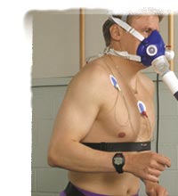
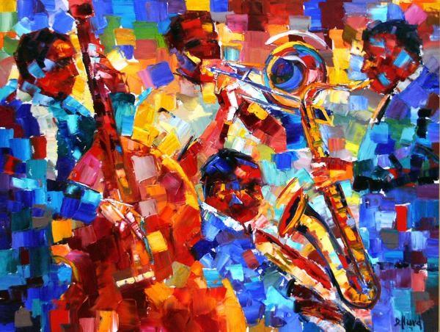
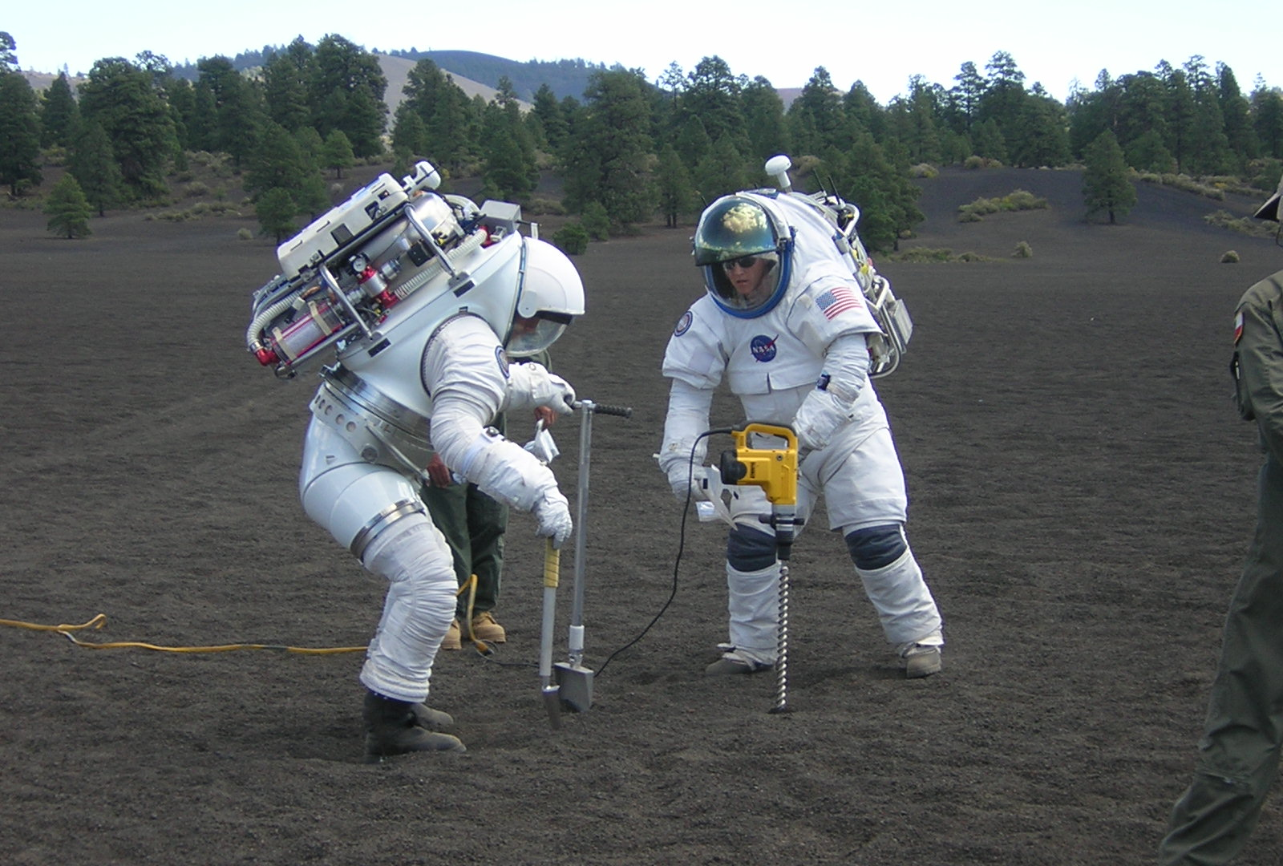
Scope
WHAT
WHO
WHEN
EVA
WHERE
HOW
" The FAA predicts 400,000 to 2.3M licensed Part 107 remote pilots by 2020”
- FAA Air Traffic Organization Policy: Order JO 7200.23
WHY
Notes:
Thank you.
The agenda I propose will address the What, Why, Who, How, When and Where of Test and Evaluation.
This will range from Test and Evaluation
of an individual,
of machines (such as this NASCAR vehicle in a wind tunnel rolling on a belt that is moving at 180 mph in order to discover ground effects),
of individuals collaborating on a previously defined task and
of several individuals co-learning in a dynamic situation.
The latter approximates the activity of System Engineering, a system that also needs to be tested and evaluated.
Yes, that means you. And I will tell you why in a few minutes.

Slide 7
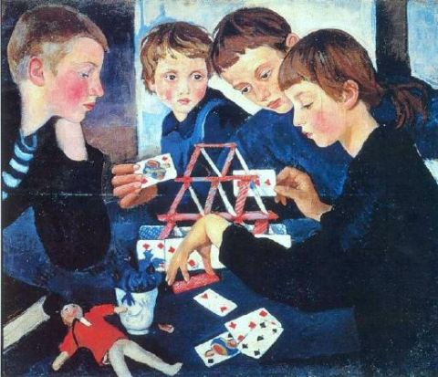
SE Constructs a Theory
Zinaida Serebryakova (1884 – 1967)
Notes:
I apologize if it hurts your feelings but we cannot escape the fact that a system model is a hypothesis formulated by only partially informed people who, like other people, have a finite likelihood of error In their decisions.
Would you be surprised if the error rate was 1 in 17 assertions?

Slide 8
Questions for Ontologists
What’s the problem? Stakeholders, our intended beneficiaries, are overwhelmed with the Extent, Variety (semantic and temporal), and Ambiguity of their respective fields of discourse each of which is becoming increasingly non-deterministic.
Because they lack a mutually coherent understanding of what ‘system’ signifies they do not understand ‘The Problem’ as a system let alone conceive and leverage Problem Suppression as a system.
Who cares? Who are these stakeholders and what makes them our intended beneficiaries? What value proposition will they respond to and how meaningful is it to them? Do we need an ontology of the intended beneficiaries?
What will help them? Will providing them with cogent ontologies be sufficient and efficient? Will they adopt and successfully apply such artifacts? Or will they need to experience formulating useful ontologies? Or what?

Slide 9
Questions for Ontologists, con’t.
How can we be sure that our recommendations will or did help them?
Systems are composed of automatons, automatons containing faults and humans as operators and administrators.
Are we too focused on procedural models (Data Base and Data Processing) vs. Goal-seeking Objects ala Smalltalk, and Objective C? Note: Object-oriented is not Object Technology.
Do Requirements establish Ontology? Should we estimate the efficacy of a set of requirements?
Example Ontological faults:
Aircraft on ground → wheels turning
One year = 365 days
Metric vs. English units

Slide 10
Your P(faults)
P(fault) = f(EVA, CQS, # Assertions, # languages)
Extent
Operational Whole System
Variety
Ambiguity
Competency
Deployed System
Style
Development (project) System
Quality Ethic
N1 Automatons
SE (project) system
N? Faulty Automatons
N2 Humans (>7 kinds)
Problematic Situation
Notes:
The roots of your faults are three-fold.
First is the degree of Extent, Variety and Ambiguity in the problem system.
The second is your competency levels, your standard of care, particularly your quality ethic, and your interpersonal style as we will discuss in a later chart.
The third is the number of translations and transformations that a system model goes through from Identification of system need to Operational Whole system.

Slide 11
Objective vs. Team Player? (highly simplified)
Unexplored
Territory
of the
Intelligent
Enterprise
100%
Workgroup Efficiency Limit
75%
Encouraging,
Admonishing
Percent Achievement
50%
Anxious,
Insincere
Interpersonal style is
dominant factor with
5X leverage on
achievement
25%
Critical,
Destructive
5
10
15
20
Size of Workgroup
Adapted from Amity and Enmity, R. Starkermann
©jring7@gmail.com. Attributed copies permitted
Notes:
This chart indicates the results of applying Prof. Rudolph Starkermann’s model of the relative achievement of a workgroup as a function of workgroup size and style Among humans the characteristic curve is non-linear [loss is proportional to n(n-1)/2]. A key point is that a workgroup size of more than 4 is the point of diminishing marginal utility.
Another factor is even more dramatic. That is the effect of interpersonal style within the group. Excellent style can outperform poor style by over five fold.
Prof. Starkerman has identified ten other factors that come in to play between any two or more people but size and interpersonal style are the more dominant.
In my experience most SE efforts operate somewhat below Anxious and insincere.
At any rate, as the goal-seeking mode is instilled in participants they acquire the ability to a co-learn and co-evolve in smaller groups which seems to simultaneously avoid corrosive interpersonal style conflicts. As a result, increasingly difficult pursuit challenges are met with relatively less cost of the controller. This is change proficiency.
Note: Do not extrapolate these curves. The situation deteriorates rapidly beyond the 15 to 20 person range.

Slide 12
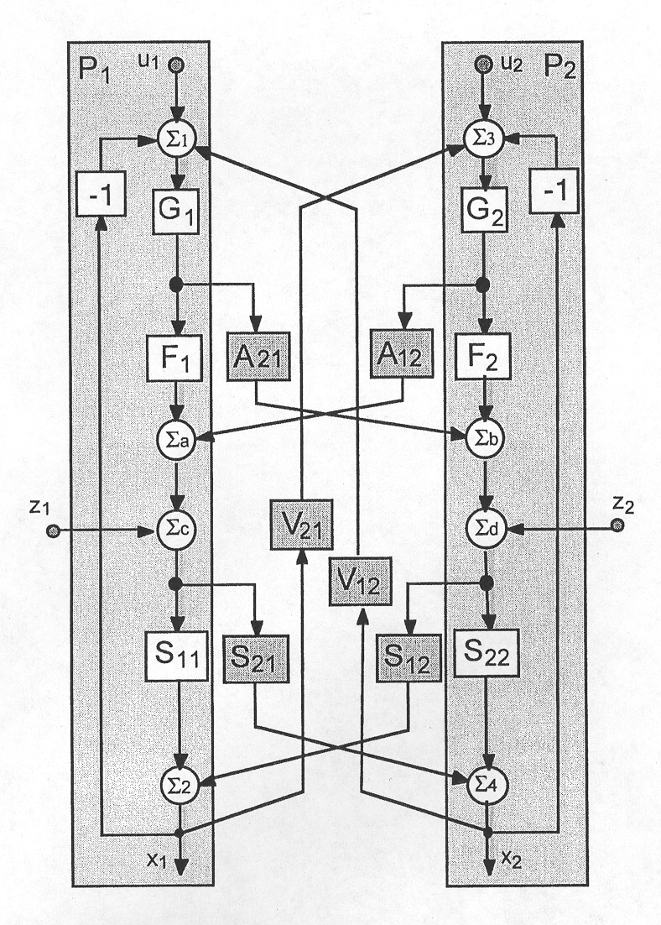
Humans Interaction Model
Self realization goals
Will Powers
disturbances
Conscious
Unconscious
“Amity and Enmity”
by R. Starkerman
info@editions.ch
ISBN 3-908730-29-5
Fig. V-9
©jring7@gmail.com. Attributed copies permitted
Notes:
Here is one facet of Prof. Starkermann’s actual model. U1 and U2 indicate the goals of Person 1 and Person 2 respectively. G indicates the Gain or Will Power of each. Each has a big control loop through which the effects of last choices and actions affect the perception of goal achievement thus the preference for next choice and action. Of course Disturbances happen. These come into play such that a disturbance has less effect on a person with high will power than on one with lesser will power.
Now comes the interesting part. See all these cross feeds. There are two kinds. Toward the bottom are ones that are motivated by unconscious attitudes. Each of you have an attitude toward others. Interestingly your attitude can be perceived by others even though you are unaware of it.
The upper two sets of crossfeeds are conscious and are motivated by observation and interaction.
The pattern of signals on these paths is not stationary. Two people can start out working reasonably collaboratively and become quite combative.

Slide 13
Limits of System Adaptation
System Evolution Options
Adjust: Gradients on relationships
Arrange: Pattern of relationships
Co-align: Content of system with context constraints.
Within Conservation Laws
X, d(X)/dt, d²(X)/dt²
Thermodynamics: mass, momentum and energy
Informatics: data, information and knowledge?
Teleonomics: skills, rate of learning, and rate of invention?
Human social dynamics: trust, enthusiasm, co-evolution?
Economic: Investment, ROI, Liquidity?
Ecology: Waste, Fads, Unintended Consequences?
©jring7@gmail.com. Attributed copies permitted
Notes:
When things don’t happen as planned, as is usually the case, Situation Assessment and Convergence are key capabilities.
Three kinds of changes may be necessary, Adjust gradients on the relationships, Re-arrange pattern of relationships and Co-align content.
When a change is made, several types of constraints must be honored, else the unintended consequences can be severe.
Most of us are familiar with the conservation of mass, momentum and energy as a physical constraint on the dynamics of change.
Also we must acknowledge and honor several other kinds of contraints associated with Informatics, Teleonomics, Human Social Dynamics, Economics and Ecologics.
Overlooking any one can give rise to unintended consequences within the system.

Slide 14
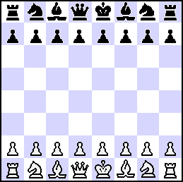

Angel(s) vs. Demons
System behavior may be studied as a game between an angel and demons where the correct solution is the determination of the existence of a winning strategy for our champion: the angel.
The demon may react to all the angelic moves attempting all possible tricks to defeat the angel. That means the angel must be able during the system lifetime to counter continuously any new demonic action: she must change her strategy in response to demonic actions
3/31/2020
OntoPIlot LLC
Notes:
Autonomous. systems, pose new and different T&E challenges. These can be treated as non-deterministic systems and viewed as a formal game between an Angel (or more) and Demons.

Slide 15

Design Intent vs. Efficacy Estimation
This will work!
Build a theory:
Problematic Situation
Desired Effects
Sufficient Capabilities
Input/Output
Performance
Technology
Cost
Tradeoff
Measures of Effect-iveness
Functions and Features
Architecture
Components Make/Buy
User Initialization
Production Utilization
Deployment Jigs and Fixtures
Will this work?
Find the limits:
Quality
Estimate Effects
Measure Effects
Determine Limits
Dynamic
Integrity
Parsimony
Simplify, Extend
Beauty
MOE of Efficacy Estimation and Measurement
Acuity, Accuracy, Cycle Time
Distance from the action
Notes:
Here is a checklist to keep you straight about Design vs. T&E.
The focus of the designer is indicated on the left. He or she pursues what will work as they build a theory, the prescriptive model of the intended system.
The focus of the T&E designer is indicated on the right. He or she pursues what doesn’t work under which situations, finding the fallacies in the prescriptive model and subsequent implementation. Their mantra is Oh, Really? ---- Then What?
Note that the Measures of Effectiveness of the T&E activity include Acuity, Accuracy, and Cycle Time. Acuity and Accuracy are influenced by Distance from the real action.

Slide 16
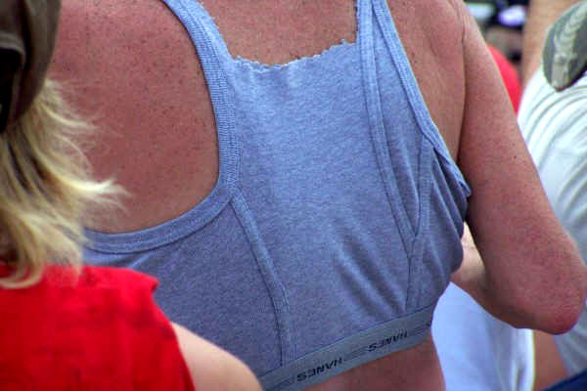
Four Known Fallacies
Proof of Correctness
“Beware of bugs in the above code; I have only proved it correct, not tried it”
Prof. Donald Knuth
Simulation
Use simulation to verify
that you understand the problem,
never to justify a design.
– Prof. Jay Forrester
Beware ReUse
Fidelity of Red Force
Represents Reality
KPP’s and TPM’s vs MOE’s
Designer as tester
Notes:
You should be aware of at least four fallacies regarding T&E.
Simulation is being increasingly touted as a way to accelerate and confirm designs. However, please be aware of the frequent caution by Prof. Jay Forrester, MIT, father of System Dynamics.
Secondly, Proof of Correctness is not the goal. We test to determine Fit for Purpose.
Third, when we test against a contrived situation then the fidelity of that situation to the anticipated real situation must be determined and test results discounted accordingly.
Finally, beware of re-use. A component that worked fine yesterday may not work if included in with components that were not involved yesterday.

Slide 17
Potential Participants
International Council on Systems Engineering
Object Management Group
IEEE-SMC
IEEE Systems
Systems Engineering Research Center; Stevens Inst. Tech.
Institute of Industrial and Systems Engineering
etc.

