Slide 1


DEVELOPER’S QUICK GUIDE
16/07/2020
CEllST -spa- v1.0
Notes:
1
REGLA DE LOS DOS PIES "Si en cualquier momento durante el tiempo que usted esté aquí, se encuentra en una situación en la que no está ni aprendiendo ni contribuyendo, use sus dos pies. Vaya a otro lugar donde pueda aprender o contribuir"

Slide 2
Configuration requirements
Installation
Compilation
Run and debug
Modules
Data parameterization
Architecture
Test base
Test context
Browser
Business Objects
Page Objects
Page Elements
Zahorí properties
Project properties
Evidence generation
i18n
Extended functionalities
Good practices

Slide 3

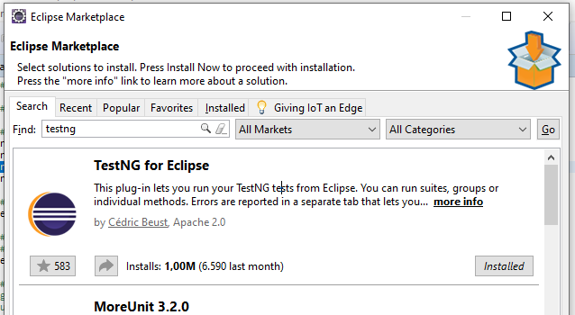
Configuration
Install TestNG plugin for Eclipse:
Help menu > Eclipse Marketplace
Search “TestNG”
Install the plug-in

Slide 4
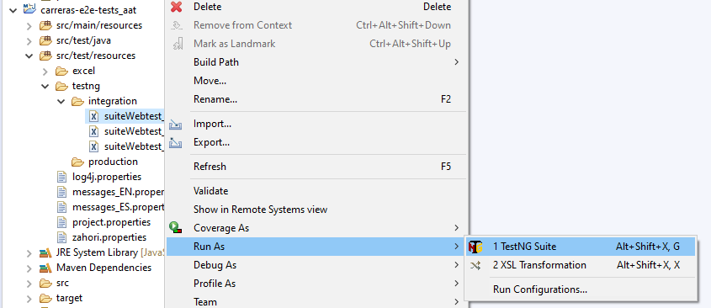
Configuration
After the installation Eclipse lets us execute TestNG suites

Slide 5
Configuration
DOWNLOAD THE EXAMPLE PROJECT
git clone https://github.com/TeamSQAPanel/Zahori-Example

Slide 6
Configuration
INSTALL ZAHORÍ DEPENDENCY
Download zahorí jar file to directory “lib” located in the project root folder:
https://drive.google.com/file/d/1CDYXJBFeEqJbYVadOsq5-ws99iFhHe0D/view?usp=sharing
Run the following command from the project root folder:
mvn install:install-file -Dfile=lib\zahori-3.17.jar -DgroupId=es.panel.cest -DartifactId=zahori -Dversion=3.17 -Dpackaging=jar
This will install the jar in the Maven local repository:
Ej: C:\Users\<USER>\.m2\repository\es\panel\cest\zahori\3.17

Slide 7

Configuration
Install WebDriver for Chrome:
See what Chrome version you have installed locally
Download the specific version for the webdriver of your Chrome browser:
https://chromedriver.chromium.org/downloads
Decompress the driver in a location of your choice
Edit zahori properties file and set the driver location to the path where the driver was decompressed
Example:
File: example-e2e-tests_aat/src/test/resources/zahori.properties
Property: webdriver.chrome.driver=C:/ENVIRONMENT/selenium/chromedriver/chromedriver.exe

Slide 8
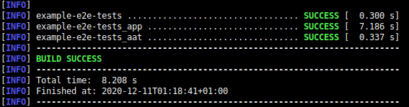
Configuration
COMPILE THE PROJECT
- From Eclipse
- From command line (from the project root folder)
mvn clean package

Slide 9
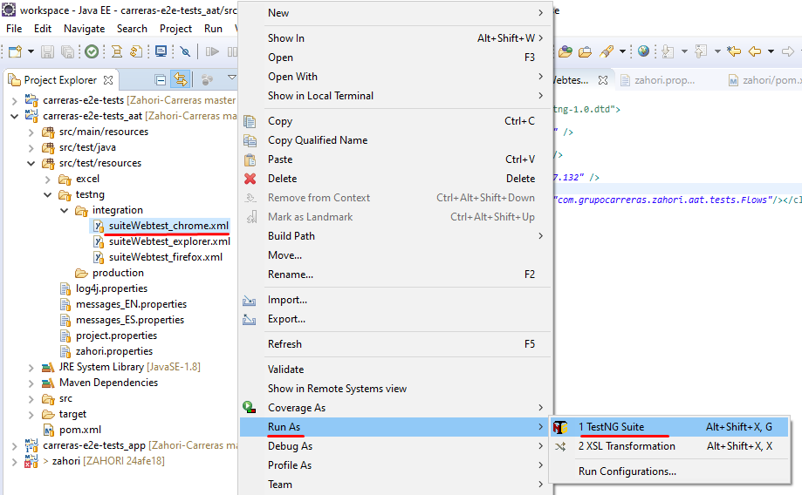
Configuration
RUN THE PROJECT

Slide 10
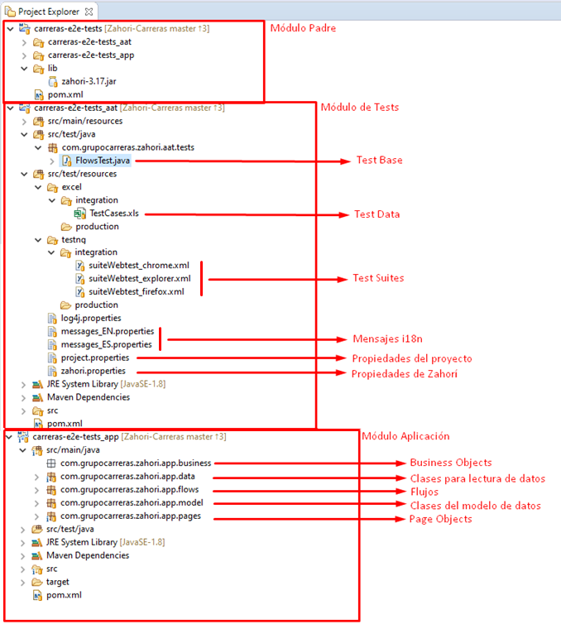
PROJECT
MODULES

Slide 11
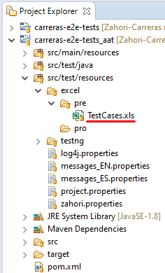
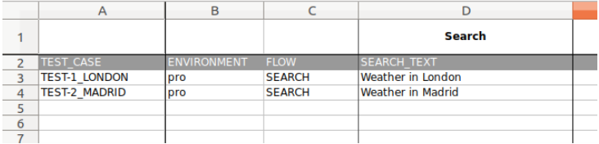
DATA PARAMETERIZATION (Excel)
Repository where case data is defined
Options: Excel, CSV, Base de datos, AirTable… whatever.
Path: example-e2e-tests_aat/src/test/resources/excel/pre/TestCases.xls

Slide 12
DATA PARAMETERIZATION (Model classes)
Java bean classes to store and manage test case data along the flow.
Good practice: create one Java bean class for each page object identified in the flow
Path: example-e2e-tests_app/src/main/java/io/zahori/example/app/model/

Slide 13
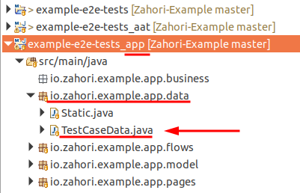
DATA PARAMETERIZATION (TestCaseData class)
Class or classes in charge of reading test data from the data repository and create instances of model classes that will store the data along the flow to be executed
Path: example-e2e-tests_app/src/main/java/io/zahori/example/app/data/TestCaseData.java

Slide 14
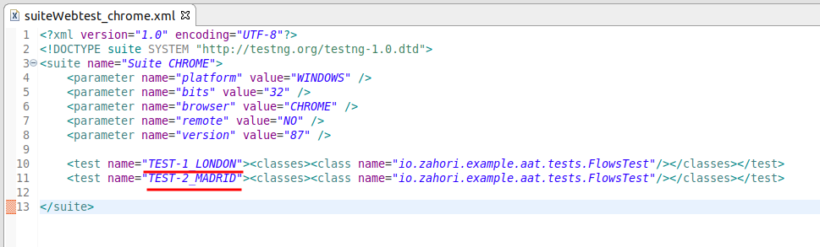
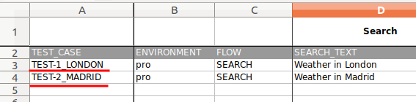

DATA PARAMETERIZATION (Cases to be executed)
TestNG suites where define and group cases to be executed
Path: example-e2e-tests_aat/src/test/resources/testng/<environment>/

Slide 15
PROJECT EXECUTION

Slide 16
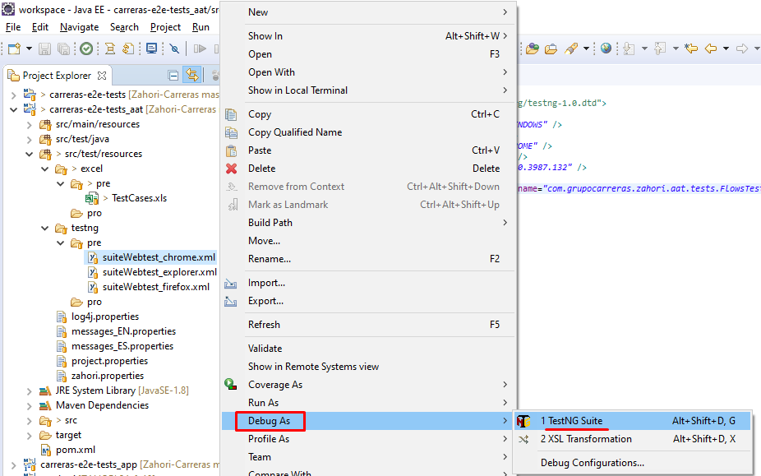
PROJECT DEBUGGING

Slide 17
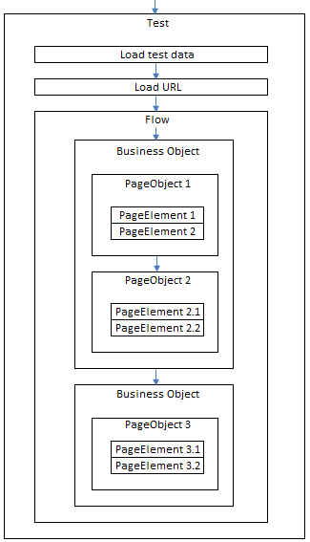
PROJECT
ARCHITECTURE
Objetives:
- Separate responsabilities
- Avoid duplicated code
- Reduce maintenance effort

Slide 18
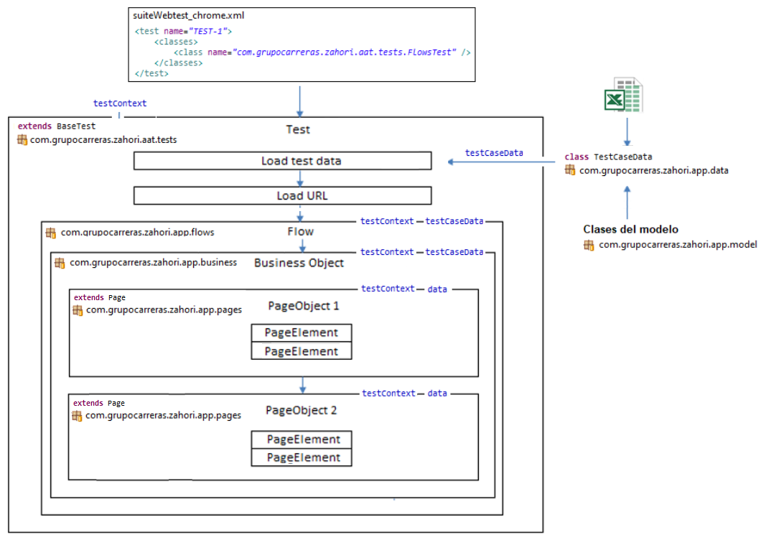
PROJECT
ARCHITECTURE

Slide 19
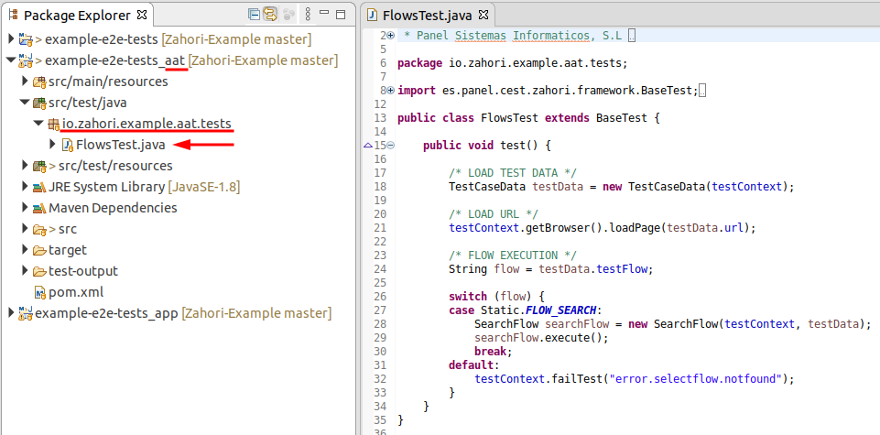
TEST BASE
This class is the first to be executed when a Test is run
Its main responsibilities are: load test case data, load url to be tested and invoke the specific test flow defined for the test.
To create this class just create a new class that inherits from BaseTest class of Zahori framework

Slide 20
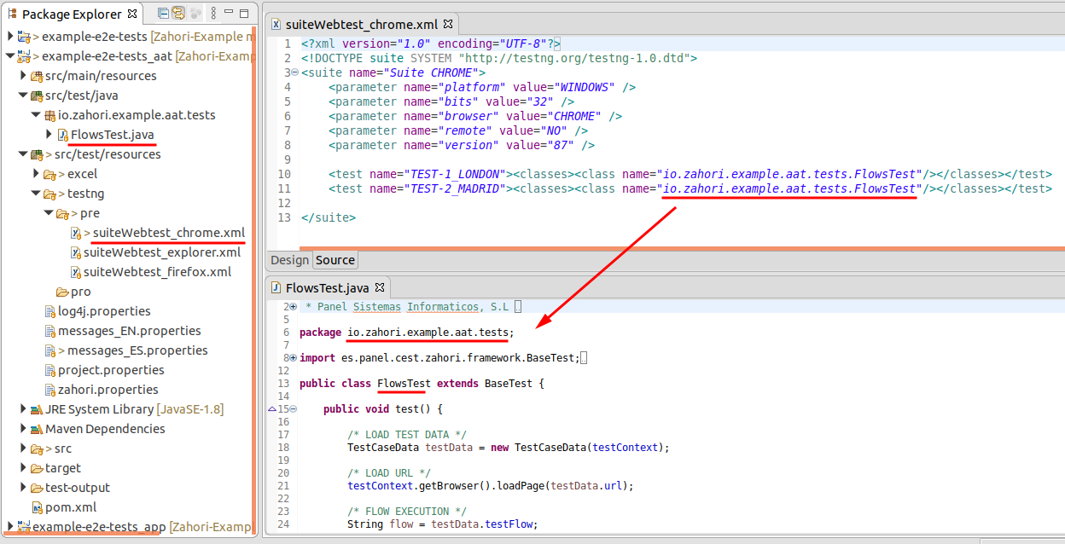
TEST BASE
Then, to be able to run our test base class we need to add it to a TestNG suite

Slide 21
TEST CONTEXT
Class from Zahori framework
Its responsibility is to manage all data and posible actions regarding the context of the current test in execution:
- Name or ID of the test case
- Creates a new instance and manages the browser driver defined for the test
- Manages the status of the test
- Manages the test execution time
- Reads properties defined in zahori.properties and project.properties
- Generates and stores evidences (i18n)
- Updates test results and evidences in external test management systems (Jira xray, TestLink, HP ALM, Azure Test Plans)

Slide 22
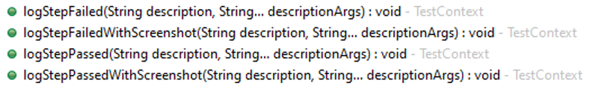

TEST CONTEXT
The test context in inherited from BaseTest class and it’s propagated along the flow
Important methods in TestContext:

Slide 23
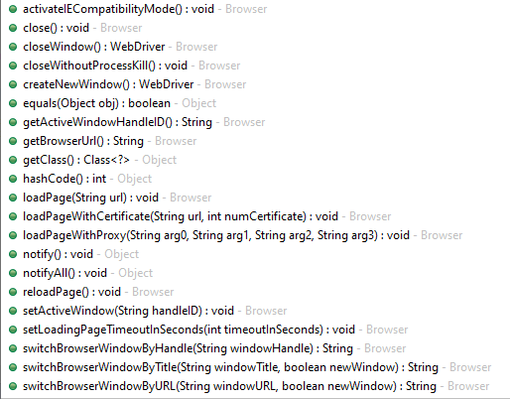
Browser class
This class is available through the Test Context:
testContext.getBrowser()
Main methods:

Slide 24
BUSINES OBJECTS (BO)
Classes whose responsibility is to define the business logic of the flow to be automated
Divides the flow to be automated in smaller logic pieces of code
Invokes to page object classes
Defines the conditions (business logic) to navigate between page objects along the flow
Defines points where a step is passed or failed along the flow
Objetive: minimize and facilitate code maintenance
Path: example-e2e-tests_app/src/main/java/io/zahori/example/app/business/

Slide 25
PAGE OBJECTS (PO)
Classes whose function is to represent the different pages and elements of the process that we want to automate
In each class or page we define the different elements that compose it and the actions to be carried out on them
Objective: Minimize and facilitate code maintenance
Path: example-e2e-tests_app/src/main/java/io/zahori/example/app/pages/

Slide 26

PAGE OBJECTS (PO)
These classes inherite from the Page class of Zahorí
The constructor must receive the testContext as a parameter to be able to invoke the Page constructor and be able to inherit all its functionality

Slide 27
PAGE OBJECTS (PO)
Important methods inherited from Page:
getPageTitle()
waitStaticPageLoad(int waitSeconds)
scrollTo(String text)
getPageElements(Locator locator)
getPageElements(Locator[] frameLocators, Locator locator)
Frames
switchToFrame(String frameName)
switchToFrame(PageElement iframeElement)
switchToFrameWebElement(Chronometer crono, PageElement frameElement)
switchToDefaultContent()
Modals
Alerts
existModalWindow()
switchToAlert()
existModalWindow(String title, int maxWaitSeconds)
acceptAlert()
numberOfModalWindowsOpen(int waitSeconds)
closeAlert()
switchToModalWindow(String title)
getAlertText()
switchToModalWindow(String[] titles)
writeTextToAlert(String text)
switchToMainWindow()

Slide 28
PAGE ELEMENTS (PE)
They represent any element included in a page and with which we want to interact
Examples: texts, links, text fields, selects, checkboxs, radiobuttons, buttons...
We can locate them in the DOM tree and perform actions on them
They should be declared and used only within Page Objects, as follows:
They receive as parameters:
The page they belong to (this)
A friendly name that identifies the page element
Locator: how to find the element in the page's DOM (by id, xpath, name, css ...)

Slide 29
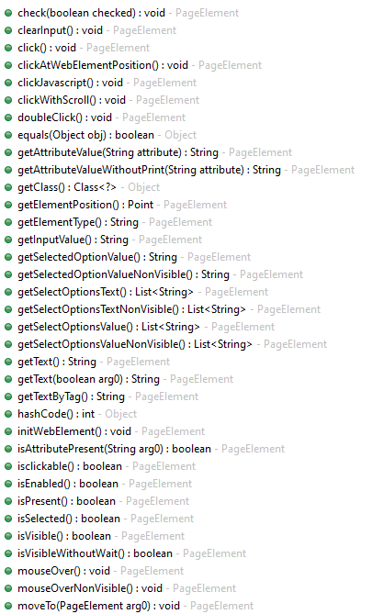
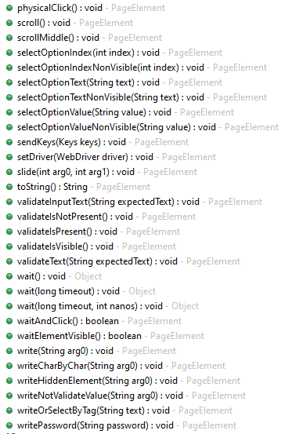
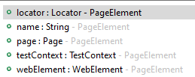
PAGE ELEMENTS (PE)
Main methods
Main attributes

Slide 30
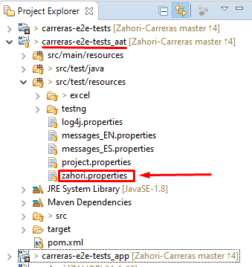
ZAHORÍ PROPERTIES (zahori.properties)
File where we can modify the behavior of Zahorí relative to:
WebDrivers paths
Load timeouts
Evidence generation
Load evidences to TMS
Browser capabilities or preferences

Slide 31
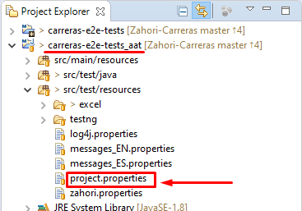

PROJECT PROPERTIES (project.properties)
It is used to define global properties or variables
They can be retrieved using the testContext:

Slide 32
EVIDENCE GENERATION (logs)
Low level logs
Including:
- All actions performed by the framework
- Messages that we want to register in automation
Activation in zahorí.properties:
How to write messages to the log:
Log levels: info, warn, debug and error
Logs and evidences location:
Zahori-Example\example-e2e-tests_aat\target\test-results\<TEST_ID>\<PLATFORM>\<BROWSER>\<TIMESTAMP>\

Slide 33

EVIDENCE GENERATION (screenshots)
Activation in zahorí.properties:
How to take screenshots:
Screenshots and evidences location:
Zahori-Example\example-e2e-tests_aat\target\test-results\<TEST_ID>\<PLATFORM>\<BROWSER>\<TIMESTAMP>\

Slide 34
EVIDENCE GENERATION (Video)
Activation in zahorí.properties:
Be careful when the number of tests and executions is high (consumption of disk space)
Ideas.:
- Activate only the generation of video files when tests fail
- Remove periodically old executions
Video and evidences location:
Zahori-Example\example-e2e-tests_aat\target\test-results\<TEST_ID>\<PLATFORM>\<BROWSER>\<TIMESTAMP>\

Slide 35
EVIDENCE GENERATION (documents)
Word document with high-level test messages (does not include technical details)
The goal is to include relevant information at test step level
Includes screenshots
Activation in zahorí.properties:
How to write messages in documents (same as in logs)
Documents and evidences location:
Zahori-Example\example-e2e-tests_aat\target\test-results\<TEST_ID>\<PLATFORM>\<BROWSER>\<TIMESTAMP>\

Slide 36
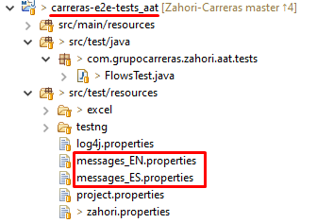
INTERNATIONALIZED MESSAGES
The texts included in the different types of evidence can be internationalized to generate evidences in several languages
Where it applies: in logs and documents
Activación en zahorí.properties:
Definir un fichero properties por cada idioma declarado anteriormente

Slide 37

INTERNATIONALIZED MESSAGES
In each properties file declare the different messages in key=value format
Then, to write an internationalized message in the files:

Slide 38
EXTENDED FUNCTIONALITIES
DATA BASE connections
FILE management: EXCEL, CSV, WORD, LOG, PROPERTIES, JSON, XML
NETWORK: SSH, SCP, FTP
TMS (Test Management System): TestLink, Jira xray, HP ALM, Azure DevOps TestPlans
...

Slide 39
GOOD PRACTICES
In development to make automation easier
Add IDs to web elements with which the user interacts: links, buttons, fields...
Add different IDs to different web sections
Add IDs to texts that it can be automated (language independence)
Add IDs to errores messages and include de error code
Add IDs to important data so that its validation can be automated
Avoid iframes
Take care of non-productive environments: integration, pre-production
Charging times, data batteries, ...

Slide 40
GOOD PRACTICES
In automation
Code flows or processes, not test cases
Use the Page Object pattern
Selection of elements by Ids, xpath or name
Do not repeat code
Generate evidences for each execution
Report results and evidence to a test management tool (TMS)
Do not try to automate everything. Impacts on the cost and maintenance efforts and also increases execution times

