Slide 1


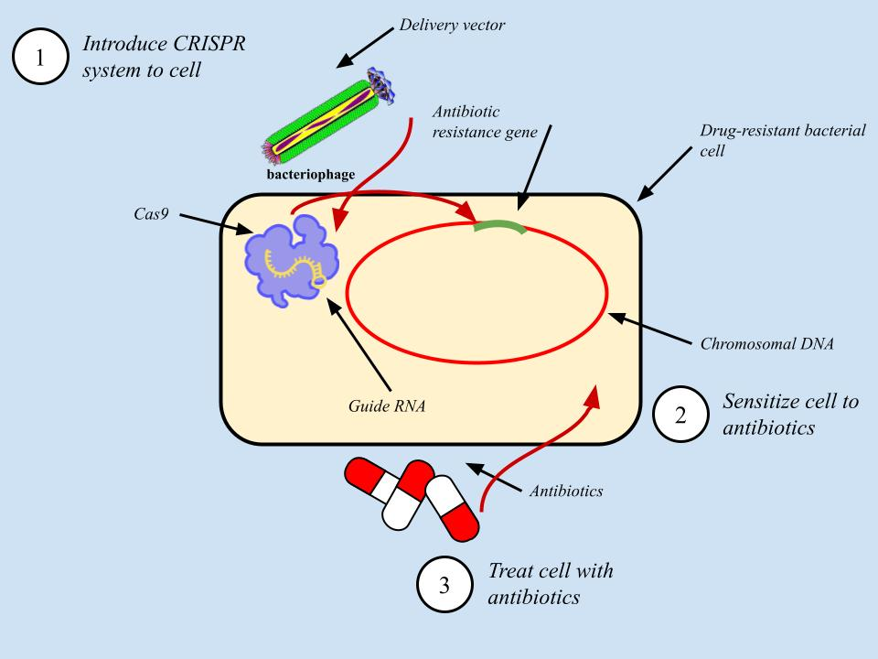
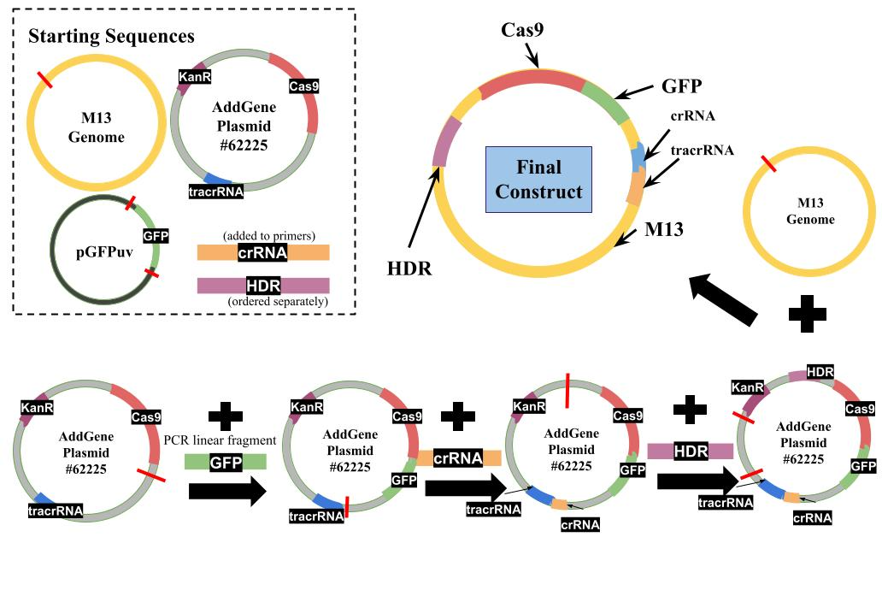
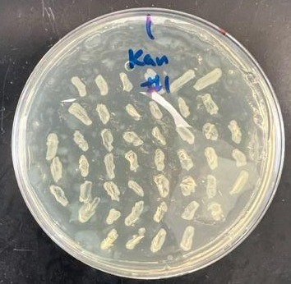
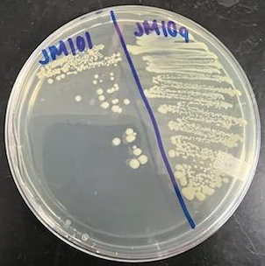
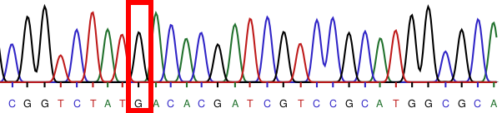

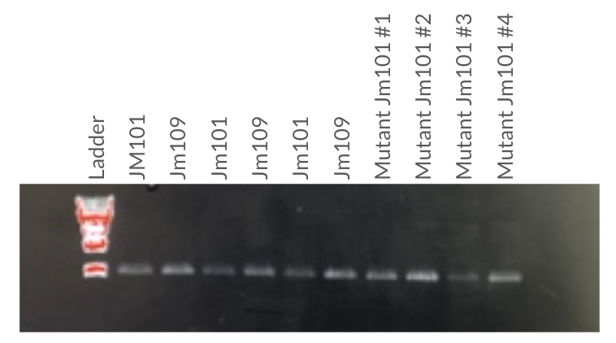

Spread Prevention and Eradication of Resistant Bacterial Growth
Team SUPERBUG
Neha Sripathi, Joshua Kim, PhucLam Dinh, Amber Rayford, Nicholas Breymaier, Cristina Zhang, Mackenzie Hillman, Dr. Daniel Stein
Introduction
Methodology Overview
Current Work
Diseases caused by drug resistant bacteria are a pressing public health threat
This is due to a lack of new antibiotics and the evolution of multidrug resistance
Drug resistance is caused by mutant or novel genes known as resistance genes
CRISPR-Cas9 gene editing has been shown to edit resistance genes and increase susceptibility to antibiotics
We aim to improve upon the efficiency of previous studies.
Research Problem
A
B
1
2
3
Drug resistance disproportionately affects minorities and people of lower socioeconomic status (1).
Antibiotic resistant infections are more expensive to treat, further burdening disadvantaged populations (2).
We are studying a common nalidixic acid resistance mutation in the gyrase A gene (gyrA) in E. coli.
Single nucleotide substitution at codon 87 in the gyrase A gene
Ideal for targeting with CRISPR-Cas9 and homology directed repair (3)
Urinary Tract Infections (UTIs) caused by E. coli are the most common type of bacterial infection in females (4).
UTIs are rapidly becoming nalidixic acid resistant.
Colistin, a harsher antibiotic, is the only current alternative treatment.
Figure 1. A) Graphical overview of methodology, outlined below. B) Bioinformatic design of the final CRISPR-Cas9 construct.
Create JM101 E. coli mutants and culture JM101 and JM109 strains
Verify strain resistance
Verify sequences
Design gene sequence of the bacteriophage M13 insert which will be used to deliver the CRISPR-Cas9 system to E. coli cells
Conduct PCR and restriction digest experiments to create the final construct
Insert construct into M13 vector, isolate transductants, and verify codon 87 editing & re-sensitivity
Figure 4. Cas9-GFP transformants
Validating plasmid modification and bacterial transformation using GFP expression
Working on adding additional CRISPR and HDR components to plasmid
Results
Remaining Work
Transform modified CRISPR plasmid into JM109 colonies
Screen for Cas9-GFP expression and nalidixic acid sensitivity
Sequence transformants to verify successful editing of codon 87
Insert modified CRISPR plasmid into M13 genome and produce modified virions
Infect JM109 with modified M13 viruses
Screen for effective delivery and expression of CRISPR and reversion of codon 87 mutation
WT
JM109
Research Question
Figure 2. Generation of JM101 nalidixic acid resistant mutants & validation of JM109 resistance and gyrA codon 87 mutation.
Table 1. Primer Design
Can we efficiently deliver a CRISPR-Cas9 gene editing system into nalidixic acid resistant E. coli in order to edit a single nucleotide substitution in gyrA and resensitize it to nalidixic acid?
Primer Function | Forward Sequence | Reverse Sequence
gyrA sequencing | 5’-CAGATGTCCGAGATGGCCTG-3’ | 5’-CGGCCATCAGTTCATGGGCA-3’
Adding Cas9 plasmid FseI restriction site | 5’-attGGCCGGCCttttagatgaagattatttct-3’ | 5’-actGGCCGGCCtatacttcagtcacctccta-3’
Adding FseI restriction sites to GFP sequence | 5’-cagtcaGGCCGGCCaacaatttcacacaggaaacagctatga-3’ | 5’-ctgacaGGCCGGCCggaattcattatttgtagag-3’
Inserting crRNA | 5’-ctggtaacaggattagcaga-3’ | 5’-CTATAACACGATCGTCCGCAgttttagagctagaaatagc-3’
Acknowledgements and References
We would like to thank our faculty mentor, Dr. Daniel Stein; our team librarian, Ms. Nedelina Tchangalova; and the Gemstone Program staff for their guidance and support throughout our research.
Scan QR code for references
Figure 3. PCR of gyrA across JM101 and JM109 strains; primer validation.
Notes:
‹#›

