Slide 1


Flapper game
Team “Simba”
Notes:
*

Slide 2
Team members
Илиана Йорданова
Username: Nailses
Константин Кондов
Username: kskondov
Иван Колчагов
Username: kolchagov
Марин Стоянов
Username: marin.stoyanov
Notes:
*

Slide 3
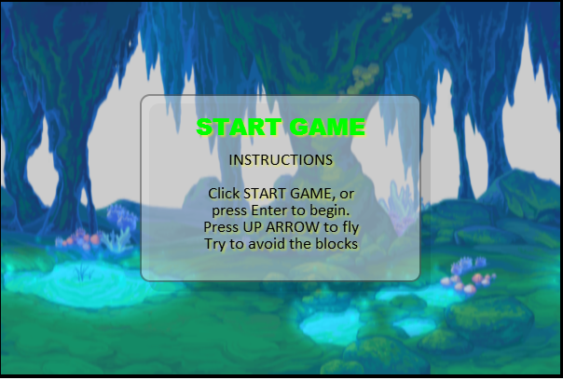
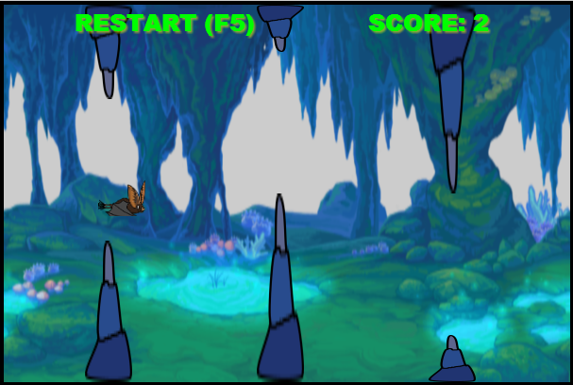
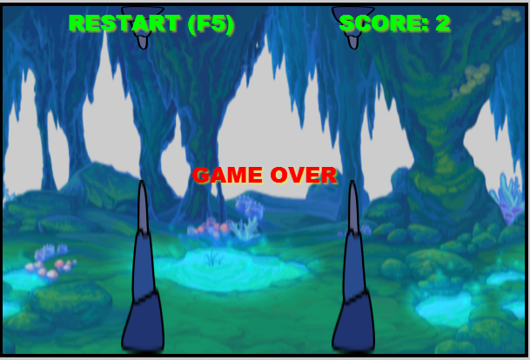
Game overview
Main functions:
Initialization
Instructions
Game
Scoring
Notes:
*

Slide 4
Used technologies
HTML5
CSS
Canvas + Kinetic JS
JavaScript
Notes:
*

Slide 5

Team repository:
Hosted on GitHub
https://github.com/TeamSimba/Flapper
Commit log:
https://github.com/TeamSimba/Flapper/commits/master
Notes:
*

Slide 6

Questions?
Notes:
*

