Slide 1
Software Development Process
GAM200
©Copyright DigiPen Institute of Technology, All Rights Reserved

Slide 2
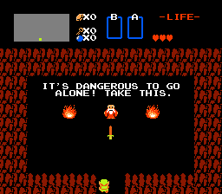

Slide 3
What is a Software Development Process?
The process your team uses to build software including defining requirements, scheduling, planning, designing, building, and testing.
©Copyright DigiPen Institute of Technology, All Rights Reserved
Notes:
Where to start, with teams.

Slide 4
Ineffective Teams
The SuperDevs^{tm}
Hidden disparity of dedication and commitment
Emperor’s New Clothes Syndrome
Little to no communication
©Copyright DigiPen Institute of Technology, All Rights Reserved

Slide 5
Team
You and your team are responsible for your success
Me = Team = Product
Communication is key to a functioning team (this means fighting)
Team problems are the #1 reason projects fail at both the student and professional levels.
©Copyright DigiPen Institute of Technology, All Rights Reserved

Slide 6
Visualizing the Iterative Development Process
©Copyright DigiPen Institute of Technology, All Rights Reserved

Slide 7
Space of all possible games
(Distance is work)
You are here
©Copyright DigiPen Institute of Technology, All Rights Reserved

Slide 8
Space of all possible games
(Distance is work)
Two Semesters of Work
©Copyright DigiPen Institute of Technology, All Rights Reserved

Slide 9
Space of all possible games
(Distance is work)
Two Semesters of Work
Possible
Impossible
©Copyright DigiPen Institute of Technology, All Rights Reserved

Slide 10
Space of all possible games
(Distance is work)
Trivial
Possible
Impossible
©Copyright DigiPen Institute of Technology, All Rights Reserved

Slide 11
Phase 0: Game Concept
Not a good Idea.
©Copyright DigiPen Institute of Technology, All Rights Reserved

Slide 12
Phase 0: Game Concept
Not a good Idea.
Meh.

Slide 13
Phase 0: Game Concept
Not a good Idea.
Perfect!
Meh.
©Copyright DigiPen Institute of Technology, All Rights Reserved

Slide 14
Phase 0: Perfect Development
Not a good Idea.
Perfect!
Meh.
©Copyright DigiPen Institute of Technology, All Rights Reserved

Slide 15
Phase 0: Realistic Plan
Not a good Idea.
This might work.
Perfect!
Meh.
©Copyright DigiPen Institute of Technology, All Rights Reserved

Slide 16
Phase 0: Realistic Plan
Not a good Idea.
This might work.
Or this might.
Perfect!
Meh.
©Copyright DigiPen Institute of Technology, All Rights Reserved

Slide 17
Phase 0: Realistic Plan
Not a good Idea.
This might work.
Or maybe this.
Or this might.
Perfect!
Meh.
©Copyright DigiPen Institute of Technology, All Rights Reserved

Slide 18
Phase 1: Engine Proof
Initial Concept
©Copyright DigiPen Institute of Technology, All Rights Reserved

Slide 19
Phase 2: Prototype
!?
©Copyright DigiPen Institute of Technology, All Rights Reserved

Slide 20
Phase 2: Prototype
New Possibility Space
©Copyright DigiPen Institute of Technology, All Rights Reserved

Slide 21
Phase 2: Prototype
New Destination
©Copyright DigiPen Institute of Technology, All Rights Reserved

Slide 22
Phase 3: First Playable
Adjusted Direction
©Copyright DigiPen Institute of Technology, All Rights Reserved

Slide 23
Phase 4: Alpha
©Copyright DigiPen Institute of Technology, All Rights Reserved

Slide 24
Phase 4: Alpha
A Better Idea!
©Copyright DigiPen Institute of Technology, All Rights Reserved

Slide 25
Phase 5: Beta
©Copyright DigiPen Institute of Technology, All Rights Reserved

Slide 26
Phase 6: Final
Victory!
©Copyright DigiPen Institute of Technology, All Rights Reserved

Slide 27
Work Velocity
Velocity is not constant
Can be affected by
Classes, Work, Health, Relationships, Etc.
Highly dependant on morale and motivation
This can go two ways
Vortex of Misery
Cascade of Joy
©Copyright DigiPen Institute of Technology, All Rights Reserved

Slide 28
Vortex of Misery
Failure is recursive
You MUST change velocity, not accelerate toward doom
Fatigue effects productivity
The more skilled your team is the more likely this will happen to you
The teams that think it can’t happen to them are exactly who this happens to and they never ask for help
©Copyright DigiPen Institute of Technology, All Rights Reserved

Slide 29
Cascade of Joy
Success is also recursive
Idea gains momentum
Motivation increases
Work speed increases
Most likely to occur if you
Start simple
Build and Iterate
Kill the good, keep the great
©Copyright DigiPen Institute of Technology, All Rights Reserved

Slide 30
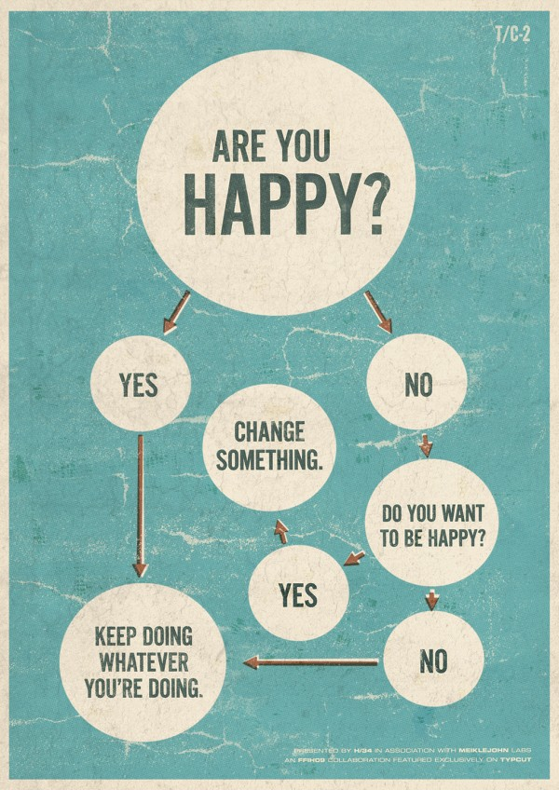

Slide 31
Embrace Change
There is only one constant in software development, change.
Resisting change only leads to mediocre results.
Plan for it!
©Copyright DigiPen Institute of Technology, All Rights Reserved

Slide 32
Bias Towards Action
Do not pretend to know everything upfront.
Start small and build up.
Learn by doing.
Don’t argue over something that can be tested.
Learning how to quickly prototype.
Develop good enough.
So…
©Copyright DigiPen Institute of Technology, All Rights Reserved

Slide 33
We don’t need planning!
©Copyright DigiPen Institute of Technology, All Rights Reserved

Slide 34
How do you plan?
You need a high concept (multiple ones).
GTA in space
GTA with squads
GTA in Paris, France
Team based FPS with paint
But first you need a vision.
©Copyright DigiPen Institute of Technology, All Rights Reserved

Slide 35
Vision
Vision - An experience in which a personage, thing, or event appears vividly or credibly to the mind, although not actually present, often under the influence of a divine or other agency - Random House Dictionary, © Random House, Inc. 2009.
The emotional core of the game
©Copyright DigiPen Institute of Technology, All Rights Reserved

Slide 36
Example Visions
“Paint Everything”
“Fire, Flames, Lava and Action”
“Always With Me” – song from credits of Spirited Away
©Copyright DigiPen Institute of Technology, All Rights Reserved

Slide 37
Iterative Development
Once you have a vision and some concepts, start iterating
Focus on making a working game
Don’t emotionally invest in far-off features
Follow where the game takes you
Iteration Wins
©Copyright DigiPen Institute of Technology, All Rights Reserved

Slide 38
Iteration Structure
Plan
Build
Test
React
©Copyright DigiPen Institute of Technology, All Rights Reserved

Slide 39
Planning
Create design documents (but don’t over-do it).
Create a backlog of features/tasks.
Determine the goals for the current milestone and what features/tasks are needed to reach those goals.
Goals should always be focus on making the game playable as soon as possible.
©Copyright DigiPen Institute of Technology, All Rights Reserved

Slide 40
Building
Do not change the goals
Have short informal meetings (SCRUM)
Have a visual way of tracking progress
Team Awesome
In Queue
In Progress
Done

Slide 41
Testing
If code has not been tested it does not work.
Hallway testing – just grab someone and see if it works
Have a workable build every week
Automate your game so it can play itself
©Copyright DigiPen Institute of Technology, All Rights Reserved

Slide 42
React
Analyze and evaluate testing results
Determine what needs to be changed and what does not
Evaluate all assumptions and goals after an iteration is complete
Adjust destination and direction of project
Change concept if necessary
©Copyright DigiPen Institute of Technology, All Rights Reserved

