Slide 1
2D Graphics and Sprites
GAM200

Slide 2
Graphics Loop
1. Clear the screen
2. For every object
A. Determine if is visible
B. Update transform
C. Update animations
D. Draw the object
3. Post Process
4. Flip the buffers

Slide 3

Sprites
Standard Image
2d Arrays of Pixels
Each Pixel Multiple Channels
Each channel usually a byte

Slide 4

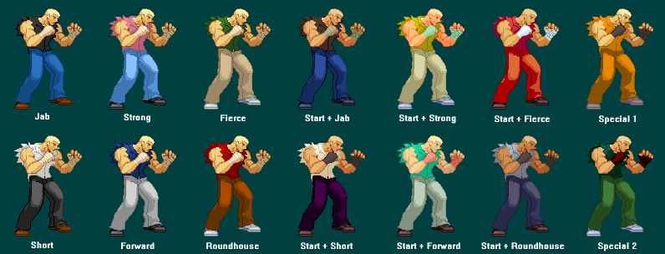
Palettes
Palette Image
2d Array of palette indices
Palette stores pixel colors
Palette Swaps can be used to change costume highlights or simple animations
Much smaller in memory

Slide 5

Sprite Animation
Sprites are animated by drawing slightly different frames at a frame rate (usually 30, 24, 12)
Large about of memory needed for many frame animation

Slide 6

Multi Part Animation
Each element is a sprite
Sprite will change frames
Sprite will also rotate and translation to generate animation
Flash is best example
Can create animations quickly
Similar to 3d

Slide 7
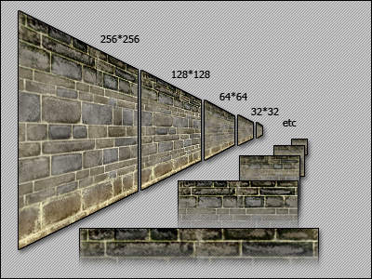
Textures
Array of bitmaps with mip levels
Each level is half the size of previous level
Mip mapping Allows quick texture scaling with distance and high quality visuals

Slide 8
Sprite Mapping?
Should each sprite be its own texture?
Should each frame be its own texture?
What works best on modern hardware?

Slide 9
Draw Calls
Number of Draw has a disproportional effect on performance (DrawPrims)
Overhead of Hardware layer
Communication to GPU
State Management
Context switches expensive
Changing textures or shaders
Want to group draws so how?

Slide 10
Batching
Place as many sprites as possible on one texture
Sort by layer and then in each layer sort by texture used
Transform each sprite filling a vertex buffer with the 4 verts
When the buffer is full or a different texture is used flush the buffer

Slide 11
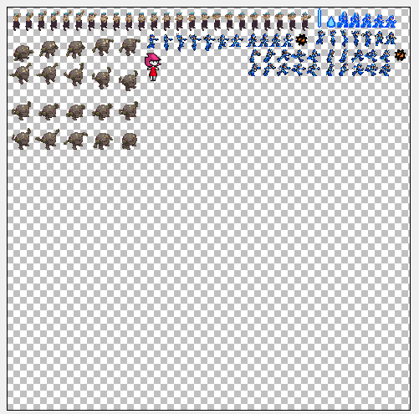
Generated Sprite Sheet

Slide 12
Batching
Ideally group background tiles on one large texture so it can be draw all at once
Find a good size for your vertex buffer
Can precache the background into pieces for every faster drawing

Slide 13
Vertex Buffers
In DirectX you want to use Dynamic Vertex Buffers
Basically a buffer that is constantly uploaded every frame
Use the same trick for particle systems

Slide 14
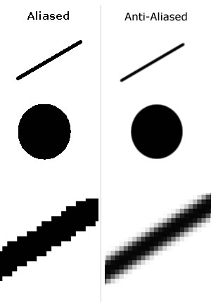
Aliasing Anti Aliasing
Aliasing is the jagged edges on polygons
Get rid of jaggies
Make lines appear smooth
Can be baked into sprite
GPU will do resampling
But…

Slide 15
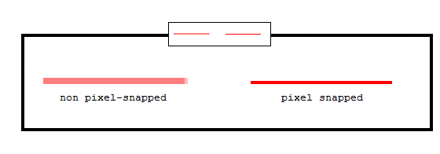
Pixel Snapping
With tile maps a visual artifact can occur when images are drawn half a pixel off
Object blurs and un blurs
Same artifact shows up when scaling
In 3d sometimes called screen door effect

Slide 16
Fill Rate
Overdraw – Drawing the same pixel over and over again
Alpha Blending – Increases per pixel cost
Try to avoid massive amounts of overdraw and disable alpha blending when not needed.
Huge particles system in front of the camera
Large amount of background layers

Slide 17
Blend Modes
Alpha Blending – Traditional compositing.
Pixel = Source * Alpha + Dest * (1 – Alpha)
Additive Blending – Object color is added onto the background. Fire, sparks, etc.
Pixel = Source + Dest
Multiply Blending – Burn effects tinting etc.
Pixel = Src * Dest

Slide 18
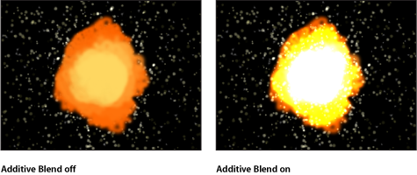

Slide 19
Post Processing
Applied to the scene as a texture
Many use depth channel or other data
Used for global effects
Glow pass
Motion Blur
Water Distortion
Advanced Lighting
Etc.

Slide 20
Questions?

